Slide 1
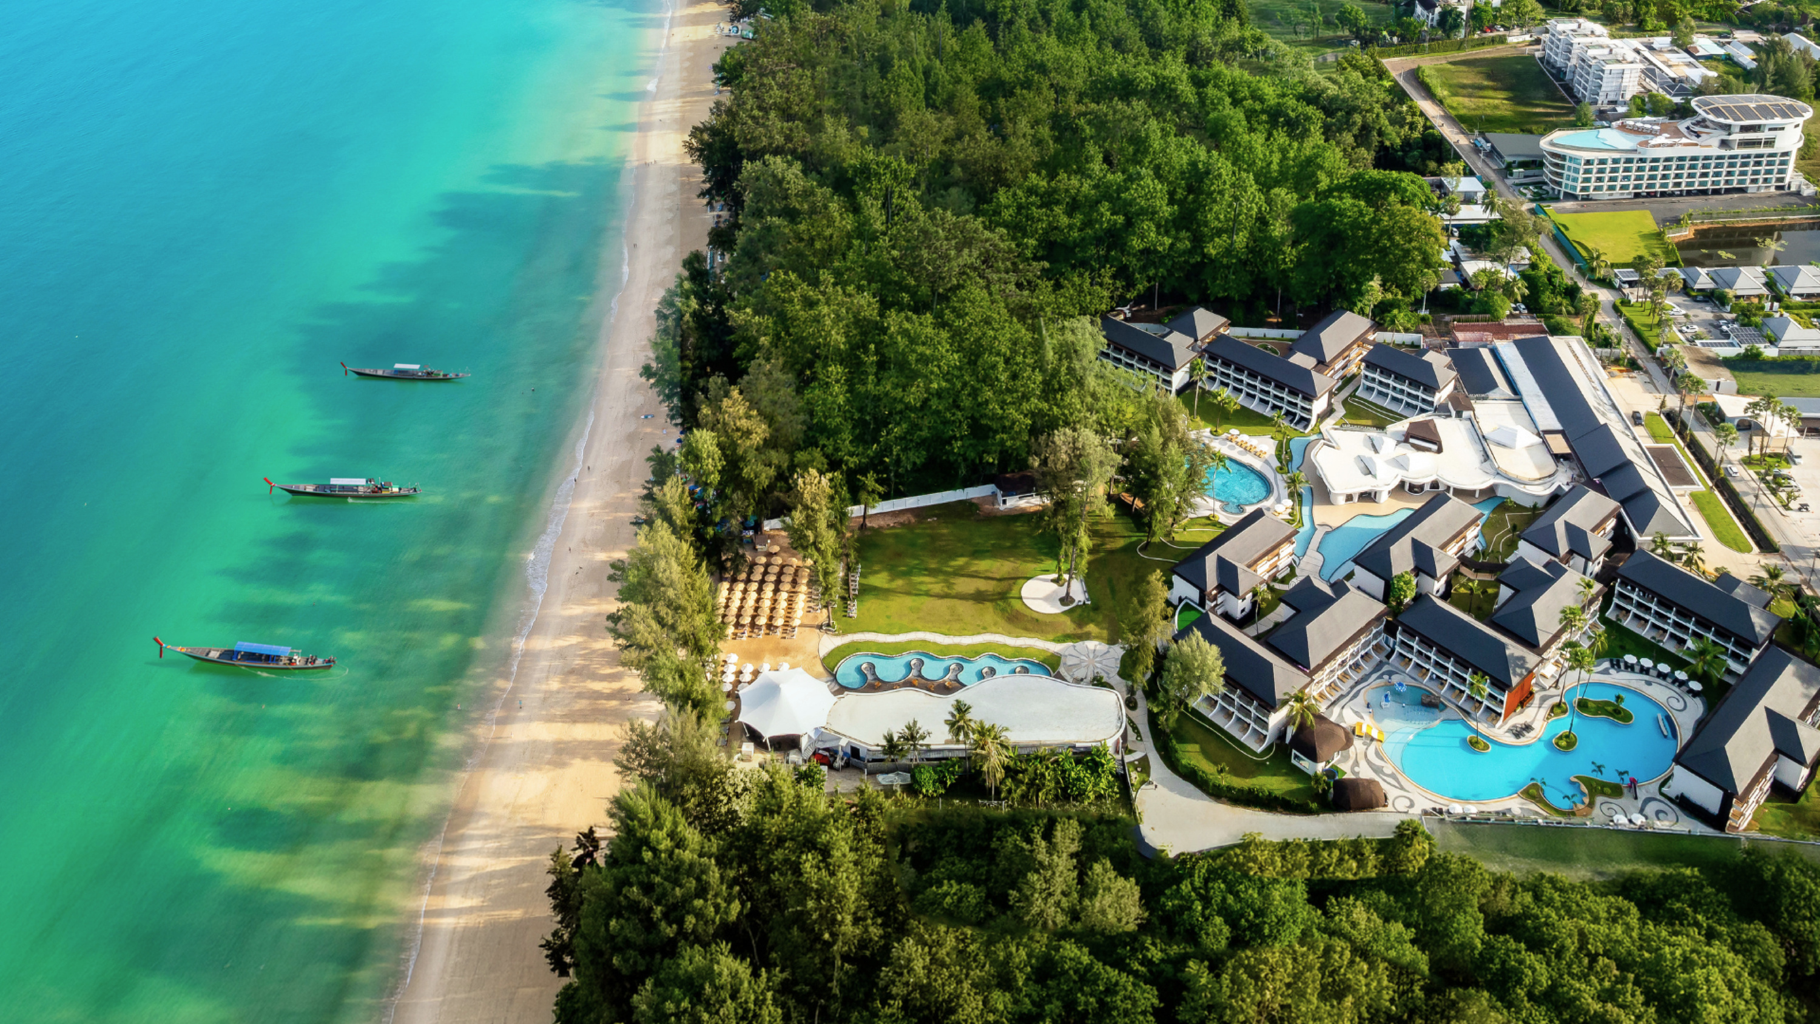



Slide 2
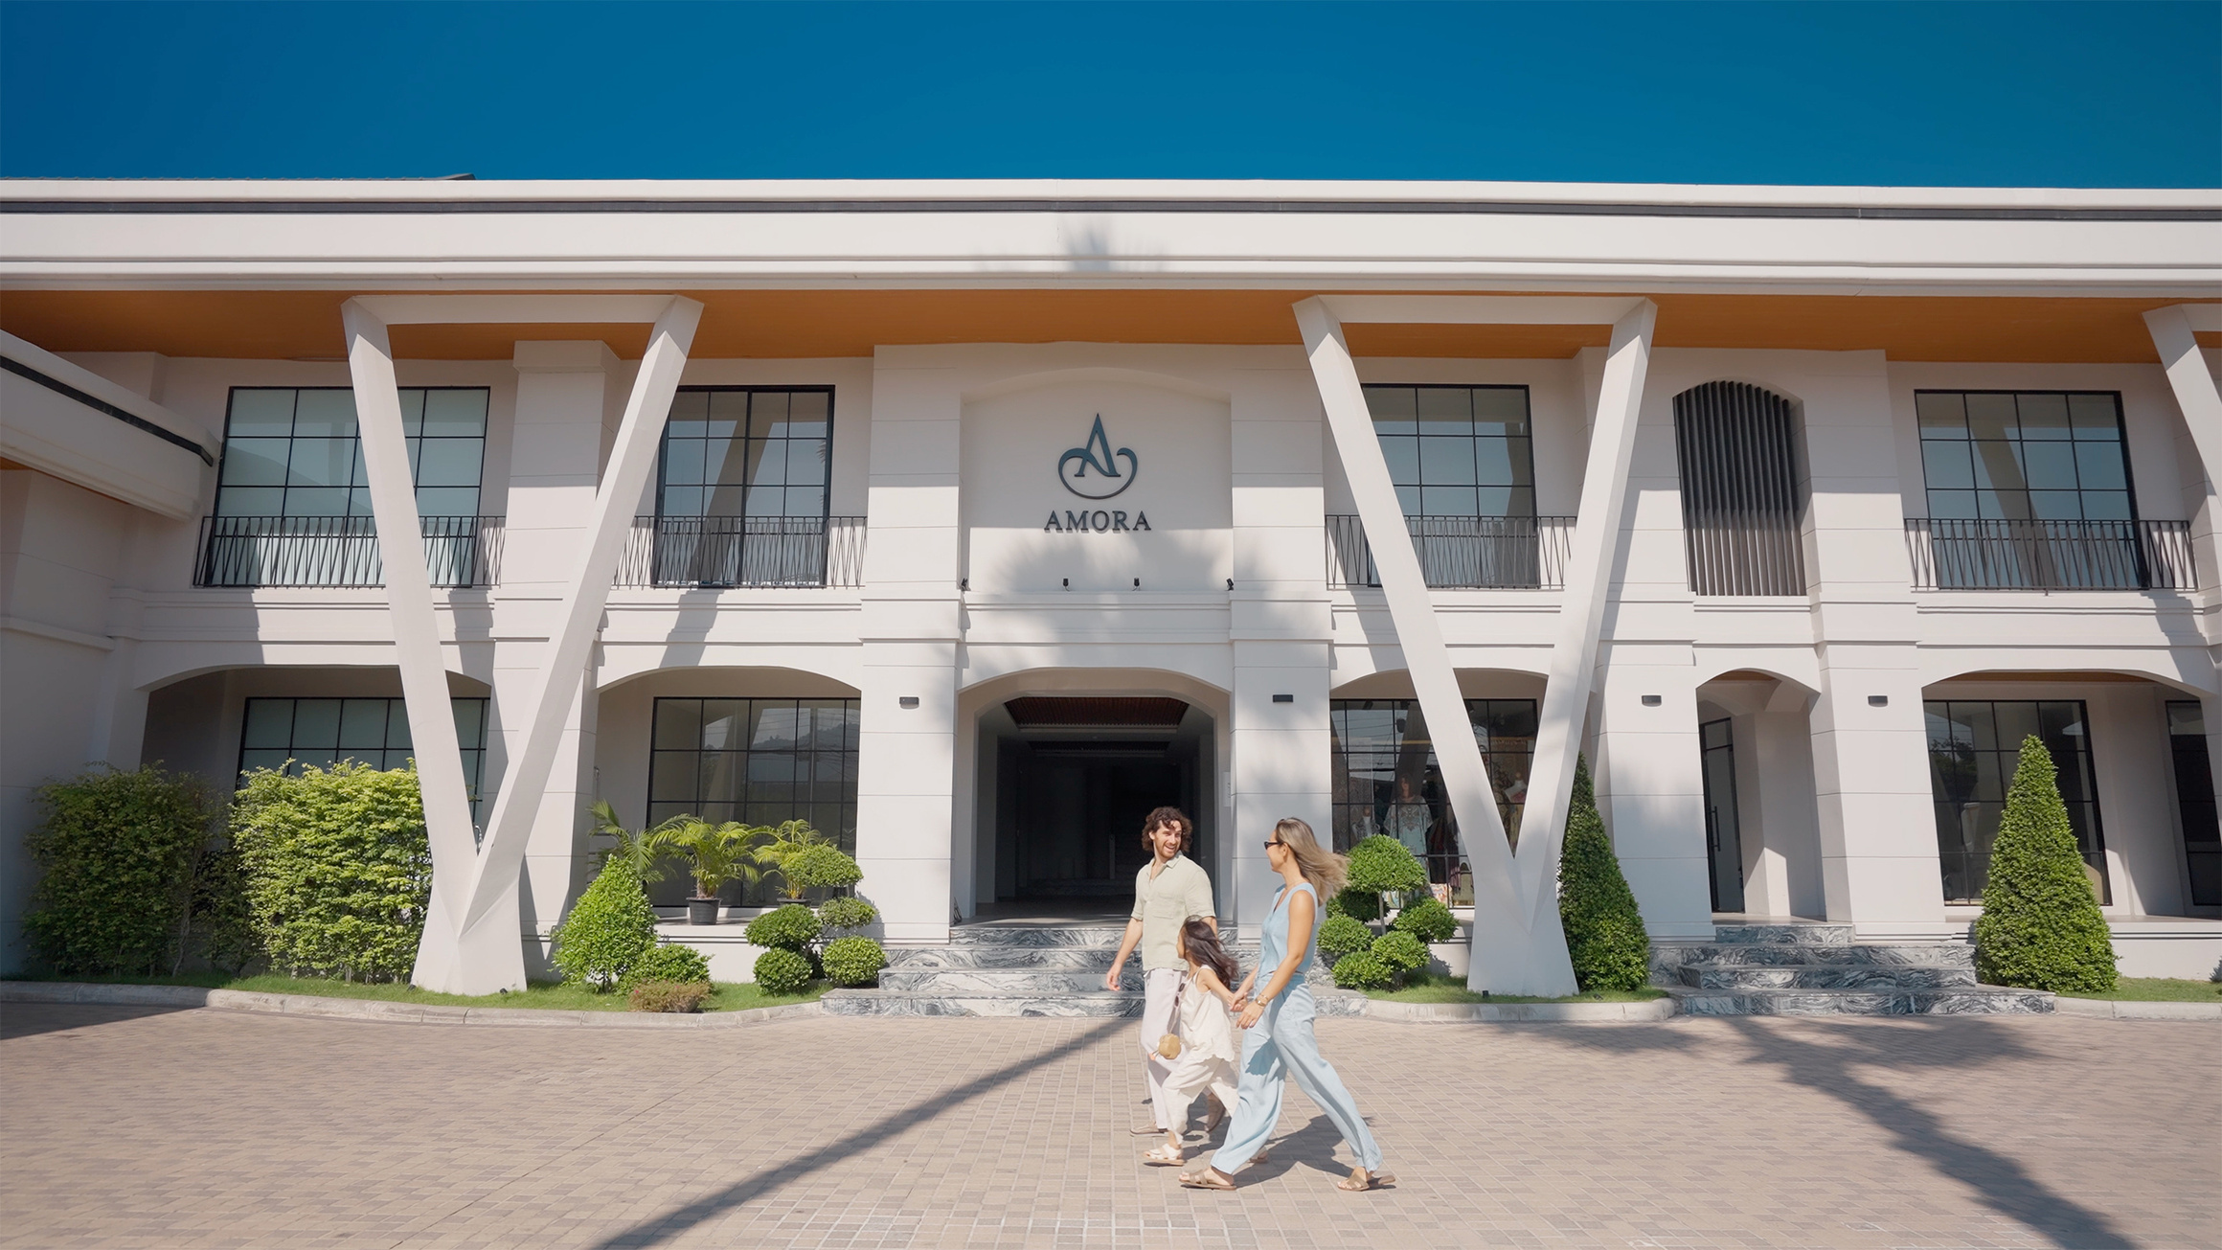


STAY · PLAY · MEET · DINE
Your Tropical Escape at Amora Beach Resort Phuket
Set along Bang Tao Beach, this beachfront resort offers soft white sands and turquoise waters, known as one of Phuket’s most family-friendly destinations. A curated blend of leisure and lifestyle experiences awaits from an 80-metre beachfront to diverse dining venues, bars, and lounges, alongside facilities designed for both relaxation and business needs.

Slide 3







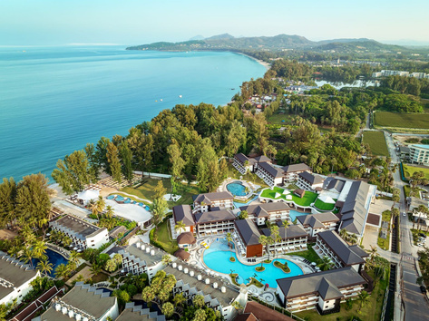





Phuket International Airport
LOCATION
Situated in Cherngtalay, one of Phuket’s most upscale neighborhoods, the resort is just minutes from Boat Avenue and Porto de Phuket. Phuket Town is approximately 17 km away, while Phuket International Airport is 18 km from the property. Easy access by taxi, car, or motorbike ensures seamless connectivity. A dedicated team is available to assist with tours, transportation, and personalized recommendations to enhance every stay.
The Amora Beach Resort is centrally located on the island:
  Phuket International Airport
  Phuket Old Town
  Patong Beach
  Boat Avenue
  Porto de Phuket
20 mins / 18 km
30 mins / 23 km - Shuttle for guests
25 mins / 17 km - Shuttle for guests
5 mins / 1.4 km
7 mins / 2.6 km

Slide 4
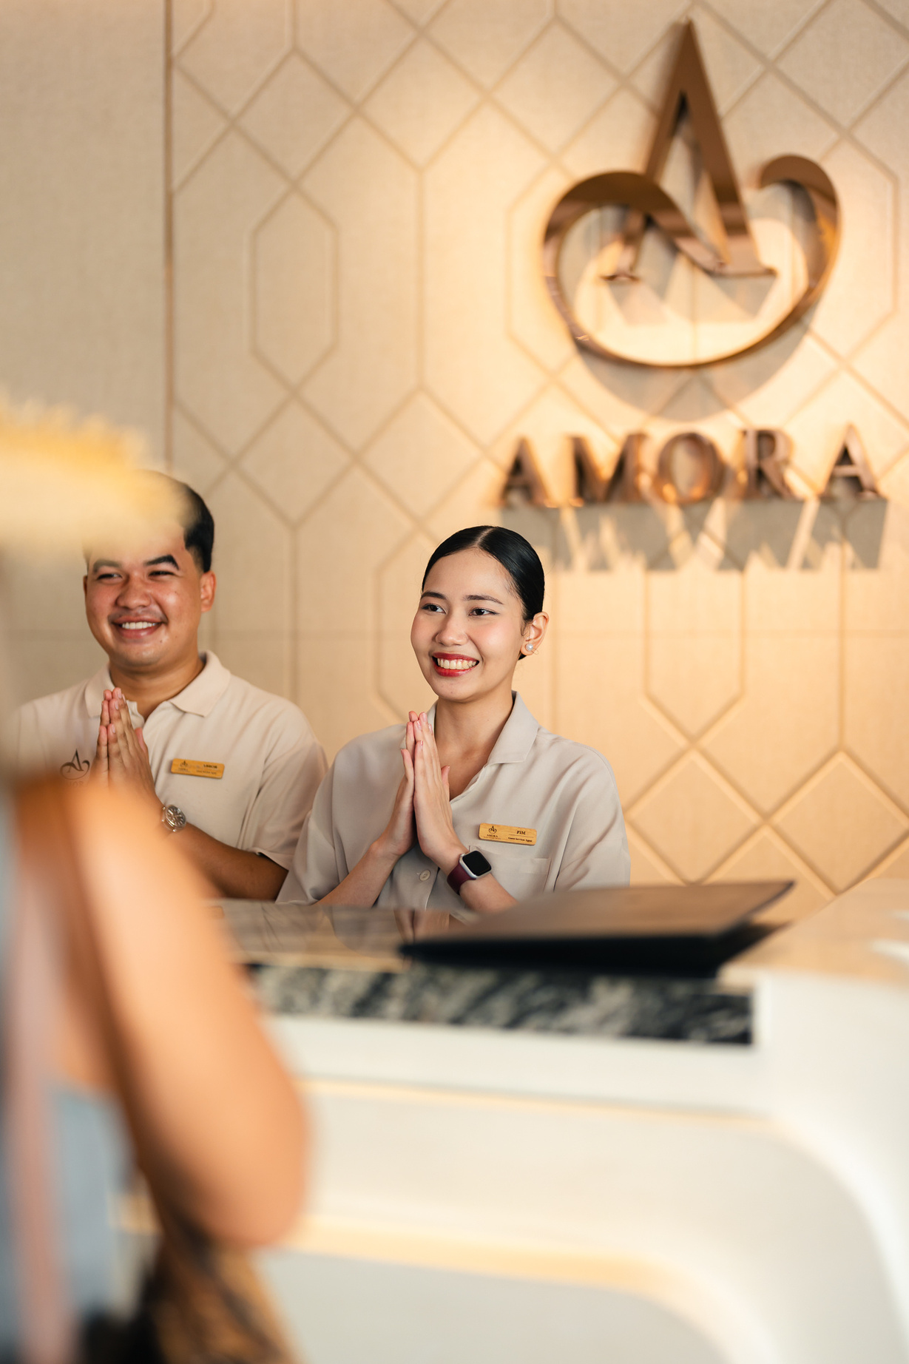
AT A GLANCE
  Beachfront access at Prime Location on Bangtao Beach, Phuket
  265 contemporarily designed rooms and Suites
  Smart TV with Netflix & Youtube
  Beach Club & Restaurant, All-Day Dining Restaurant,
Rooftop, Lobby lounge
  Lomtalay Spa and Fitness Center
  3 Swimming pools
  Family friendly resorts with Water parks, Kids ‘club
and family room.
  1 Grand ballroom (360sqm with LED screen), 4 Flexible meeting space with fully equipped meeting facilities.
  Event and activities lawn (2,200 sqm), ideal for weddings, corporate events, and team building

Slide 5
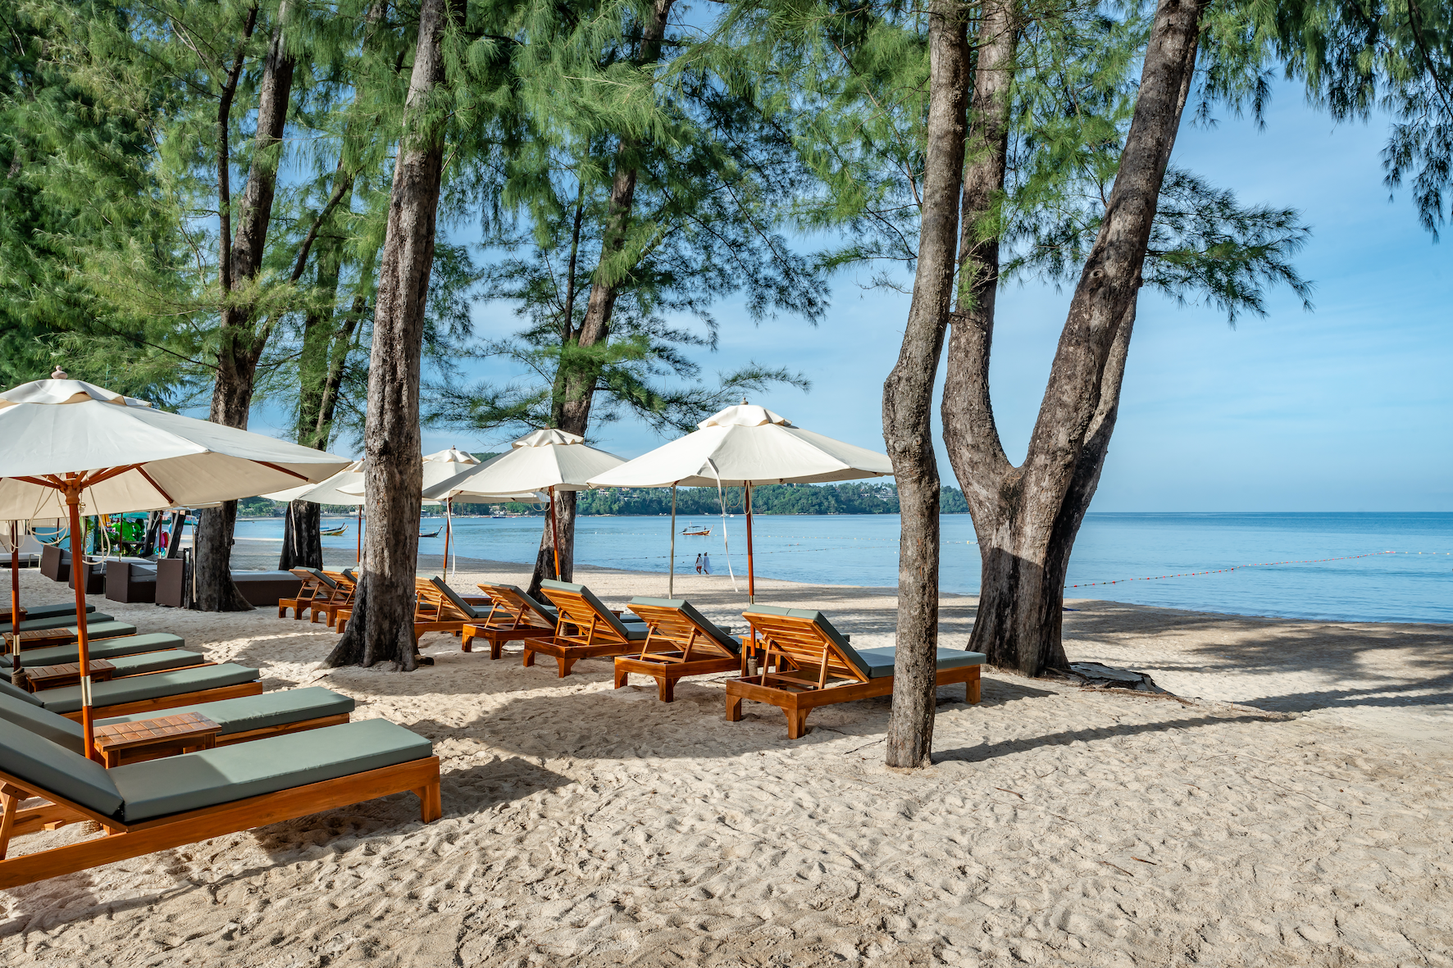
RESORT OVERVIEW
RESORT
ACCOMMODATION
  265 guest rooms
  Lobby Lounge
  ISLA All-day Dining Restaurant
  ASTRA Rooftop Bar
  NORA Beach Club & Restaurant
  In-room Dining
  Lomtalay Spa
  AQUA Kids Club
  Waterpark
  Activities Lawn
  Massage & Treatment rooms
  Fitness
  Andaman Pool
  Garden Pool
  ISLA Pool
  80 m. Private Beachfront
  Ballroom
  Event Lawn
  Meeting Room
  24-hour Reception
  24-hour Security
  Parking
  First Aid Trained Staff
  Ambulance on Call
  Complimentary Wi-Fi
  Tea & Coffee Making Facilities
  Coffee Machine*
  In-room safe
  Complimentary wi-fi
  Mini-bar
  Telephone
  Smart TV with international channels, YouTube & Netflix
  Live Chat with reception
  Individual A/C
  Bathrobes
  Terry slippers
  Beach slippers
  Laundry list & bag
  Bathroom amenities
  Hairdryer
  Shower
  Bathtub*
  Kettle
  Glass bottle water
  On request: iron & iron board
*Available in selected room categories

Slide 6
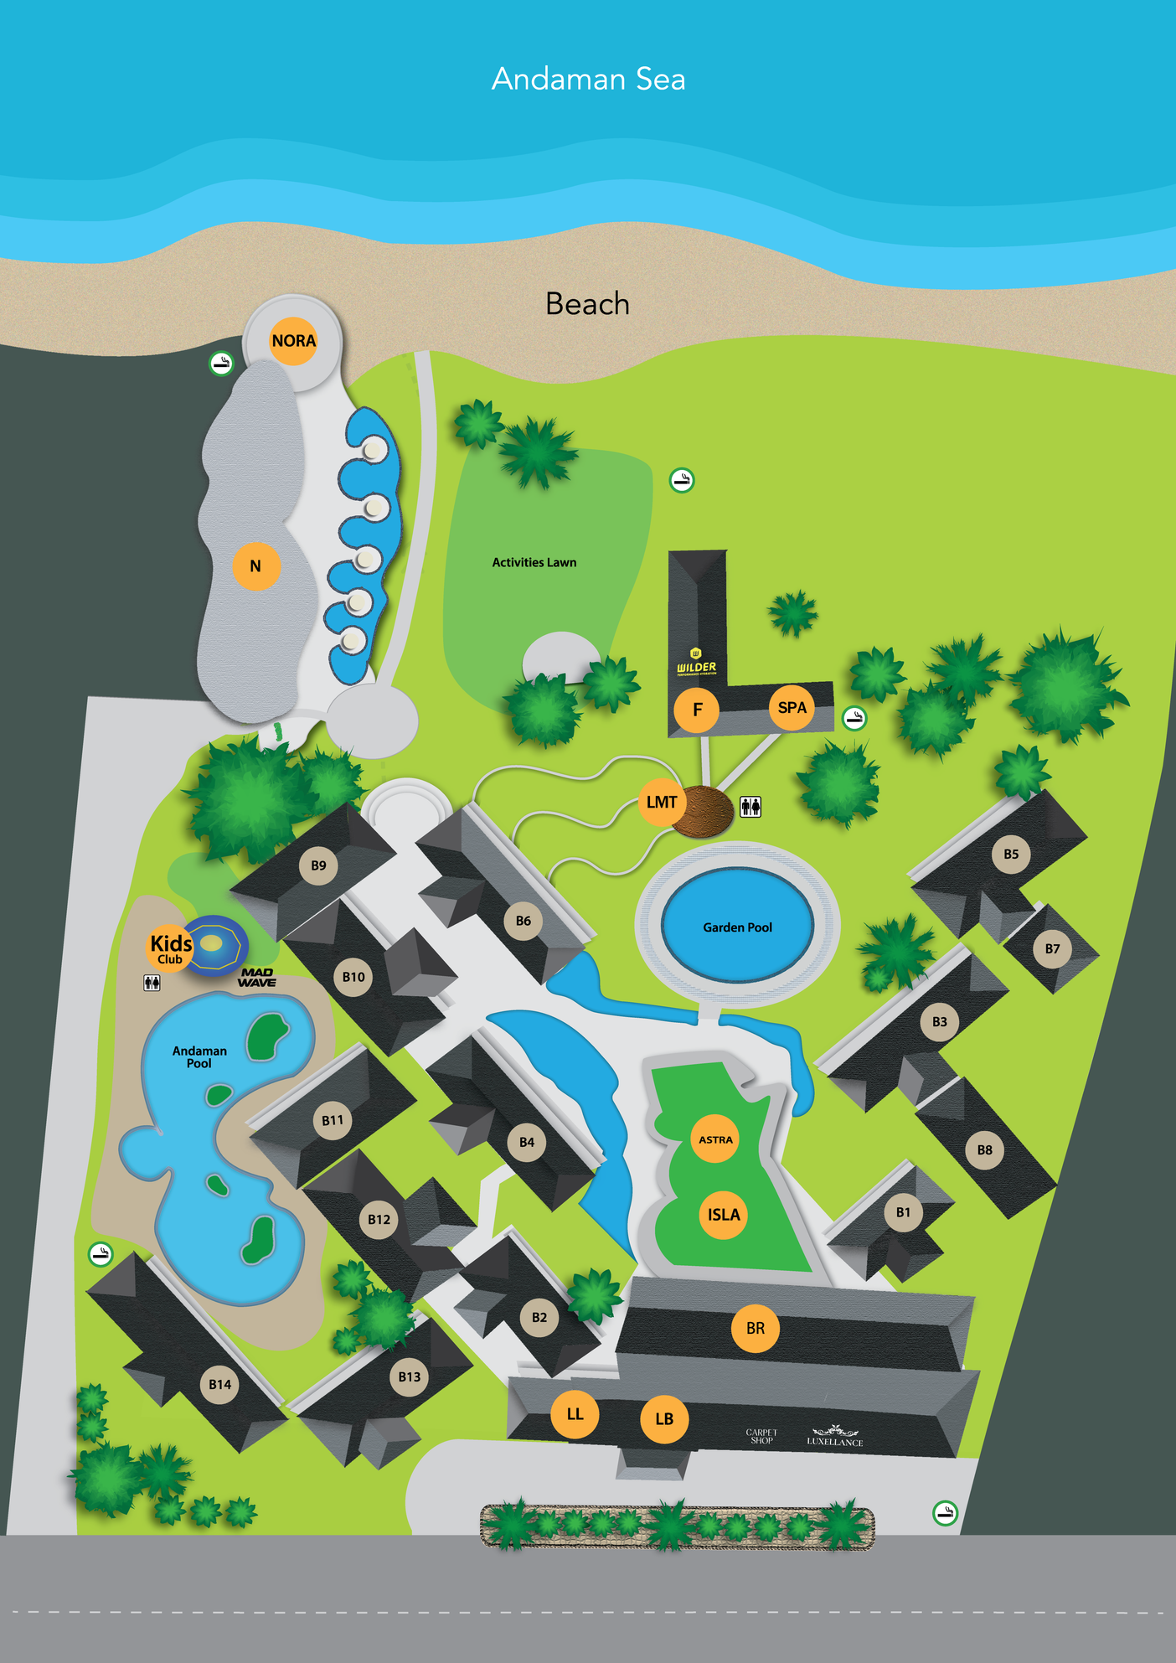
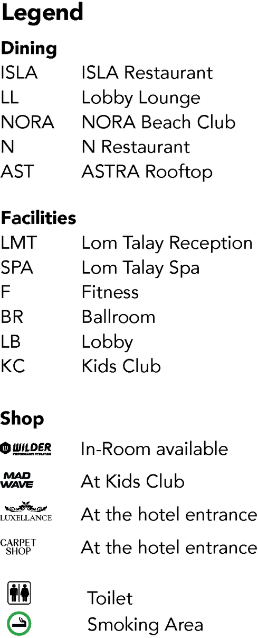
HOTEL MAP

Slide 7
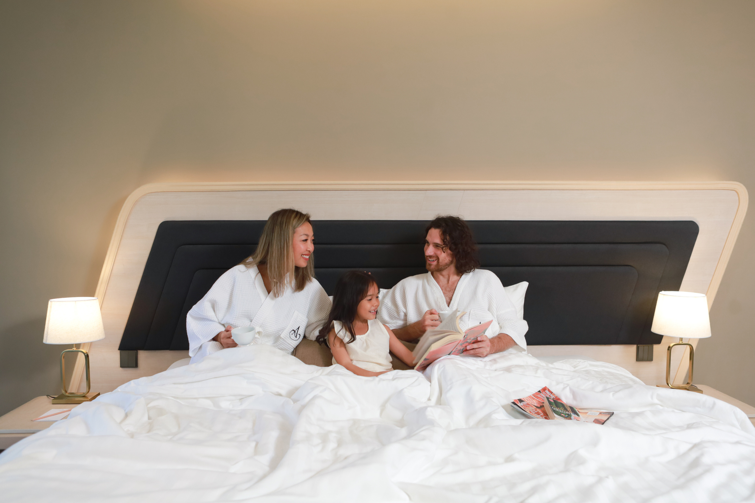
ACCOMMODATION
ROOM TYPE
Size
(sq.m)
Unit
Maximum
Bedding
Capacity
Superior Garden View
Amora Superior Pool View
Amora Superior Pool side
Amora Ocean
Deluxe Room
Deluxe Pool View
Deluxe Pool Side
Deluxe Family Pool View
Amora Grand Pool View
Amora Grand Pool Side
Casurina Suite One Bedroom
Coral Suite Two Bedrooms
Andaman Suite Two Bedrooms
Total
32
32
42
32
37
41
48
41
41
51
56
108
144
33
16
23
51
33
16
18
20
34
17
1
2
1
265
3A / 2A+1C
3A / 2A+1C
3A / 2A+1C
3A / 2A+1C
3A / 2A+1C
3A / 2A+1C
3A / 2A+1C
2A + 2C
3A / 2A+1C
3A / 2A+1C
3A / 2A+2C
5A / 4A+1C
5A / 4A+1C
King / twin
King / twin
King / twin
King / twin
King / twin
King / twin
King / twin
King / bunk bed
King / twin
King / twin
King
1 King + 1 twin
1 King + 1 twin

Slide 8
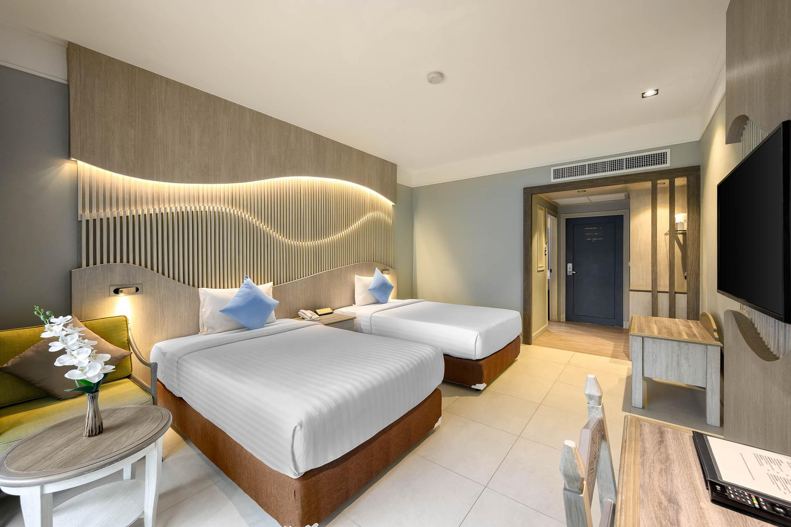



SUPERIOR GARDEN VIEW
  32 sqm indoor & Outdoor space
  Private balcony
  Bathroom with bath and shower combined
  Bathrobes and slippers
  Direct dial telephone
  Hair dryer
  Mini-bar
  Safety deposit box
  50" Smart TV
  Tea and coffee making facilities
  Individual air conditioning

Slide 9
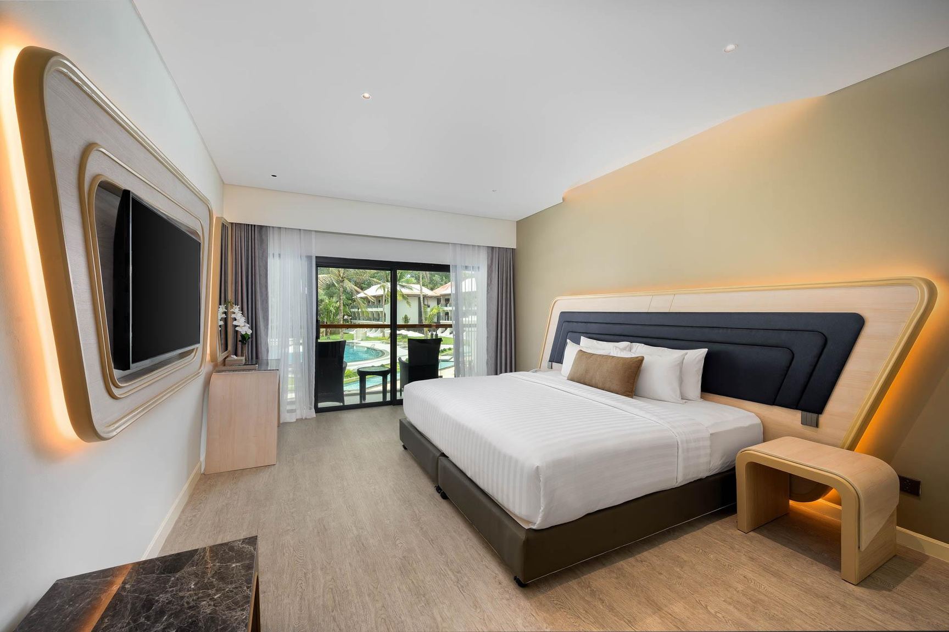


AMORA SUPERIOR POOL VIEW
  32 sqm indoor & Outdoor space
  Private balcony
  Bathroom with Rainforest shower
  Bathrobes and slippers
  Direct dial telephone
  Hair dryer
  Mini-bar
  Safety deposit box
  50" Smart TV
  Tea and coffee making facilities
  Individual air conditioning

Slide 10
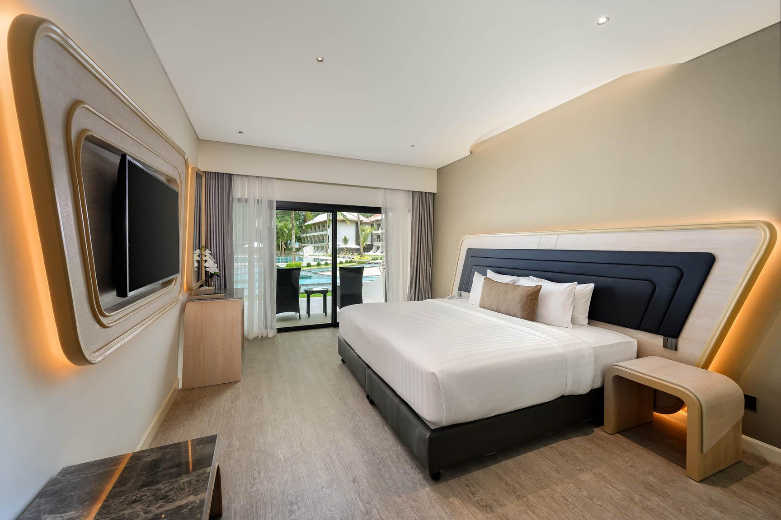


AMORA SUPERIOR POOL SIDE
  42 sqm indoor & Outdoor space
  Private balcony
  Bathroom with Rainforest shower
  Bathrobes and slippers
  Direct dial telephone
  Hair dryer
  Mini-bar
  Safety deposit box
  50" Smart TV
  Tea and coffee making facilities
  Individual air conditioning

Slide 11
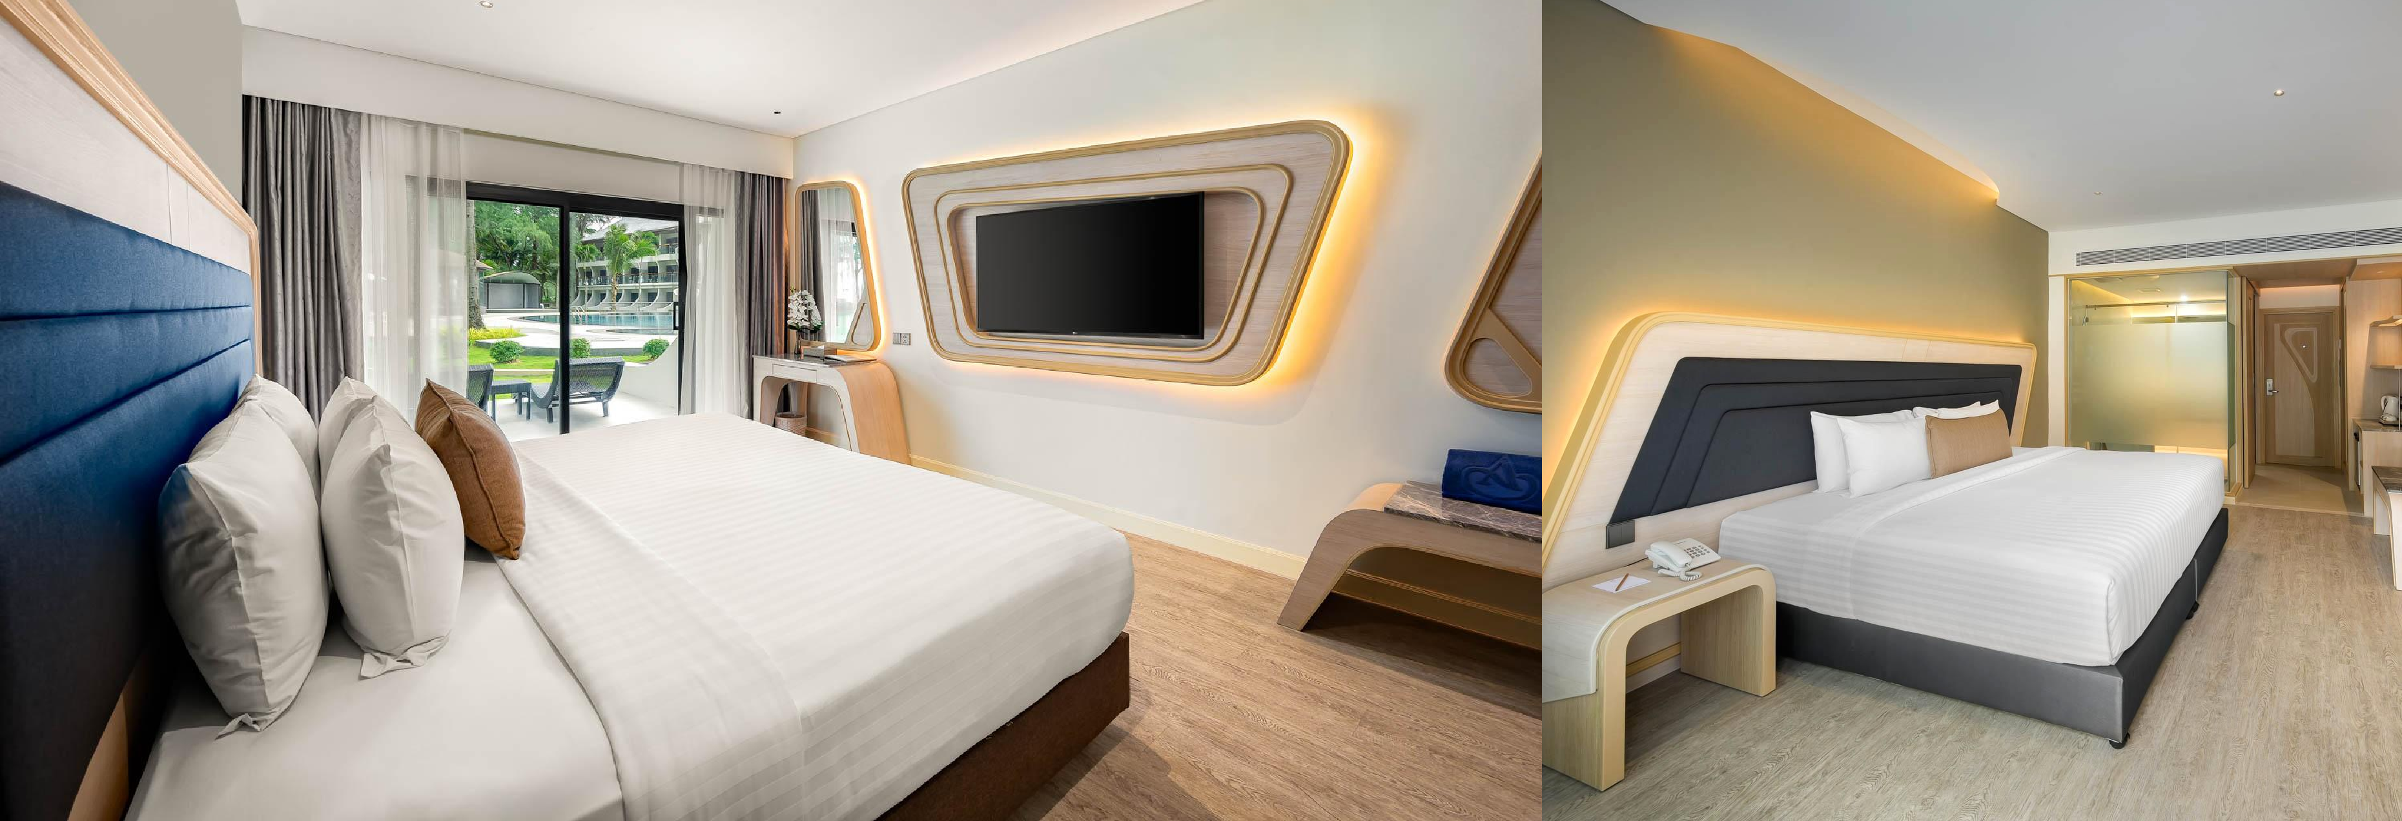
AMORA OCEAN VIEW
  32 sqm indoor & Outdoor space
  Private balcony
  Bathroom with rainforest shower
  Bathrobes and slippers
  Direct dial telephone
  Hair dryer
  Mini-bar
  Safety deposit box
  50" Smart TV
  Tea and coffee making facilities
  Individual air conditioning

Slide 12
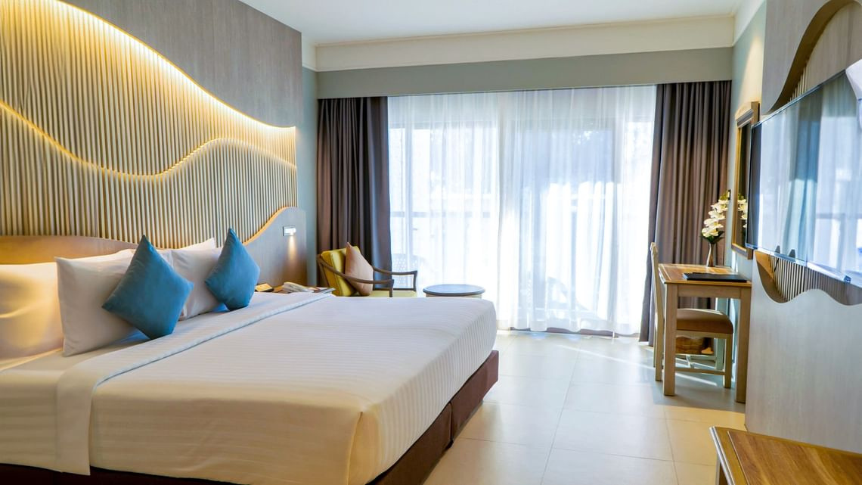


DELUXE ROOM
  37 sqm indoor & Outdoor space
  Private balcony
  Bathroom with Rainforest shower
  Bathrobes and slippers
  Direct dial telephone
  Hair dryer
  Mini-bar
  Safety deposit box
  50" Smart TV
  Tea and coffee making facilities
  Individual air conditioning

Slide 13
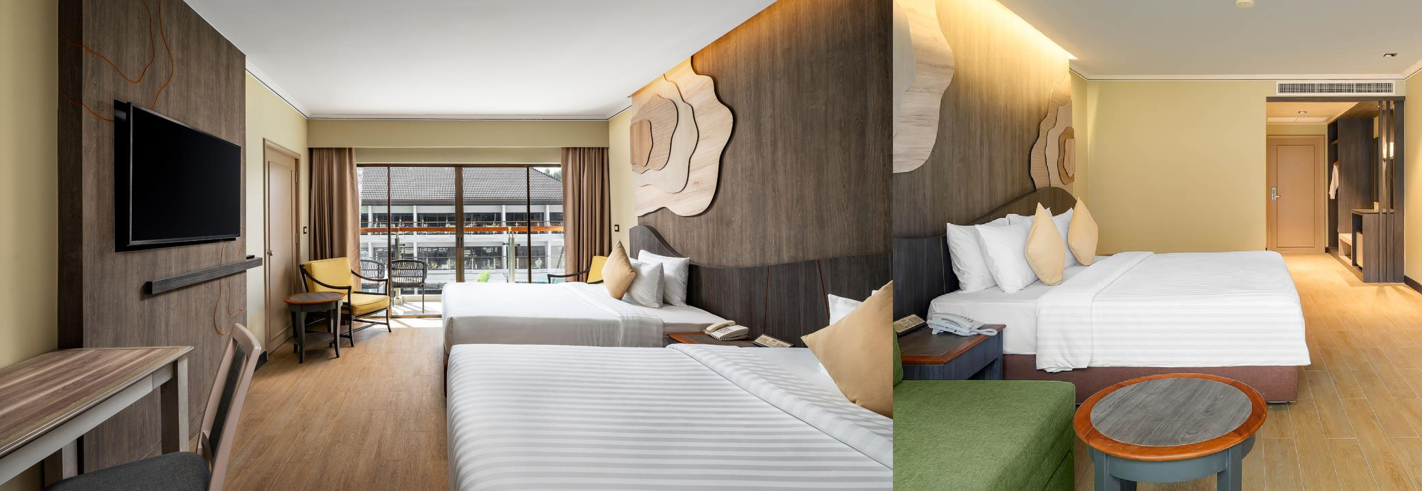

DELUXE POOL VIEW
  41 sqm indoor & Outdoor space
  Private balcony
  Bathroom with bath & shower
  Bathrobes and slippers
  Direct dial telephone
  Hair dryer
  Mini-bar
  Safety deposit box
  50" Smart TV
  Tea and coffee making facilities
  Individual air conditioning

Slide 14
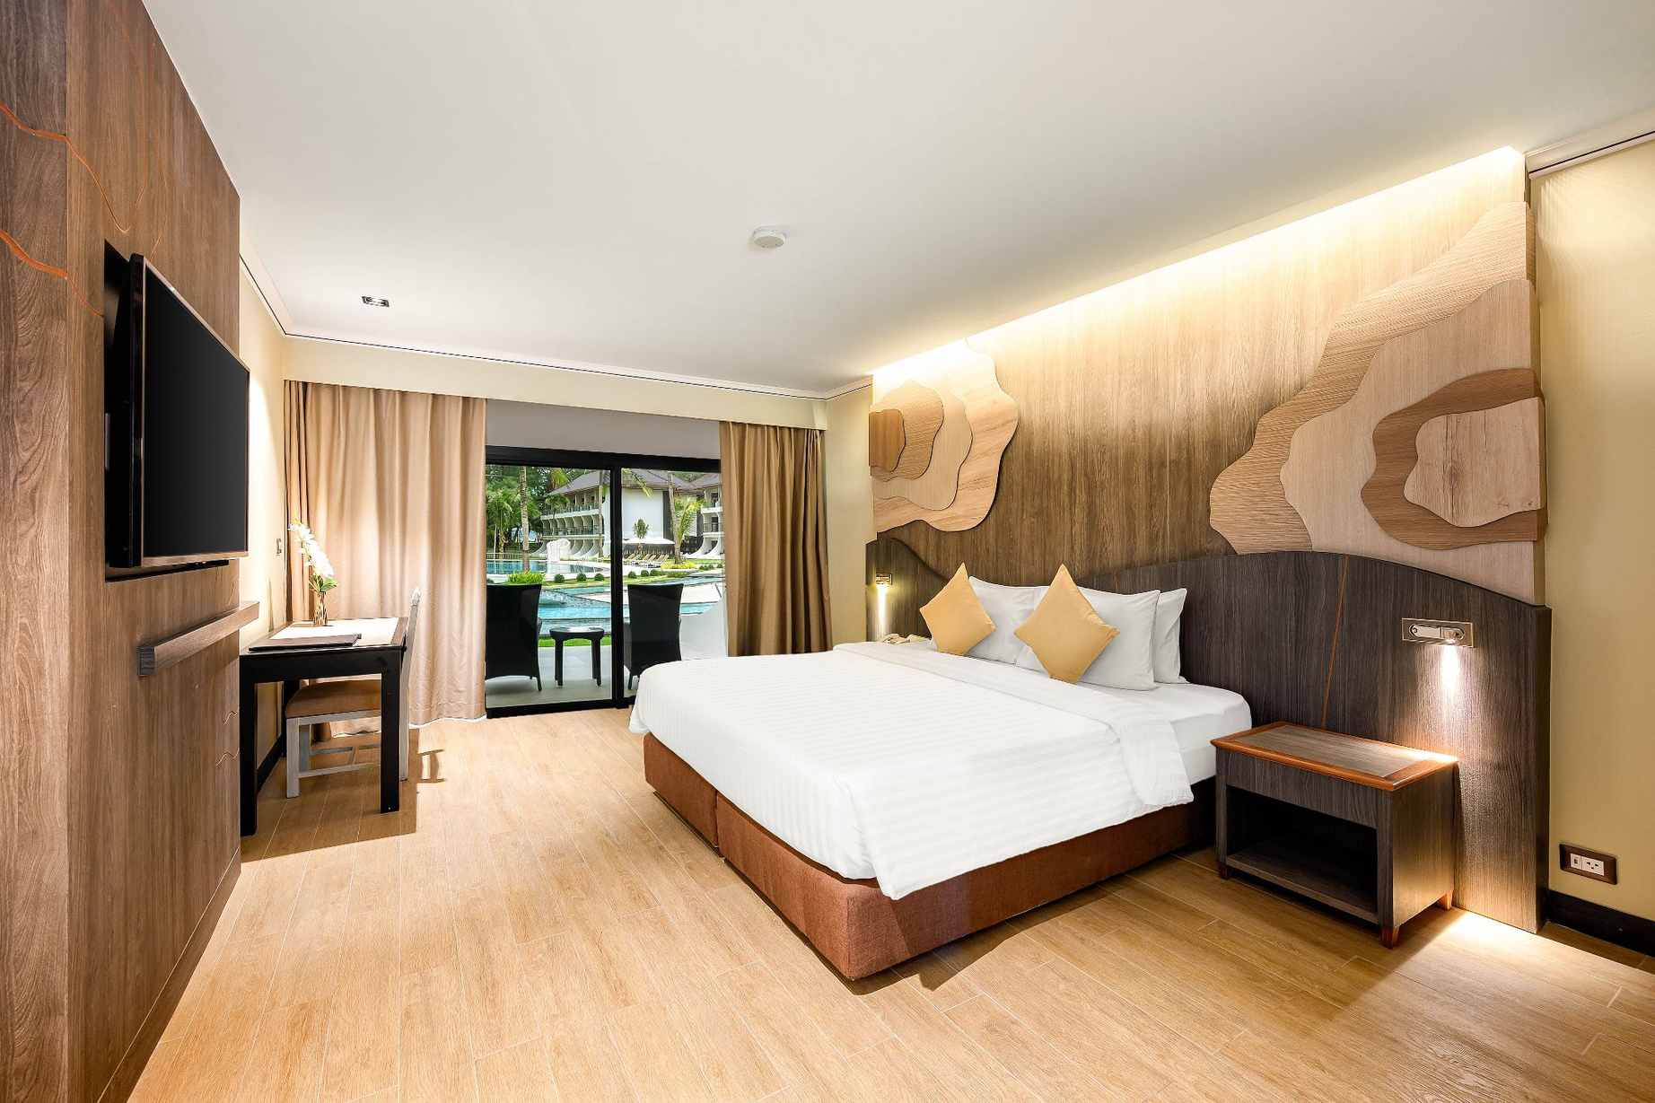
DELUXE POOL SIDE
  48 sqm indoor & Outdoor space
  Private balcony
  Bathroom with bath & shower
  Bathrobes and slippers
  Direct dial telephone
  Hair dryer
  Mini-bar
  Safety deposit box
  50" Smart TV
  Tea and coffee making facilities
  Individual air conditioning

Slide 15
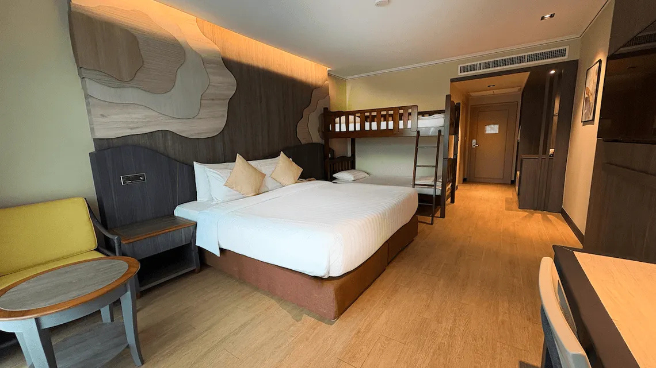


DELUXE FAMILY POOL VIEW
  41 sqm indoor & Outdoor space
  Private balcony
  Bathroom with bath & shower
  Bathrobes and slippers
  Direct dial telephone
  Hair dryer
  Mini-bar
  Safety deposit box
  50" Smart TV
  Tea and coffee making facilities
  Individual air conditioning

Slide 16
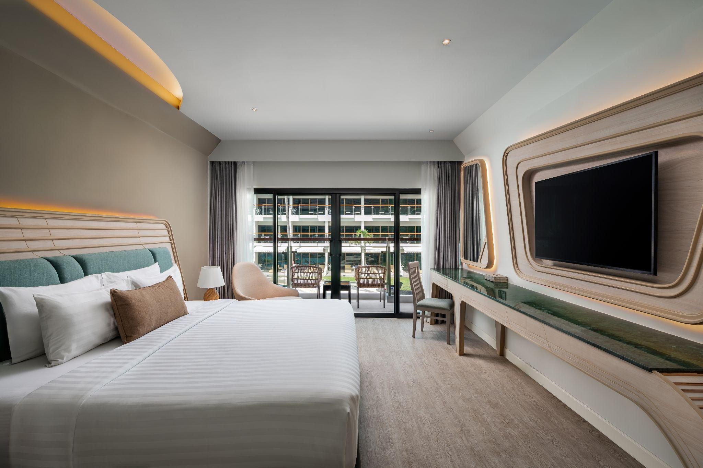


AMORA GRAND POOL VIEW
  41 sqm indoor & Outdoor space
  Private balcony
  Bathroom with bath and walk-in shower
  Bathrobes and slippers
  Direct dial telephone
  Hair dryer
  Mini-bar
  Safety deposit box
  50" Smart TV
  Tea and coffee making facilities
  Individual air conditioning

Slide 17
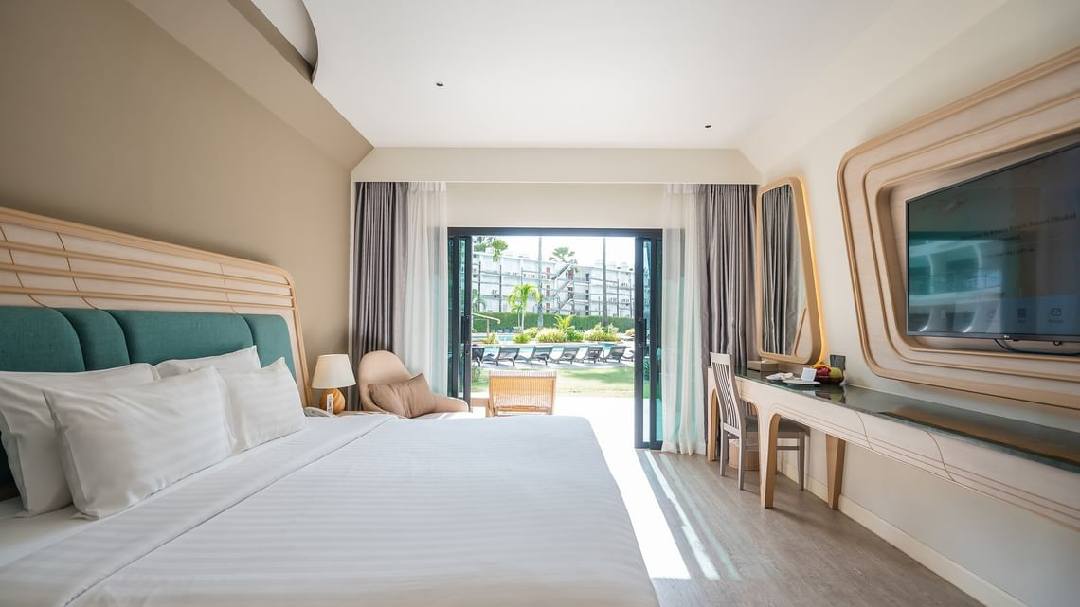
AMORA GRAND POOL SIDE
  51 sqm indoor & Outdoor space
  Private balcony
  Bathroom with bath and walk-in shower
  Bathrobes and slippers
  Direct dial telephone
  Hair dryer
  Mini-bar
  Safety deposit box
  50" Smart TV
  Tea and coffee making facilities
  Individual air conditioning

Slide 18
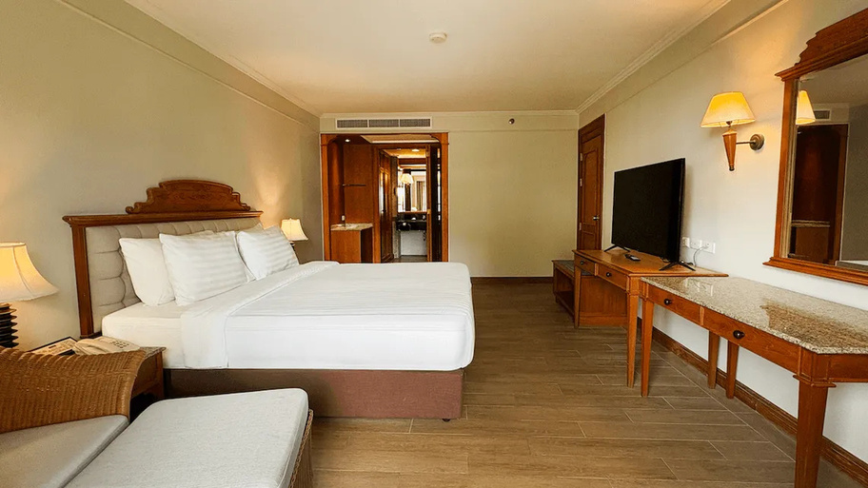

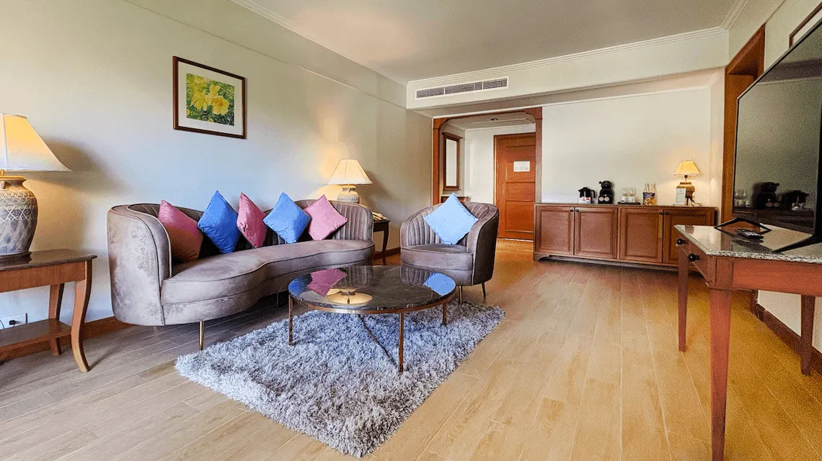
CASURINA SUITE ONE BEDROOM
Our traditional Casuarina Suite blends modern furniture with Thai elements, feature a spacious bedroom and separate living space, with private balcony. All rooms are fitted to a high standard with all the latest amenities.
Features:
  56 sqm space
  Private balcony
  Bathroom with bath and shower
  Extra half bathroom at entrance
  Bathrobes and slippers
  Direct dial telephone
  Hair dryer
  Mini-bar and refrigerator
  Safety deposit box
  50" Smart TV
  Tea and coffee making facilities
  Thermostatically controlled air conditioning

Slide 19
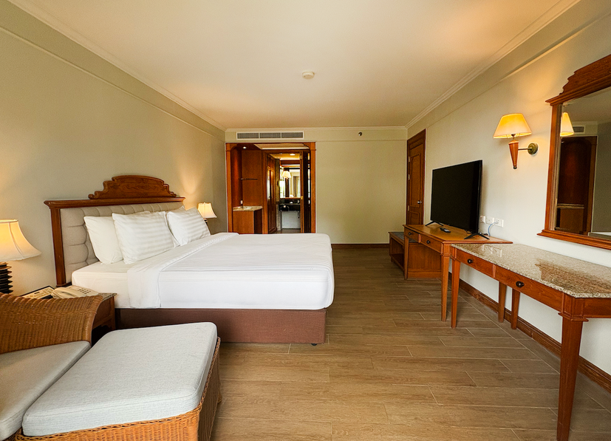
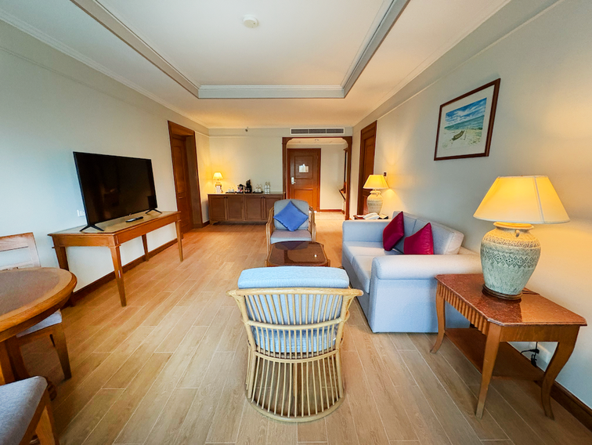
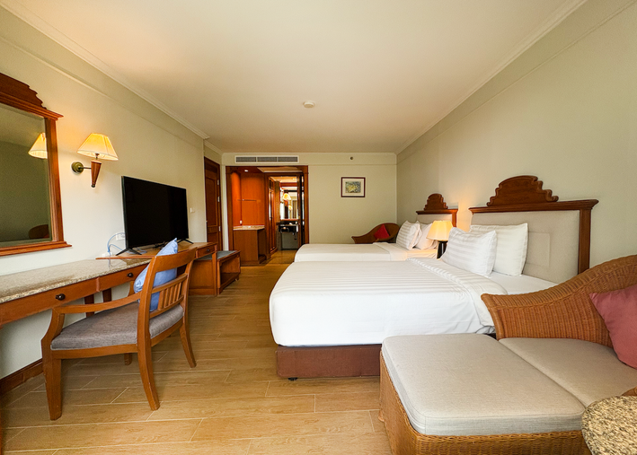
CORAL SUITE TWO BEDROOMS
Our spacious Thai designed Coral Suites feature two bedrooms and a separate lounge room, with private balcony. All rooms are fitted to a high standard with all the latest amenities, and have a maximum capacity of 4 adults.
Features:
  108 sqm space
  Private balcony
  Two bedrooms with separate lounge room
  Bathroom with bath and shower
  Bathrobes and slippers
  Direct dial ISD telephone
  Hair dryer
  Mini-bar and refrigerator
  Safety deposit box
  Satellite colour TV and in-house movies
  Tea and coffee making facilities
  Thermostatically controlled air conditioning

Slide 20
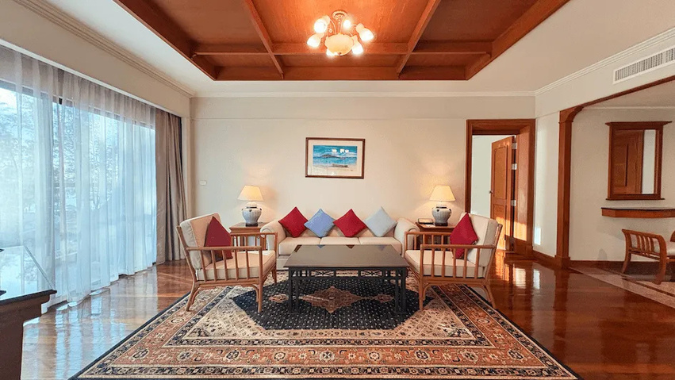
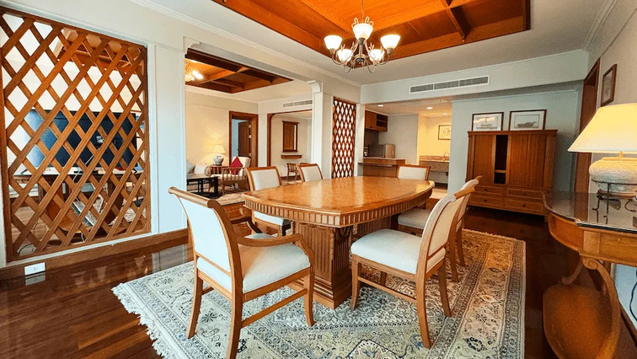
ANDAMAN SUITE 2 BEDROOMS
Our spacious Thai designed Coral Suites feature two bedrooms and a separate lounge room, with private balcony. All rooms are fitted to a high standard with all the latest amenities, and have a maximum capacity of 4 adults.
Features:
  144 sqm space
  Private balcony
  Two bedrooms with separate lounge and dining room
  Bathroom with bath and shower
  Bathrobes and slippers
  Direct dial ISD telephone
  Hair dryer
  Mini-bar and refrigerator
  Safety deposit box
  Smart TV and in-house movies
  Tea and coffee making facilities
  Thermostatically controlled air conditioning

Slide 21

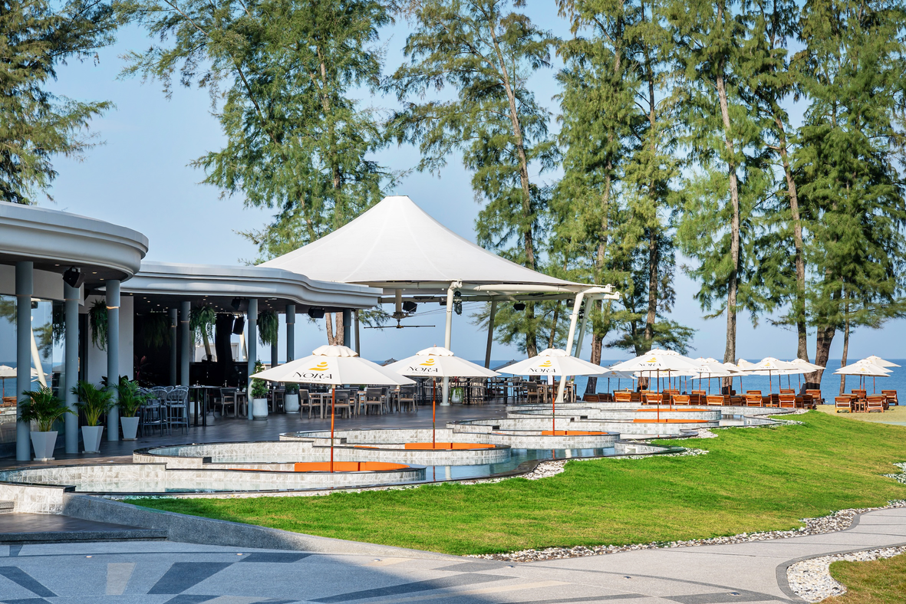


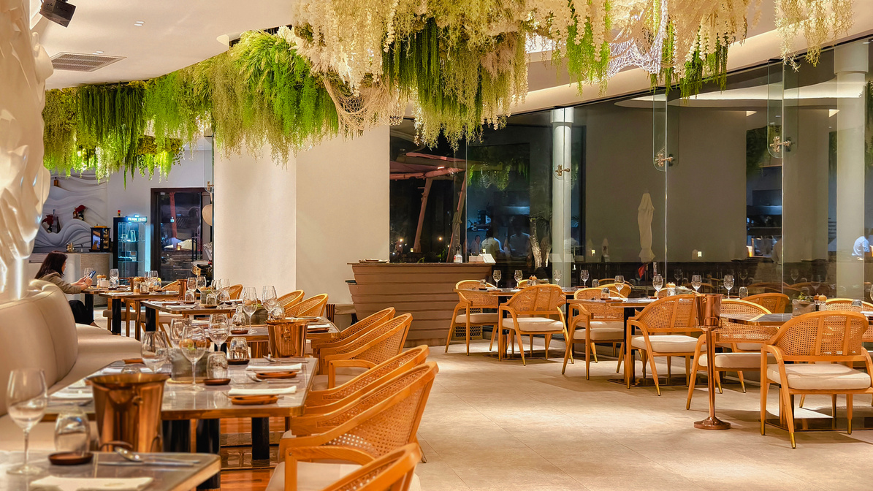
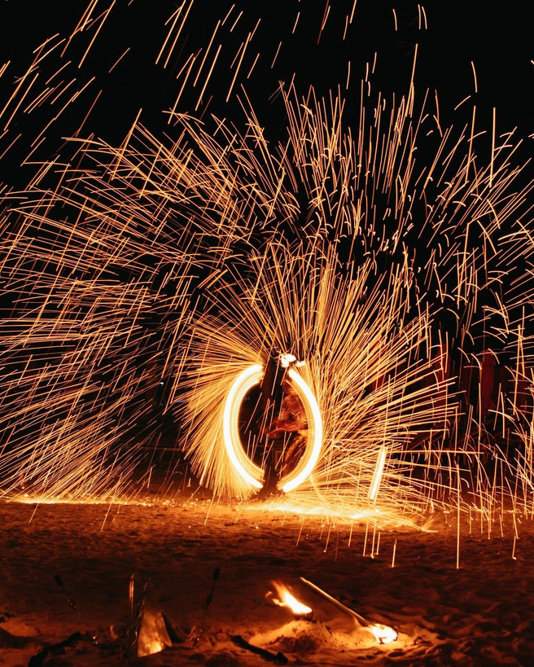

NORA BEACH CLUB
Feel the rhythm of the ocean and Balearic beats at NORA Beach Club, our reimagined seafront escape and indoor N Restaurant. Unwind with fresh Andaman seafood, signature cocktails, caviar, and Champagne from relaxed sunset sessions to vibrant beachfront nights.

Slide 22
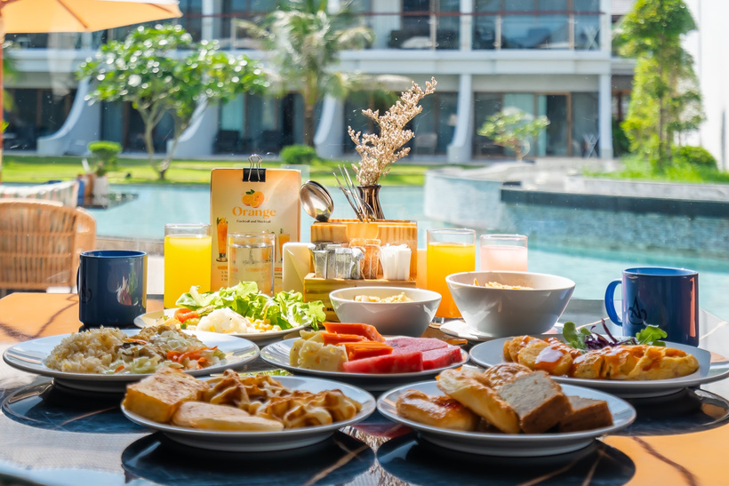

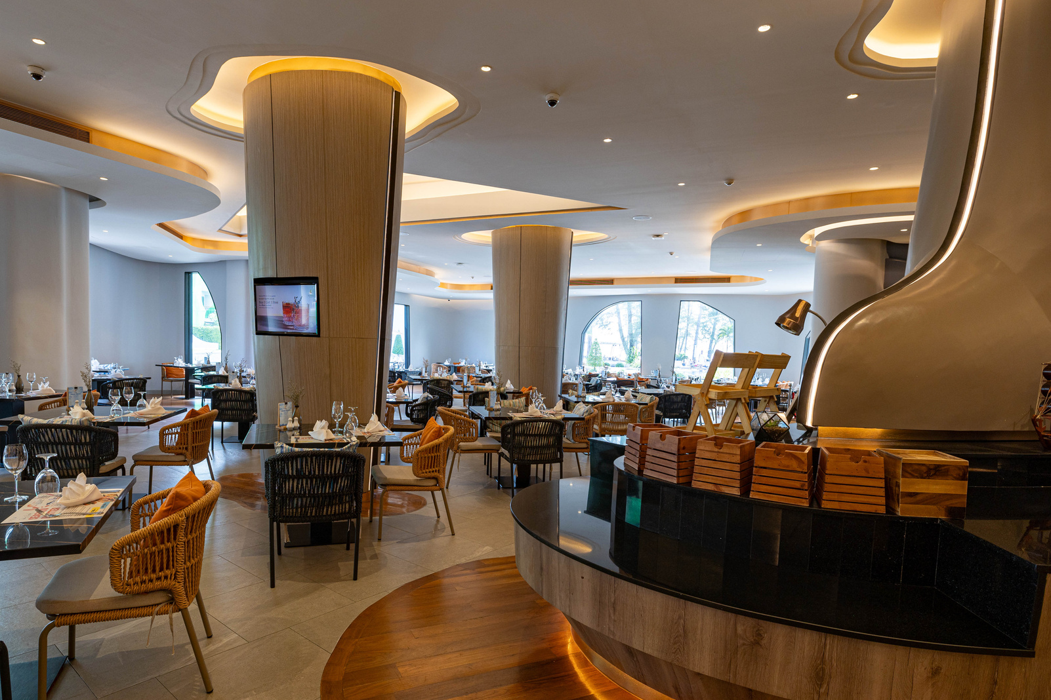
ISLA RESTAURANT
This bright and inviting all-day dining destination allows you to enjoy contemporary Western cuisine and traditional Thai dishes throughout the day and evening
An all-day dining restaurant with a good selection of the East and West including Thai dishes, western cold and hot cuisines, and a live-cooking station especially designed for your sophisticated palates.
Open for breakfast, lunch, dinner. Serves buffet and a la carte. Popular dishes from this Isla restaurant are available in the in-room dining menu

Slide 23
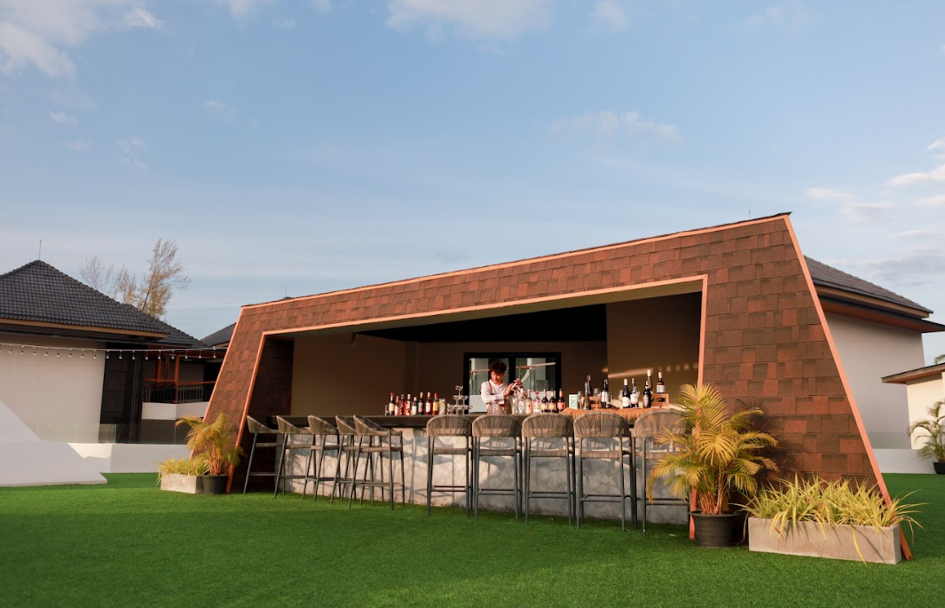
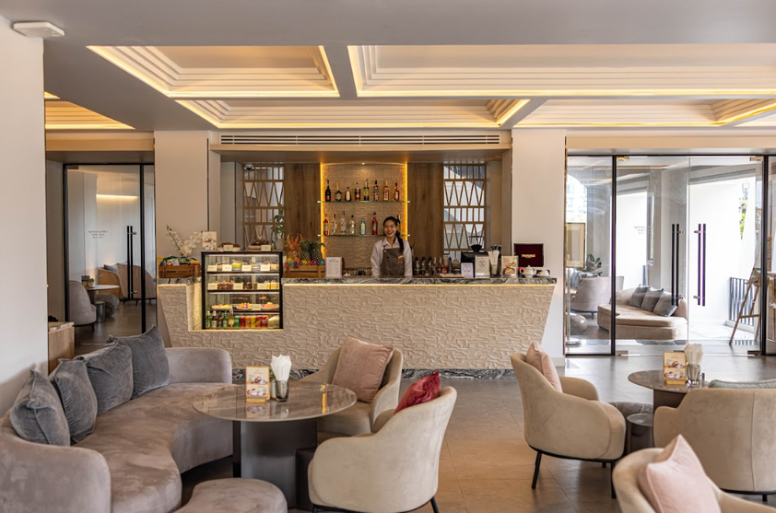

ASTRA
LOBBY LOUNGE
Astra is a vibrant rooftop venue offering stunning Andaman Sea views and breathtaking sunsets. It is the perfect setting for pre-event receptions, weddings, private celebrations, and brand activations.
Located in the lobby, the beautifully designed Lobby Lounge is the perfect place to sit back and unwind.
The offering in the Lobby Lounge: specialty coffees & teas, homemade pastries and cakes.

Slide 24
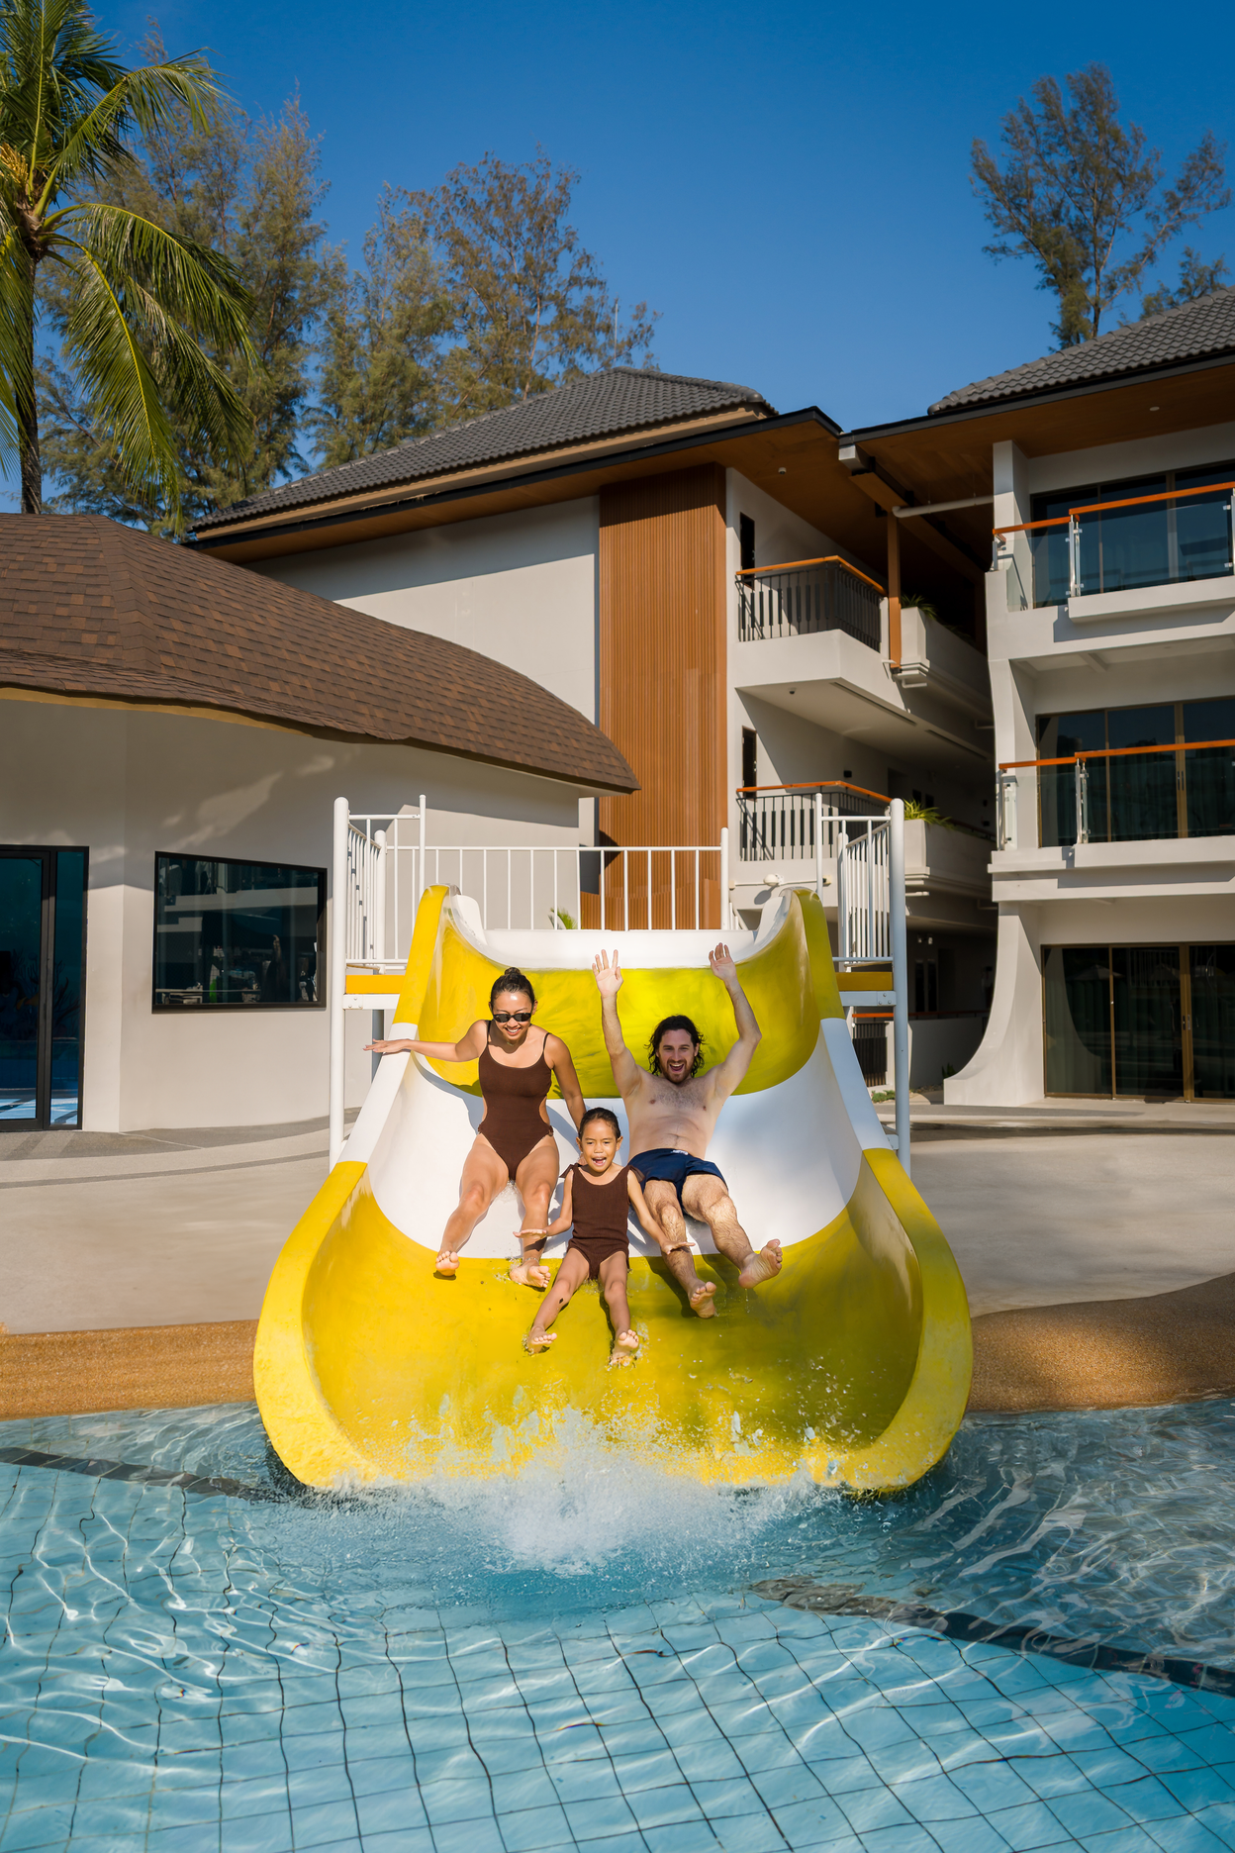
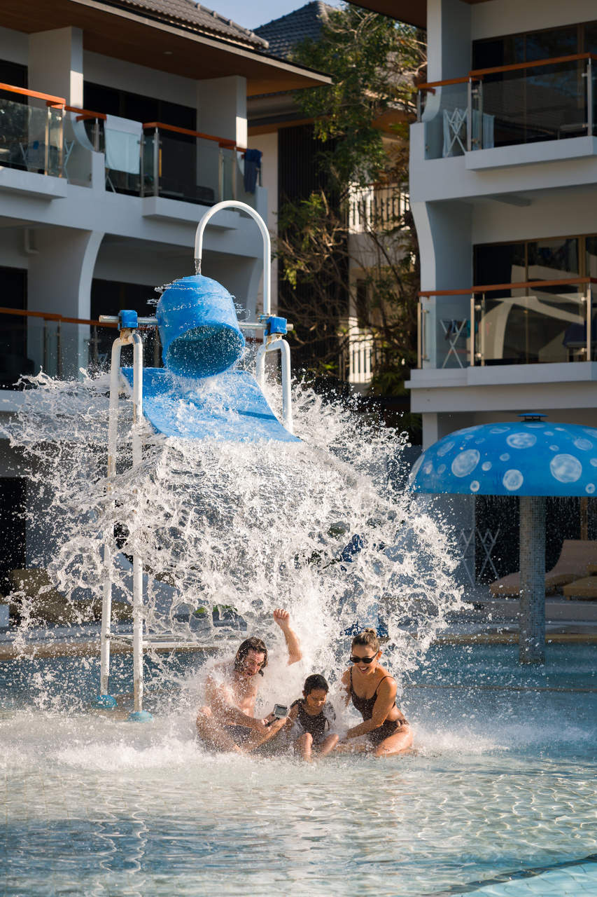
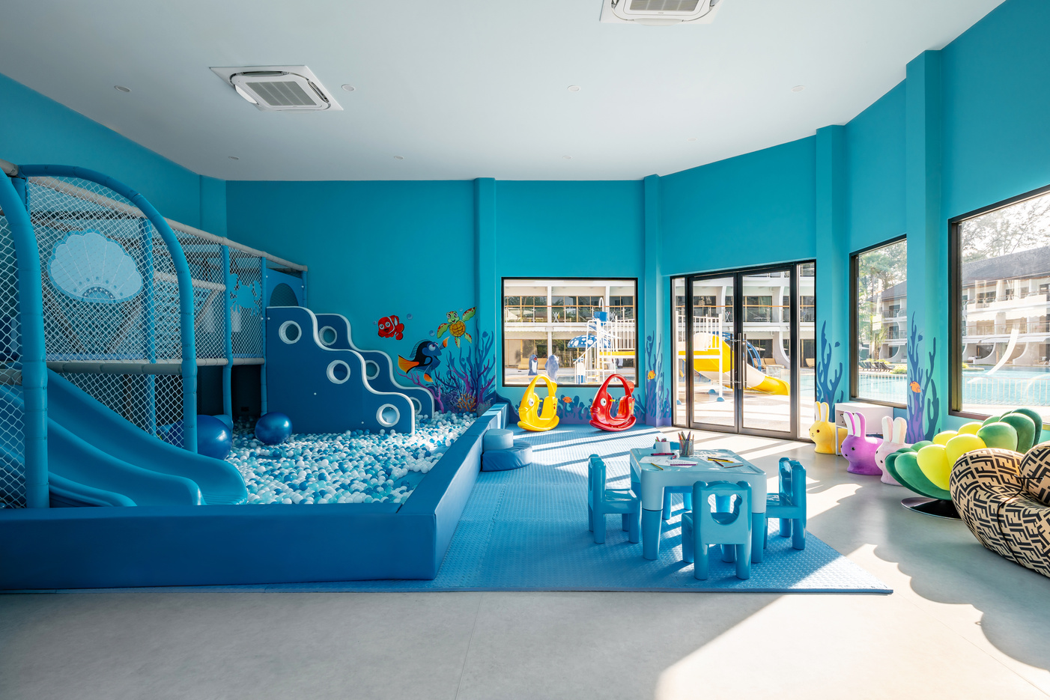
WATERPARK
Enjoy family fun at Amora’s waterpark, featuring splash zones, water slides, and spacious pools surrounded by tropical gardens perfect for unforgettable moments under the Phuket sun.
KIDS CLUB
The Kids Club offers a bright and playful space where children can enjoy games and activities in a safe and fun environment under the care of our nanny team, while parents relax and enjoy the resort.

Slide 25

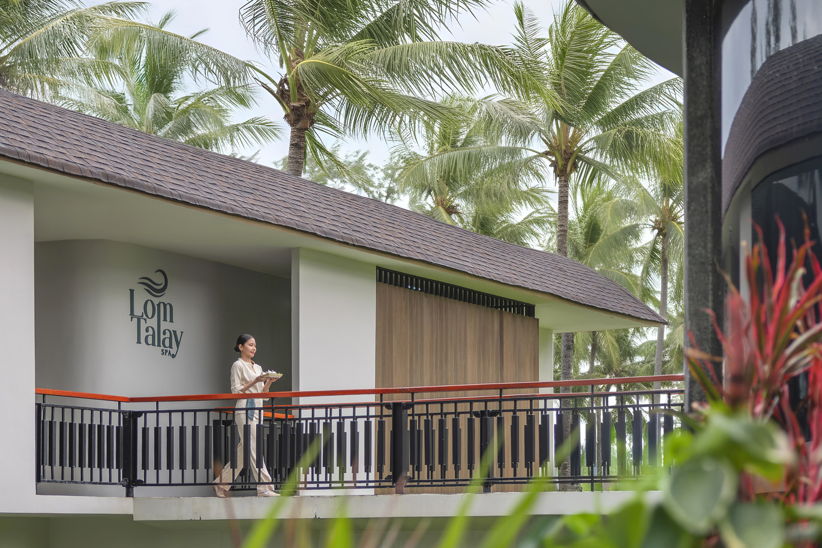
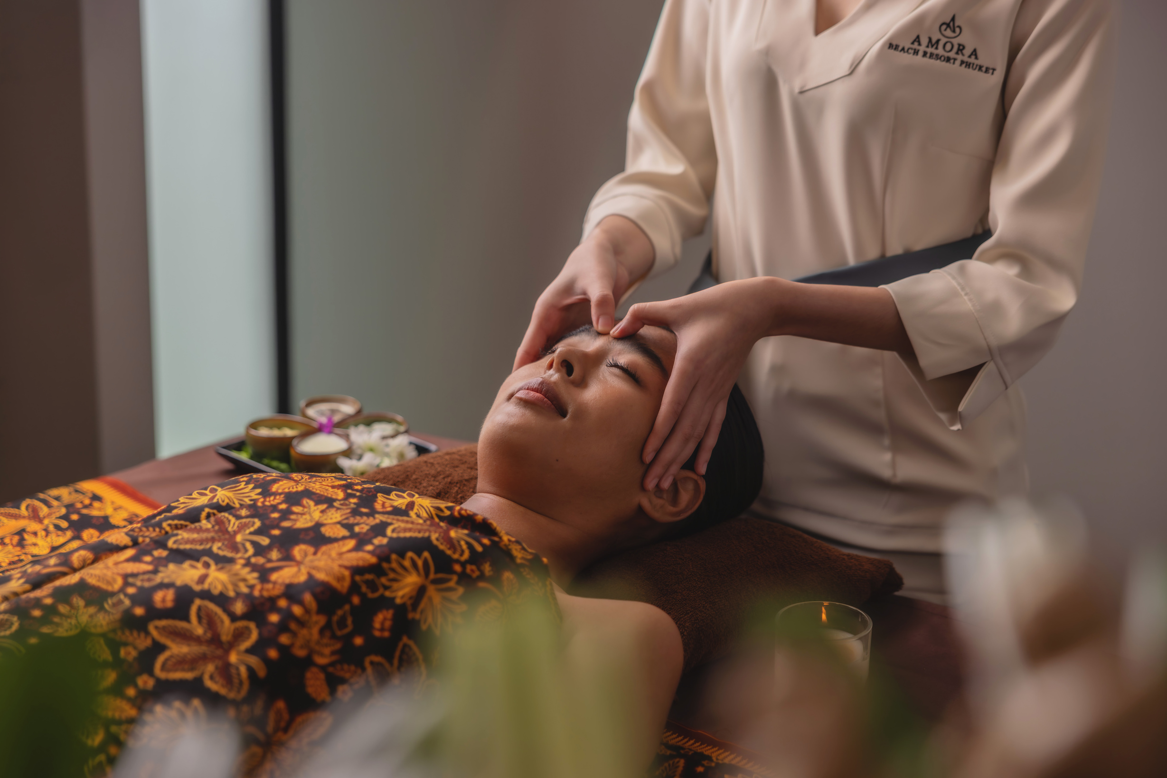
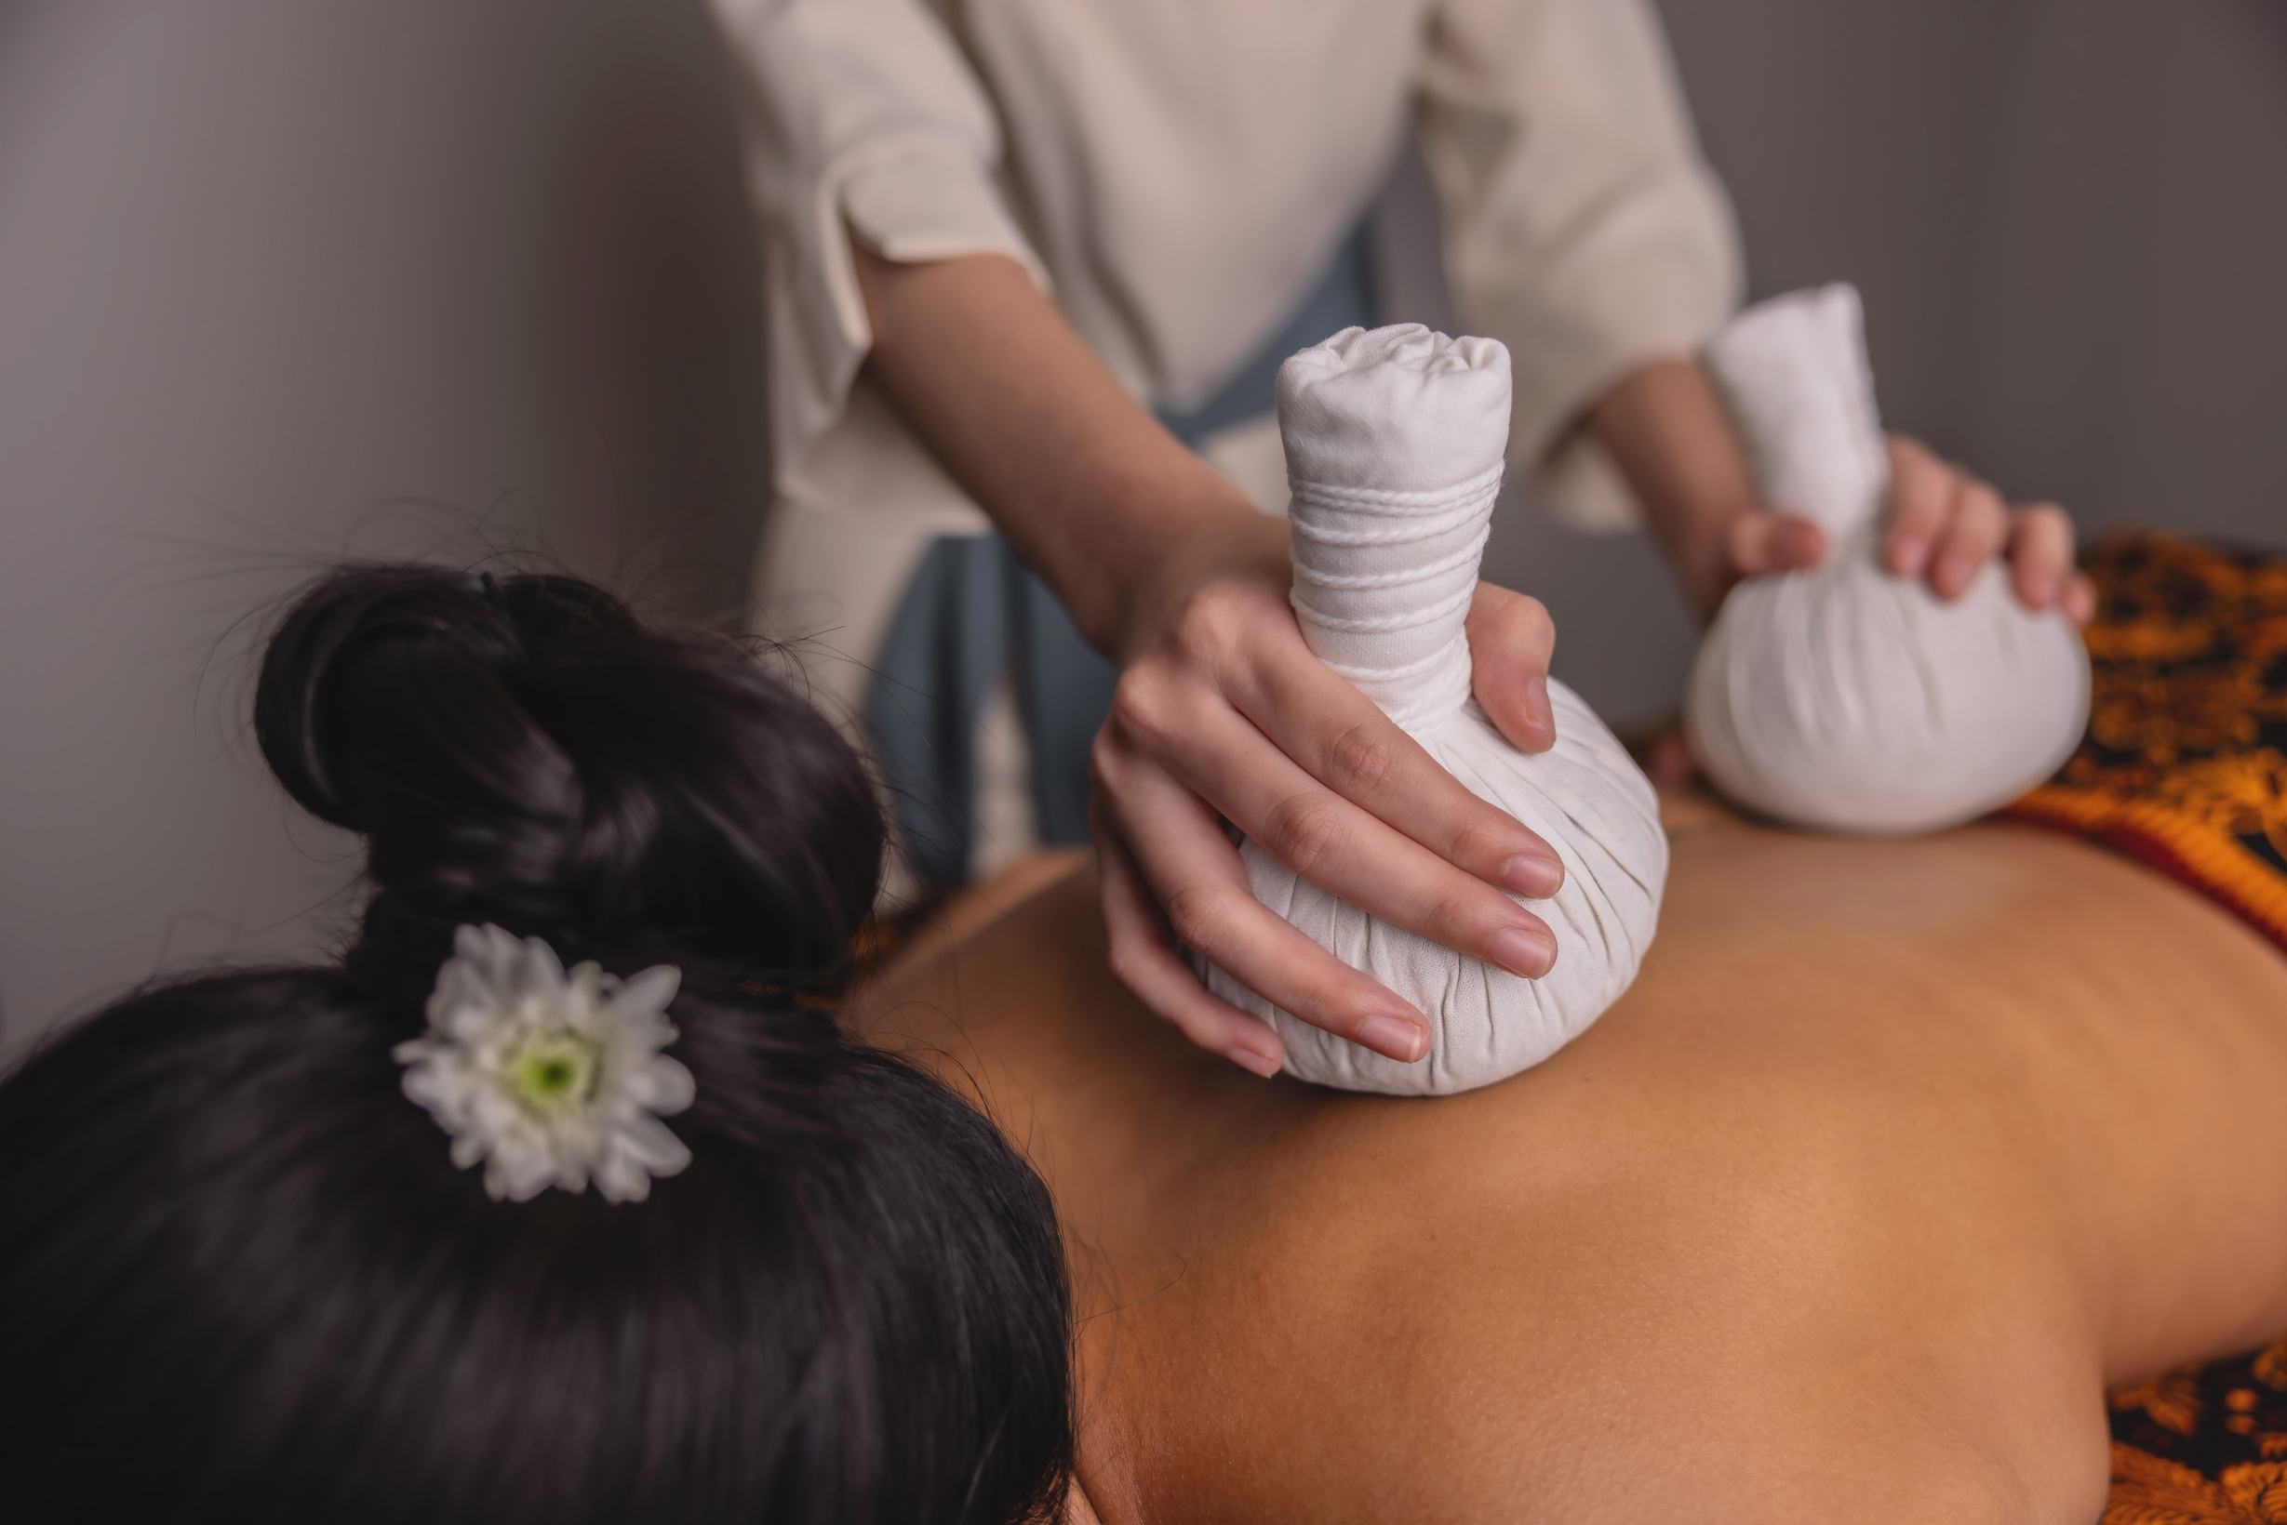
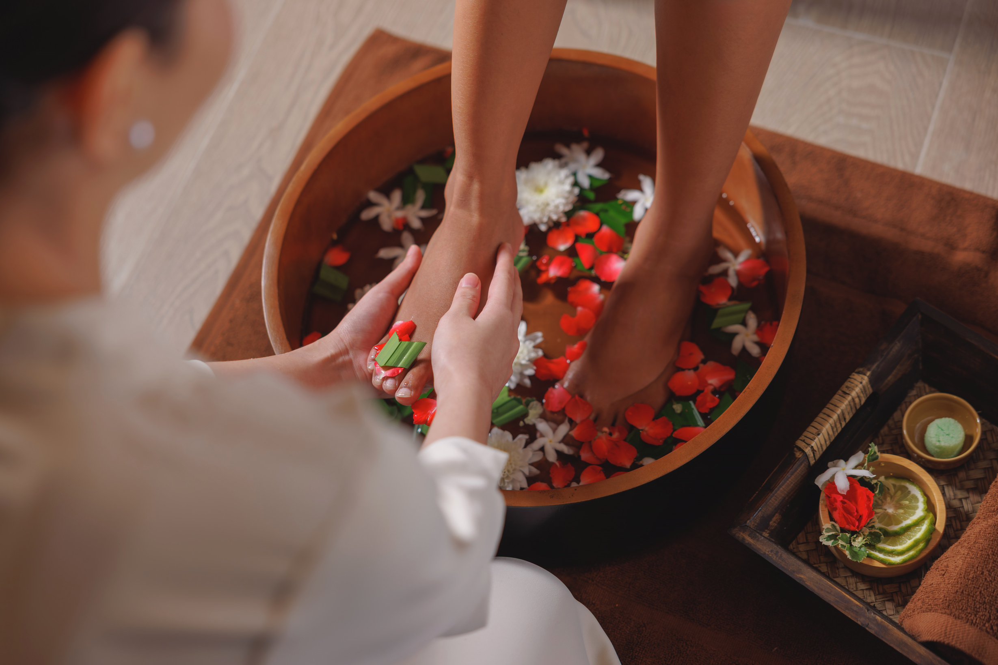
LOMTALAY SPA
Lom Tay meaning "sea breeze" in Thai is more than just a name It's a feeling, a moment, a memory carried on the wind.
Inspired by the hotel and spa's serene location beside the ocean, Lom Talay captures the essence of coastal tranquility).
There is always something special for every part of your body.

Slide 26
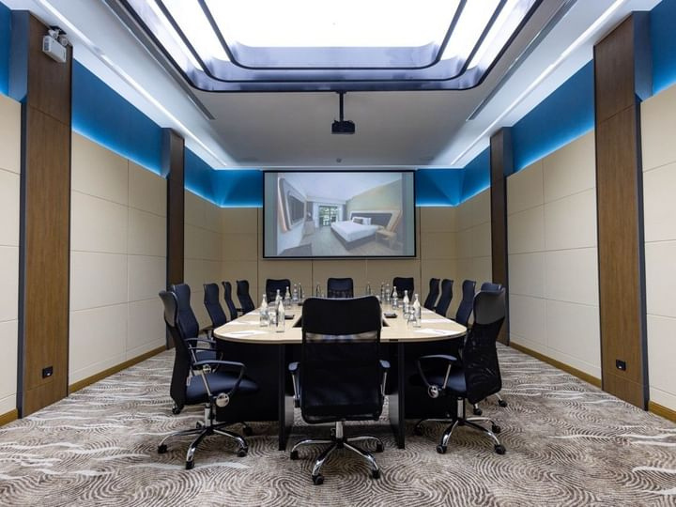
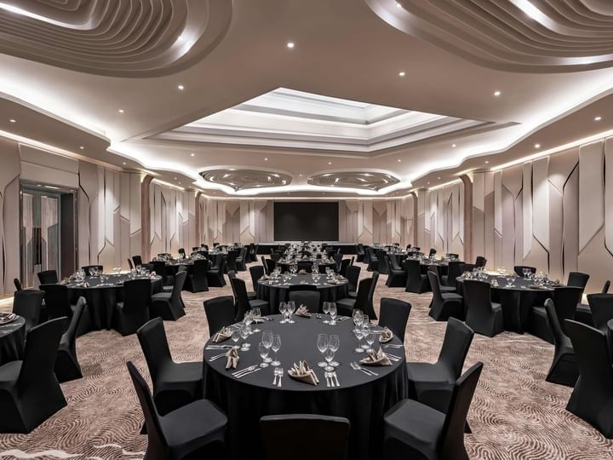
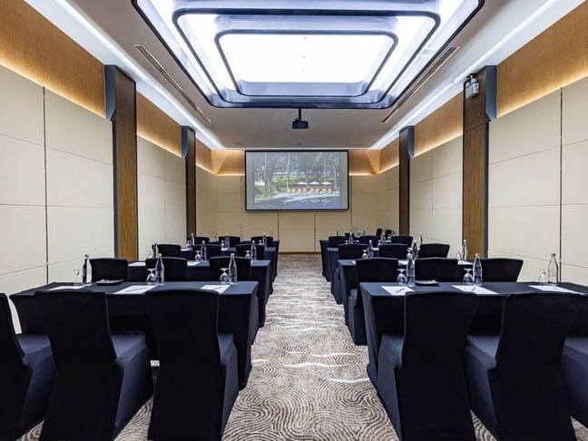
MEETING
Elevate your meetings and celebrations at Amora Beach Resort Phuket.
With over 800 sqm of elegant indoor space and a beachfront lawn overlooking the Andaman Sea, each venue is thoughtfully
designed to impress. Supported by bespoke planning, premium AV, and curated cuisine, every event is seamlessly refined.

Slide 27
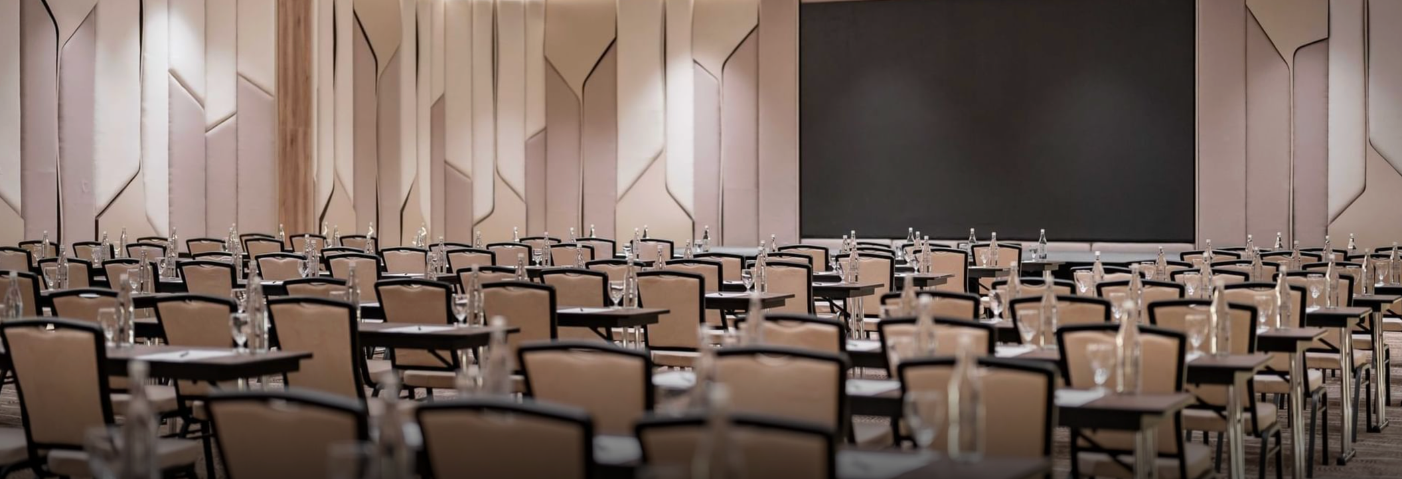
MEETING ROOM CAPACITY
Our hotel features versatile function rooms, suitable for hosting a wide variety of meetings and events.
ROOM SIZE
BANQUET
THEATER
CLASSROOM
U-SHAPE
BOARDROOM
MEETING FACILITIES
Grand Ballroom
The Sun Room
The Ocean Room
The Star Room
The Sky Room
The Galaxy Room
Library
362 sq.m.
53 sq.m.
53 sq.m.
107 sq.m.
170 sq.m.
280 sq.m.
97 sq.m.
210
30
-
60
100
160
-
250
50
-
50
80
150
-
160
30
-
40
60
100
-
-
-
-
-
-
-
20
-
-
14
-
-
-
-
  LED Screen (Ballroom)
  Projector & Screen
  Waiting Lounge
  Various pre-function space
  Theme Coffee Break

Slide 28
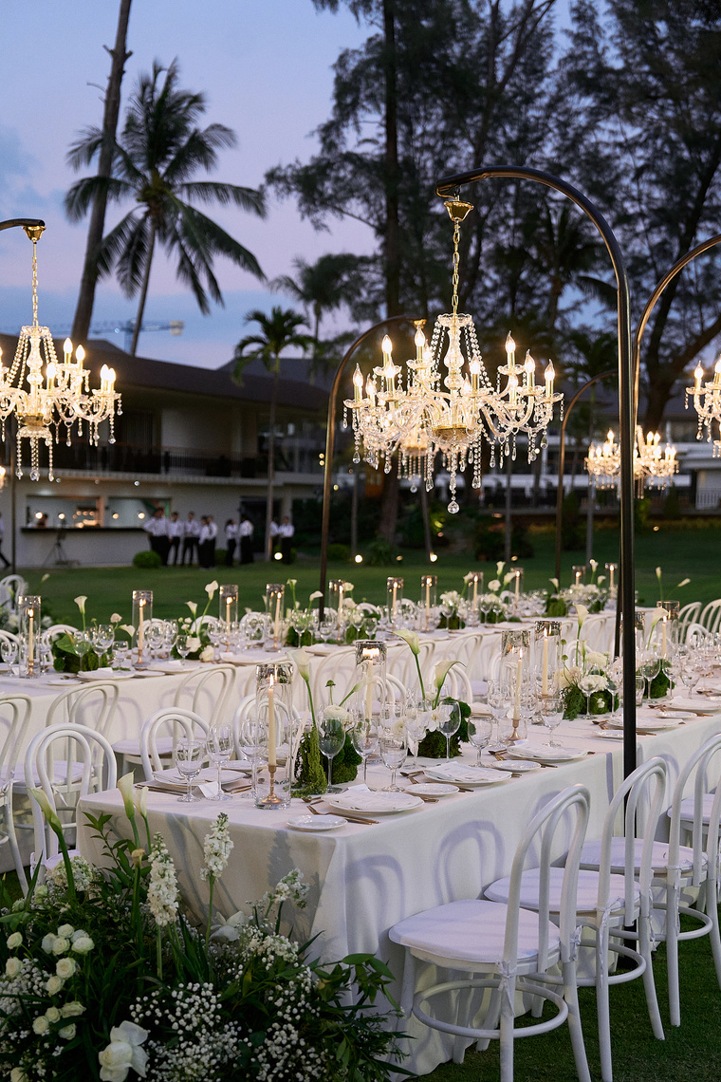
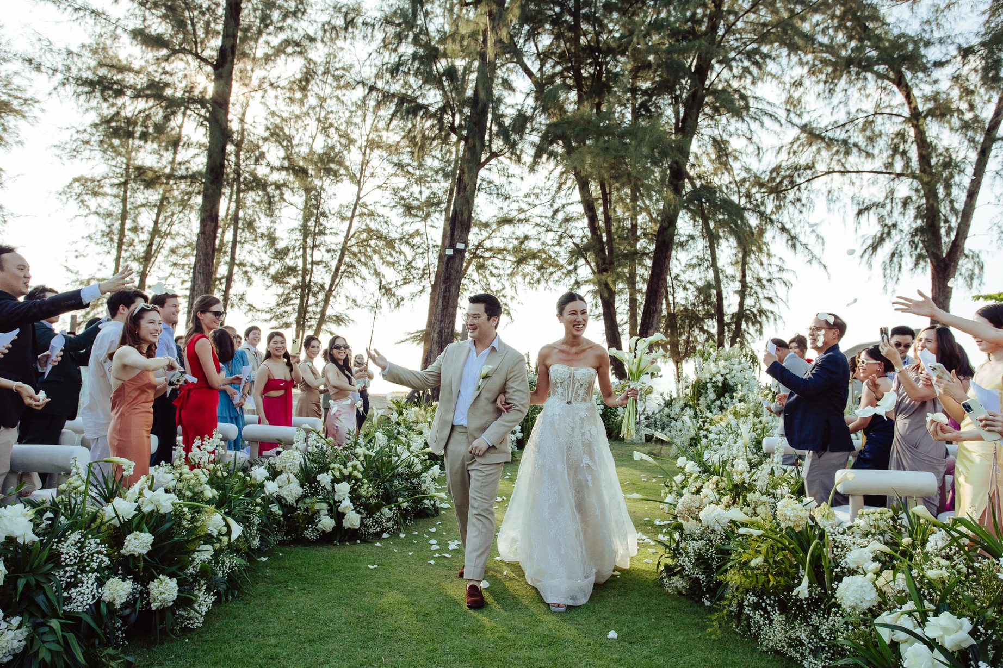
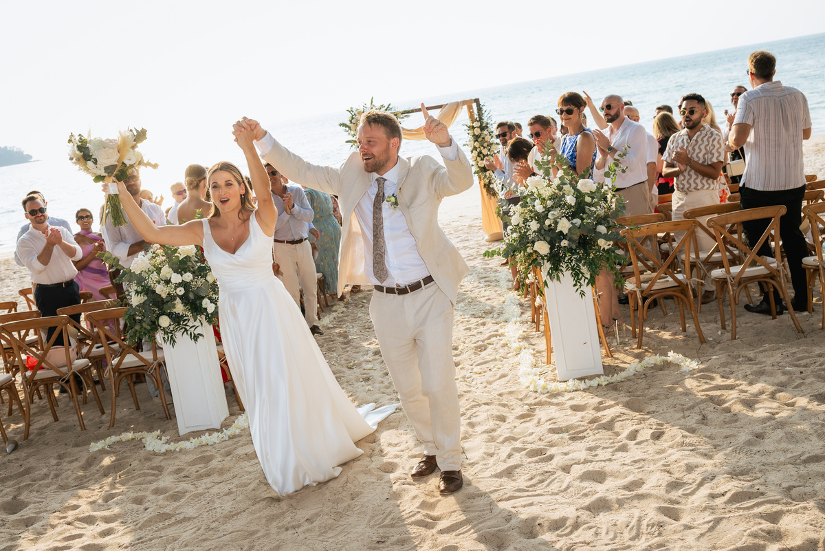
WEDDING
Experience the wedding of your dreams on the shores of Amora Beach Resort Phuket. Immerse yourselves in the magic of the moment as you exchange vows with the ocean as your witness, surrounded by the gentle caress of the sea breeze. Choose to celebrate your love with a reception on our event lawn or in our Grand Ballroom, where exceptional food and drinks await.

Slide 29
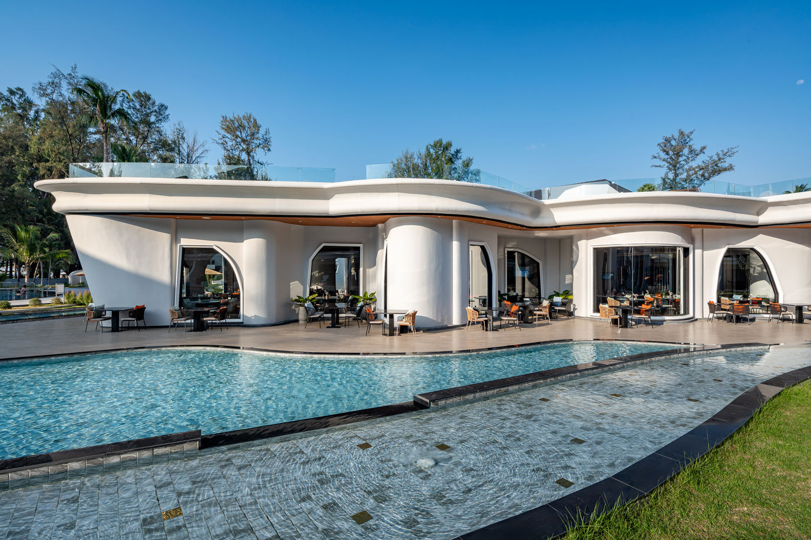
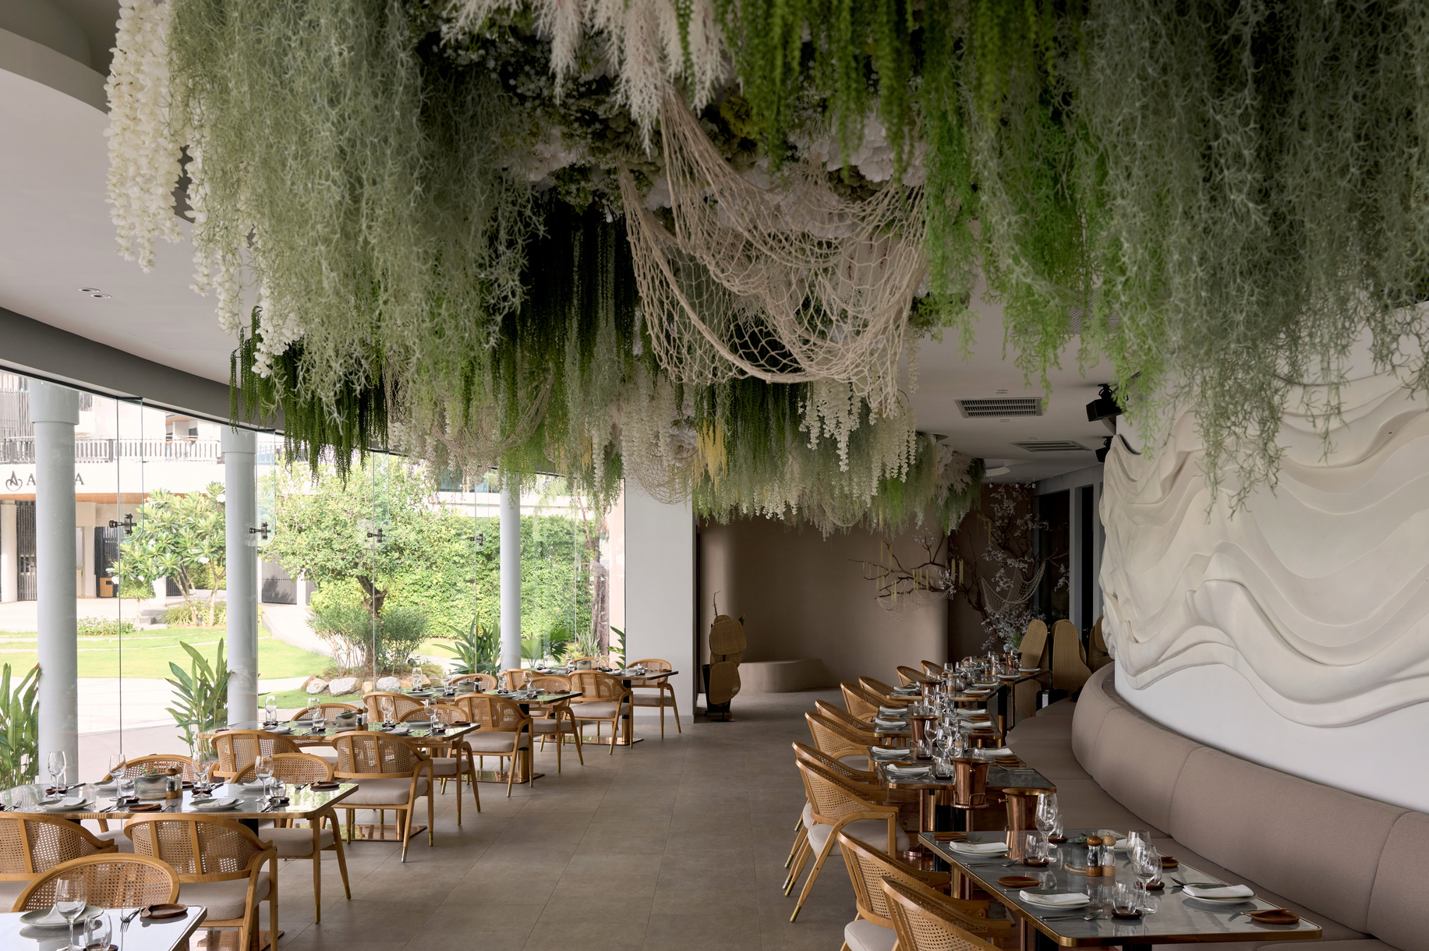
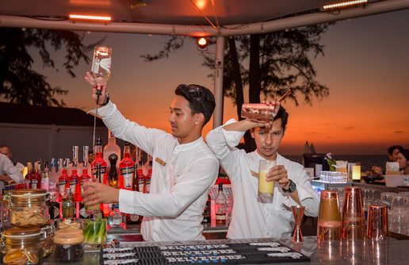
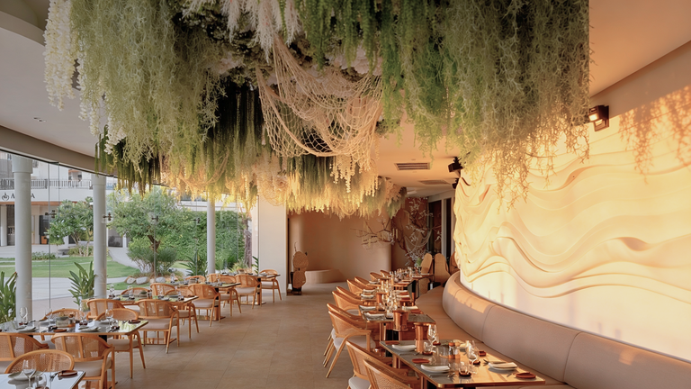













ISLA restaurant & Bar
All day dining and breakfast restaurant
Opening Hours: 06:30-23:00
N restaurant
Mediterranean cuisine by the beach
Opening Hours: 10:00-23:00
NORA Beach Club
DJ sessions and entertainments
Opening Hours: 10:00-23:00
ASTRA Rooftop
Unwind and indulge in sea view
Opening Hours: 17:00-21:00
Lobby Lounge
Elegant venue serves small bites & drinks
Opening Hours: 09:00-21:00
Pool Bar | Andaman & Garden Pool
Sip your favorite drinks by the pool
Opening Hours: 10:00-18:00
Garden Pool
Enjoy the lush & sea view on sunbeds
Opening Hours: 07:00-19:00
Andaman Pool
The biggest pool featured water park
Opening Hours: 07:00-19:00
Amora Beach Resort Phuket
322 Moo 2 Bang Tao Beach, Srisoontorn Road, Cherngtalay, Thalang, Phuket 83110
Tel: +66 76 314 236
Email: reservation-phuket@amoragroup.com
AQUA Kids Club
Special fun place for your little ones
Opening Hours: 08:00-18:00
Fitness Center
Maintain your fitness with the scenery
Opening Hours: 06:00-22:00
LomTalay Spa
Ultimate relaxation for your body & mind
Opening Hours: 10:00-20:00
Beach
Steps into the ocean with private access
Opening Hours: 07:00-19:00
Amora Beach Resort Phuket
amoraphuket

