Slide 1

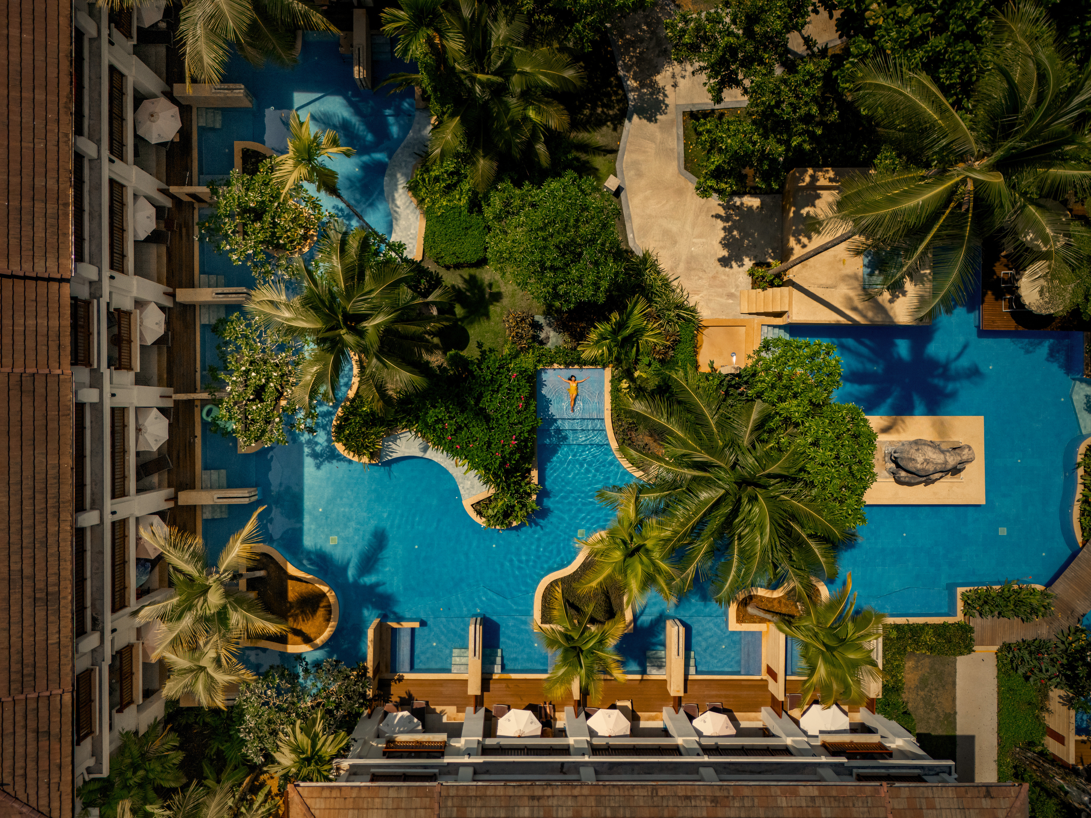
WELCOME TO
APSARA BEACHFRONT RESORT AND VILLA

Slide 2
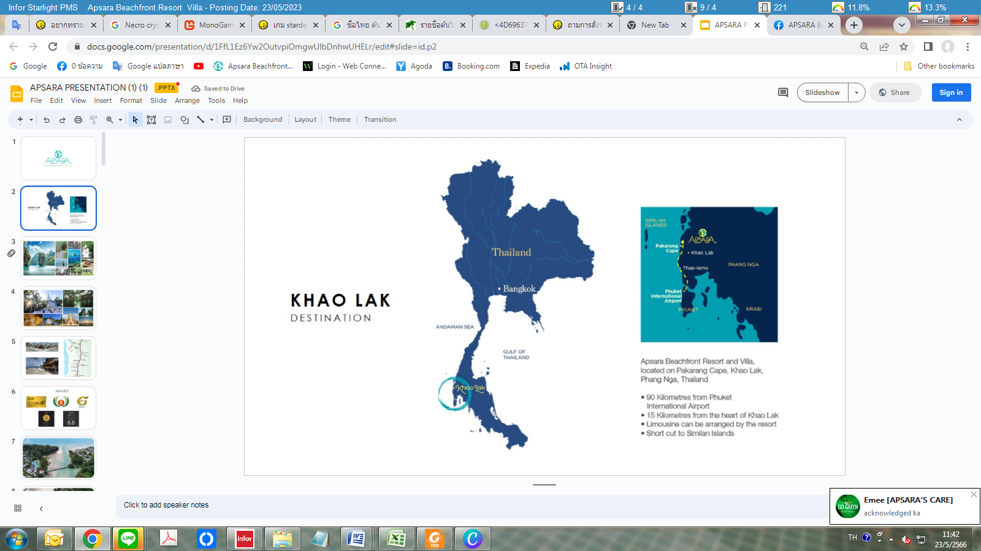


Apsara Beachfront Resort and Villa
Surat Thani International Airport
SURAT THANI
Apsara Beachfront
Resort and Villa
PHANG NGA
Phuket International Airport
KRABI
Krabi International Airport
PHUKET
APSARA Beachfront Resort and Villa is a 4 stars eco-friendly resort located on the tranquil Pakarang beach in Khao Lak,
Phang Nga province.
Accessible Destinations
    Phuket International Airport – 85 km
    Krabi Airport – 140 km
    Surat Thani Airport – 160 km

Slide 3




Apsara Awards
GREEN HOTEL
TRAVEL LIFE
TAT STAR
ASEAN GREEN HOTEL AWARD
[Gold Award]
[Gold Award]
[5 Stars]
The award is given by the Thai Authority to hotels in Thailand with exceptional eco-friendly practices
An international certification founded by TUI (Germany) for hotels excelling in sustainability and responsible tourism.
The award by TAT honors Thai tourism partners for achieving high-value sustainability across environmental, socio-economic, cultural, and governance standards.
Given to hotels in the ASEAN for adhering to strict environmental guidelines, promoting sustainable tourism through efficient resource management.

Slide 4


Area Highlights
Pakarang Cape
  Karkinos Beach Restaurant & Bar - 100 m
  Salt Surf Restaurant - 120 m
  Elephant Home - 800 m
  Malama - 2 km
  Pakarang Cape - 2.2 km
  Sairung Water Fall - 8 km
  Khaolak Center - 16 km
Coconut Beach
Malama
Salt Surf
KARKINOS Beach Bar & Restaurant
Apsara Beachfront
Resort and Villa
Memories
Beach
Elephant Home
Khaolak Center

Slide 5
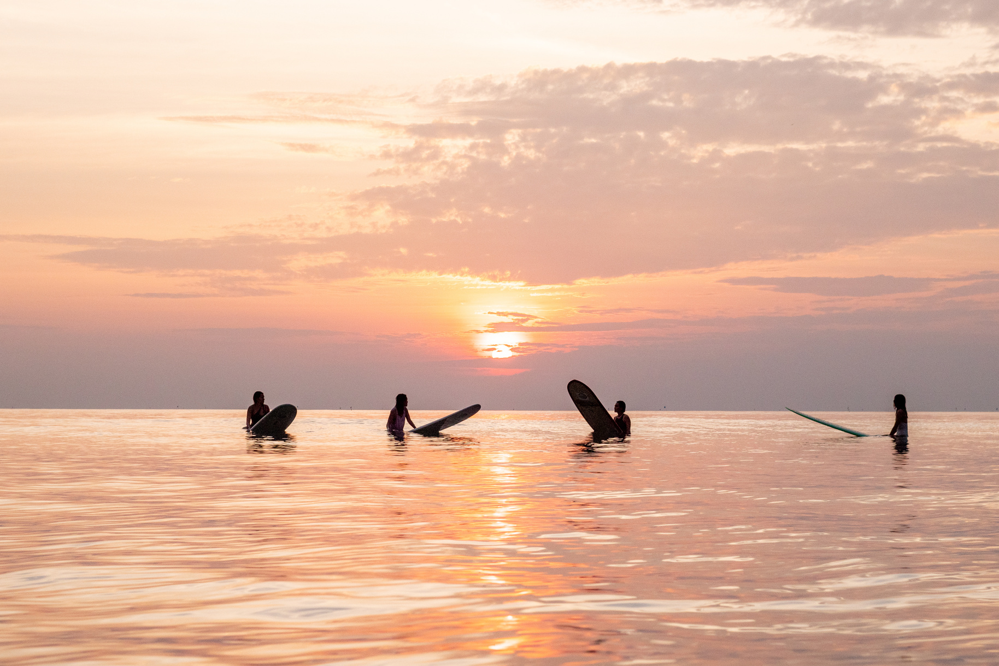

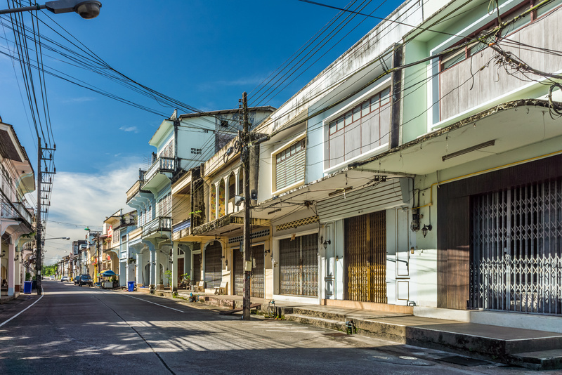
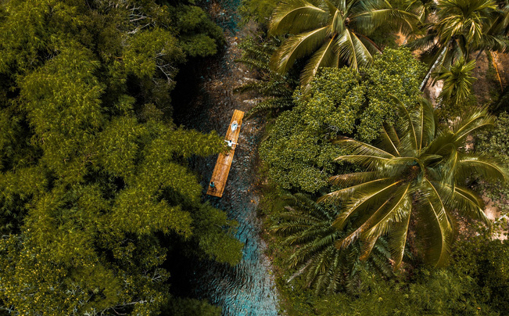
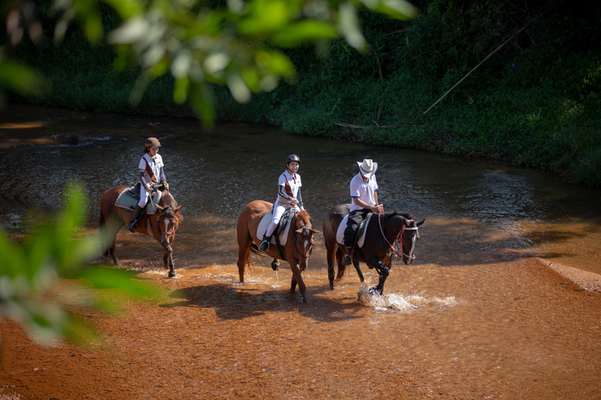
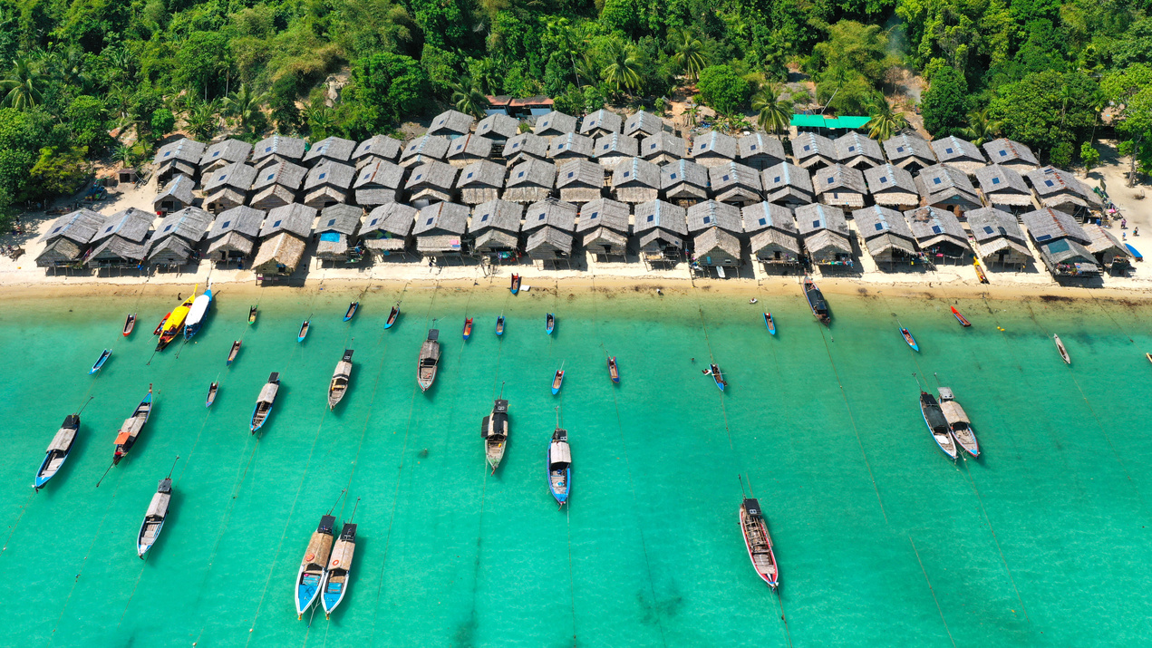
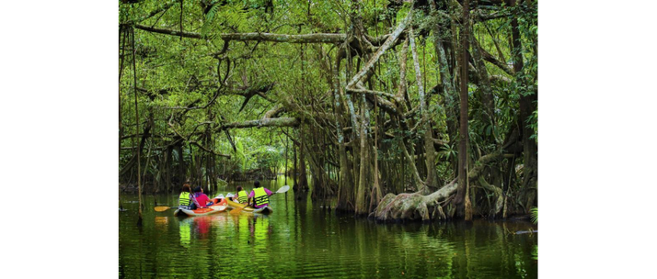


Slide 6
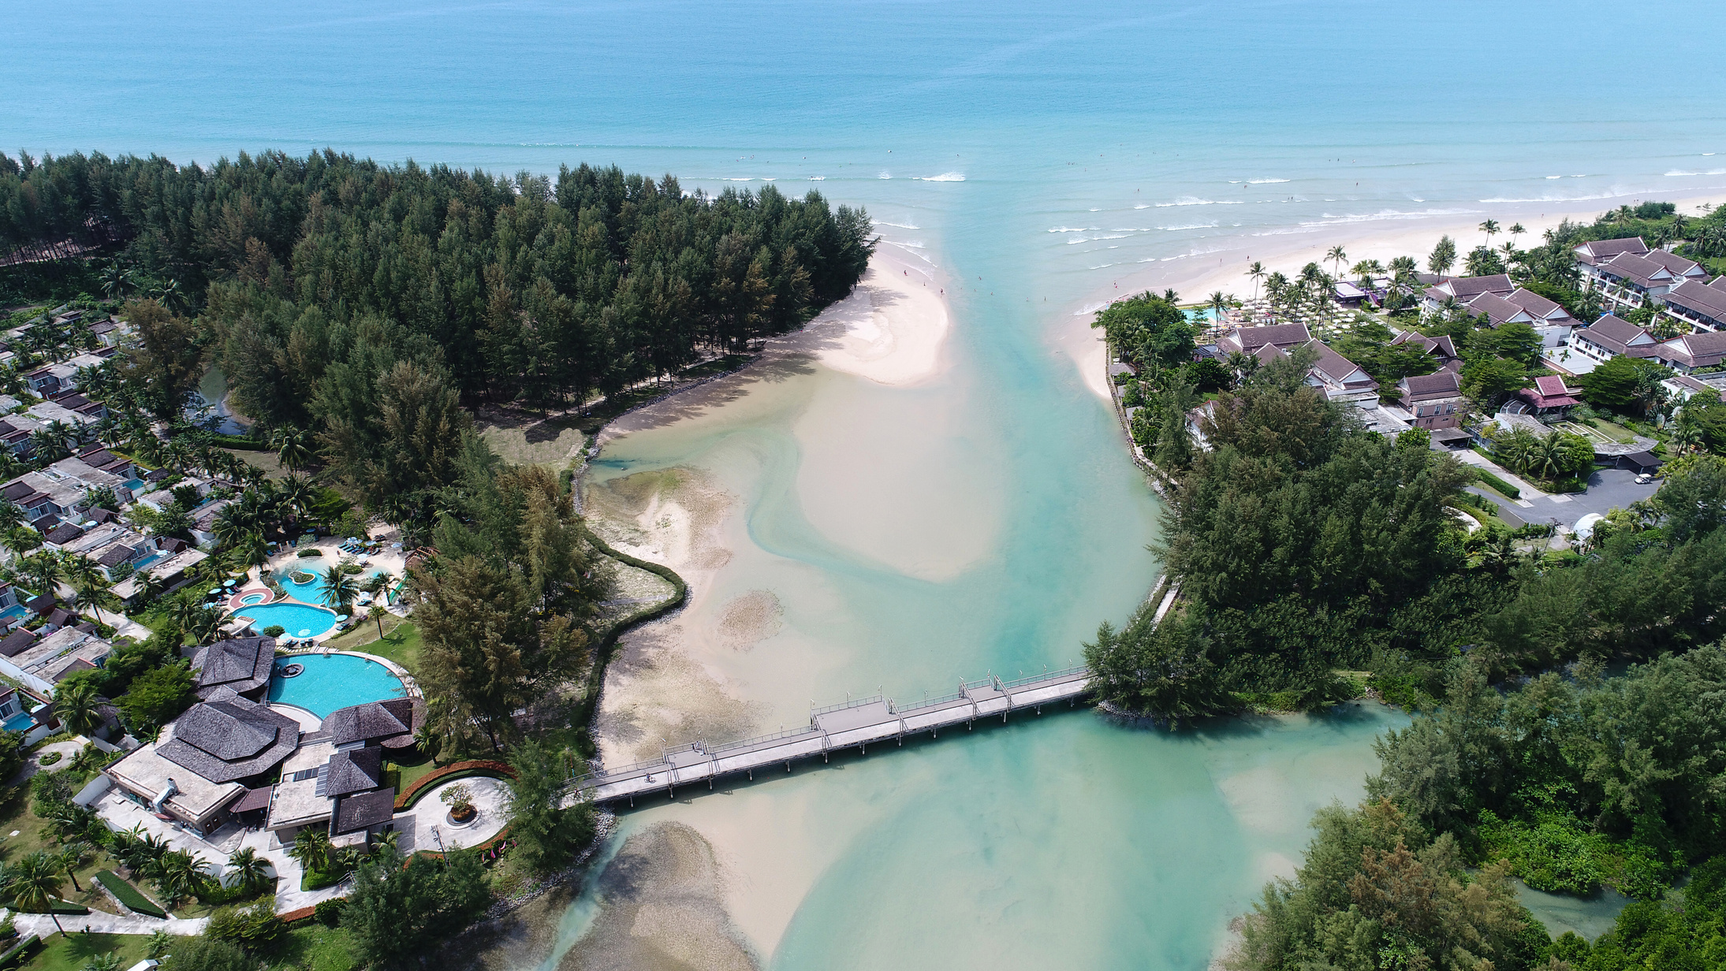

Slide 7
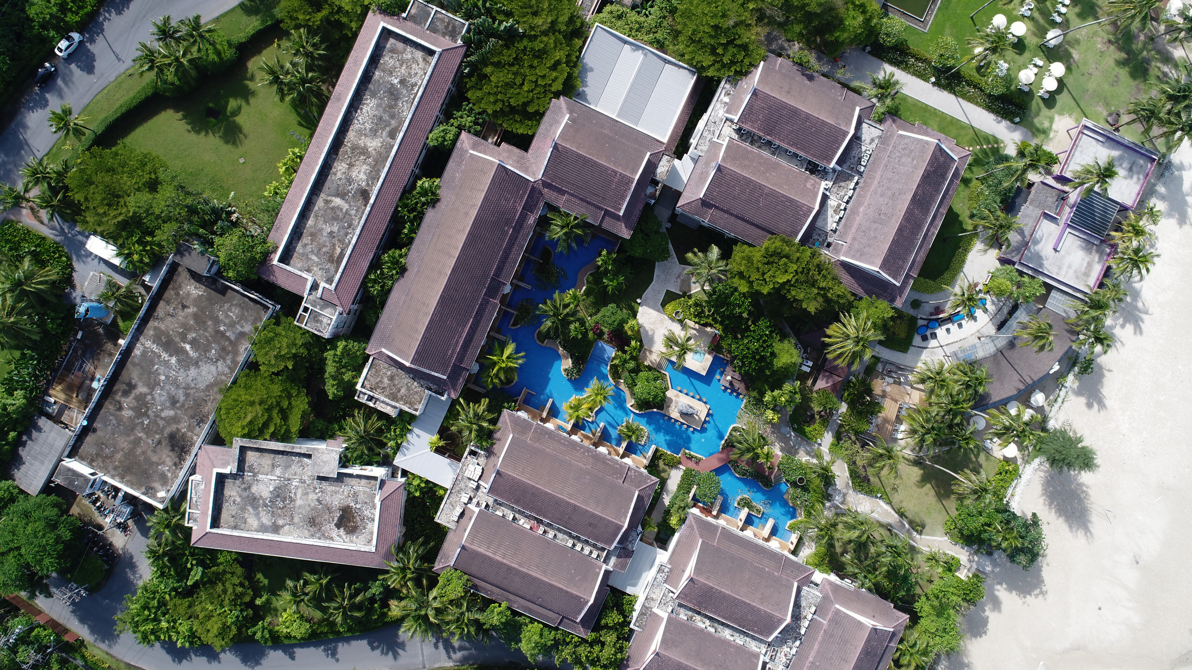
RESORT ZONE

Slide 8
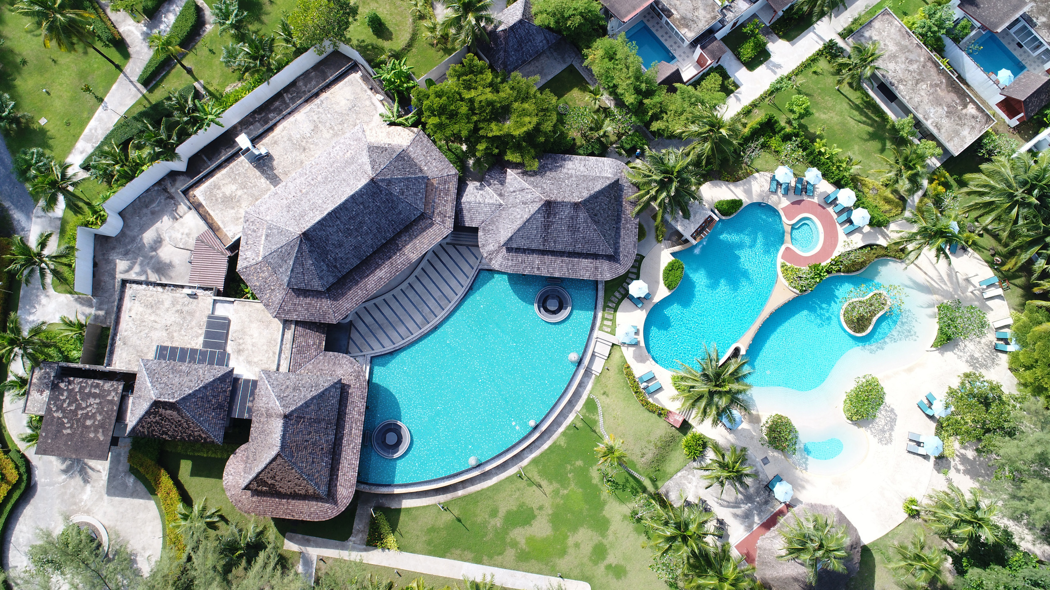
VILLA ZONE

Slide 9
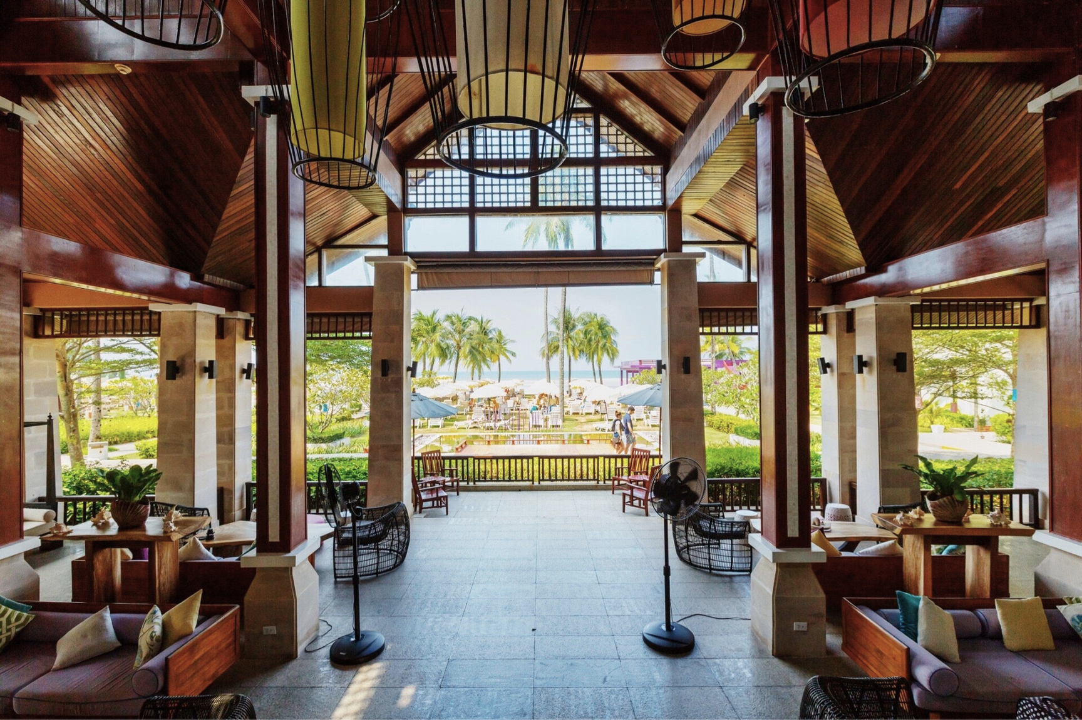
HOTEL LOBBY

Slide 10
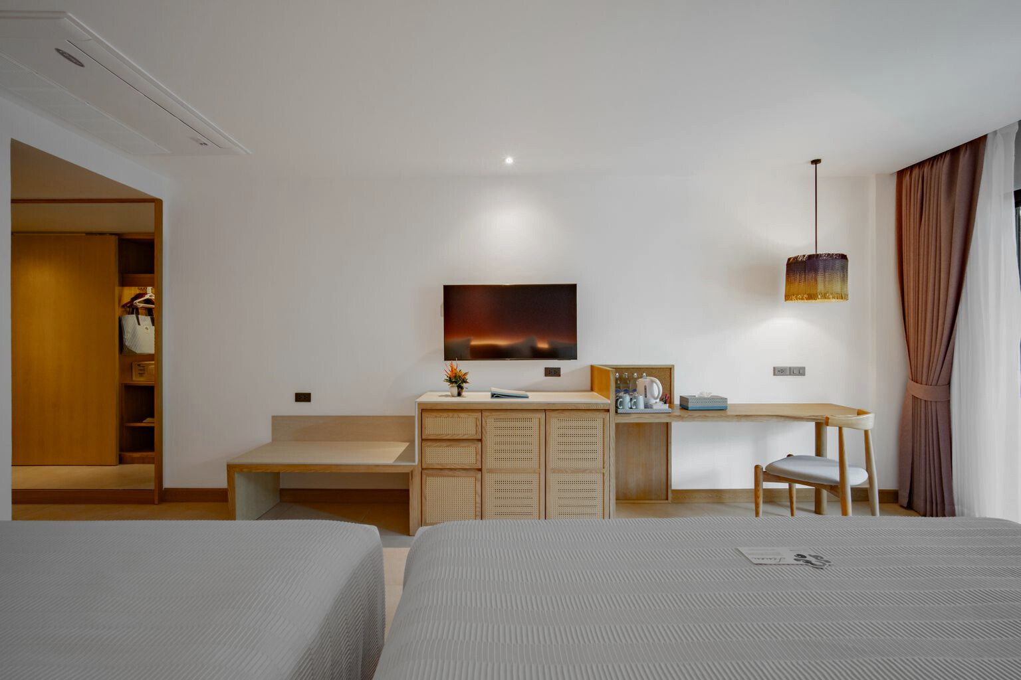
ACCOMMODATION

Slide 11
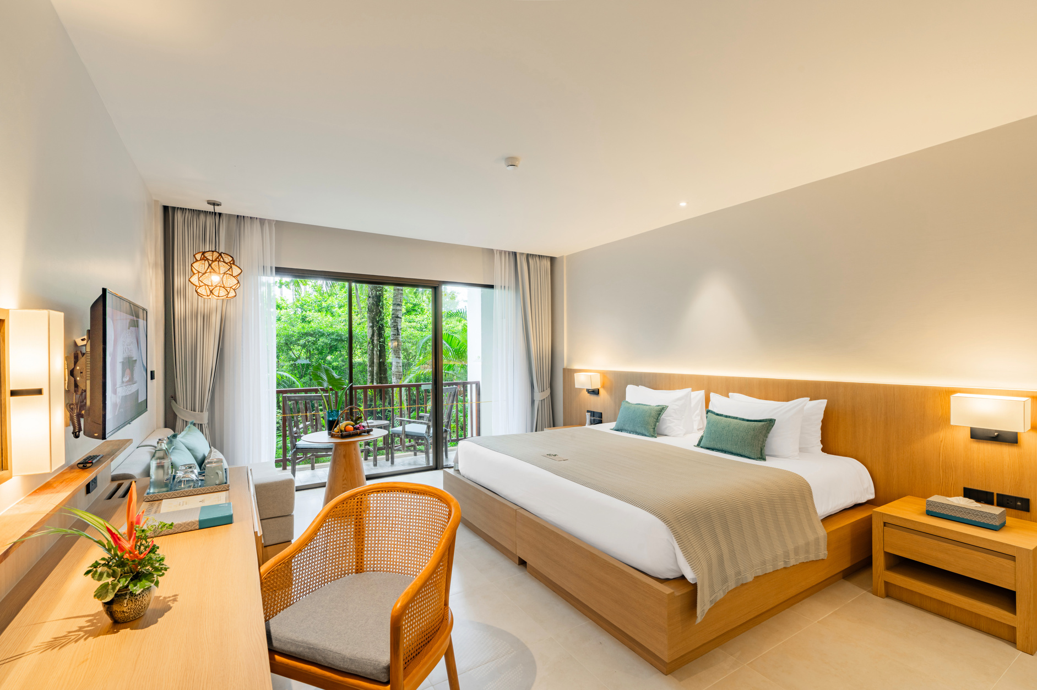
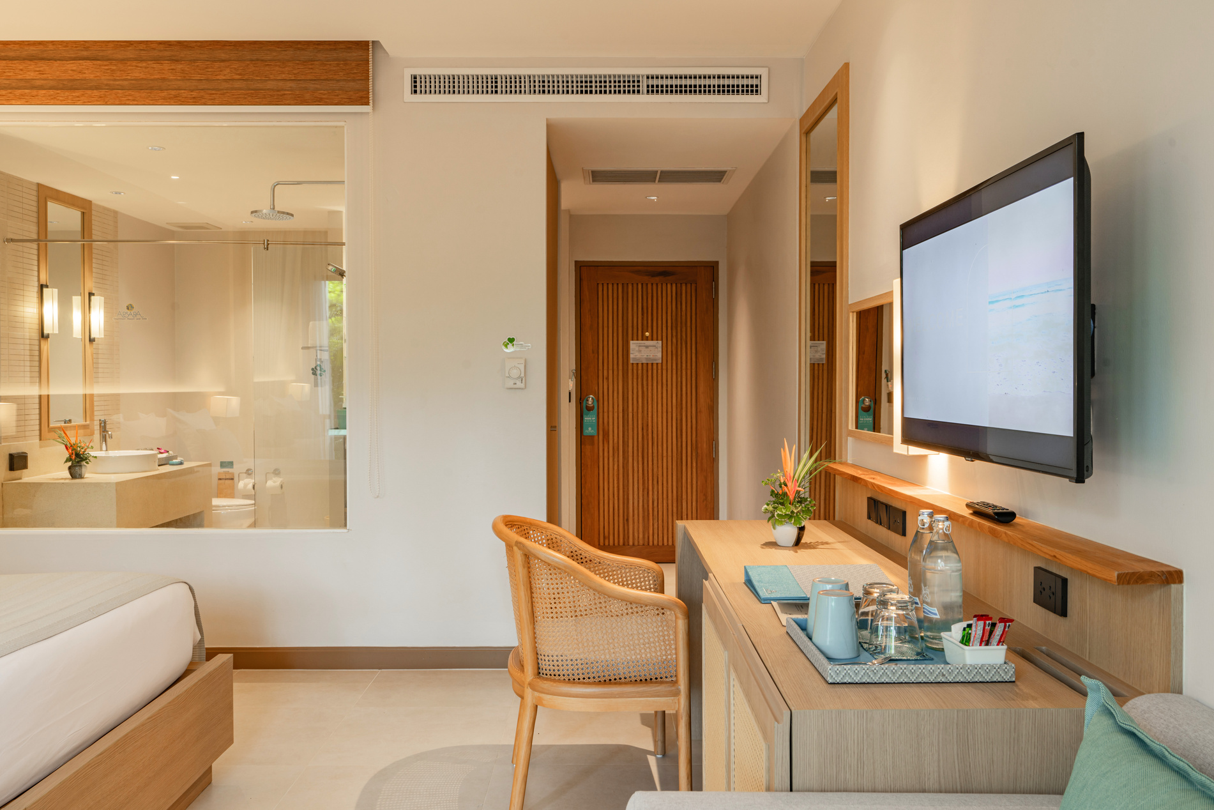
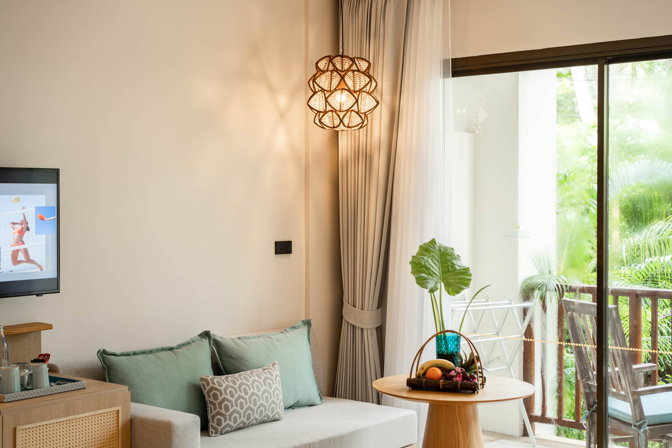
DELUXE ROOM
No. of room
Room Size
Bed Type
View
131 rooms
42 Sq.m.
Double or
Twin Bed
Garden View

Slide 12
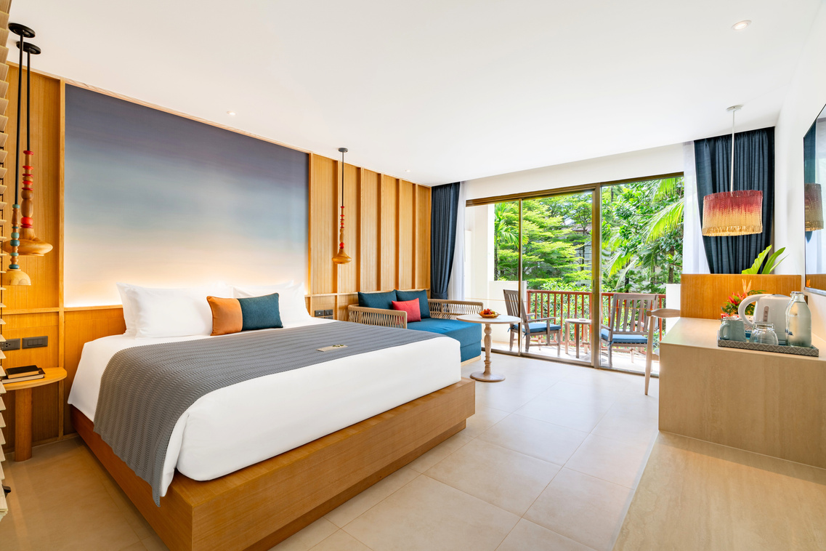
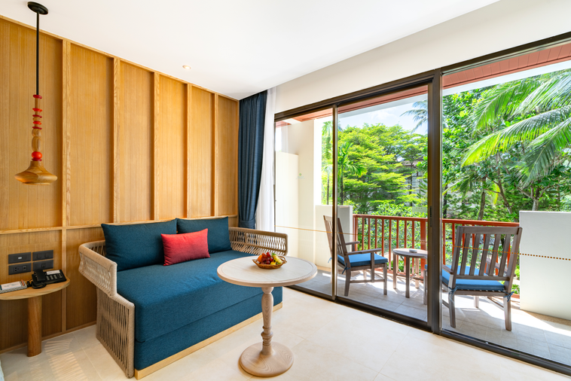
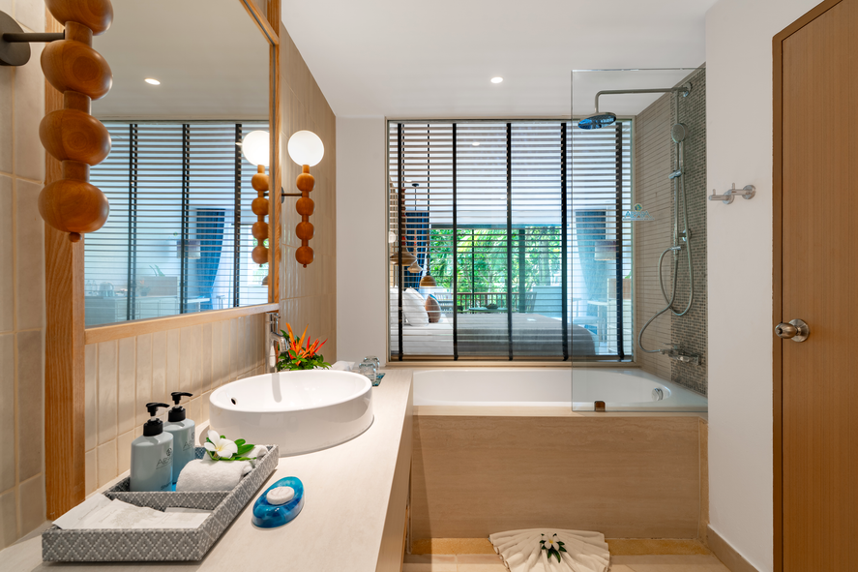
DELUXE ROOM
No. of room
Room Size
Bed Type
View
131 rooms
42 Sq.m.
Double or
Twin Bed
Garden View

Slide 13
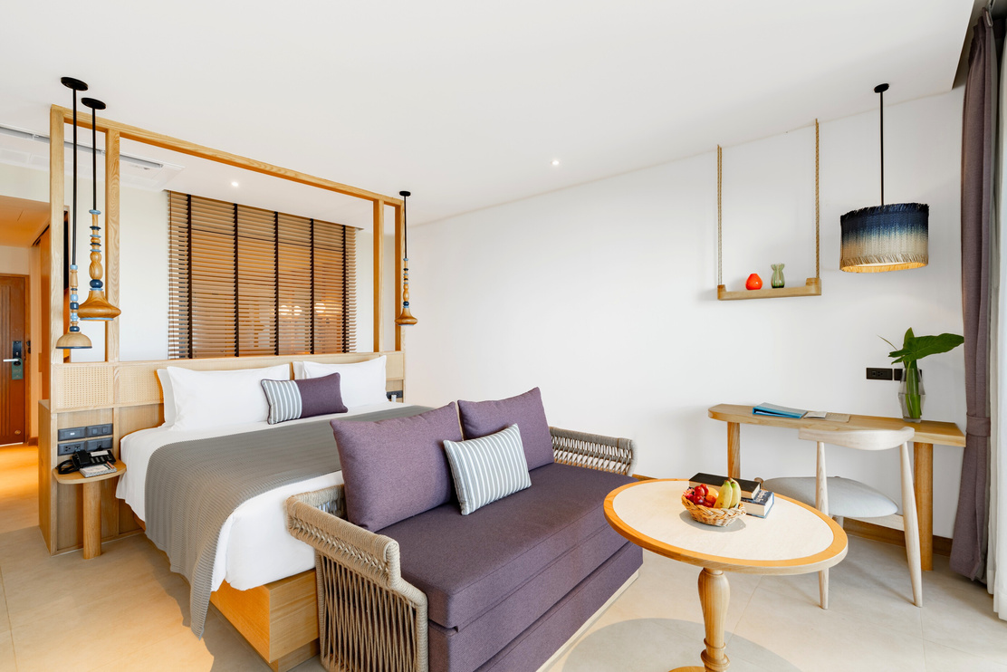
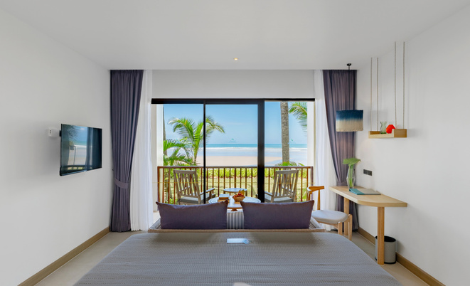
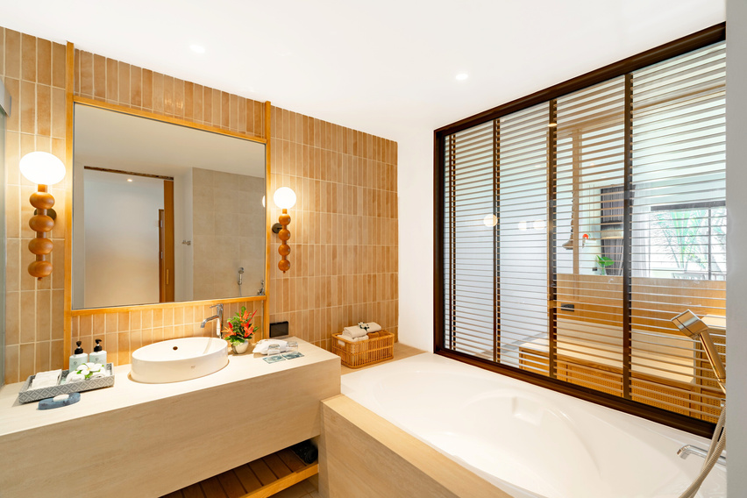
DELUXE SEAVIEW ROOM
No. of room
Room Size
Bed Type
View
22 rooms
47 Sq.m.
Double or
Twin Bed
Sea View

Slide 14
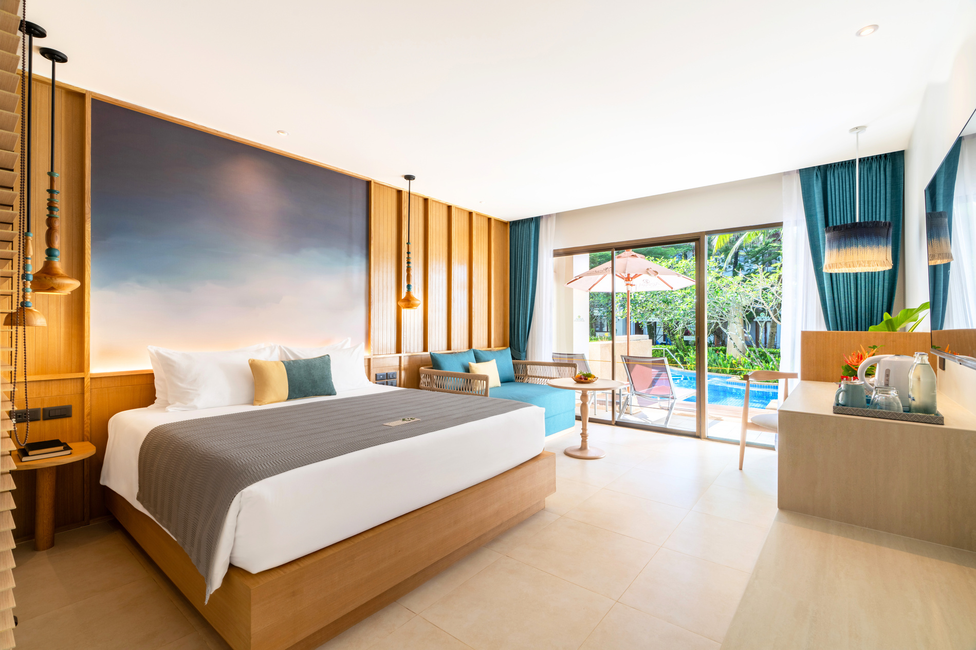
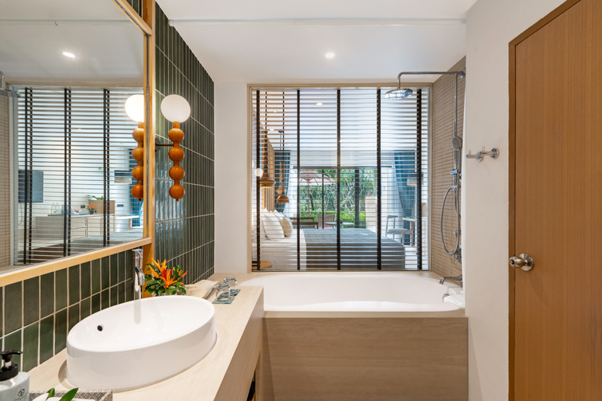
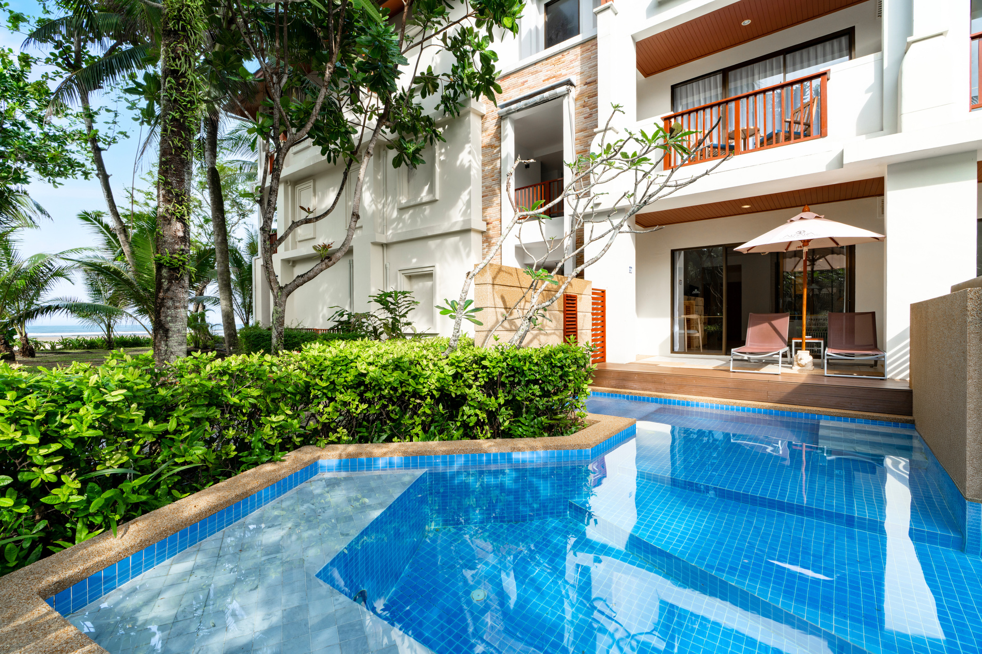
POOL ACCESS ROOM
No. of room
Room Size
Bed Type
View
19 rooms
53 Sq.m.
Double Bed
Pool View

Slide 15
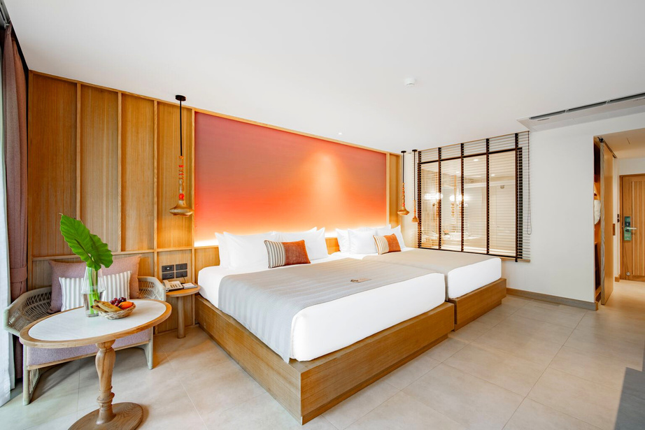
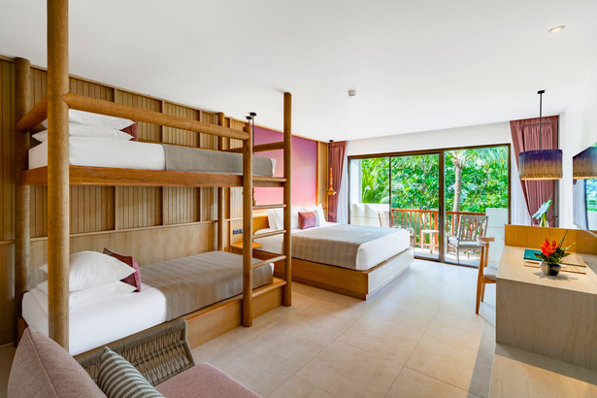
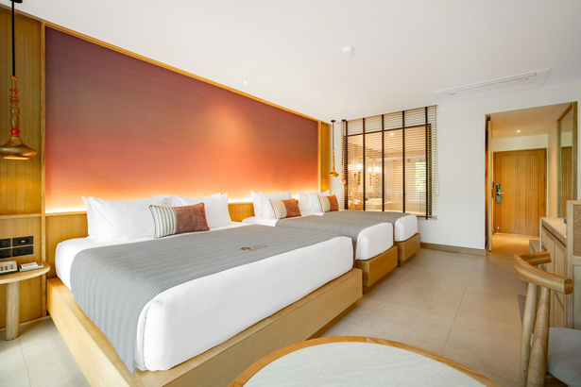
FAMILY DELUXE ROOM
No. of room
Room Size
Bed Type
View
19 rooms
47 Sq.m.
1 King Bed and
1 Queen or Twin or Bunk bed
Lagoon View

Slide 16
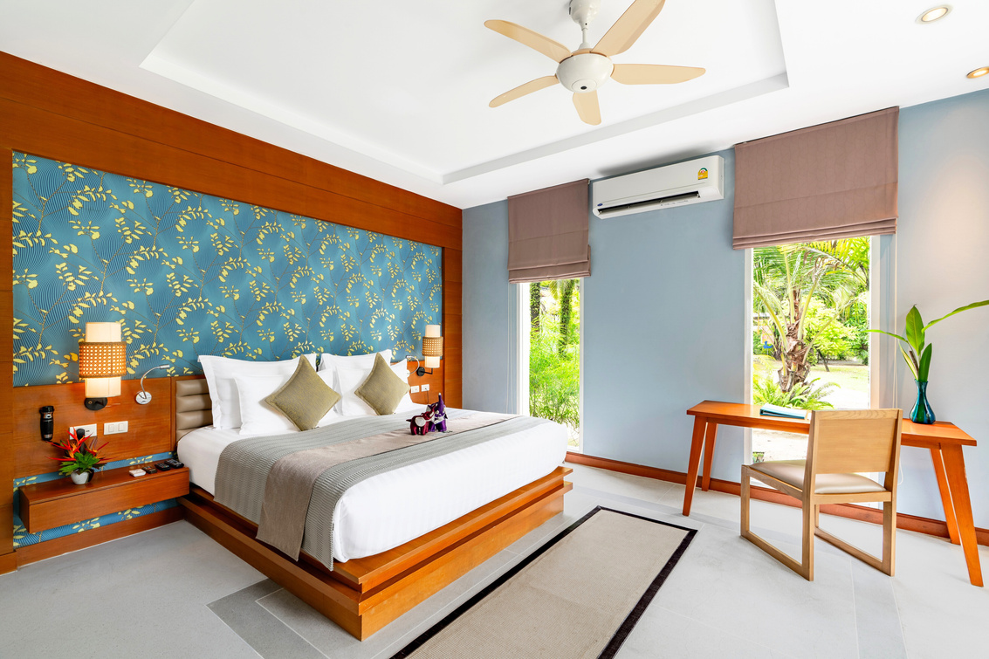
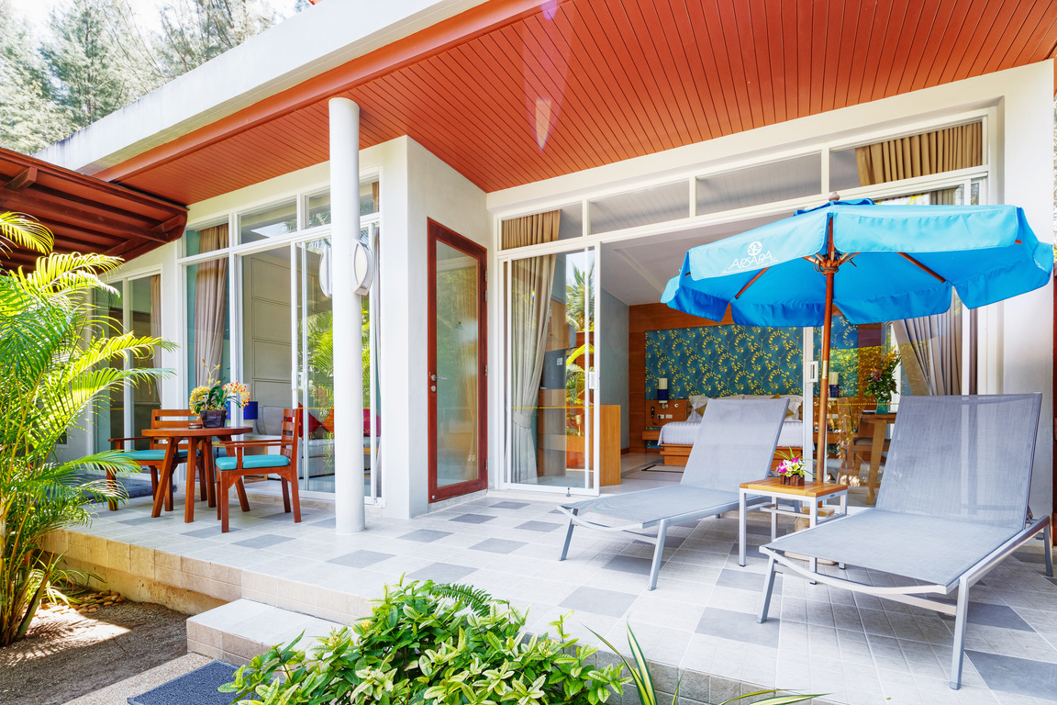
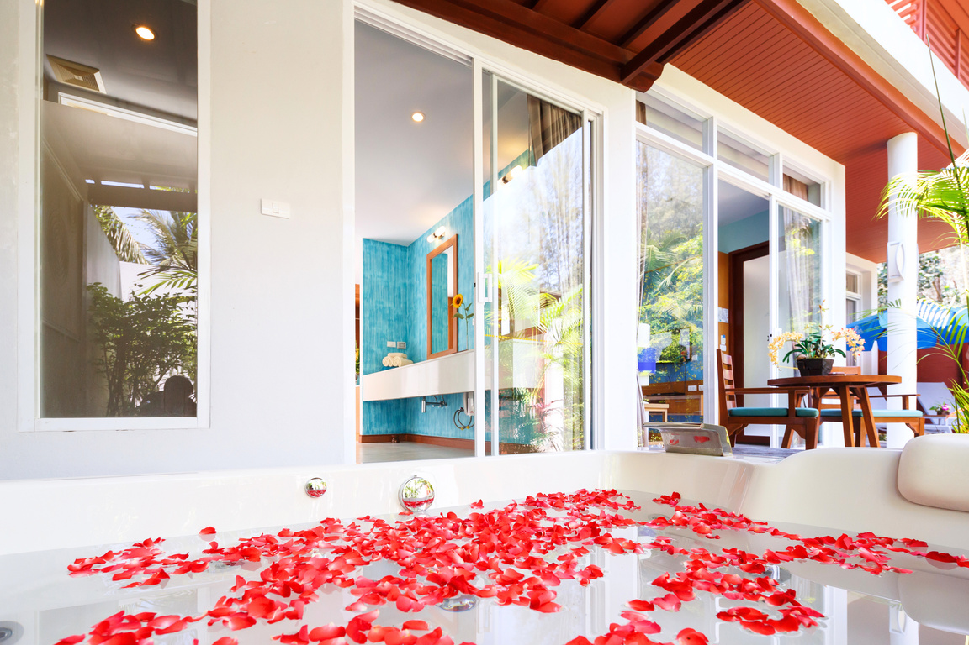
JACUZZI VILLA
No. of room
Room Size
Bed Type
View
20 rooms
120 Sq.m.
Double Bed
Garden View

Slide 17
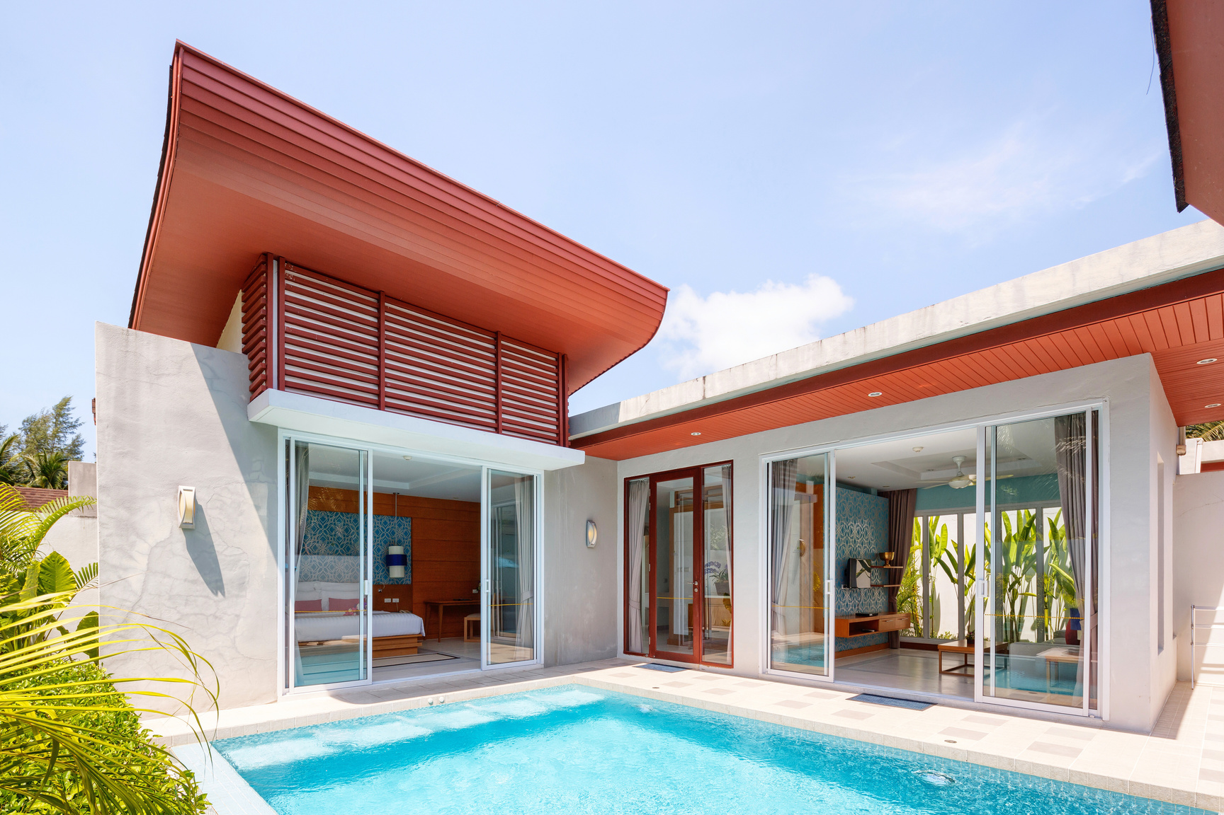
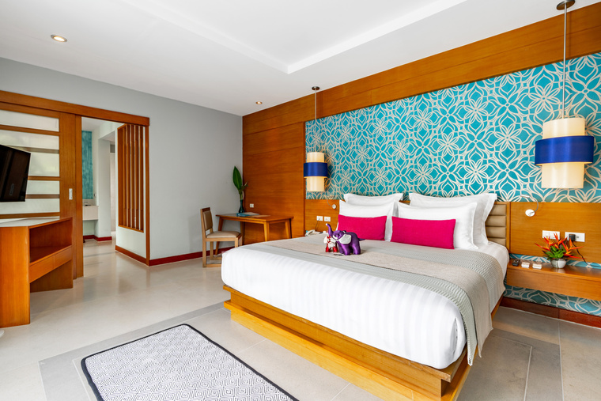
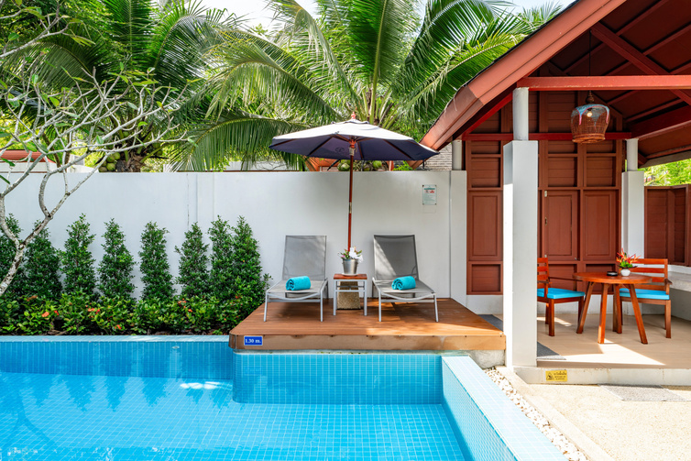
POOL VILLA
No. of room
Room Size
Bed Type
View
24 rooms
180 Sq.m.
Double Bed
Pool View

Slide 18
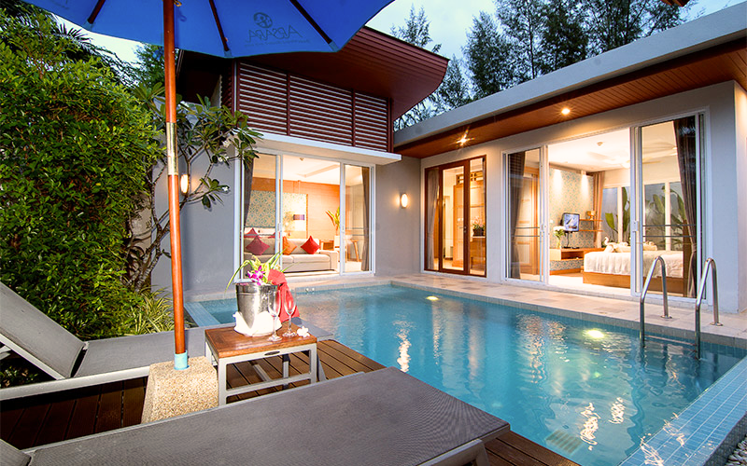
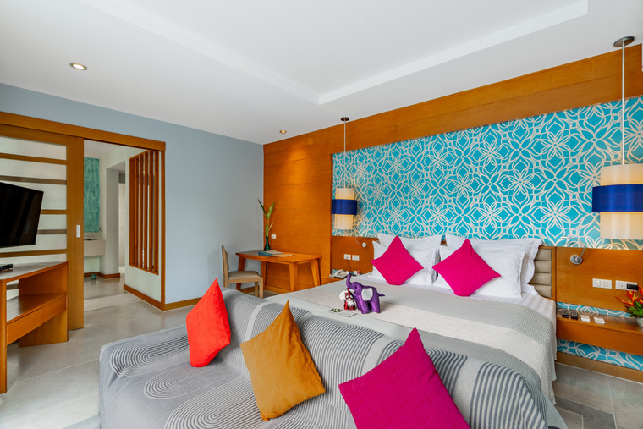
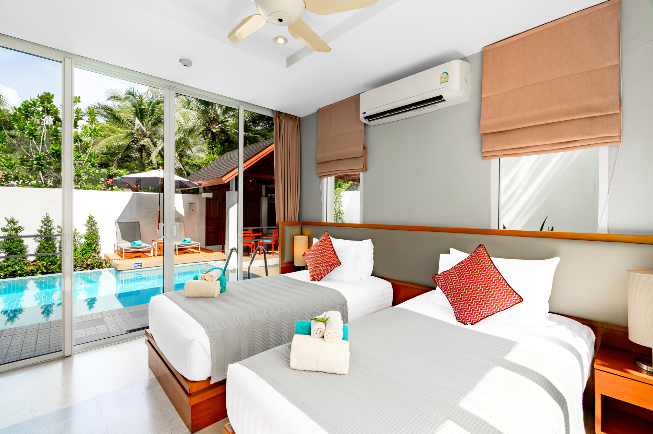
FAMILY POOL VILLA
No. of room
Room Size
Bed Type
View
16 rooms
180 Sq.m.
Double and
Twin Bed
Pool View

Slide 19
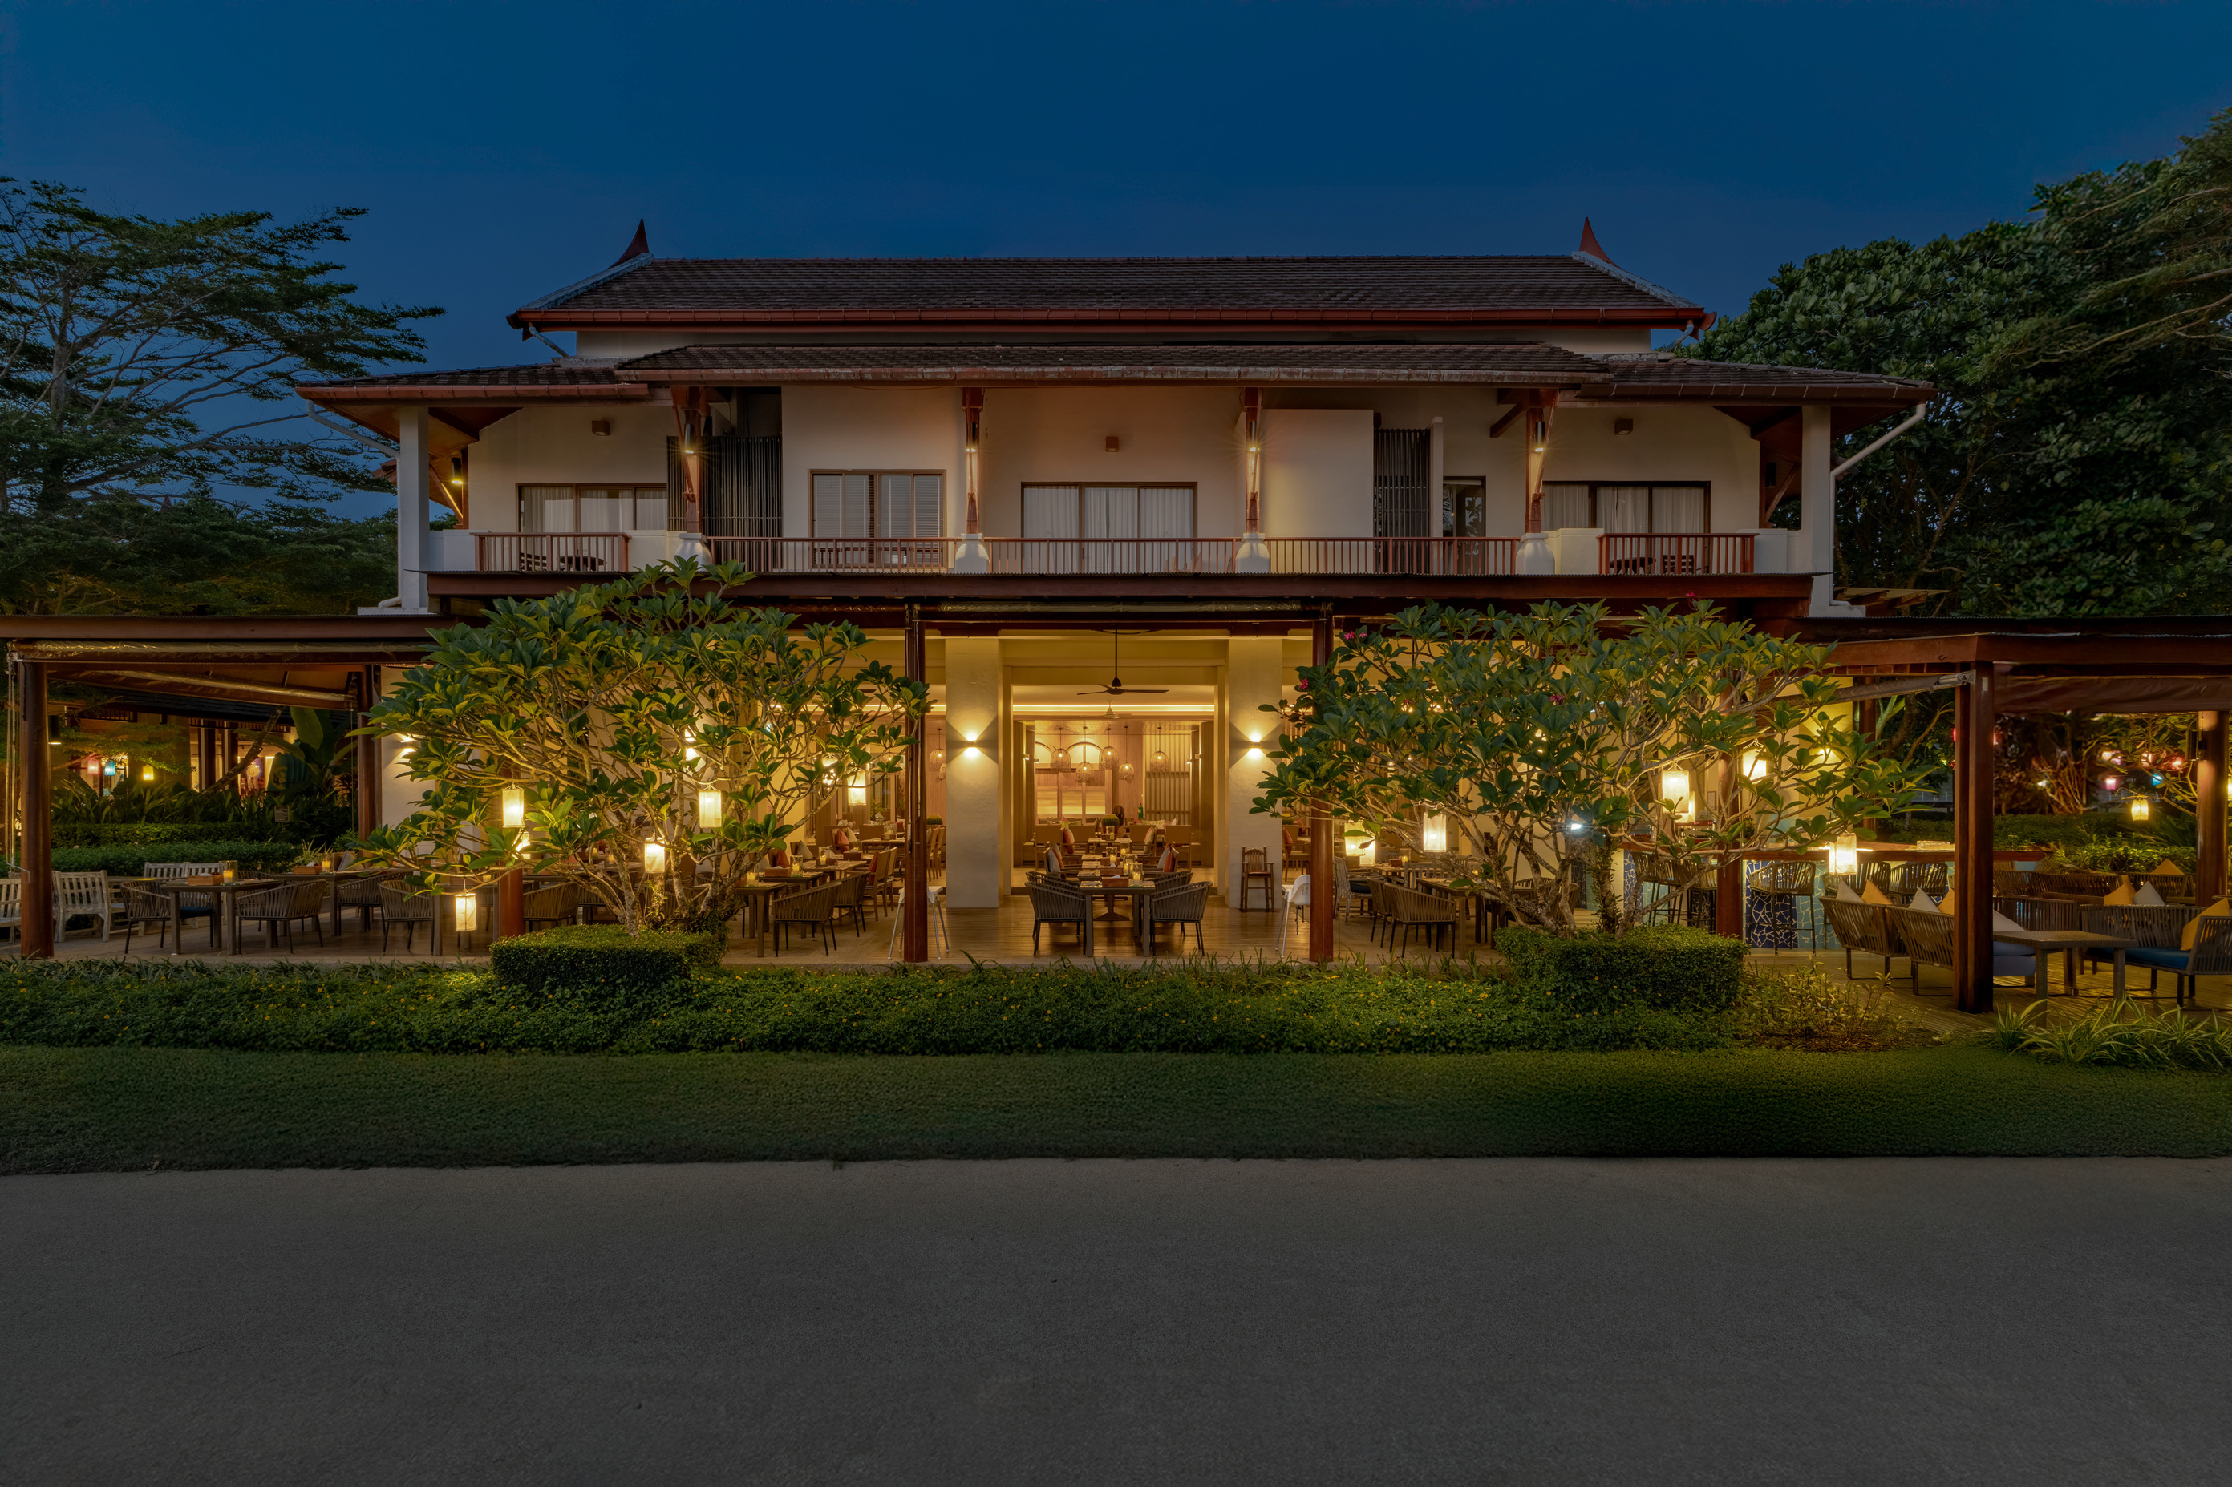
HOTEL OUTLETS

Slide 20
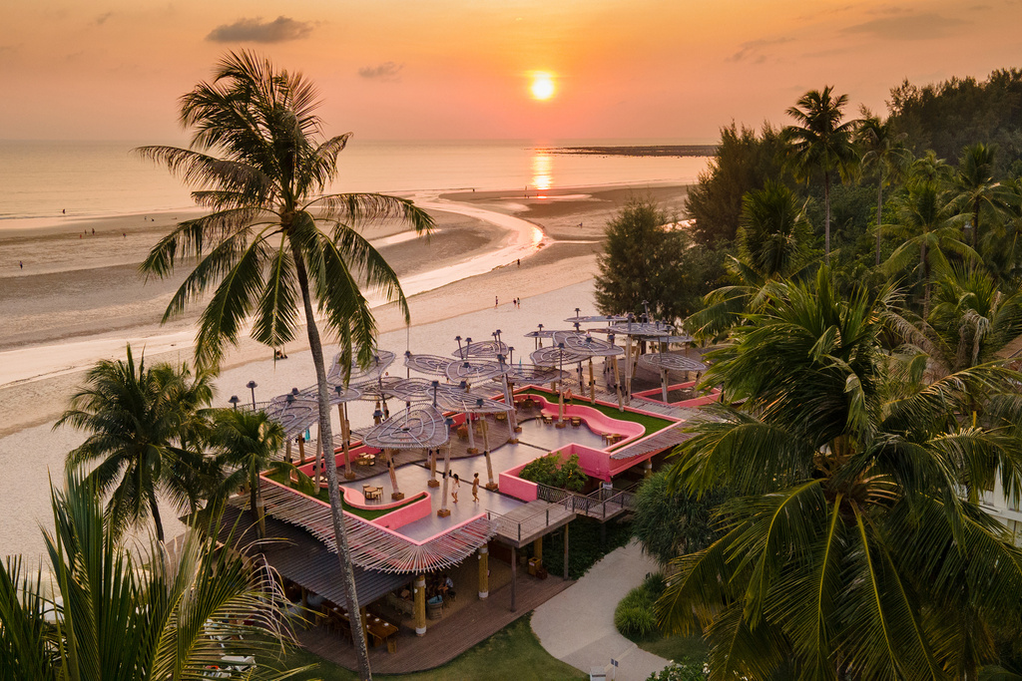
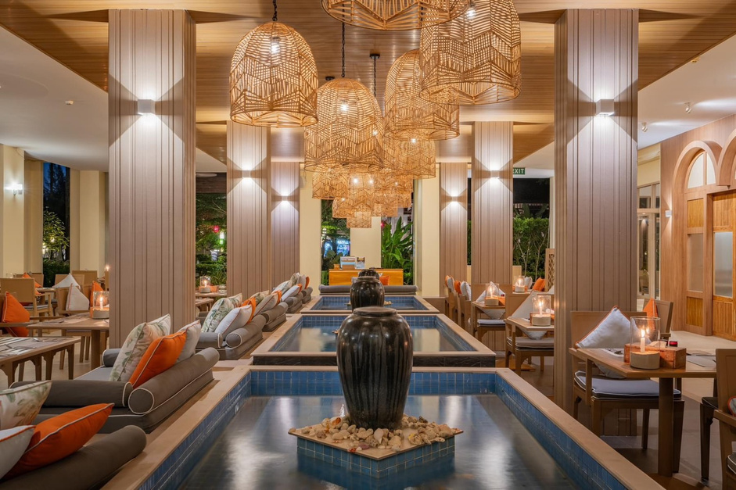
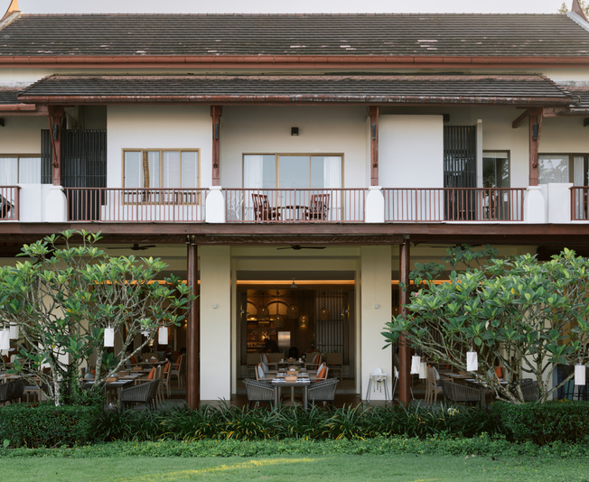
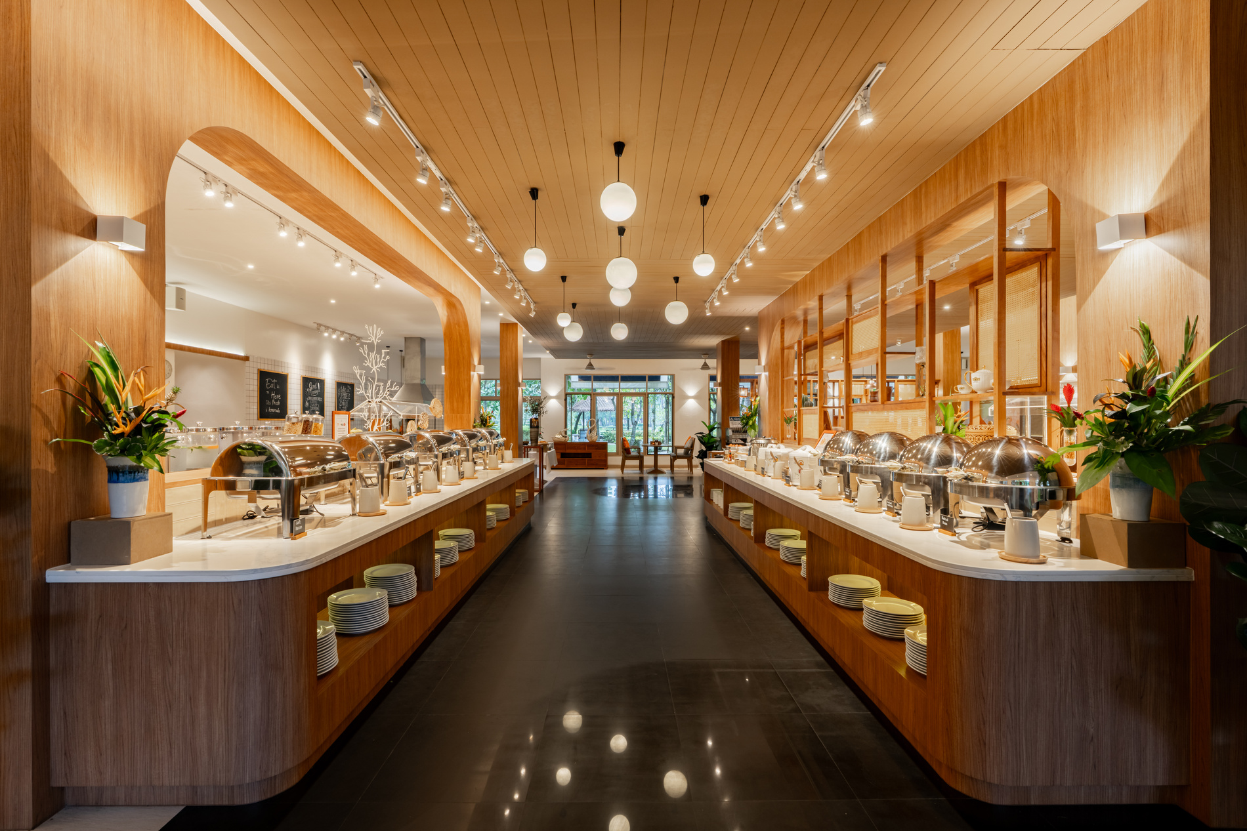
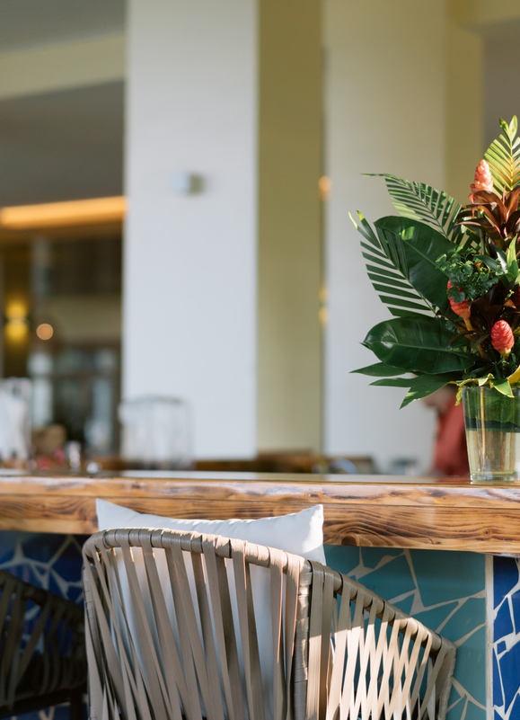
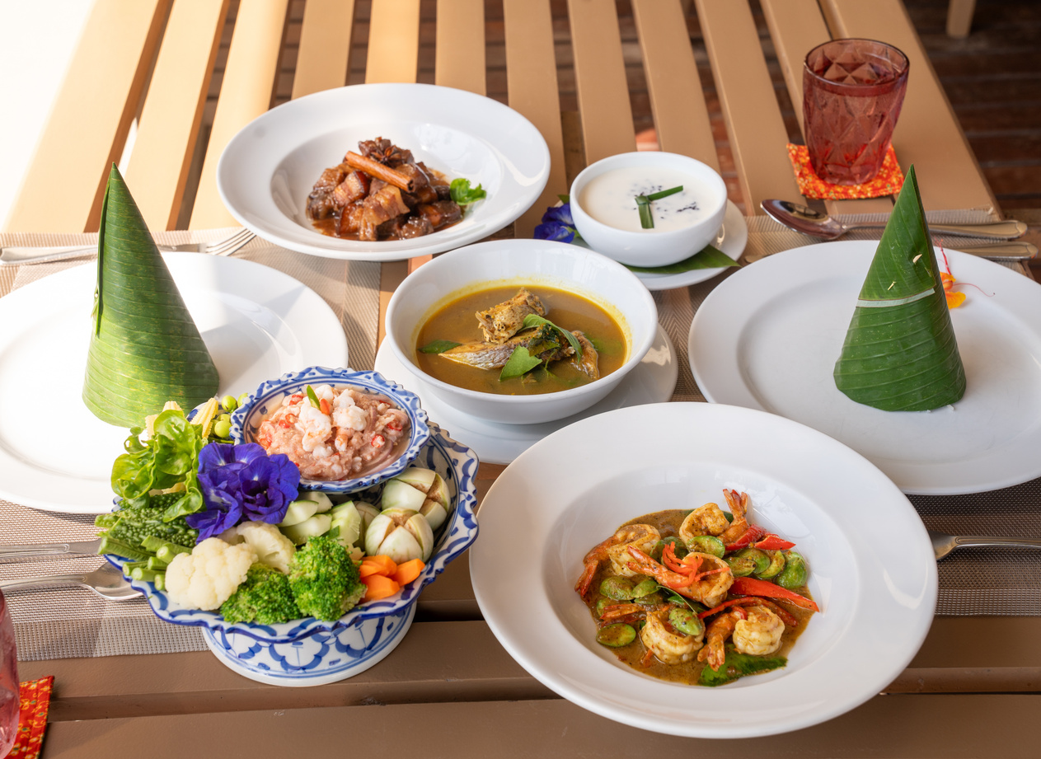
Hotel outlets
Kinnaree Restaurant
International buffet breakfast, lunch and dinner (in high season)
Opening Hours:
06:30 - 22:00
The Terrace bar
Opening Hours:
11:00 - 24:00

Slide 21
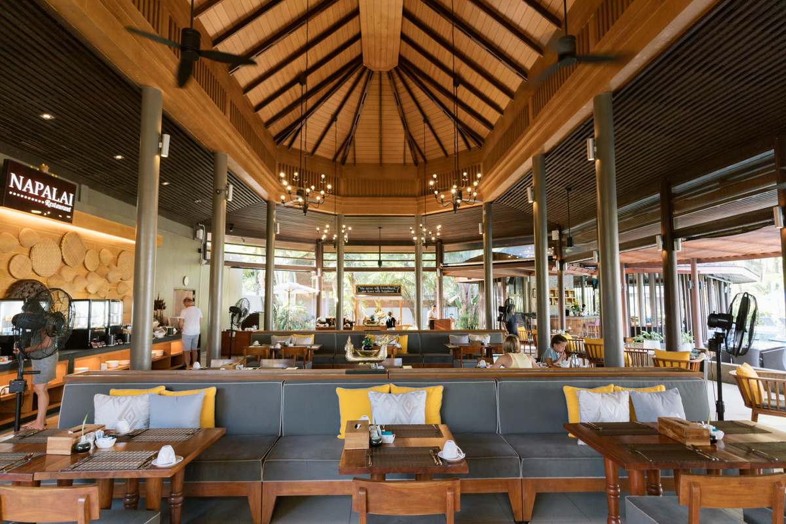
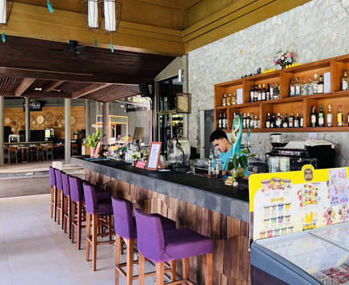
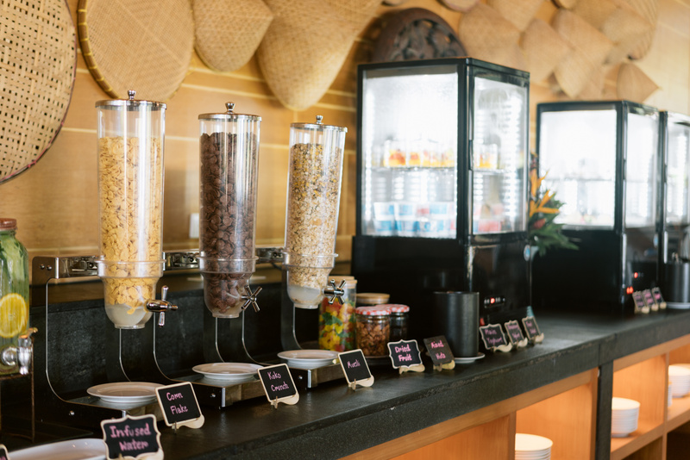
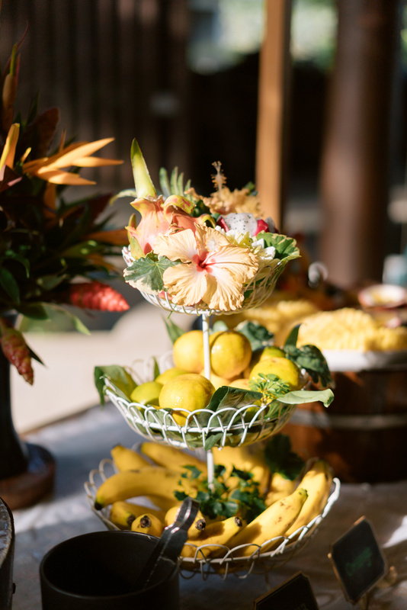
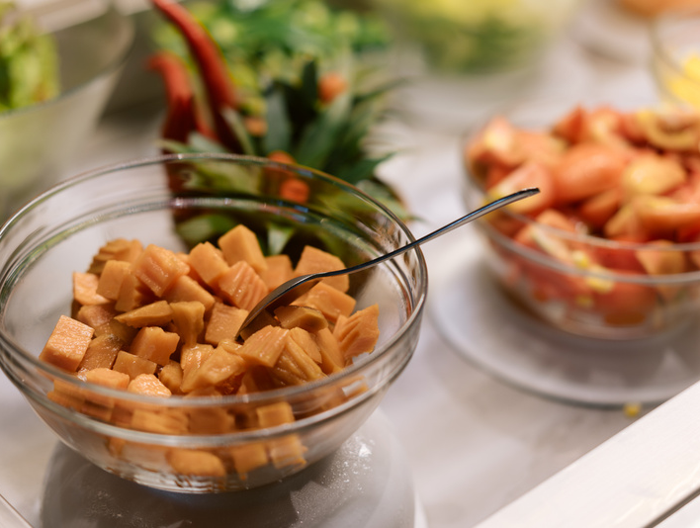
Hotel outlets
Napalai Restaurant
Napalai serves fusion Thai cuisine with international flair in a Thai-style pavilion.
Opening Hours:
07:00 - 22:00
Horizon bar
Opening Hours:
11:00 - 24:00

Slide 22
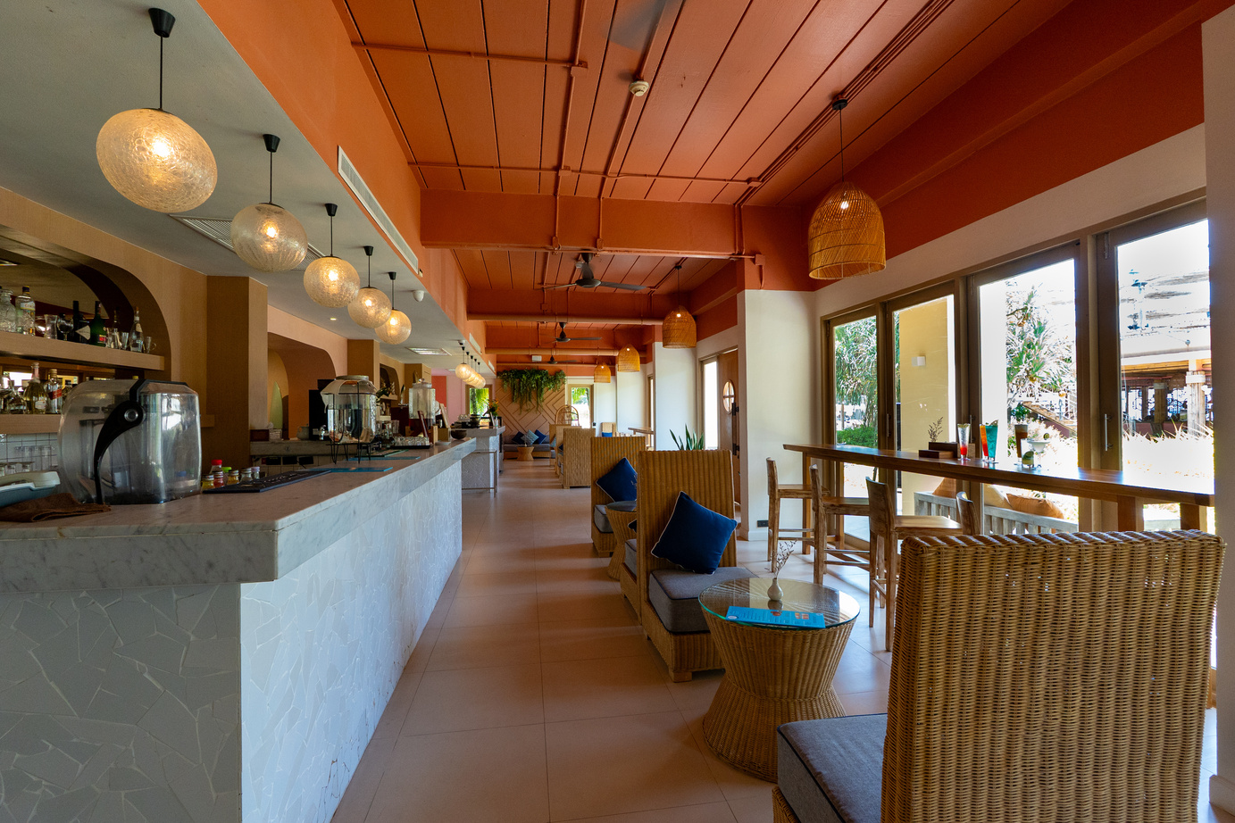




Hotel outlets
Ila Cafe:
Coffee & homemade cakes
Opening Hours:
11:00 - 20:00

Slide 23




Hotel outlets
KARKINOS Beach Bar & Restaurant:
Napolitana pizza and Italian cuisine
Opening Hours:
11:00 - 23:00

Slide 24

HOTEL FACILITIES

Slide 25



Swimming pool
Infinity Pool
Pool Access
Free-form Pool
Dive into relaxation with our 3 unique swimming pools, including the stunning Infinity Pool overlooking the ocean, the convenient Pool Access, and our Free-form Pool.
Opening Hours:
08:00 - 19:00

Slide 26







Hotel Facilities
Heihei shop
APSARA Spa
Fitness room
Kid’s room
Library
Manora Meeting room
Koru shop

Slide 27



Special Offers
ROMANTIC DINNER
WEDDING CEREMONY
GROUP PRIVATE DINNER

Slide 28

HOTEL ACTIVITIES

Slide 29




The Ocean Pulse
From Bed to Board
Directly access Memories Beach, Thailand’s top surf spot, where you can grab a board and hit the waves within 5 minutes or enjoy eco-friendly kayaking and bodyboarding in the Andaman Sea.

Slide 30




Beachfront Activities
Find Your Balance Under the Morning Sun
Energize your stay with our beachfront activities: refresh your body with Sun-Kissed Yoga by the waves, enjoy friendly matches of Beach Volleyball, or explore our coastal nature trails by jogging and cycling in the purest air of Phang Nga.

Slide 31




Eco-Thai Wisdom
Handmade memories rooted in Thai tradition and kindness to nature.
Experience the heart of Thai culture through our family-friendly activities: creating eco-friendly Tie-Dye masterpieces, cooking authentic Farm-to-Table dishes, and learning the mindful art of Fruit Carving together.

Slide 32


Sala Massage
Relax your body to the rhythm of the water.
After an active day, our Sala Spa is the perfect place to unwind by the lagoon, letting the sounds of nature and professional treatments relax your body and mind.

Slide 33


Deep Nature
From flying wings to shining stars
Connect with nature throughout the day, from watching over 20 species of tropical birds in our mangroves to enjoying a clear night of stargazing under the beautiful Khao Lak sky.

Slide 34





Festive Spirits
Creating unforgettable memories through Thai and Global traditions.
At Apsara, every season is a reason to celebrate. We bring the heart of Thai culture and international festivities to
our guests through curated experiences:

Slide 35

APSARA
Stay nature
GO GREEN WITH APSARA
Apsara garden • Sustainable hotel • Apsara care

Slide 36


Apsara Care
Eco-Friendly Resort in Khao Lak – Apsara Care
As a sustainable beachfront resort in Thailand,
Apsara is dedicated to protecting the local ecosystem.
Our initiatives include:
  Sea turtle & hermit crab conservation
  Mangrove replanting & guest eco-programmes
  On-site organic garden & local sourcing
  Recycling & greywater use for gardens
Guests are encouraged to join in beach clean-ups, tree planting, and wildlife support. At Apsara, we believe luxury and sustainability can coexist, making us an authentic eco-retreat in Khao Lak.

Slide 37








Apsara Care

Slide 38


Slide 39


Slide 40


Thank you.
APSARA
Beachfront Resort and Villa
45 Moo. 2, Kukkak, Takuapa, Phang-nga, Thailand 82220
076 584 444
rsvn@apsarakhaolak.com

