Slide 1
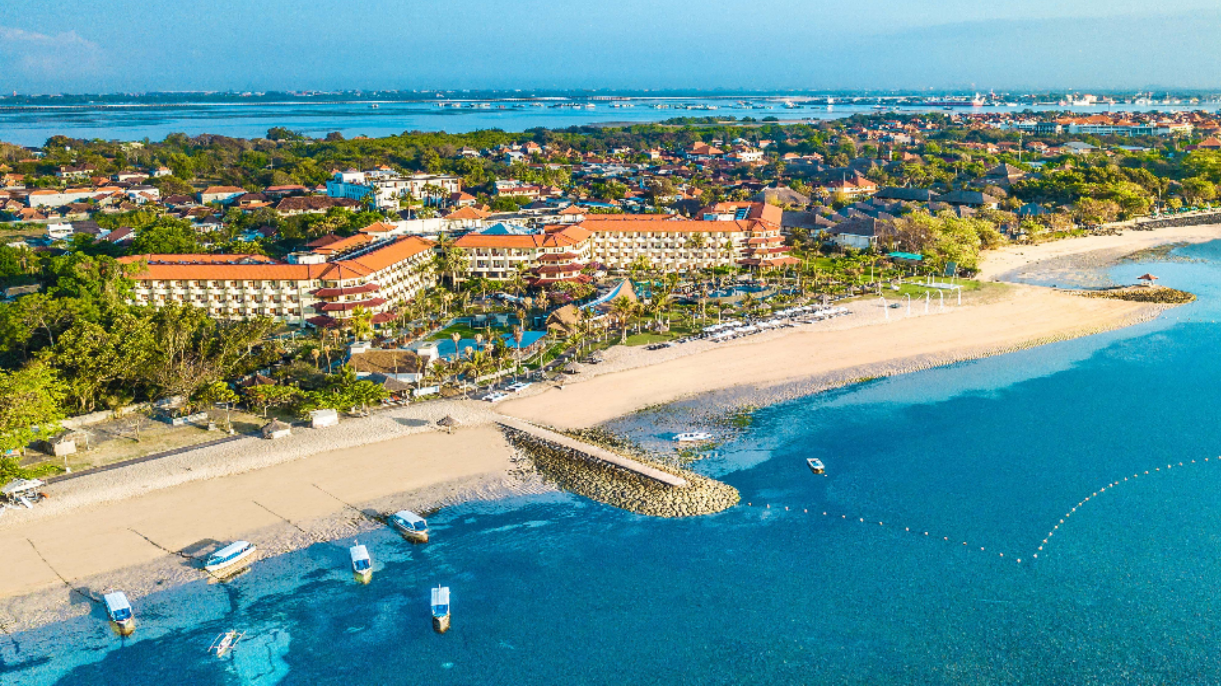


GRAND MIRAGE RESORT & THALASSO BALI
TANJUNG BENOA, NUSA DUA, BALI

Slide 2

LOCATION

Slide 3

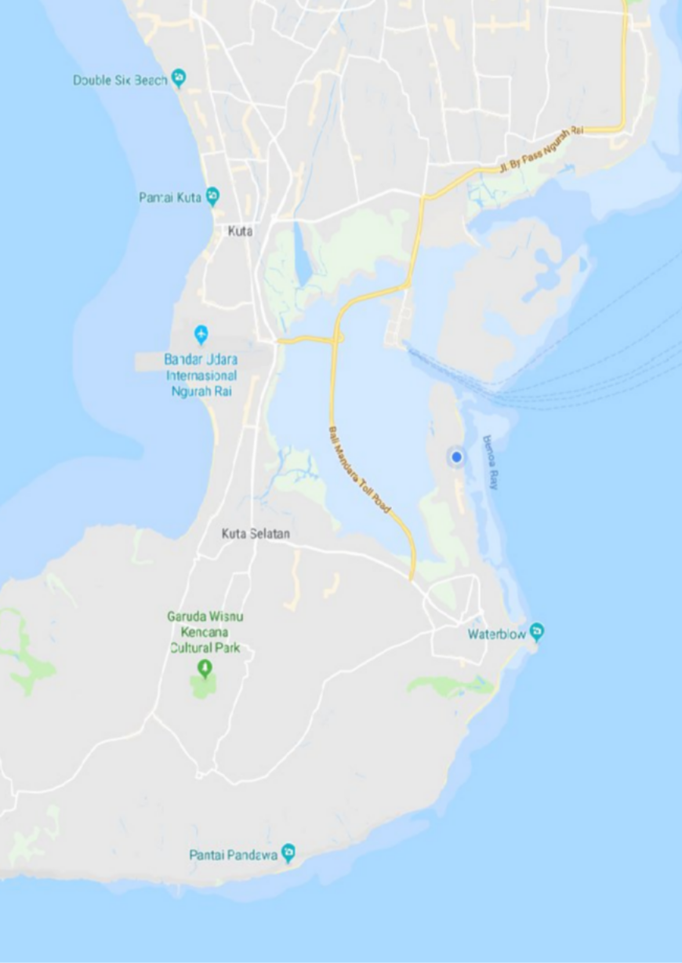

Prime positioned
only 15 minutes from Bali Ngurah Rai International airport,
3
G R A N D M I R A G E R E S O R T & T H A L A S S O B A L I
At Tanjung Benoa
Bali’s water sport center
Beach Front
With an amazing beach view form Balcony
GRAND MIRAGE

Slide 4
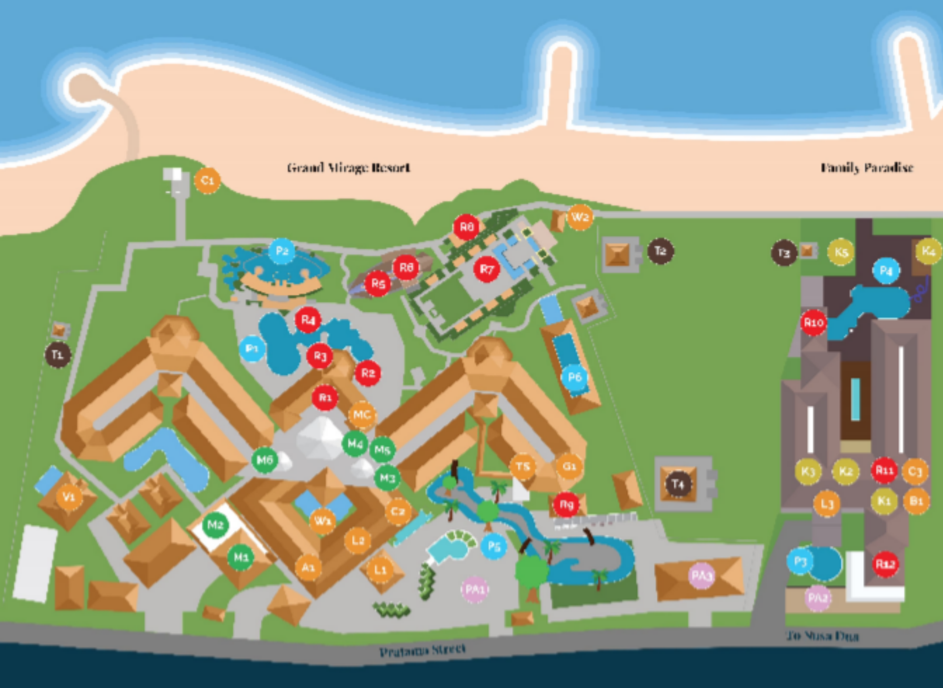
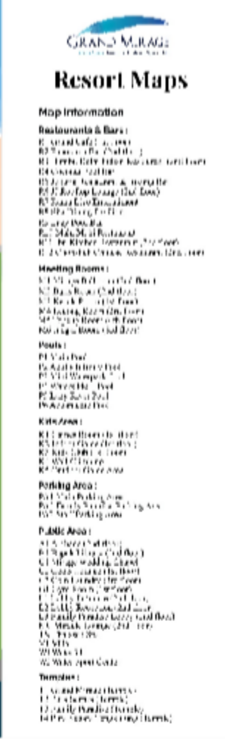
4
G R A N D M I R A G E R E S O R T & T H A L A S S O B A L I
Resort map could be download from grandmirage.com website

Slide 5

HIGHLIGHTS

Slide 6

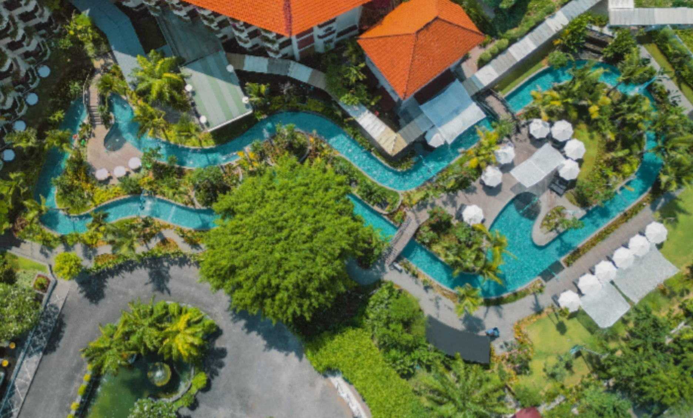
G R A N D M I R A G E R E S O R T & T H A L A S S O B A L I
6

Slide 7
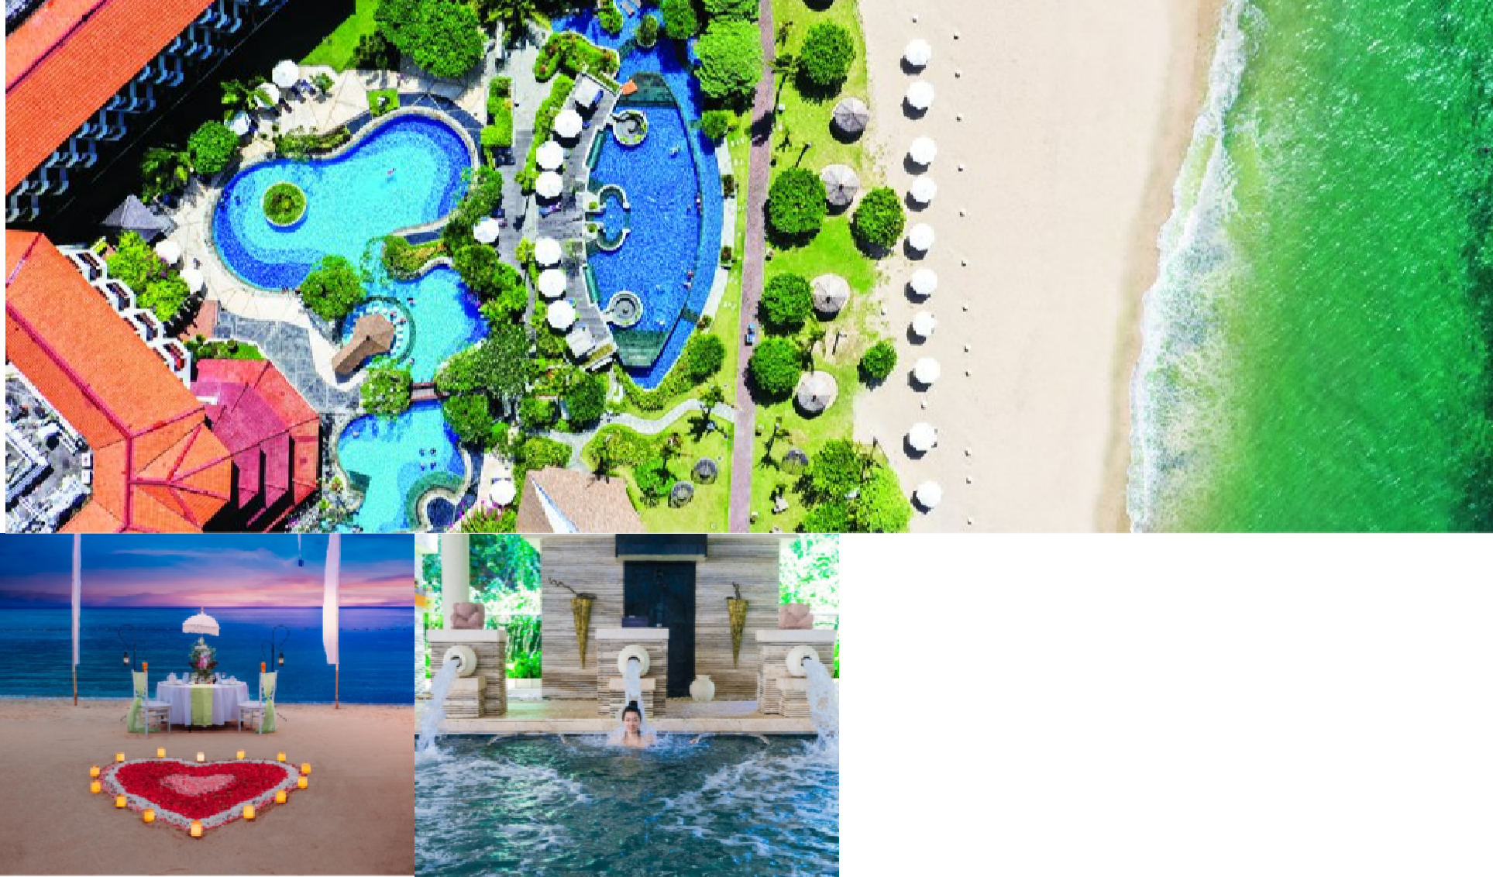
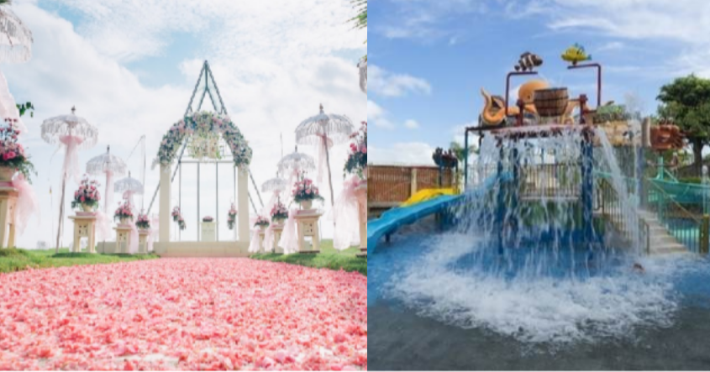
G R A N D M I R A G E R E S O R T & T H A L A S S O B A L I
7

Slide 8

WATER SPORT ACTIVITIES

Slide 9
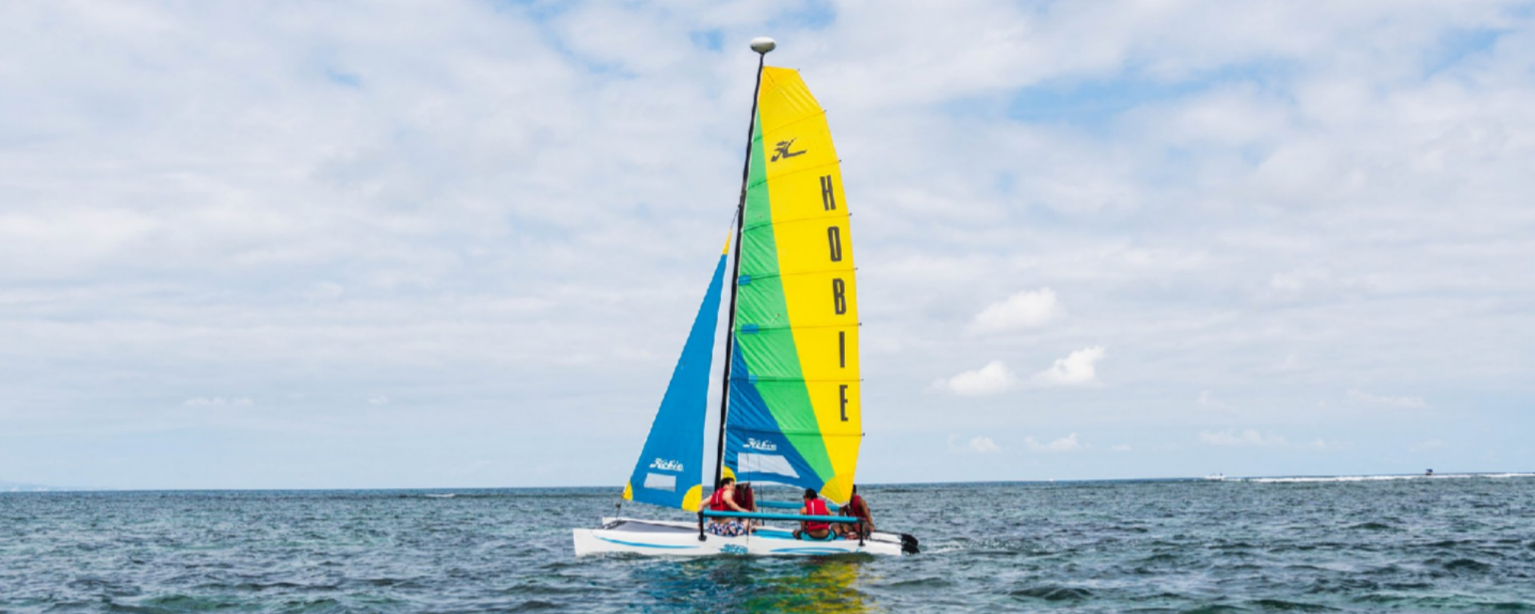
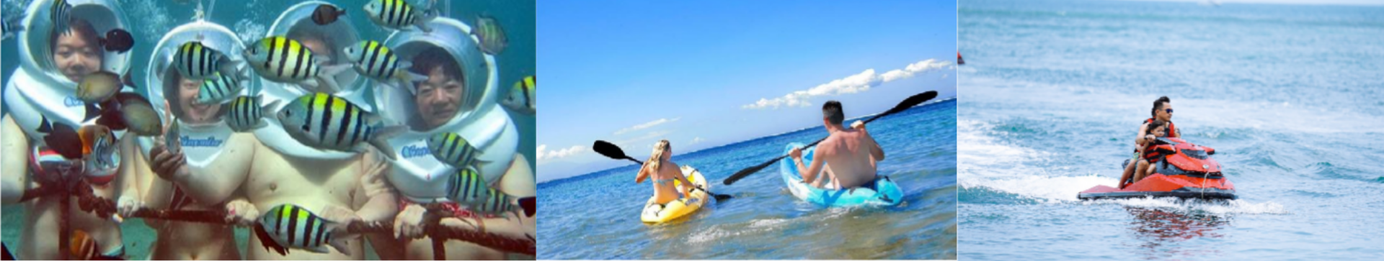
G R A N D M I R A G E R E S O R T & T H A L A S S O B A L I
9

Slide 10

NEARBY THE RESORT

Slide 11
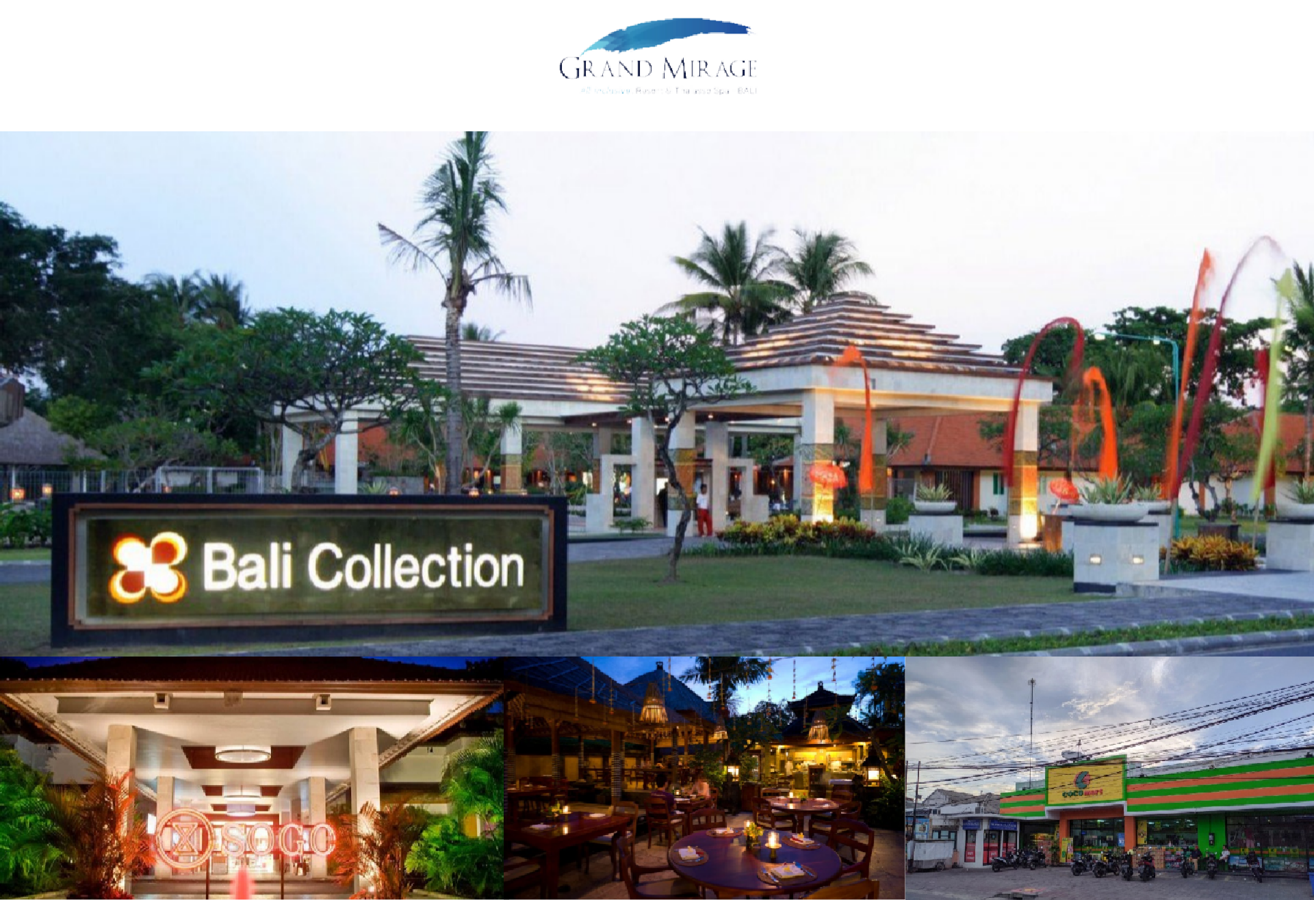
G R A N D M I R A G E R E S O R T & T H A L A S S O B A L I
11

Slide 12
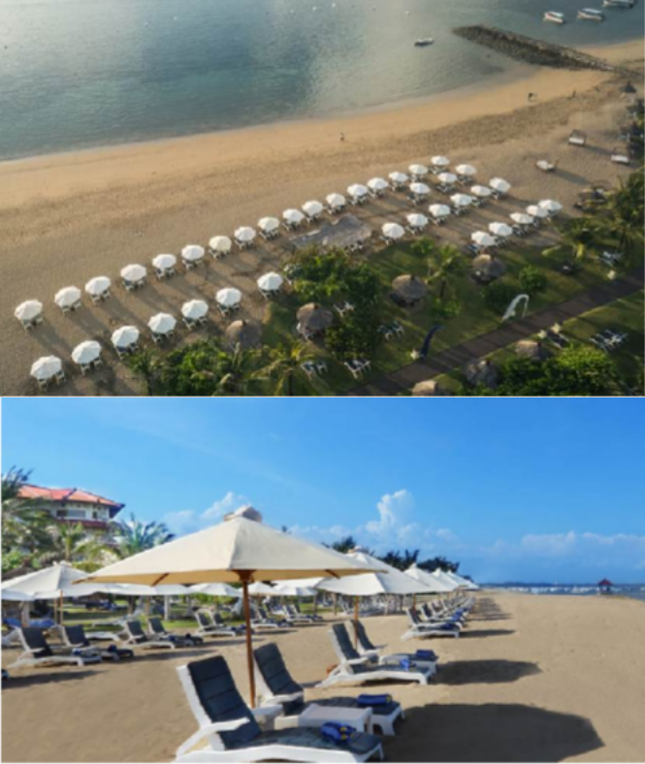
12
G R A N D M I R A G E R E S O R T & T H A L A S S O B A L I
Beach Front
Naturally blessed with a white sandy beach, Grand Mirage Resort & Thalasso Spa offers spoiling summer vacation experiences with an All-Inclusive package. Featuring unlimited food curated by the artisans, drinks mixed by the experienced bartenders, unforgettable cultural activities and exciting water sports, lively entertainments, relaxing spa treatment with seawater, and many others.

Slide 13

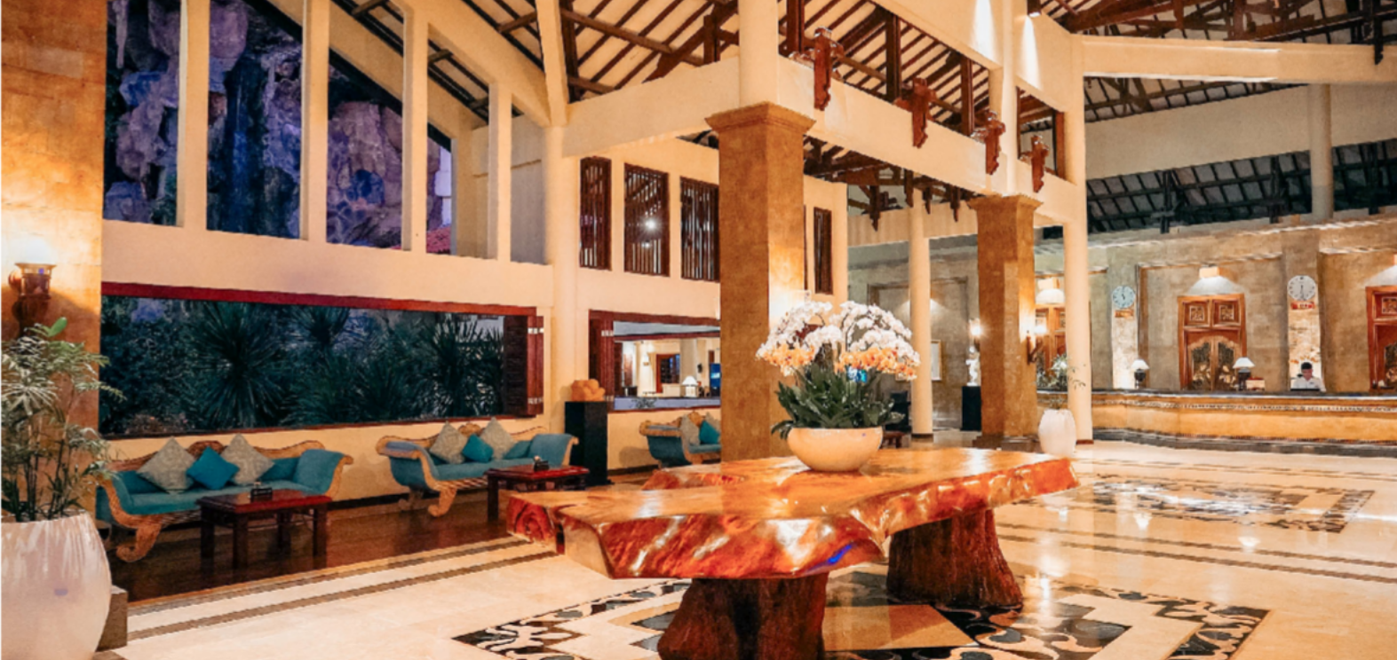
13
Lobby
Once you enter the lobby, the tranquil atmosphere start to pervade your holiday vibrancy. We set high standards and pleasant service, with passion for caring and welcoming attitude. Our charming and friendly staff will happily greet and assist you and check in time is always pleasurable at the Grand Mirage Resort & Thalasso Bali.
G R A N D M I R A G E R E S O R T & T H A L A S S O B A L I

Slide 14

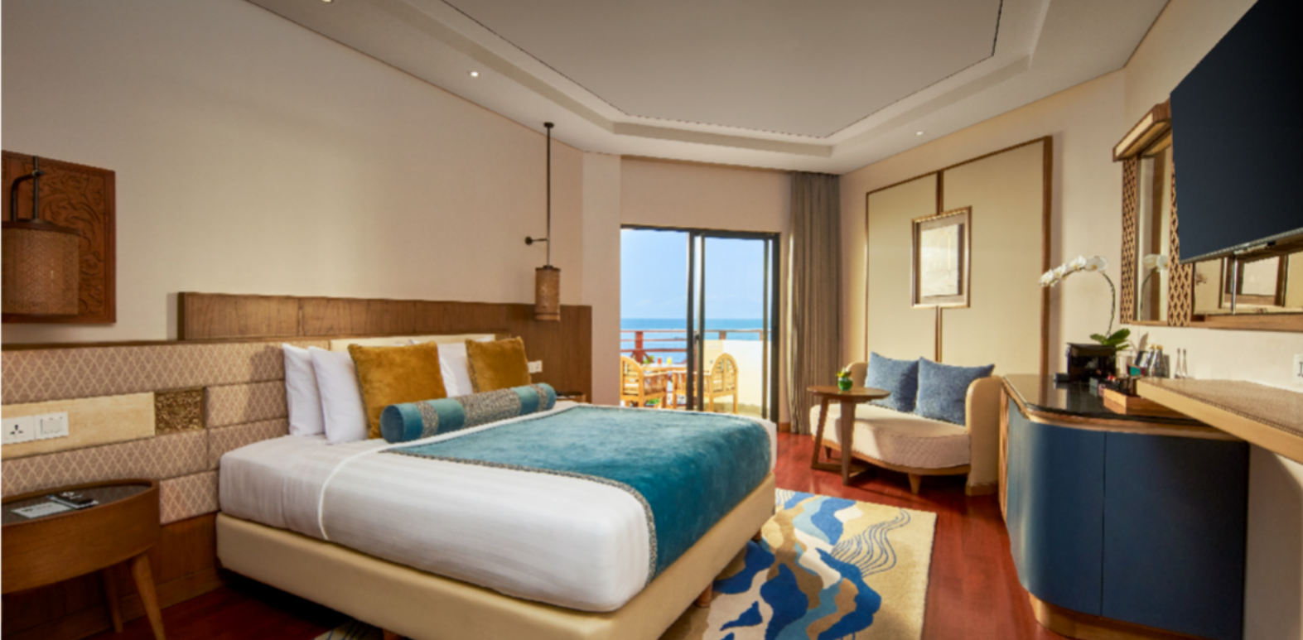
14
New Premiere Ocean
42 Sqm room with Garden or Ocean View
Smart TV
Complimentary Wi-Fi connection
Nespresso Coffee Machine
G R A N D M I R A G E R E S O R T & T H A L A S S O B A L I

Slide 15
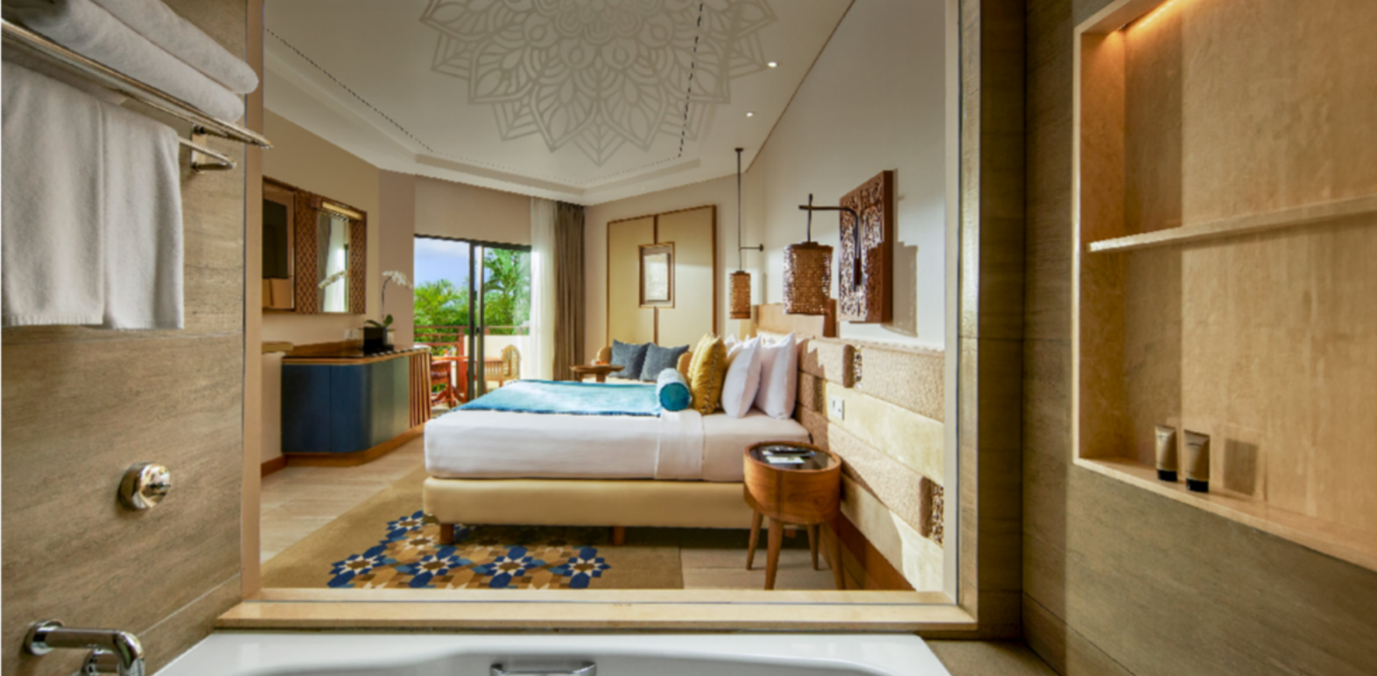
15
New Premiere Garden
42 Sqm room with Garden or Ocean View
Smart TV
Complimentary Wi-Fi connection
G R A N D M I R A G E R E S O R T & T H A L A S S O B A L I

Slide 16

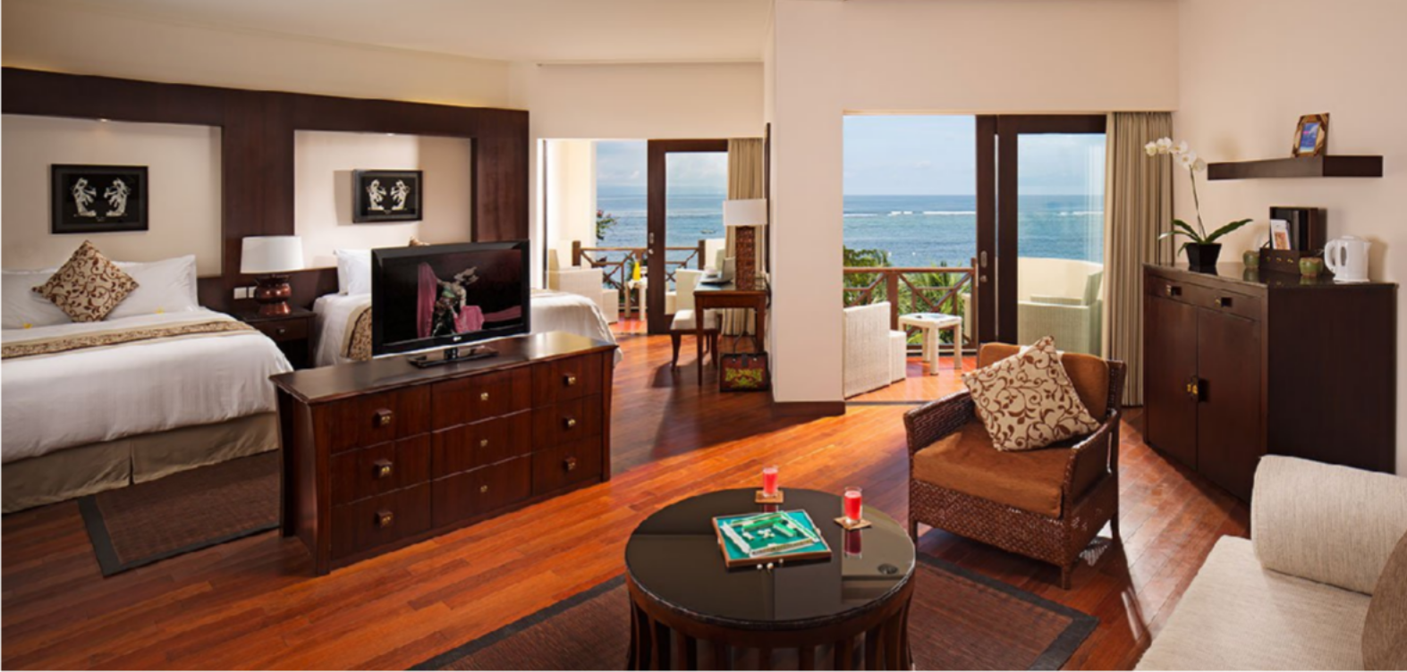
16
Ocean View Suite
80 Sqm room overlooking to the Indian Ocean
Cable and LCD TV
Complimentary Wi-Fi connection
G R A N D M I R A G E R E S O R T & T H A L A S S O B A L I

Slide 17
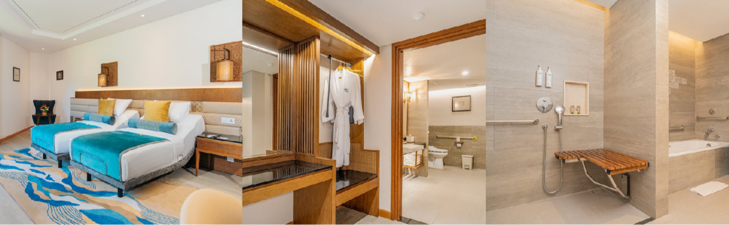
17
Universal Design Suite
58 Sqm room overlooking to the Indian Ocean
Cable and LCD TV
Complimentary Wi-Fi connection
G R A N D M I R A G E R E S O R T & T H A L A S S O B A L I

Slide 18




Slide 19

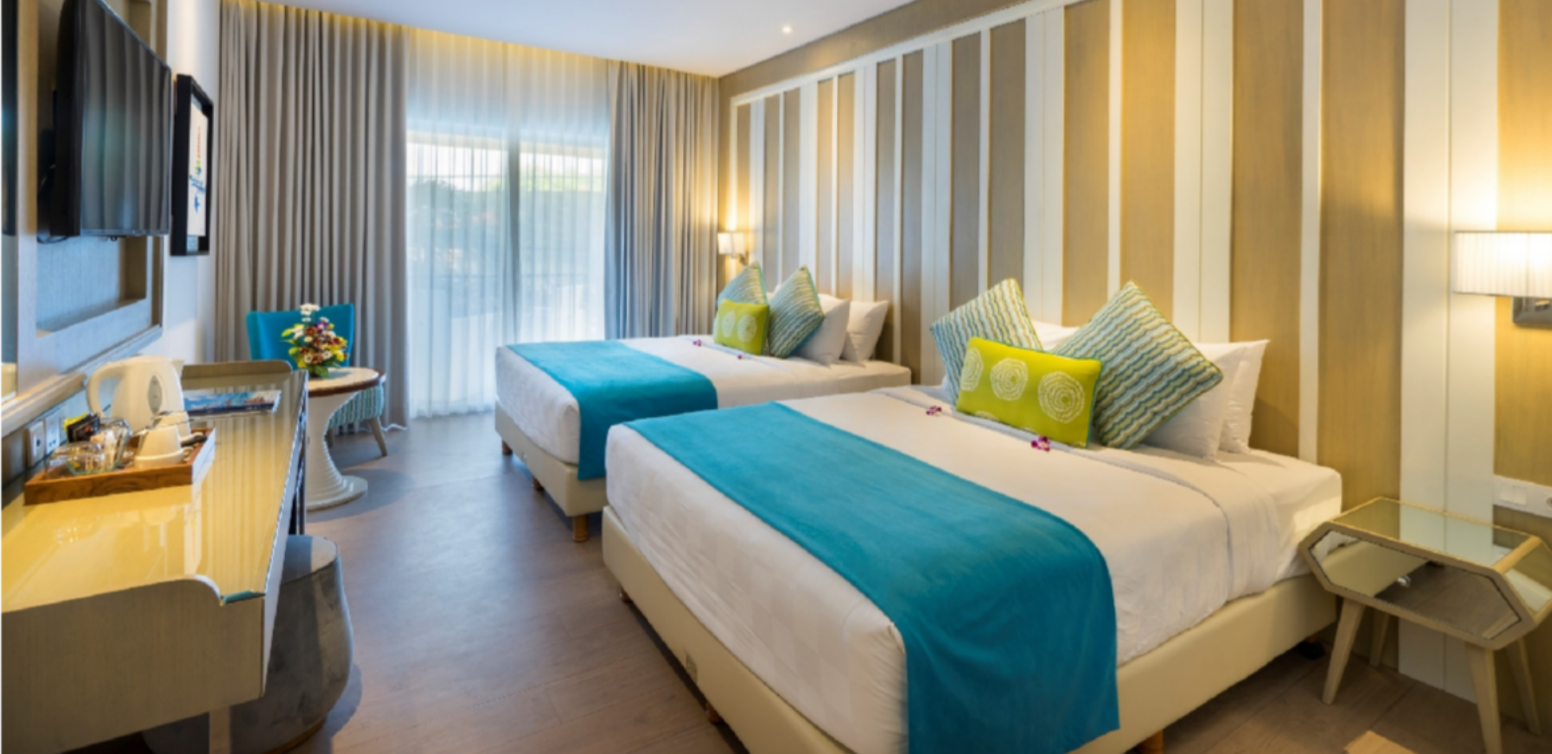
19
Family Studio
45 sqm room with Garden or Partial Ocean View
Offering Family Studio Queen (2 Queen Beds) or Family Studio Bunk Bed (King Bed and Bunk Bed)
Cable and LCD TV
Complimentary Wi-Fi connection
G R A N D M I R A G E R E S O R T & T H A L A S S O B A L I

Slide 20
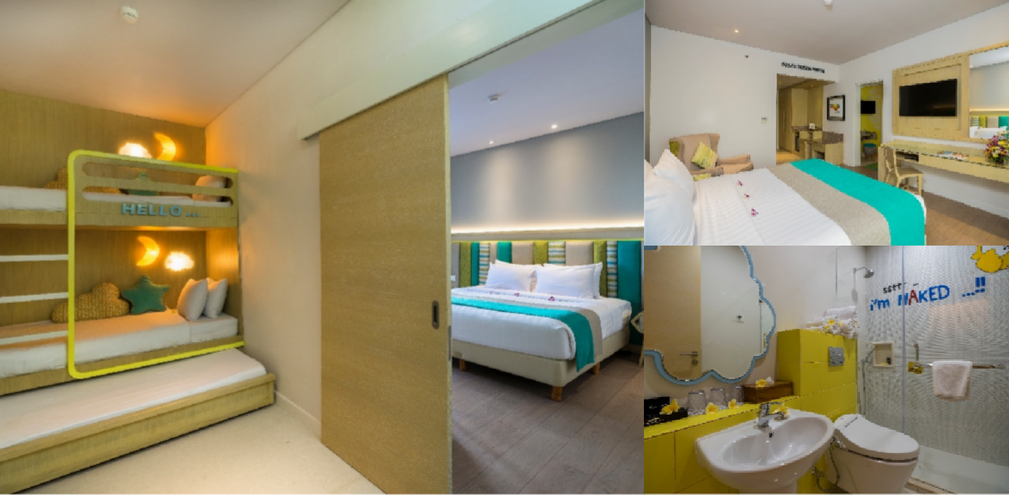
20
Kids Suite
60 sqm room with Garden or Partial Ocean View
Cable and LCD TV
Complimentary Wi-Fi connection
G R A N D M I R A G E R E S O R T & T H A L A S S O B A L I

Slide 21
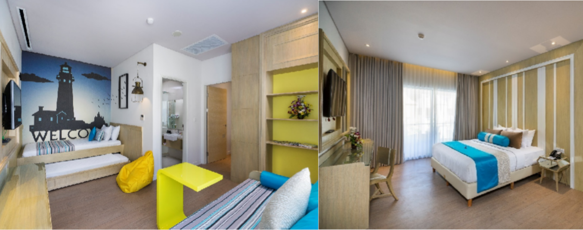
21
Junior Suite
60 sqm room with Garden or Partial Ocean View
Cable and LCD TV
Complimentary Wi-Fi connection
G R A N D M I R A G E R E S O R T & T H A L A S S O B A L I

Slide 22

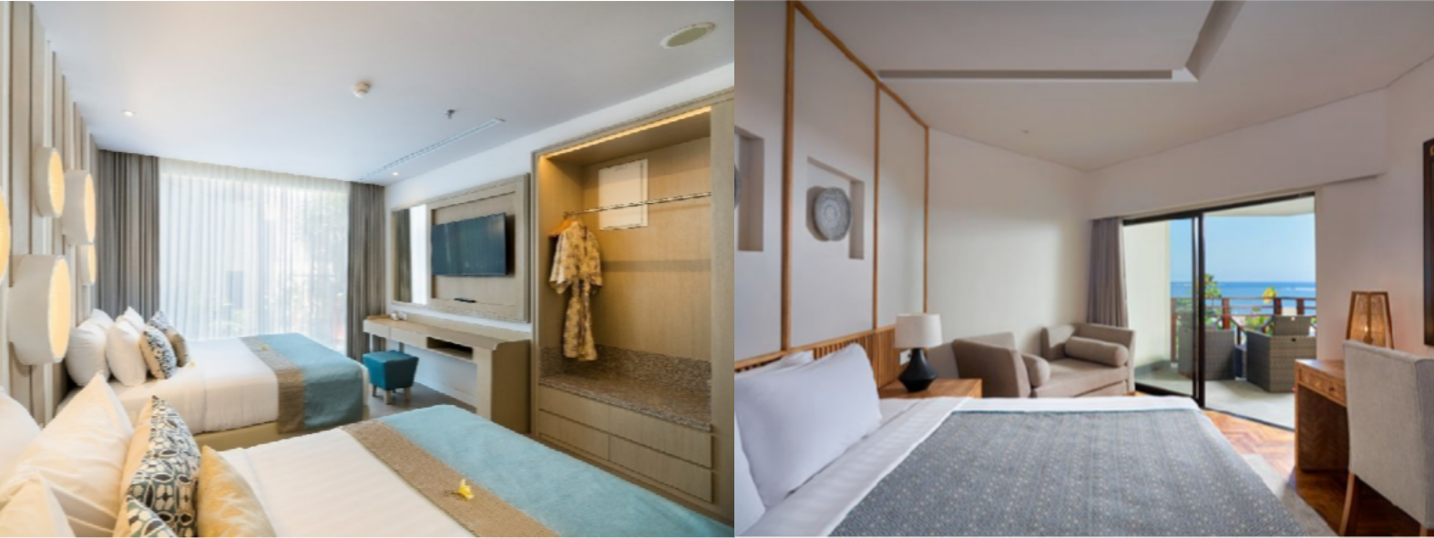
22
2 Bedroom Suite
85 Sqm room with Garden or Ocean View
2 full Bathroom and are ensuite and inside respective bedrooms
2 Cable and LCD TV
Complimentary Wi-Fi connection
G R A N D M I R A G E R E S O R T & T H A L A S S O B A L I

Slide 23
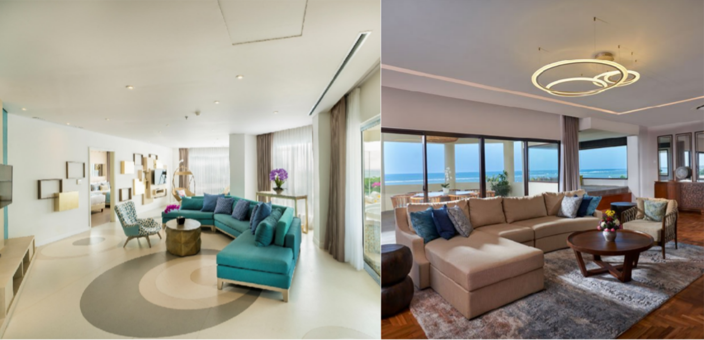
23
2 Bedroom Apartment
196 Sqm room with Ocean View
2 full Bathroom and are ensuite and inside respective bedrooms
Balcony overlooking to the ocean with dining area and Jacuzzi
2 Cable and LCD TV
Complimentary Wi-Fi connection
G R A N D M I R A G E R E S O R T & T H A L A S S O B A L I

Slide 24
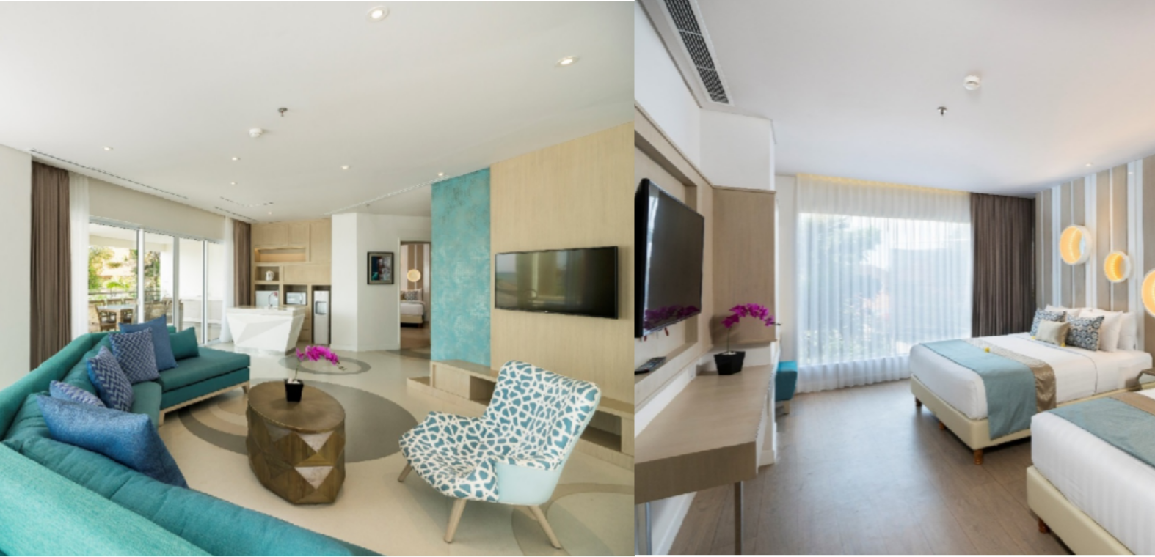
24
3 Bedroom Apartment
225 Sqm room with Ocean View
2 full Bathroom and are ensuite and inside respective bedrooms
Balcony overlooking to the ocean with dining area and Jacuzzi
3 Cable and LCD TV
Complimentary Wi-Fi connection
G R A N D M I R A G E R E S O R T & T H A L A S S O B A L I

Slide 25
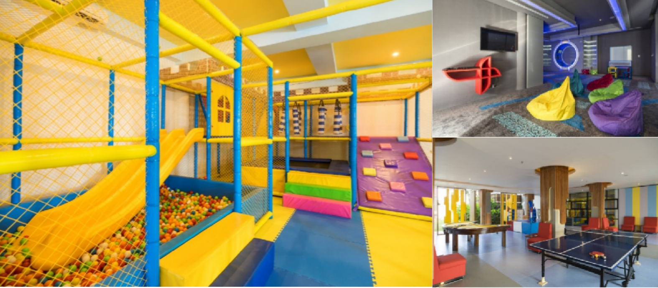
25
Kids Activity
Kids always come first when in Family Paradise. Kid’s Club at Grand Mirage Resort offers great fun! The indoor playground is complementing the existing outdoor playground. It is allowed the children from 4 to 15 years old. We ensure kids are having an equally memorable and enjoyable holiday as their parents.
Operation hours: Indoor playground open from 08.00 – 21.00 hours after 17.00 hour all kids activity programs are not available and kids must be accompanied by parents.
G R A N D M I R A G E R E S O R T & T H A L A S S O B A L I

Slide 26
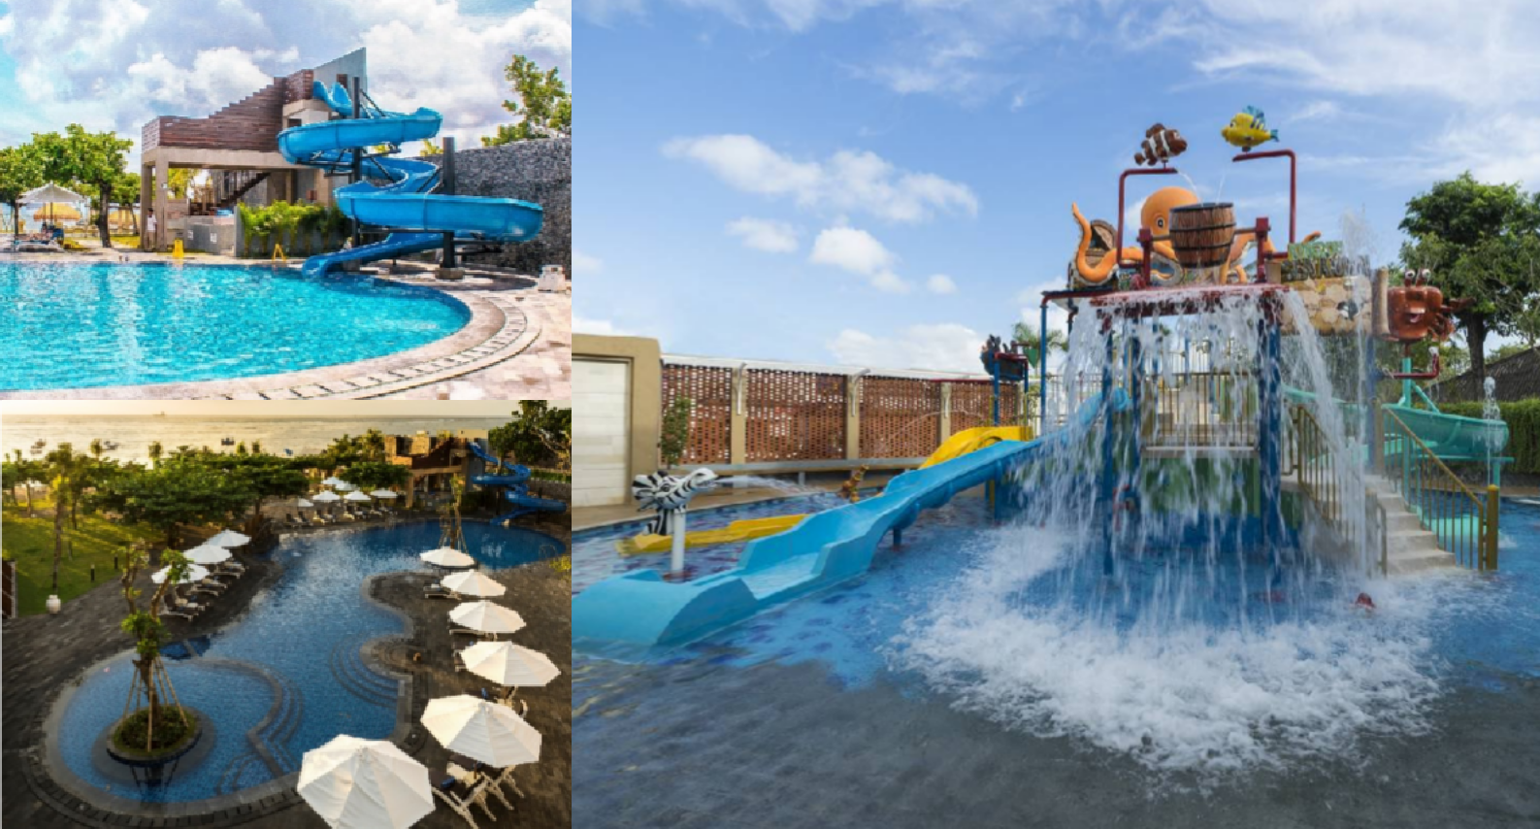
26
Mini Waterpark and Waterslide
Grand Mirage Bali Resort features kids mini water park and pool slides located at the outdoor area of Family Paradise
G R A N D M I R A G E R E S O R T & T H A L A S S O B A L I

Slide 27



ALL INCLUSIVE
Luxury Included

Slide 28
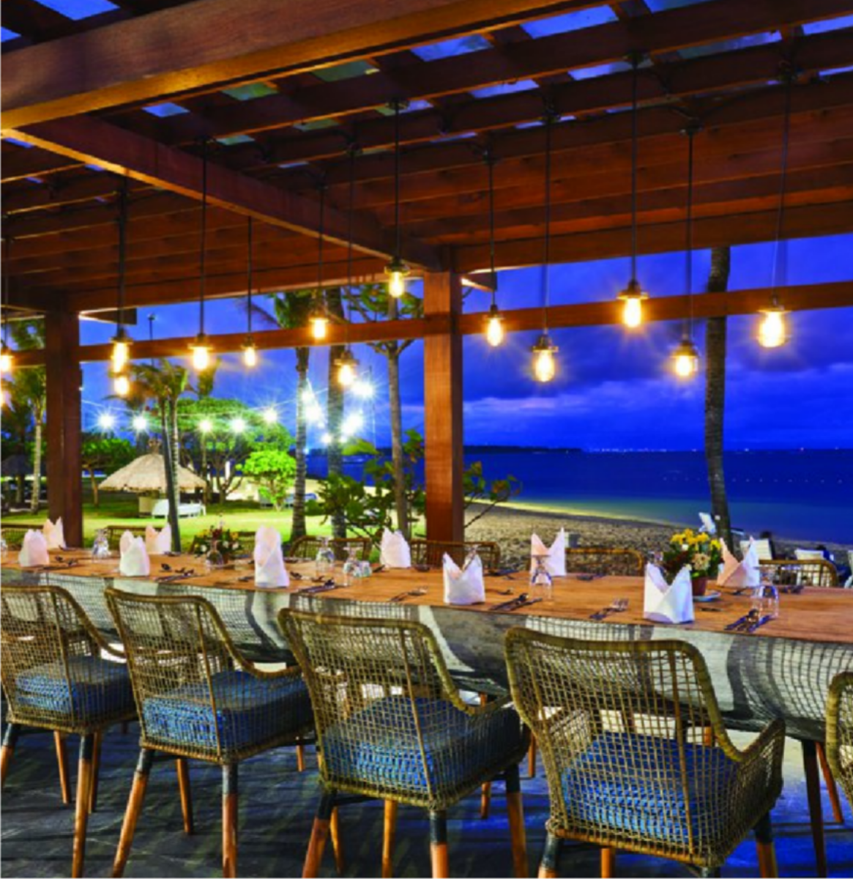
28
G R A N D M I R A G E R E S O R T & T H A L A S S O B A L I
All Meals – All Restaurants
Breakfast, Lunch, Dinner, Room Service (Food only), Daily Afternoon Tea

Slide 29

29
G R A N D M I R A G E R E S O R T & T H A L A S S O B A L I
Unlimited Beverages
All non-alcoholic, one time daily refill of mini bar, wine, beer, local spirits and cocktails, premium imported spirits at Panorama Lounge from 21:00 hour – midnight

Slide 30
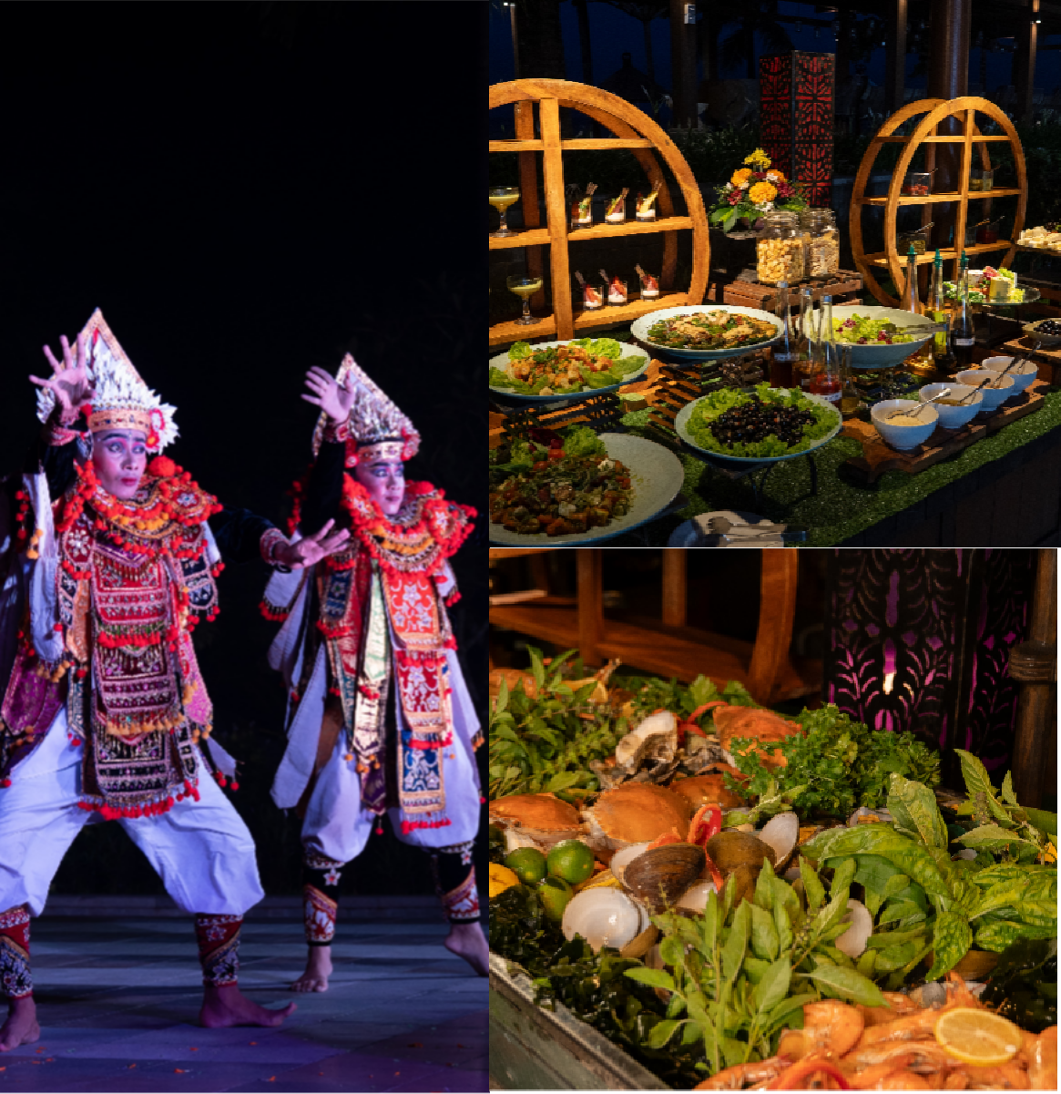
30
G R A N D M I R A G E R E S O R T & T H A L A S S O B A L I
Daily Theme Buffet Dinner
at Rama Live Entertainment
buffet dinner with cultural performances, modern dance and live music

Slide 31
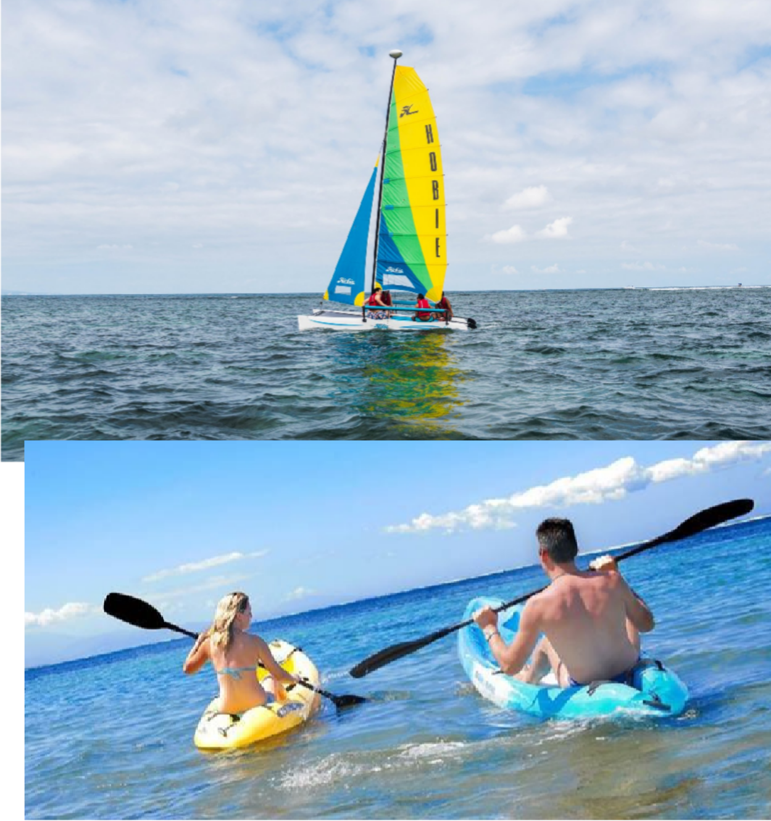
31
G R A N D M I R A G E R E S O R T & T H A L A S S O B A L I
Motorized & Non-Motorized Water Sports
For motorized water sport, minimum of 12 nights stay is required.

Slide 32
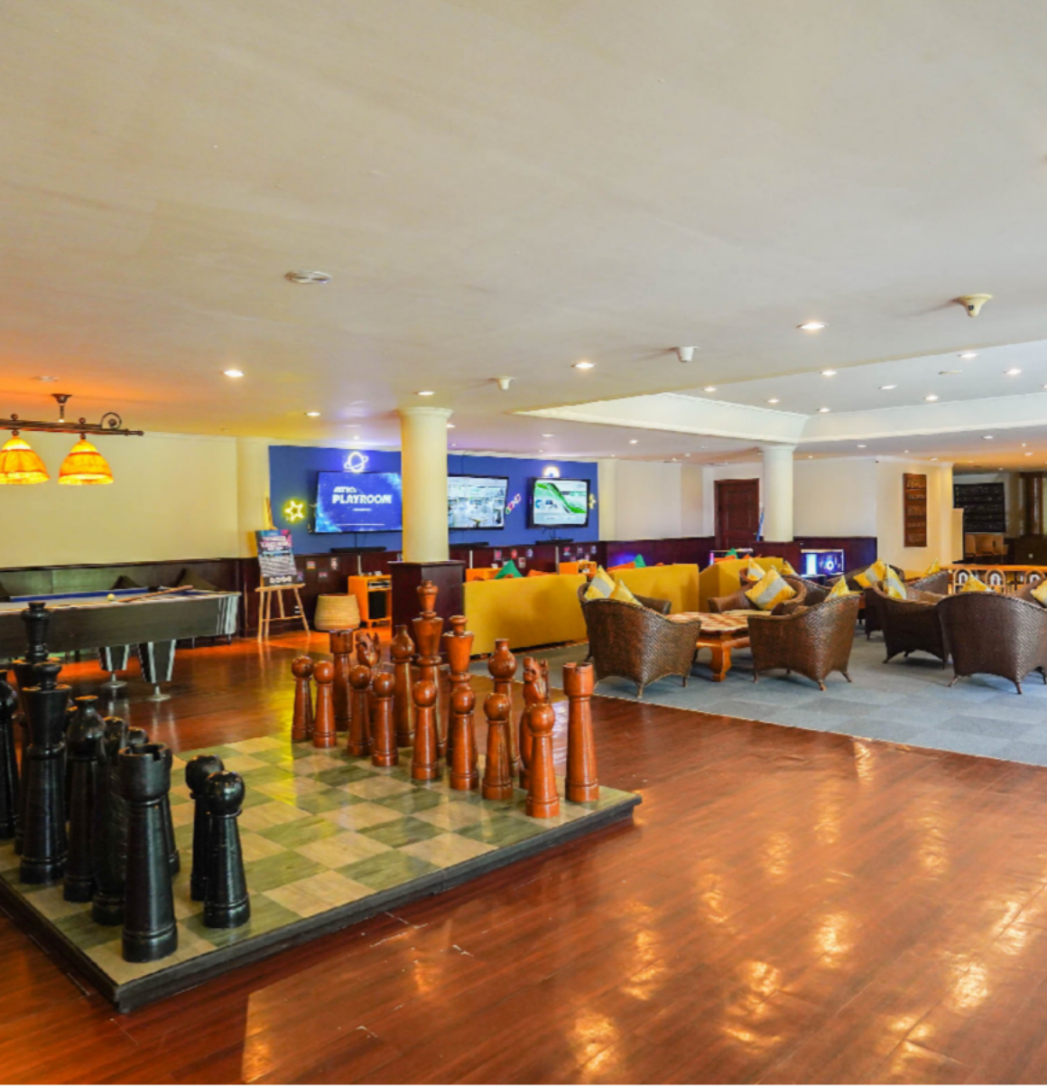
32
G R A N D M I R A G E R E S O R T & T H A L A S S O B A L I
Cool’s Leisure Lounge
Games Room, Mahjong Room, Karaoke Room, and Business Center & Internet Use

Slide 33
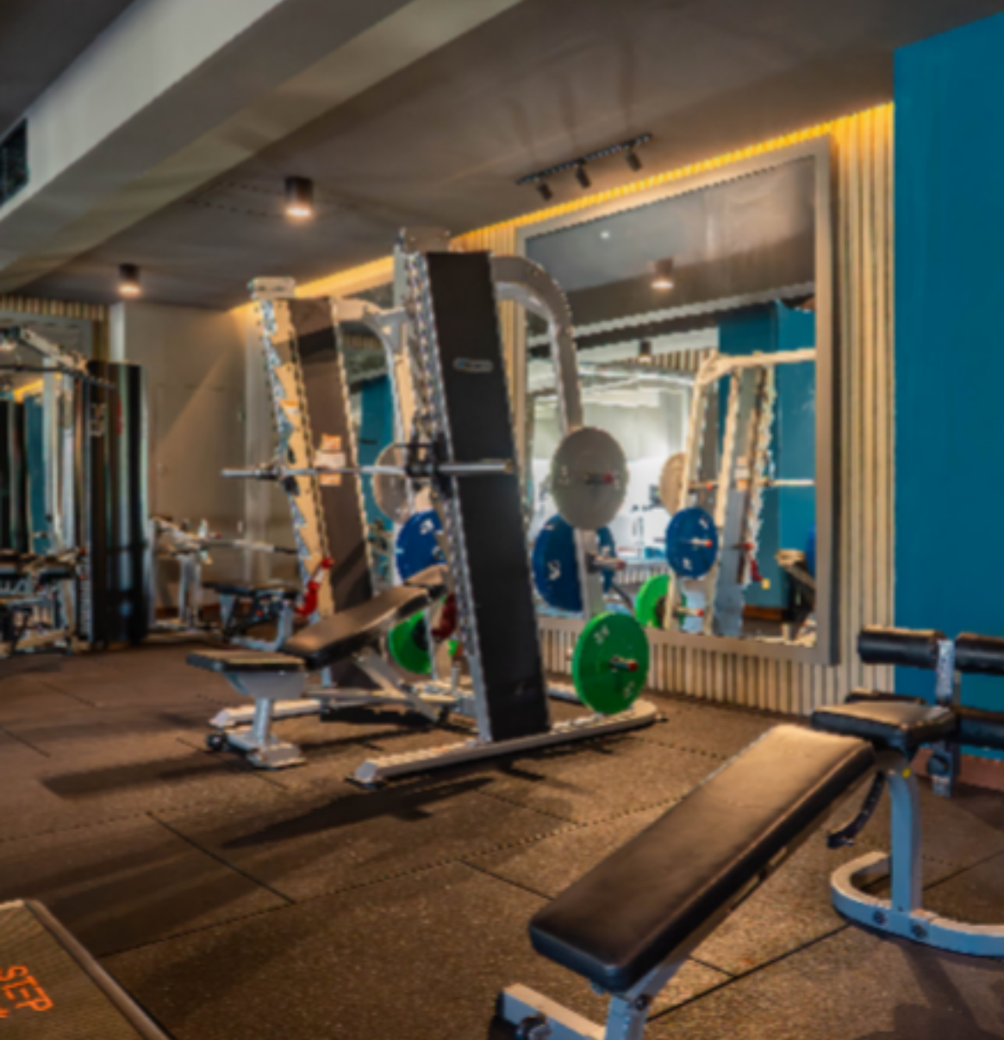
33
G R A N D M I R A G E R E S O R T & T H A L A S S O B A L I
Fitness Center
Stay active during your holiday at our fully equipped Fitness Center. Enjoy a wide range of cardio and strength-training equipment including a Smith machine, functional trainer, battle ropes, TRX, kettlebells, dumbbells, gym balls, BOSU balls, step jumps, and more.
The Fitness Center is open daily from 6:00 to 23:00 for your convenience.

Slide 34
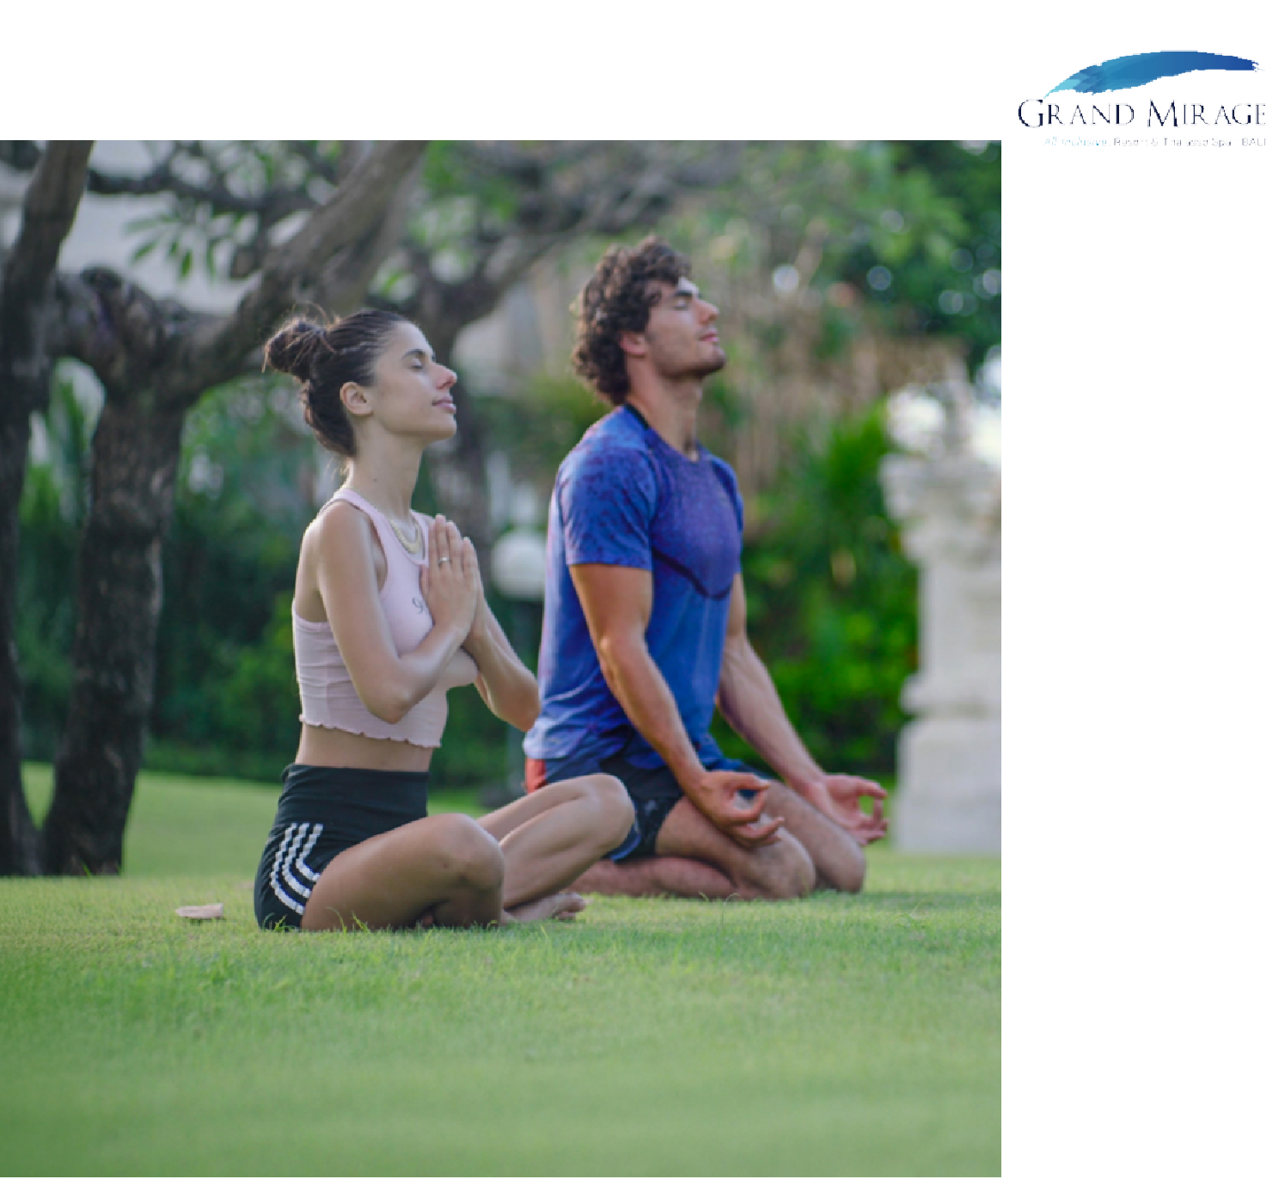
34
G R A N D M I R A G E R E S O R T & T H A L A S S O B A L I
Sport & Recreation Activities
Offering wide range of activities, starting from yoga, aerobics, beach volleyball and choices of water sports to Kids’ activity. Fun is never ends when in
Grand Mirage Resort.

Slide 35
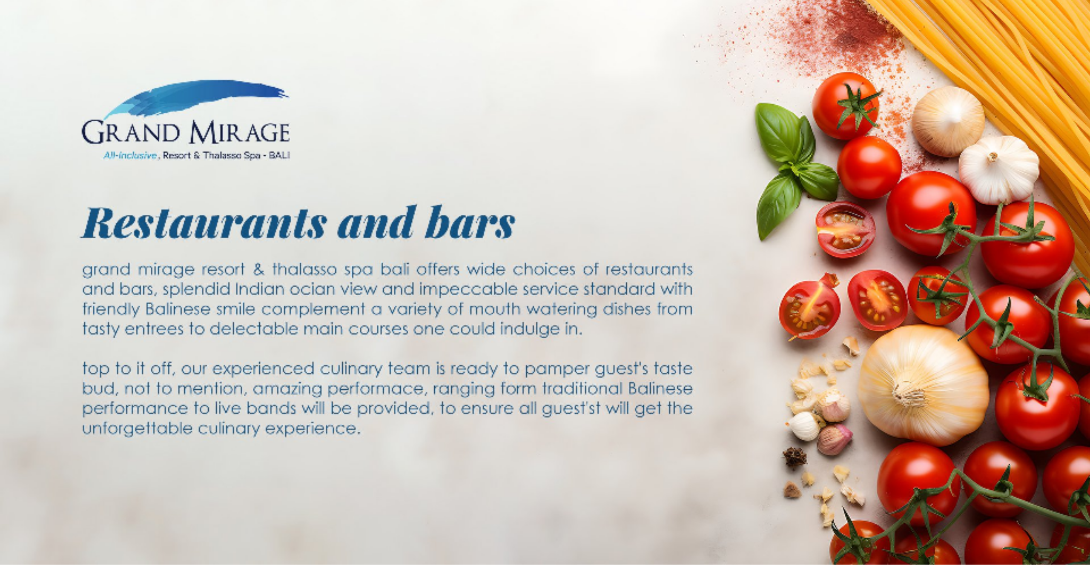
G R A N D M I R A G E R E S O R T & T H A L A S S O B A L I
35

Slide 36

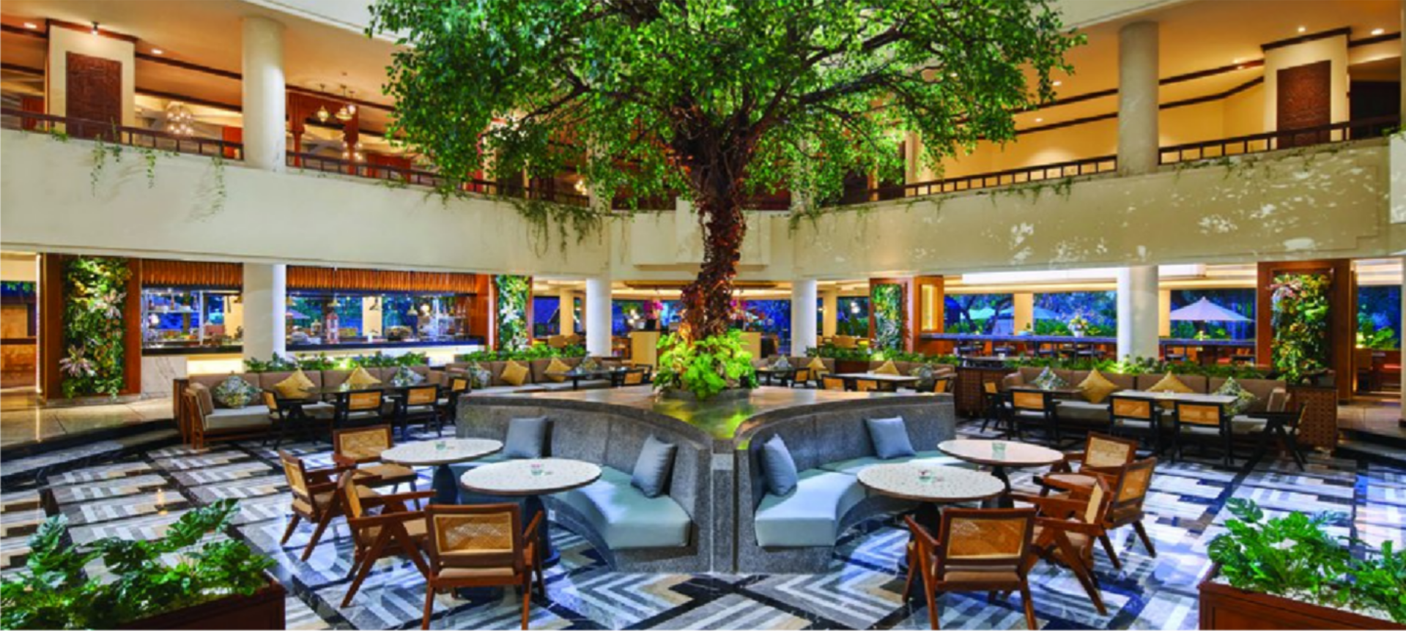
GRAND CAFE
Offers eclectic dishes with unforgettable savory tastes for the palate. Open for 24 hours this restaurant serves an alluring a la carte menu and appetizing buffet for breakfast, lunch, and dinner. The calming sea breeze soothes the feeling and creates an extraordinary dining experience. This restaurant is perfect for treasuring the free time with the companion of afternoon tea or coffee and savory cakes.
Breakfast Lunch Dinner
: 07.00 – 11.00 Hours
: 12.00 – 15.00 Hours
: 18.30 – 22.00 Hours
G R A N D M I R A G E R E S O R T & T H A L A S S O B A L I
36
R E S T A U R A N T

Slide 37

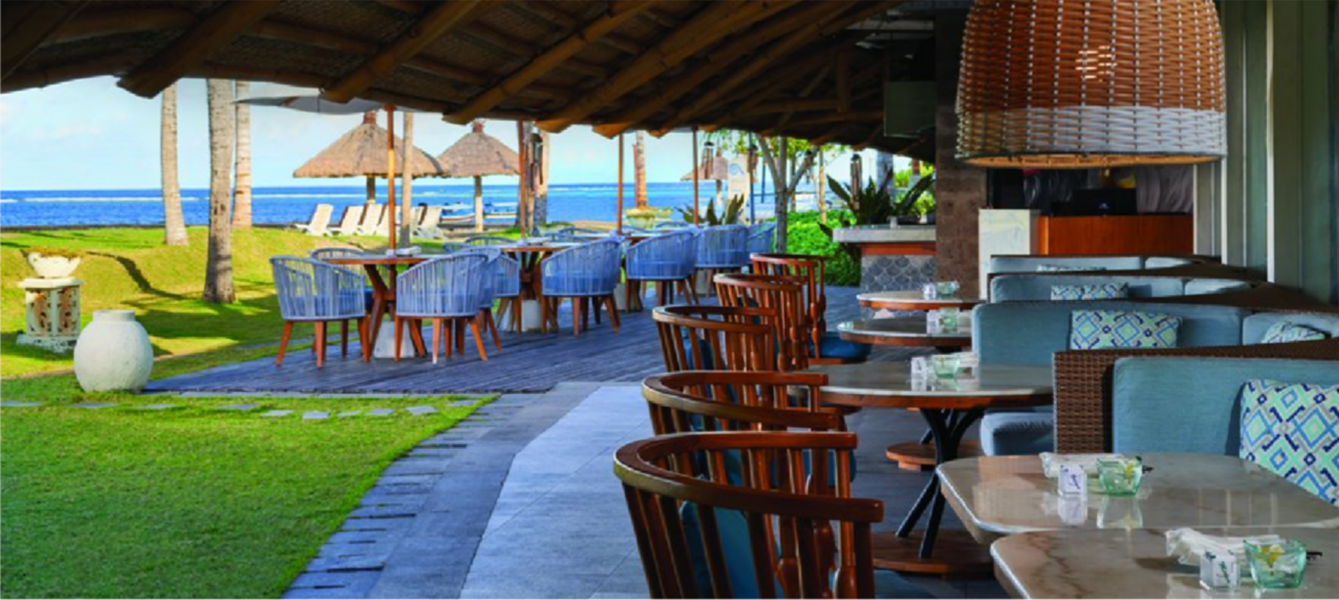
JUKUNG SEAFOOD GRILL
The incomparable grilled fish taste, the magnetizing Indian Ocean View and the soothing sea breeze are the ultimate opulence of this restaurant. Adorned with Balinese furniture and artwork, this restaurant resonates the authentic luxury of a 5-star Bali resort.
Complimentary Wi-Fi
Seating capacity up to 72 seats
Grilled seafood, meat and Italian menu
Relaxing ambiance with an awesome view of Indian Ocean
G R A N D M I R A G E R E S O R T & T H A L A S S O B A L I
37
R E S T A U R A N T

Slide 38

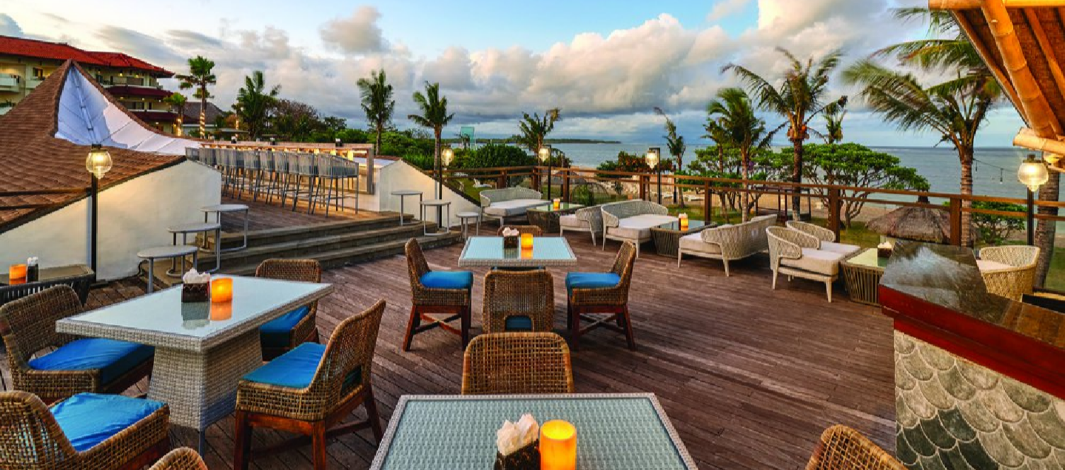
JJ ROOFTOP LOUNGE
Set on the top of the Jukung Seafood Grill, JJ Rooftop Lounge will embrace your afternoon bliss with set of delightful cocktails, mocktails and choices of bites while enjoying the excitement of starry evening to light up the night.
G R A N D M I R A G E R E S O R T & T H A L A S S O B A L I
38
R E S T A U R A N T

Slide 39

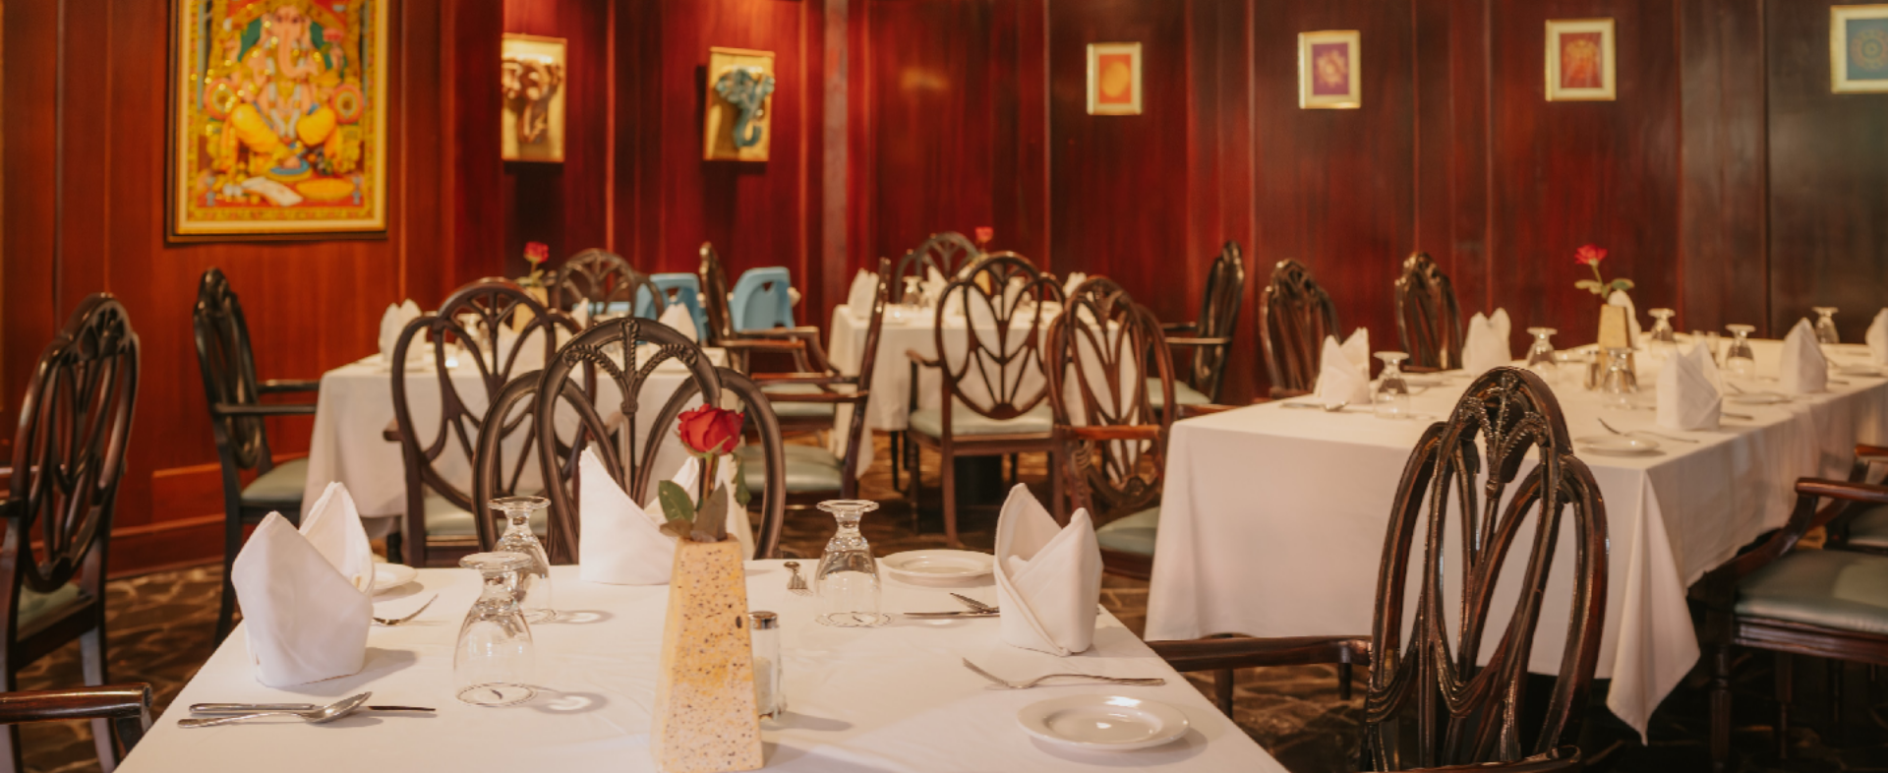
BUMBU DELHI
Tantalizing blend between essences and the beauty of spices are offered at Bumbu Delhi – the new Indian restaurant. The passionate Indian Chef and breathtaking Ocean View invite those who are craving to experience the Indian cuisine world. Bumbu Delhi offers halal food, as well as vegetarian dishes.
Open daily from 19.00 to 22.00 hours
G R A N D M I R A G E R E S O R T & T H A L A S S O B A L I
39
R E S T A U R A N T

Slide 40

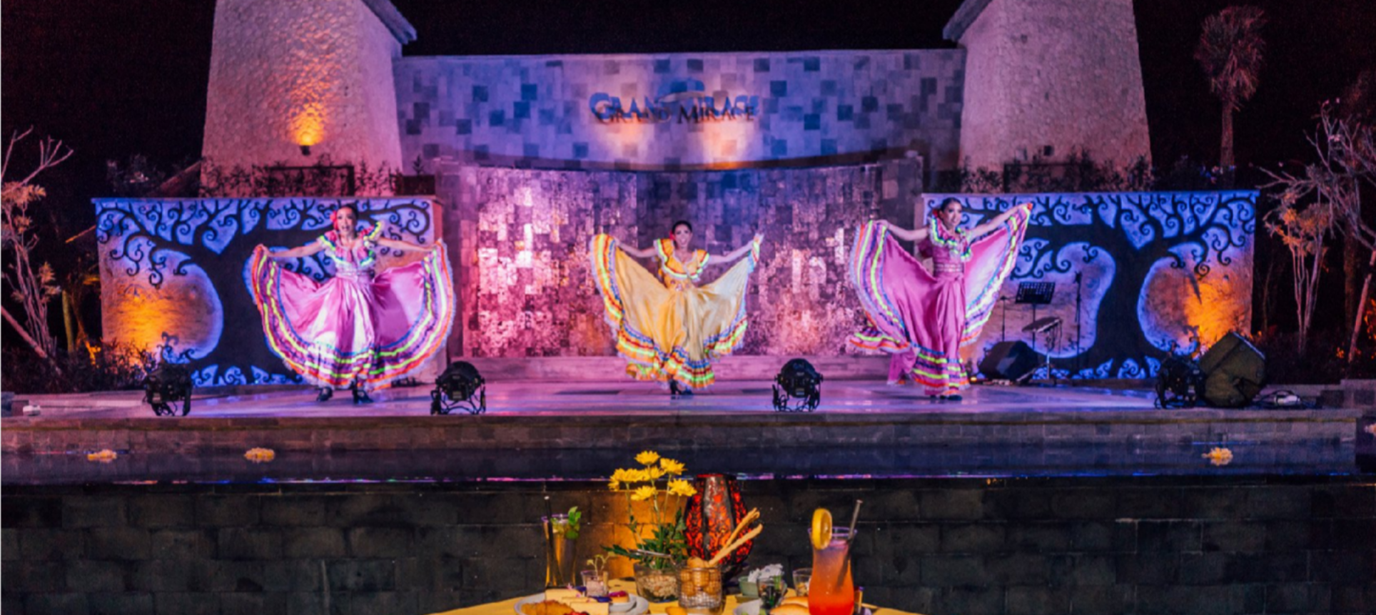
THEMED BUFFET DINNER
Themed buffet dinner is a grandeurs night entertainment that Grand Mirage Resort & Thalasso Bali has to offer. The inviting dishes and glorious shows enliven the starry evening.
Complimentary Wi-Fi
Perform 5 times a week starting from
19.00 to 22.00 hours
Relaxing ambiance with the ocean breeze and ocean view.
Seating capacity 500 seats
G R A N D M I R A G E R E S O R T & T H A L A S S O B A L I
40
R E S T A U R A N T

Slide 41

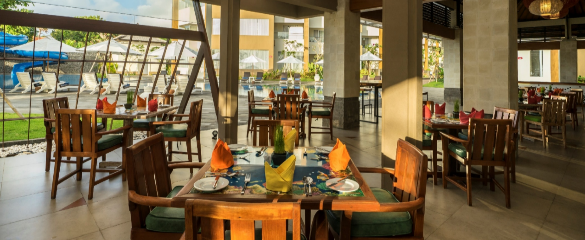
MAHI - MAHI
Wide selections of tantalizing cuisines are ready to boast up your energy, an indoor restaurant to escape the midday sun. Located next to the main pool which suitable for your ultimate amusement.
Open daily from 11.00 to 18.00 hours
G R A N D M I R A G E R E S O R T & T H A L A S S O B A L I
41
R E S T A U R A N T

Slide 42

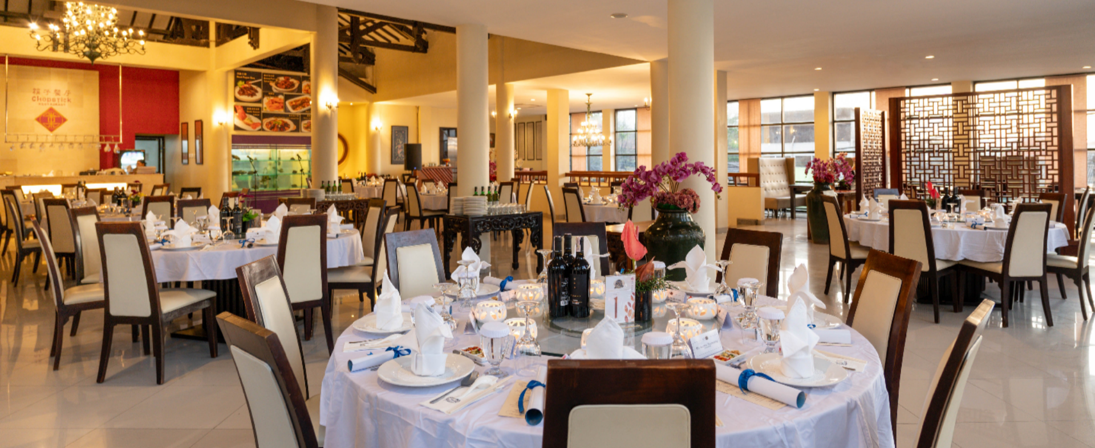
CHOPSTICK
Located at Family Paradise, Chopstick Chinese Restaurant is an authentic restaurant serving tasteful Chinese dishes and seafood. Freshly cooked seafood with Chinese ingredients leaves a wonderful savour on taste buds.
Open daily from 11.00 to 22.00 hours
G R A N D M I R A G E R E S O R T & T H A L A S S O B A L I
42
R E S T A U R A N T

Slide 43

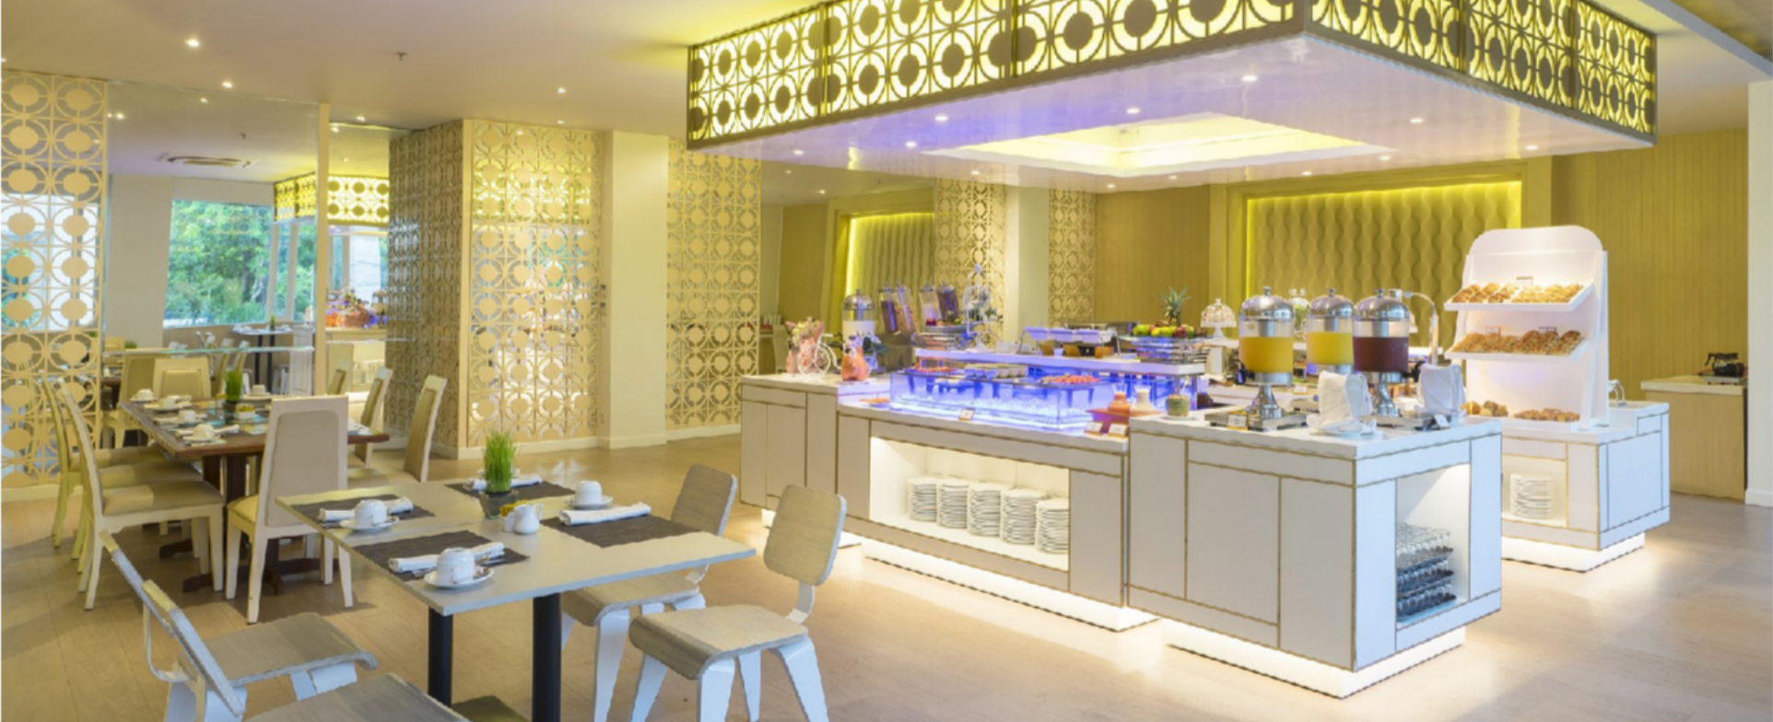
IBU KITCHEN
Creative Indonesian recipes featuring the freshest local product, offers a sumptuous Indonesian buffet and a’la carte menu that whet anyone’s appetite. The authentic and exotic Indonesian tastes nestled in an elegant and modern touch, which are suitable for group of friends or family.
Breakfast Dinner
: 07.00 - 10.30 hours
: 19.00 - 22.00 hours
G R A N D M I R A G E R E S O R T & T H A L A S S O B A L I
43
R E S T A U R A N T

Slide 44

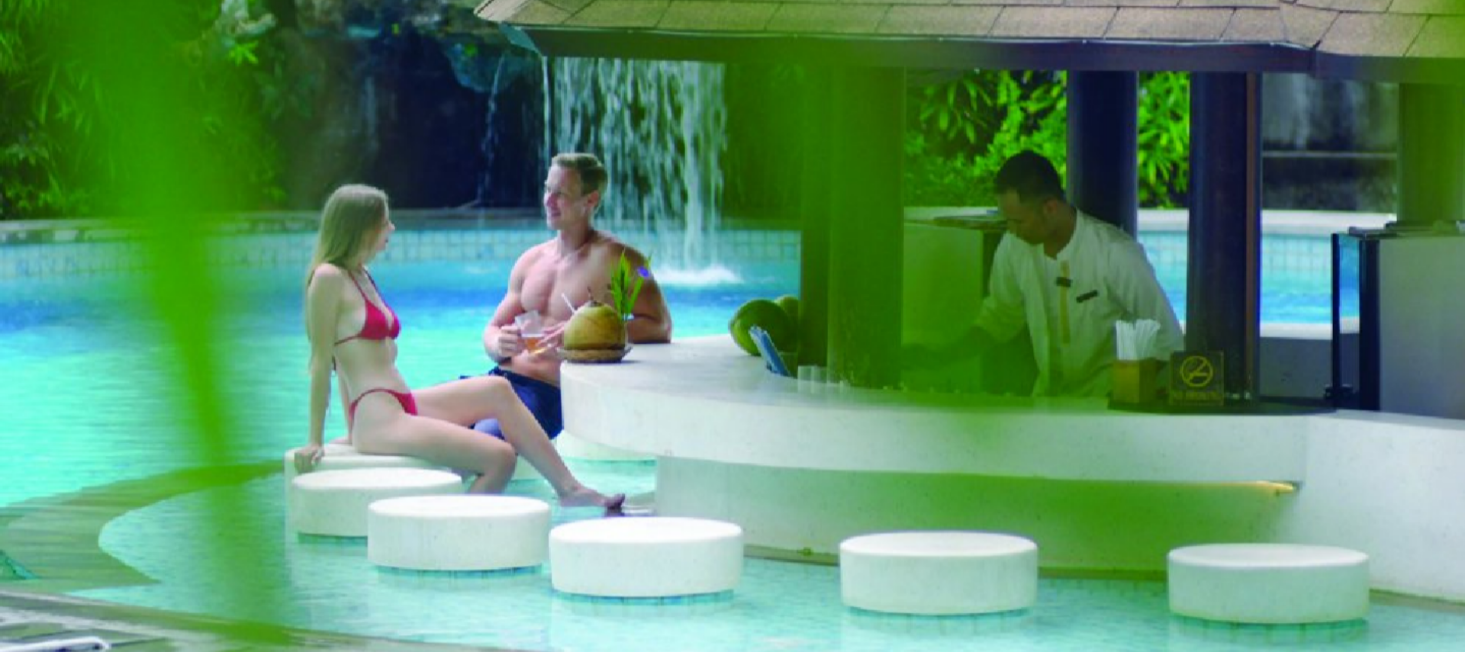
COCONUTS POOL BAR
Hypnotizing moments of unwinding at a pool bar is one thing not to be missed while staying in this Bali resort. This pool bar offers an unexpected innovation, coconut cocktails with coconut from the trees at Grand Mirage garden.
Open daily from 10.00 to 18.00 hours
G R A N D M I R A G E R E S O R T & T H A L A S S O B A L I
44
R E S T A U R A N T

Slide 45

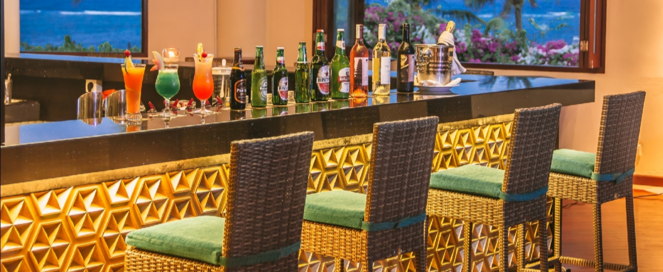
PANORAMA BAR
Panorama lounge serves as a lobby lounge with eclectic cocktails, mocktails, fresh juice, and other inviting beverages. The ocean and pool views make this lounge glorious. Live music playing at the lounge is the greatest companion for an intimate conversation.
Open daily from 17.00 to 01.00 hours
G R A N D M I R A G E R E S O R T & T H A L A S S O B A L I
45
R E S T A U R A N T

Slide 46

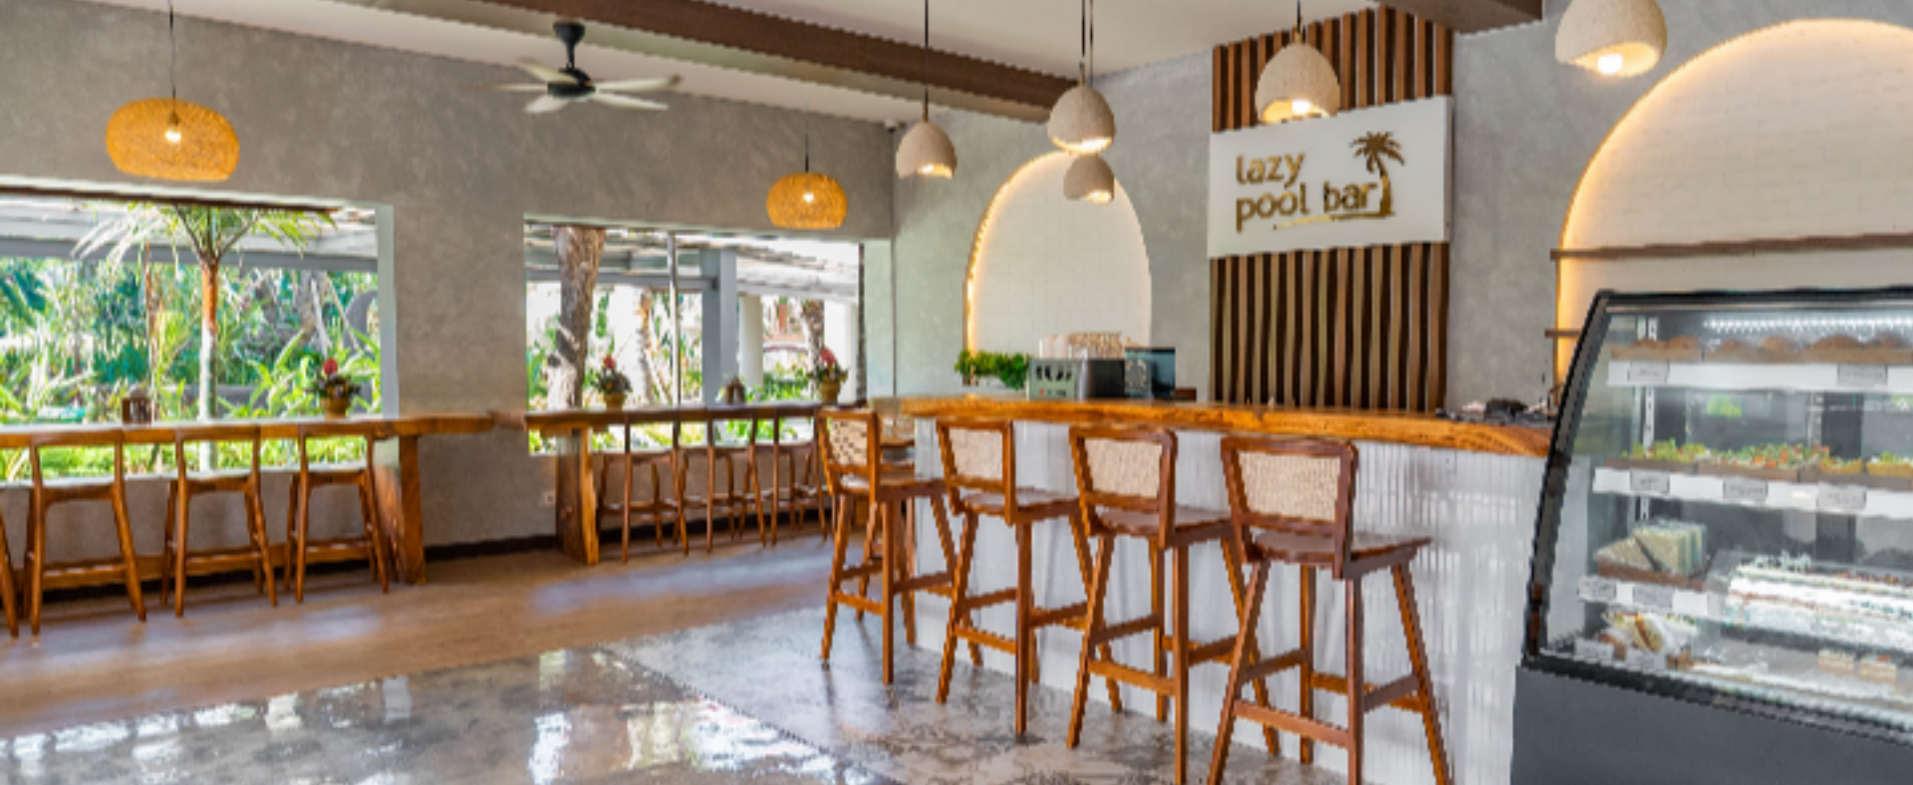
LAZY POOL BAR
Located at the Lazy River, the Lazy Pool Bar is the perfect spot to relax while enjoying snacks and refreshing drinks. You can order your favorite bites and beverages to accompany your time by the Lazy River. Whether you’re taking a break from swimming or just drifting along, every moment here is made for pure relaxation.
Open daily from 11.00 to 06.00 hours
G R A N D M I R A G E R E S O R T & T H A L A S S O B A L I
46
R E S T A U R A N T

Slide 47

WEDDINGS

Slide 48
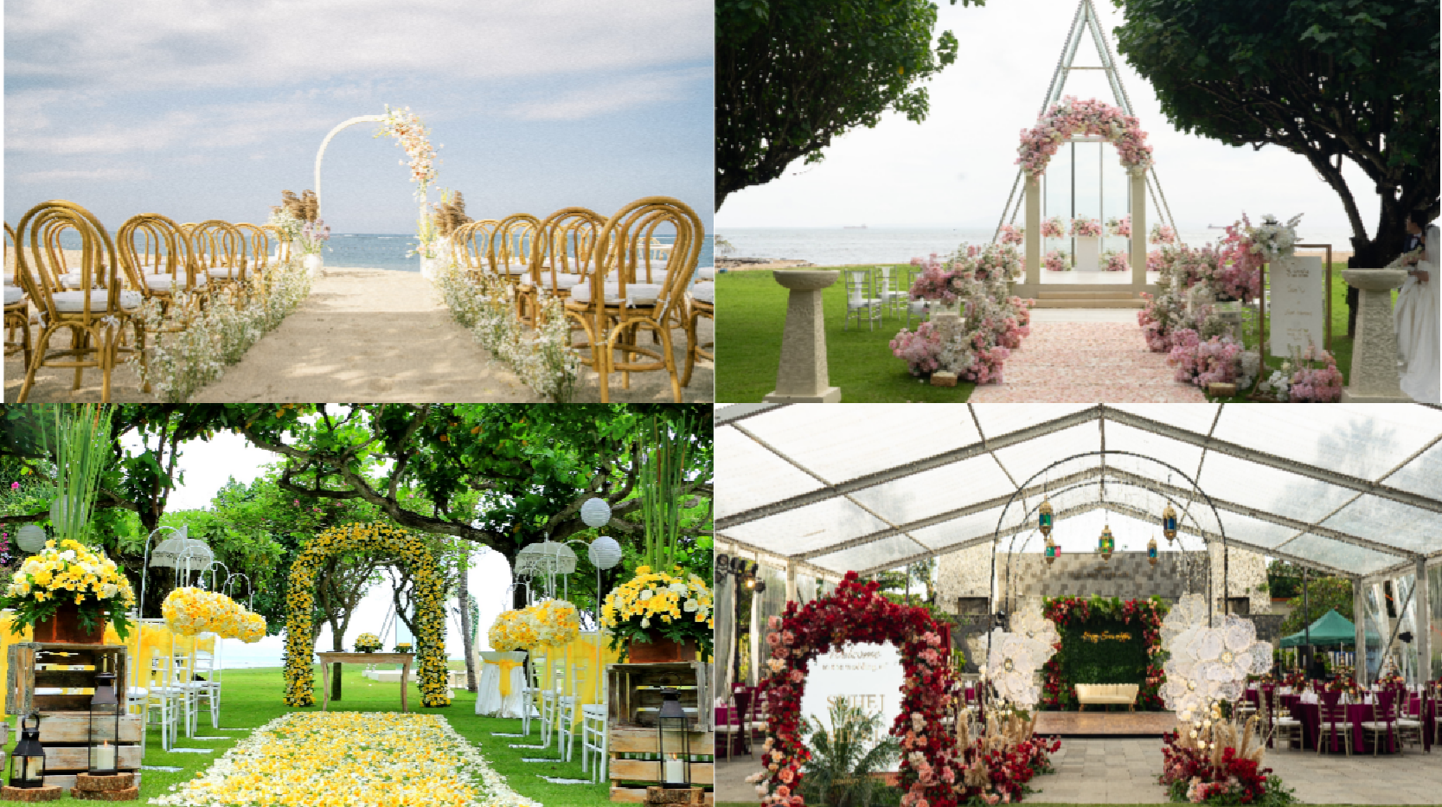
WEDDING
48
Featuring selections of Bali Wedding Packages and four exotic Bali Wedding Venues, Grand Mirage Resort and Thalasso Bali offers the most magical Bali wedding. The on- site wedding team organizes every petite detail and bewitch them into splendid nuptials. A beautiful outdoor wedding? or a sacred indoor wedding? Which one would you prefer? One thing for sure, Grand Mirage Resort and Thalasso Bali promises an unforgettable matrimony in paradise.
This resort features seven wedding venues: Mirage Wedding Chapel, Beach Wedding, Wedding on Water, Wedding at Rooftop Bar, Garden Wedding, Mirage Ballroom, and Rama Live Entertainment. Each venue is exotic with different charm.
G R A N D M I R A G E R E S O R T & T H A L A S S O B A L I

Slide 49


Slide 50
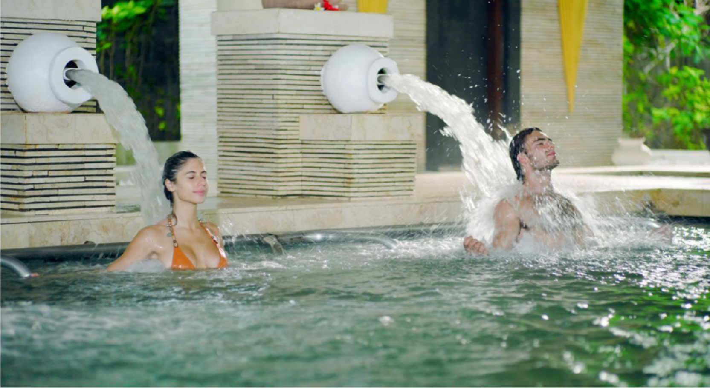
50
THALASSO BALI
In front of the beach and blue of the ocean, Thalasso Bali is situated at the very heart of Grand Mirage Bali Resort. Offering a wide range of Thalasso and spa treatments, it is ensured to provide the perfect relaxation and rejuvenation of the body and soul.
Featuring an Aquamedic pool with 100% heated seawater and seaweed, as well as 16 uniquely designed treatment rooms, Thalasso Bali offers unique experiences. From Thalasso therapy to traditional Asian treatments, Thalasso Bali and its French trained therapists deliver more than just a spa.
G R A N D M I R A G E R E S O R T & T H A L A S S O B A L I

Slide 51
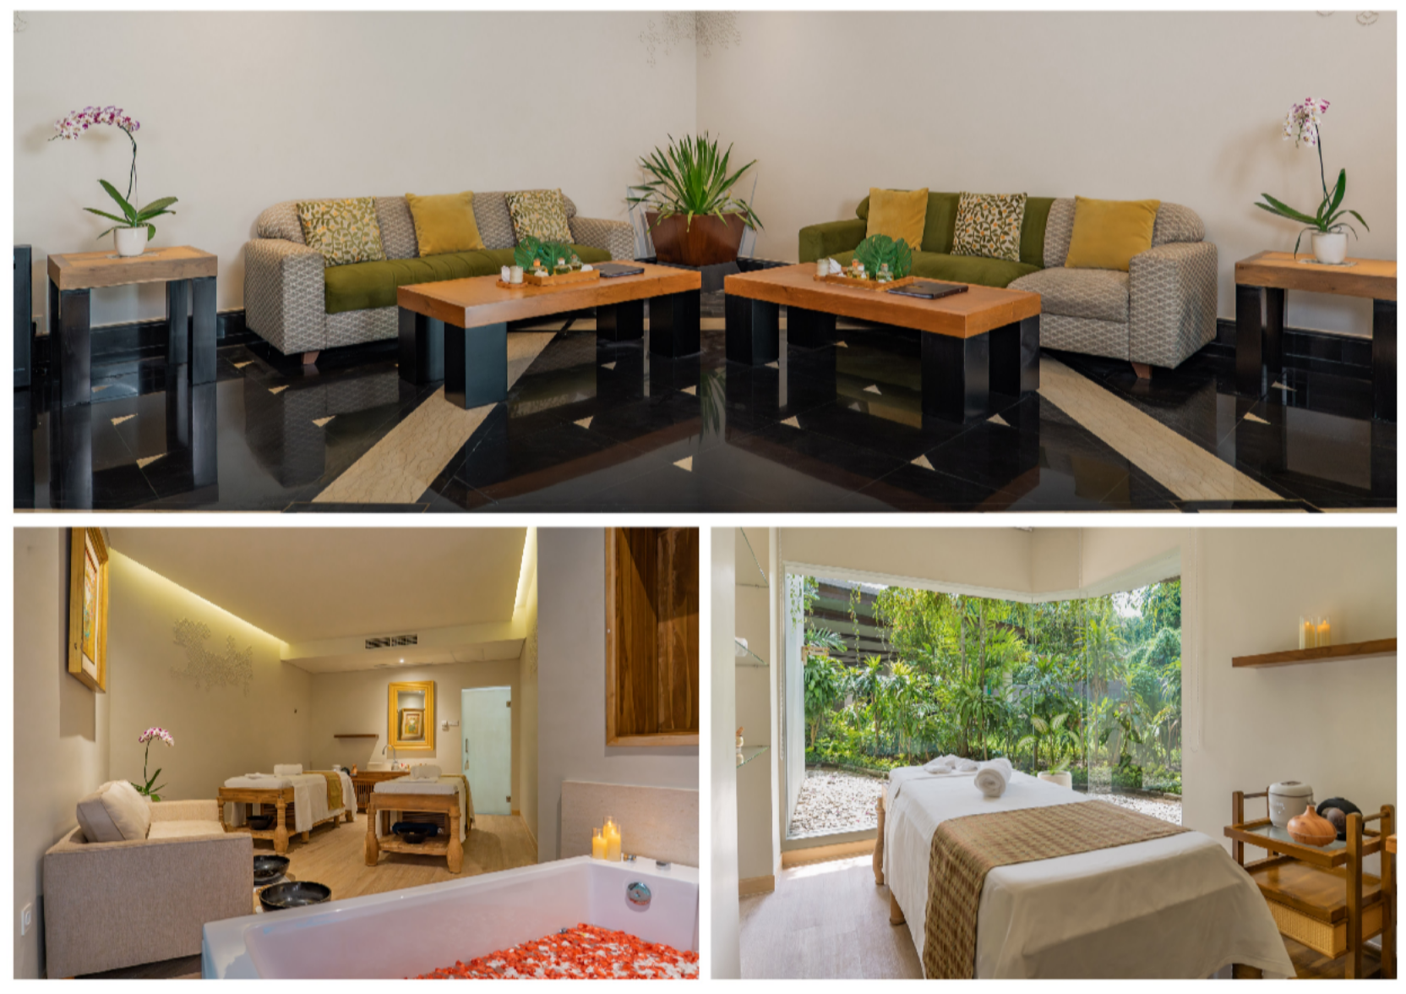
51
THALASSO BALI
G R A N D M I R A G E R E S O R T & T H A L A S S O B A L I

Slide 52


