Slide 1
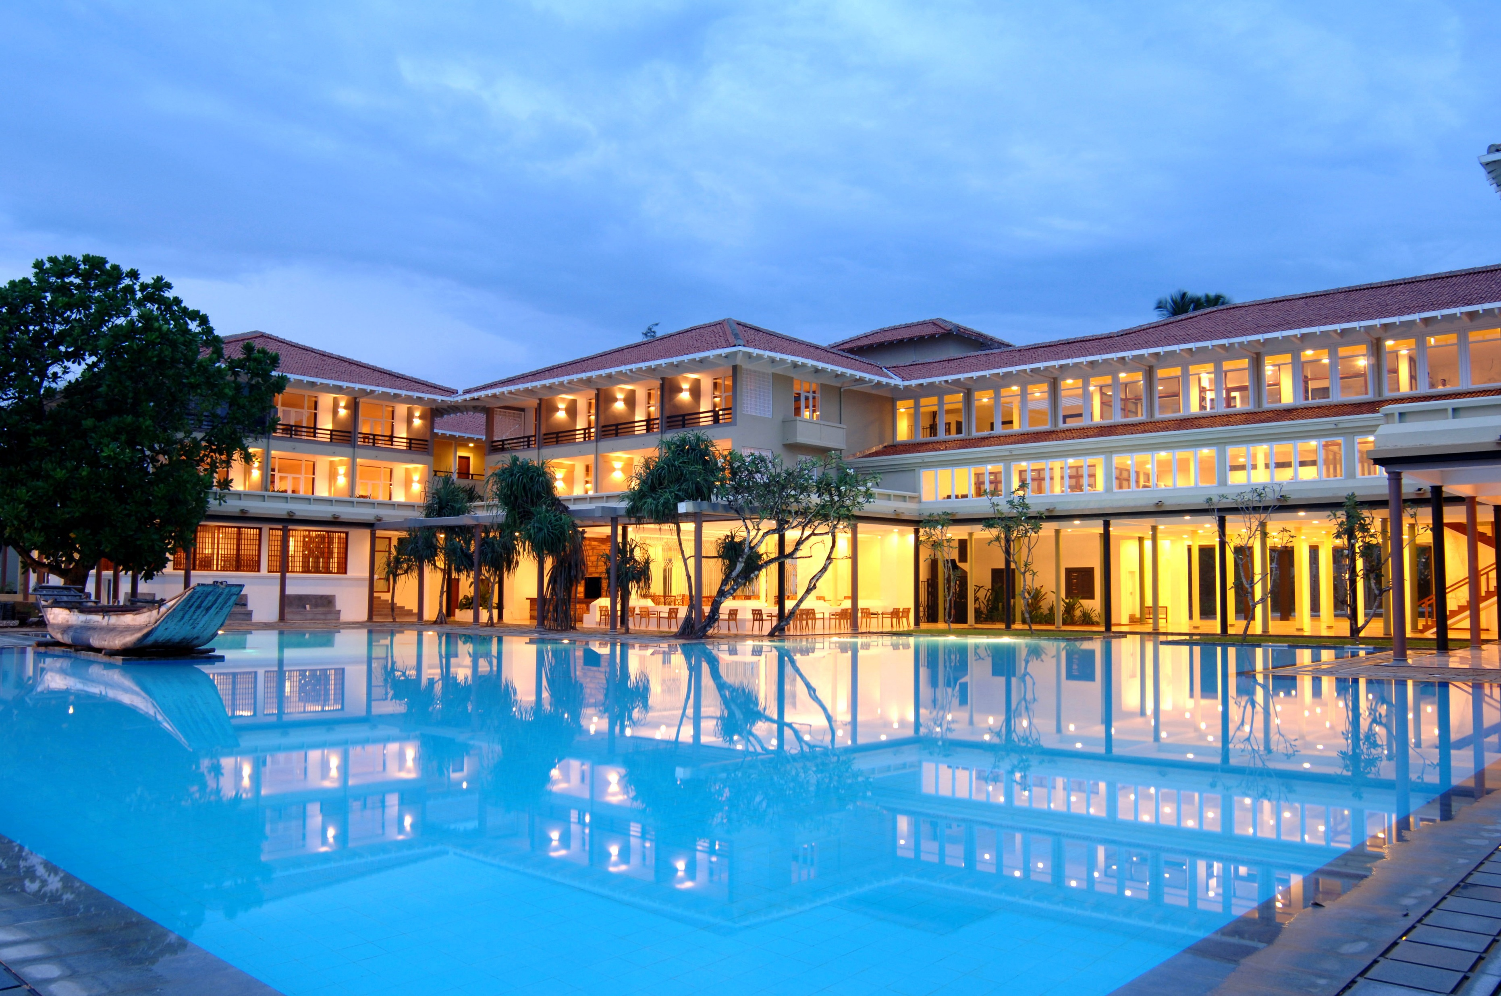


Slide 2
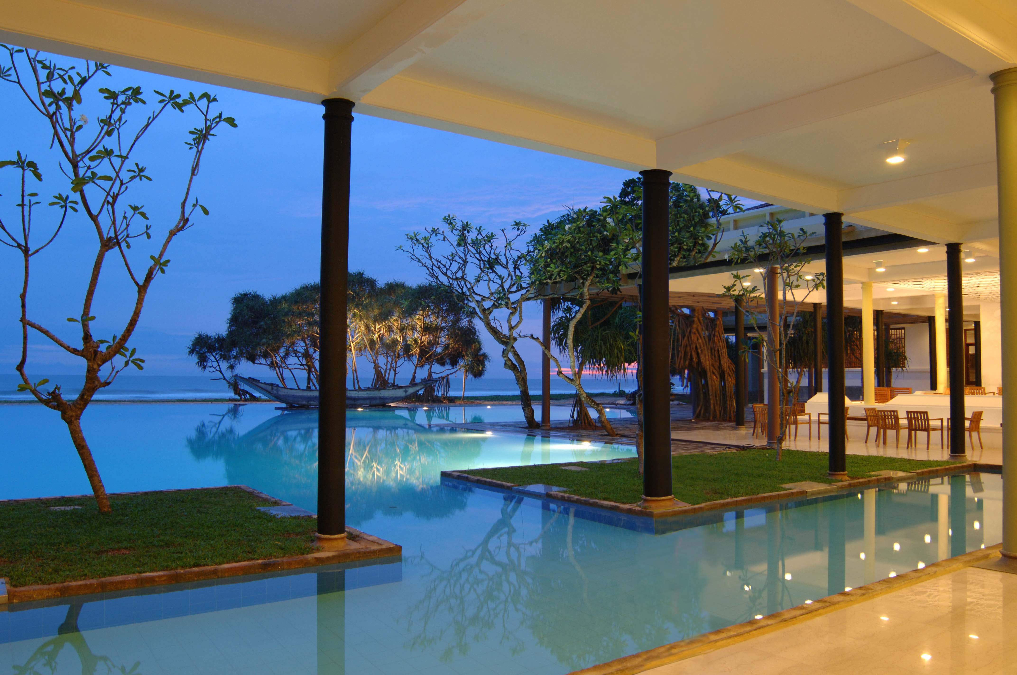
Heritance Ahungalla
Sri Lanka’s first ever five-star beach resort, Heritance Ahungalla blends the vivid blues that meets the eye of a guest when they first step in to the hotel, with elegance, and the charm of Sri Lankan culture. Catering to a clientele that yearns for the infinite views of the sea, alongside superior facilities and amenities, the hotel is also well-known for their exceptional cuisine and outstanding service. Designed by legendary Geoffrey Bawa, the hotel fuses site, climate and tradition to unveil a property that invites relaxation. Among its many accolades, this was the first hotel in Sri Lanka to be ISO5001 certified.

Slide 3
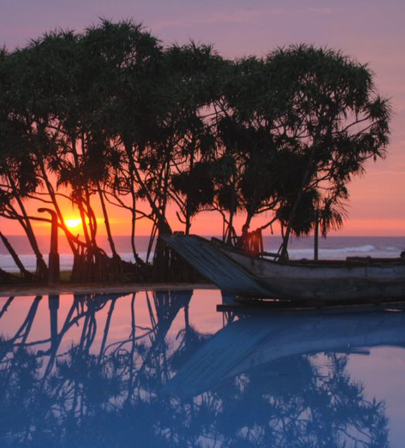
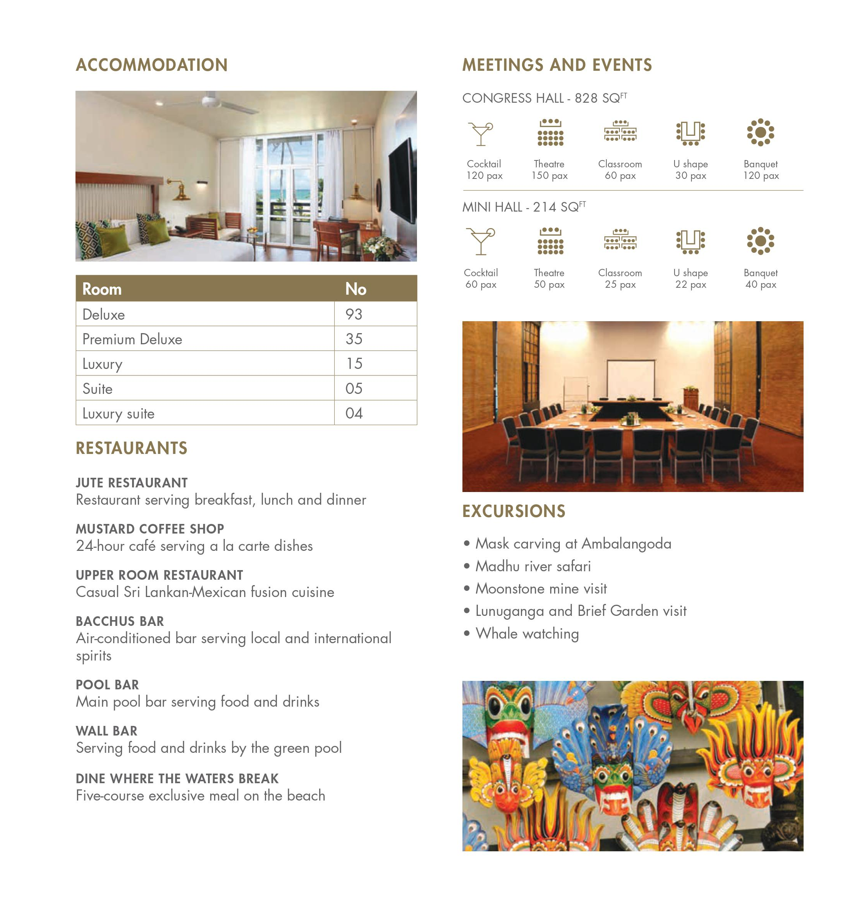
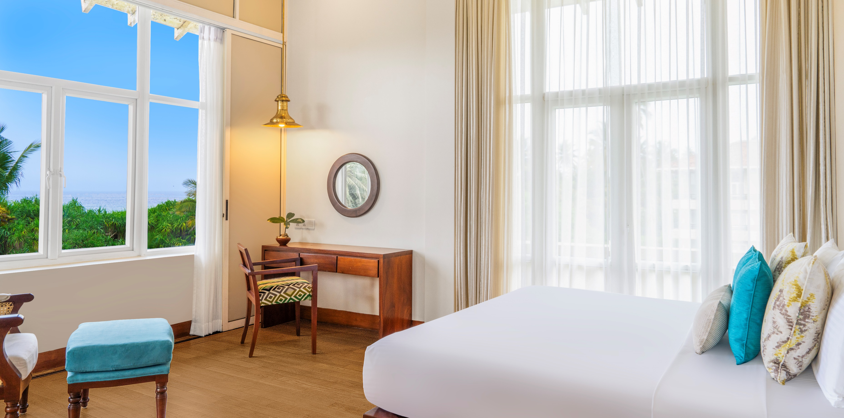
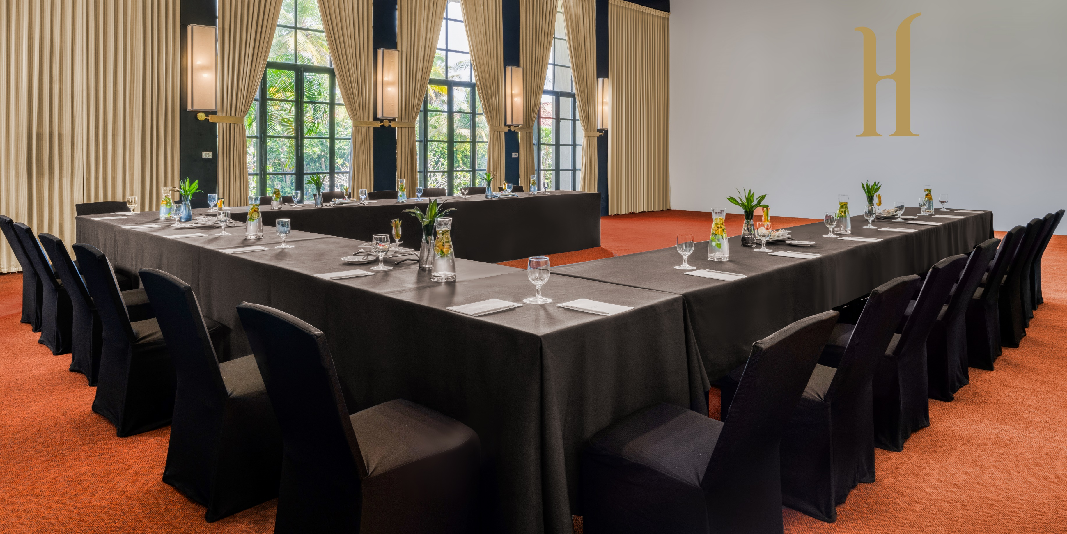

Slide 4
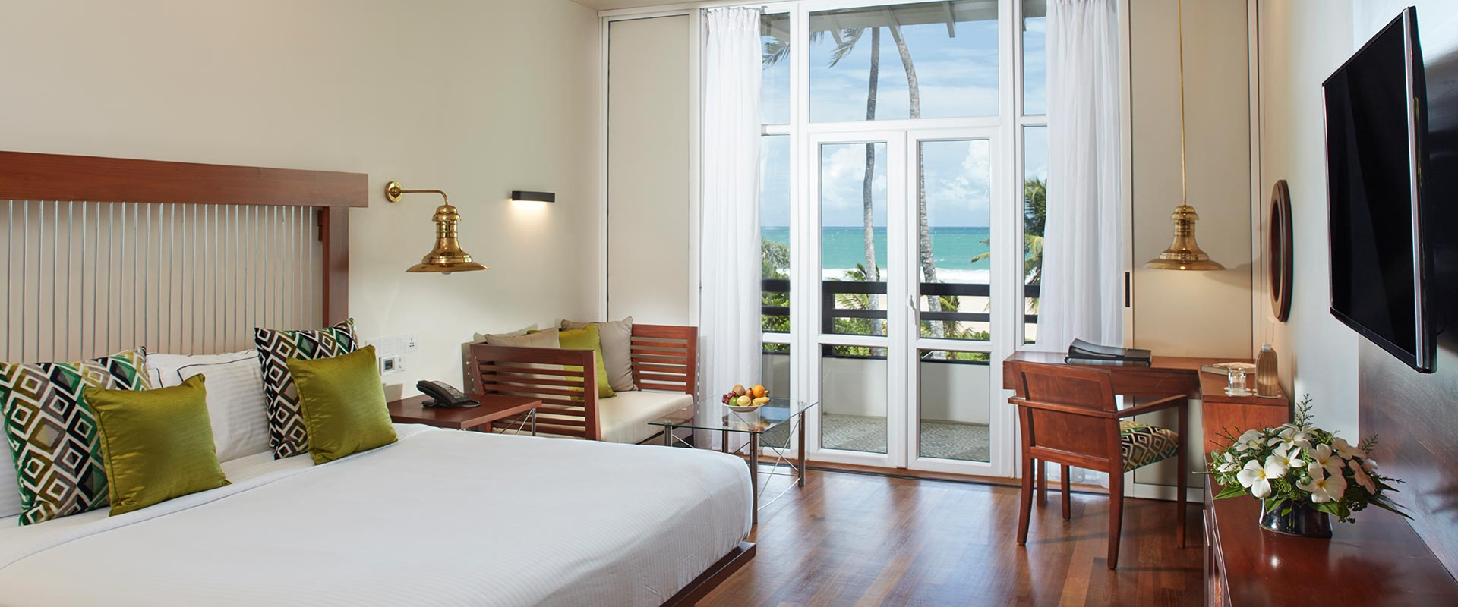
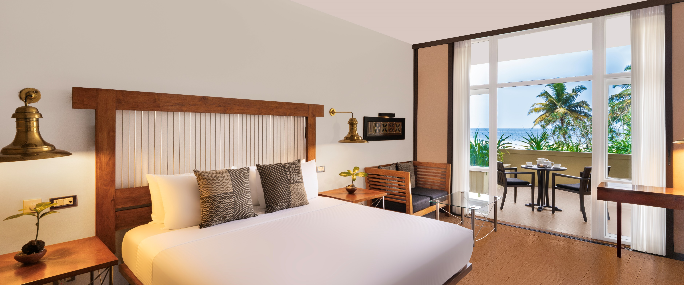
Deluxe Room
Size: 301 sq.ft. of area | No of Rooms: 93
Facilities: Private Balcony or Terrace, Telephone, Satellite TV, Air conditioning, 24-hour room service, Free Toiletries, Free Wi-Fi, Mini Bar, TV with cable channels, Tea/Coffee Makers, Private Balcony

Slide 5
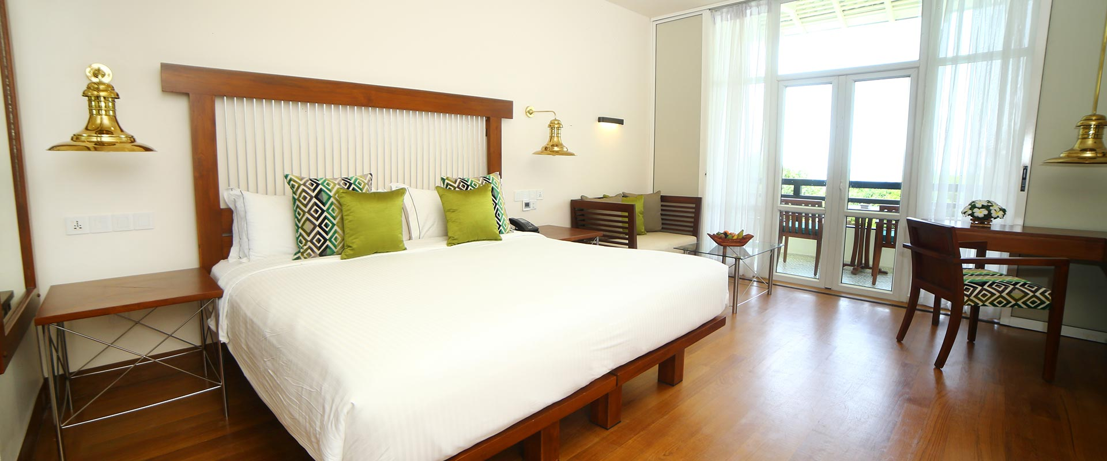
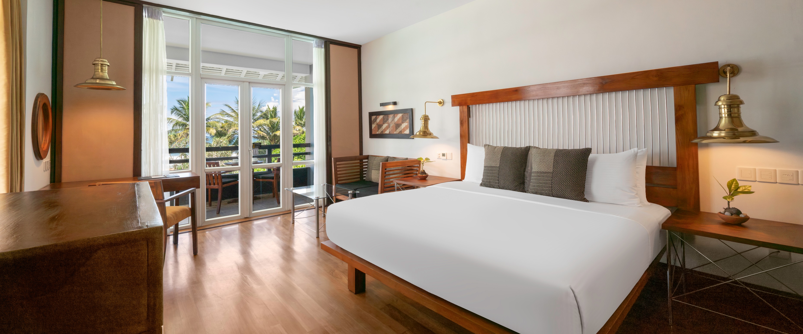
Premium Deluxe Room
Size: 301 sq.ft. of area| No of Rooms: 35
Facilities: Private Balcony, Beach View, Telephone, Satellite TV, Air conditioning, 24-hour room service, Free Toiletries, Free Wi-Fi, Mini Bar, TV with cable channels, Tea/Coffee Makers

Slide 6
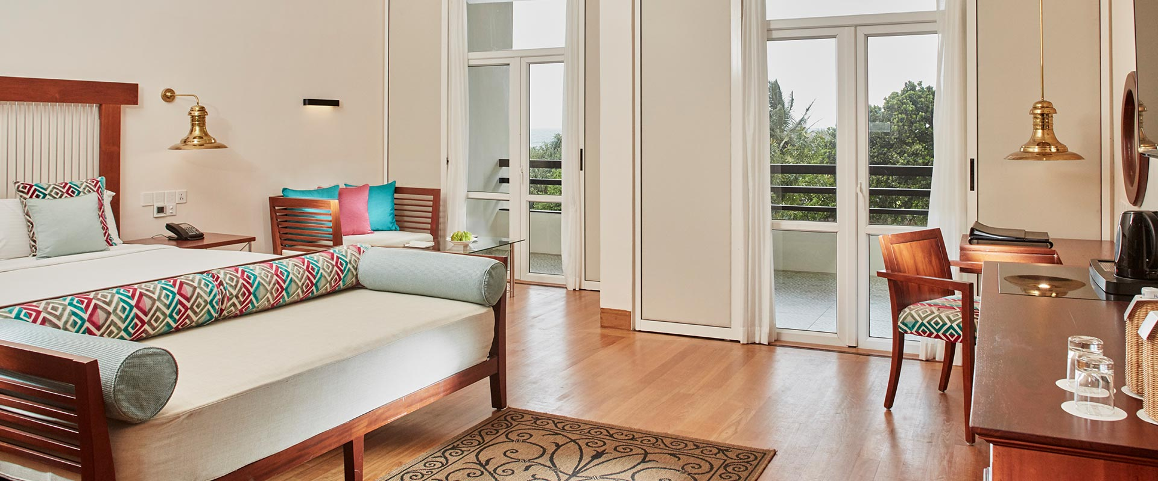
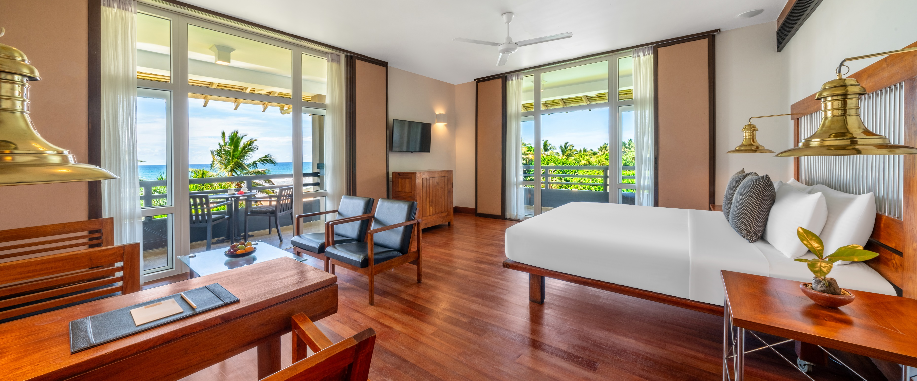
Luxury
Size: 484sq.ft. of area| No of Rooms: 15
Facilities: Large Balcony, Telephone, Satellite TV, Air conditioning, Spacious bathroom with bathtub and overhead shower, 24-hour room service, Free Toiletries, Free Wi-Fi, Mini Bar, TV with cable channels, Tea/Coffee Makers, Private Balcony

Slide 7
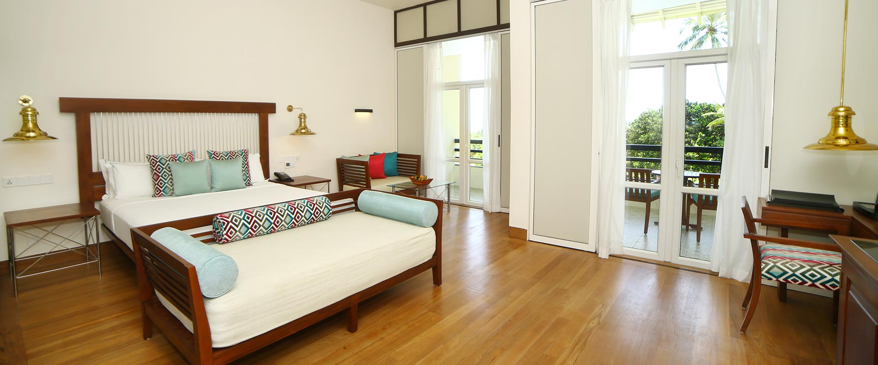
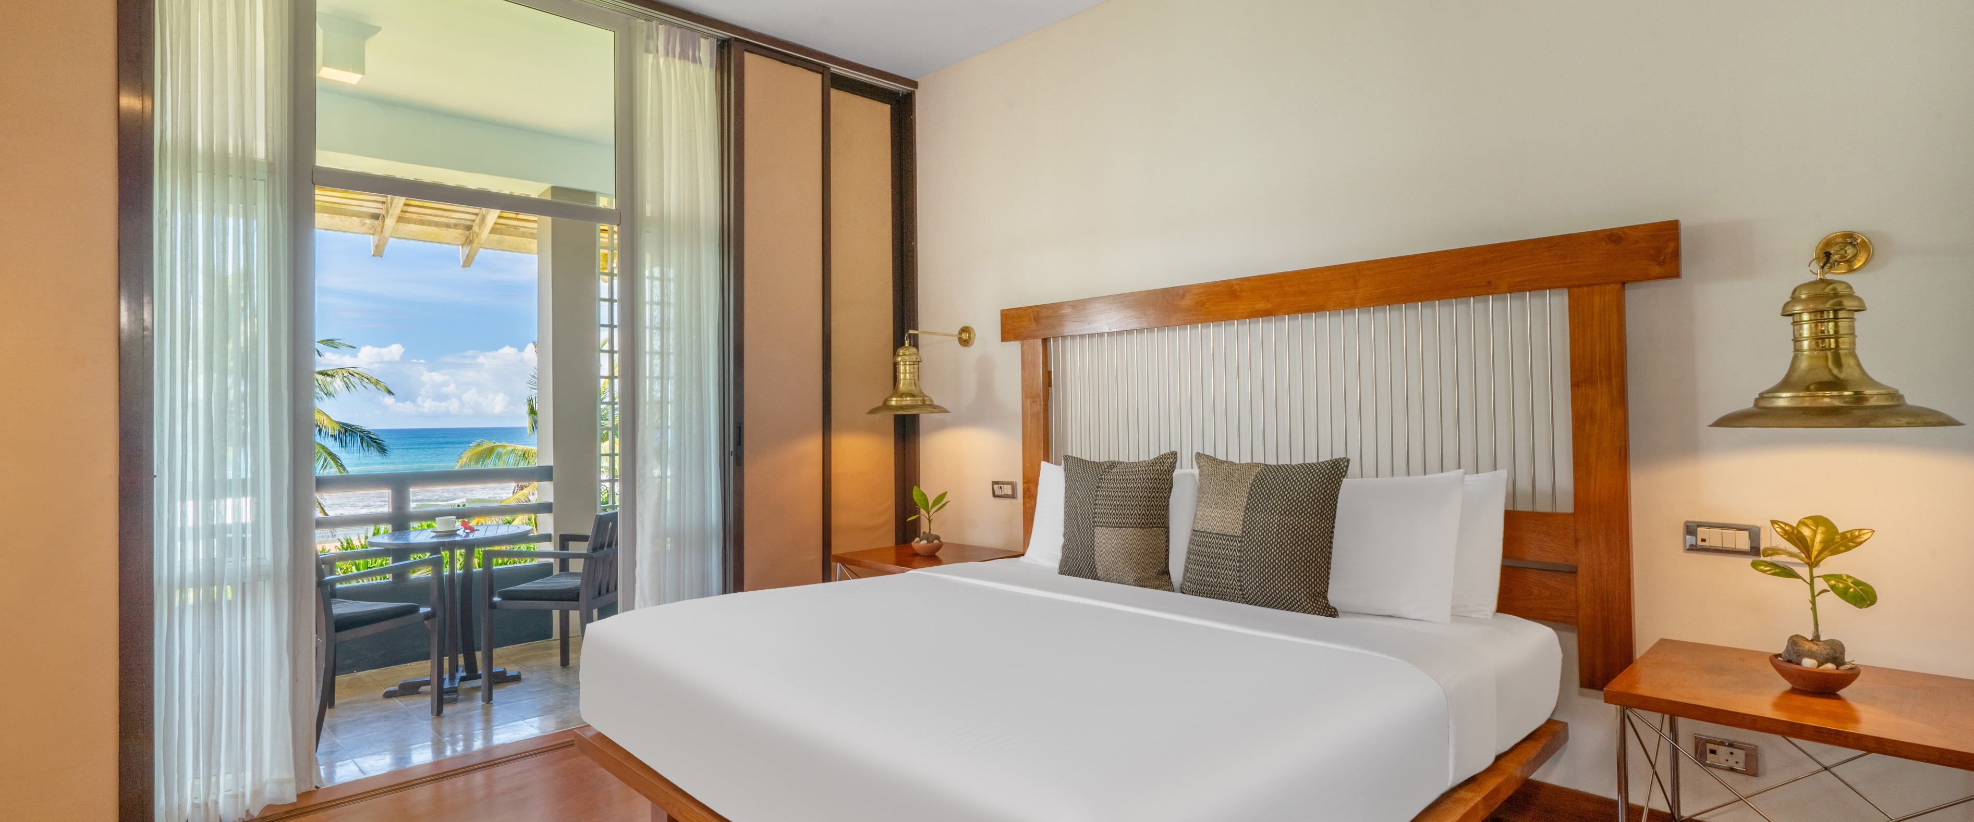
Suite
Size: 699sq.ft. of area| No of Rooms: 5
Facilities: Private Balcony or Terrace, Sitting Area, Jacuzzi or Bathtub, Air conditioning, 24-hour room service, Free Toiletries, Free Wi-Fi, Mini Bar, TV with cable channels, Tea/Coffee Makers, Private Balcony

Slide 8
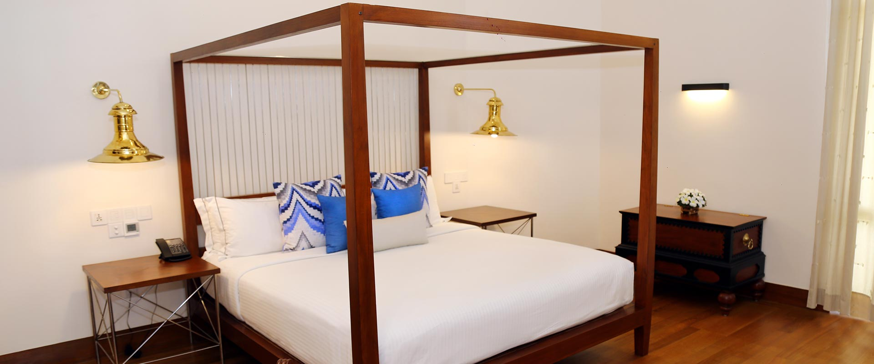
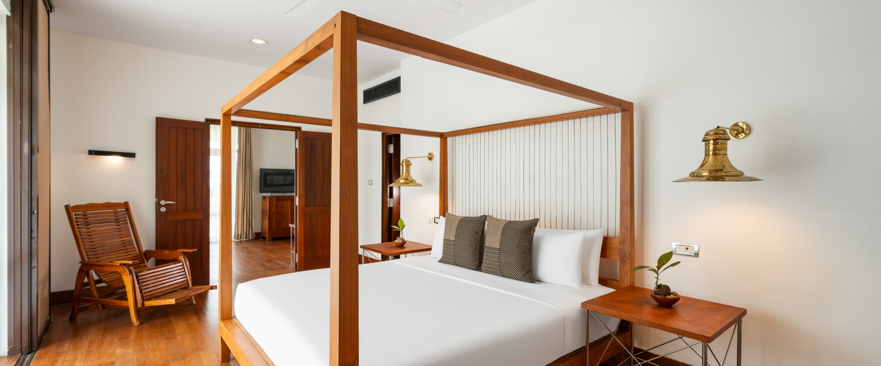
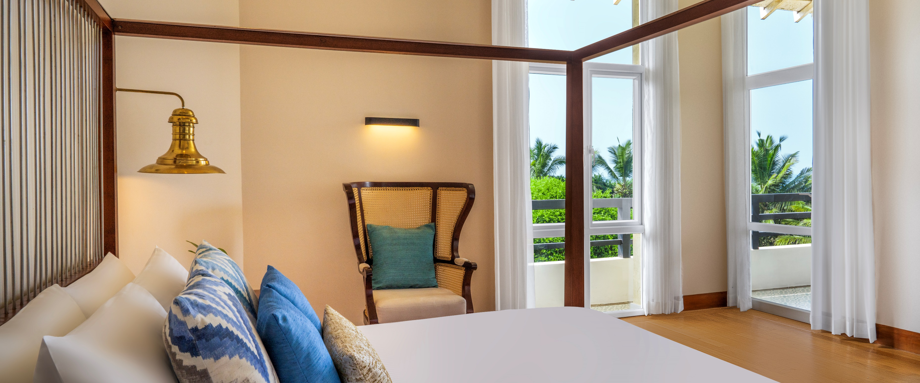
Luxury Suite
Size: 839sq.ft. of area| No of Rooms: 4
Facilities: Private Balcony, Living Room, Jacuzzi, Air conditioning, 24-hour room service, Free Toiletries, Free Wi-Fi, Mini Bar, TV with cable channels, Tea/Coffee Makers, Private Balcony

Slide 9
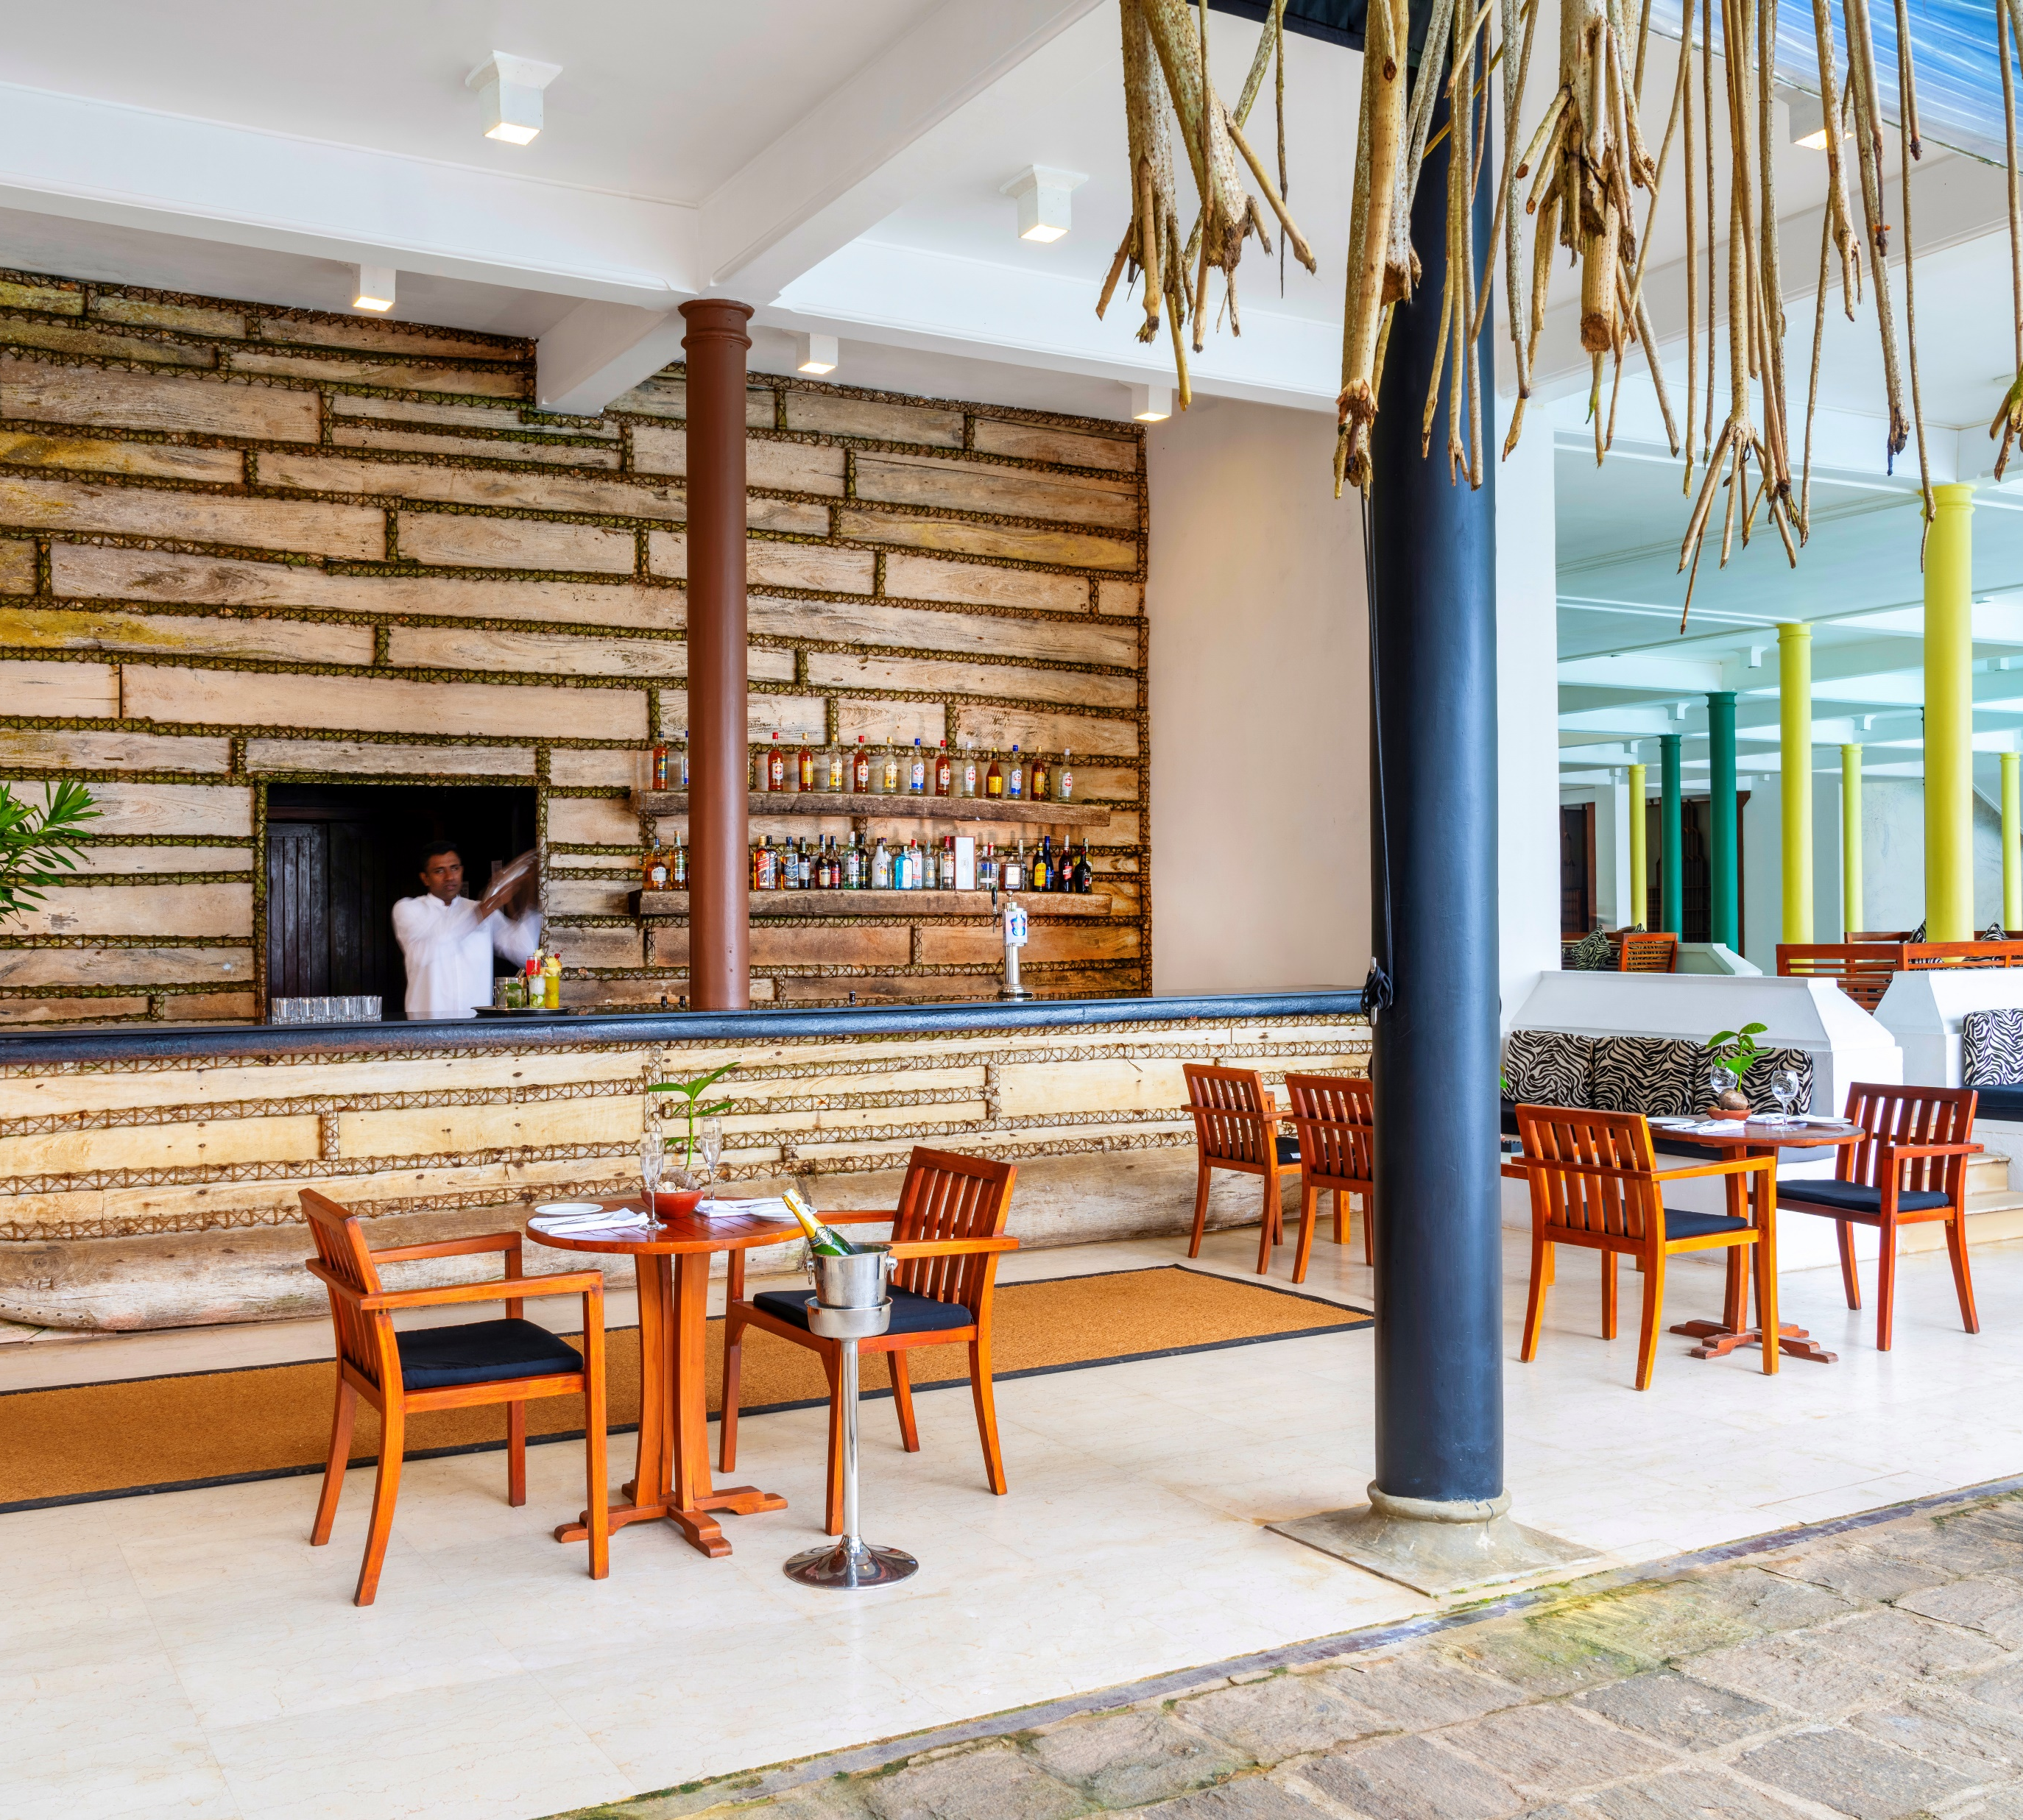
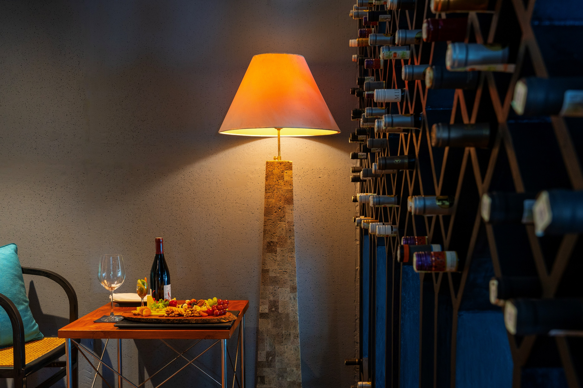
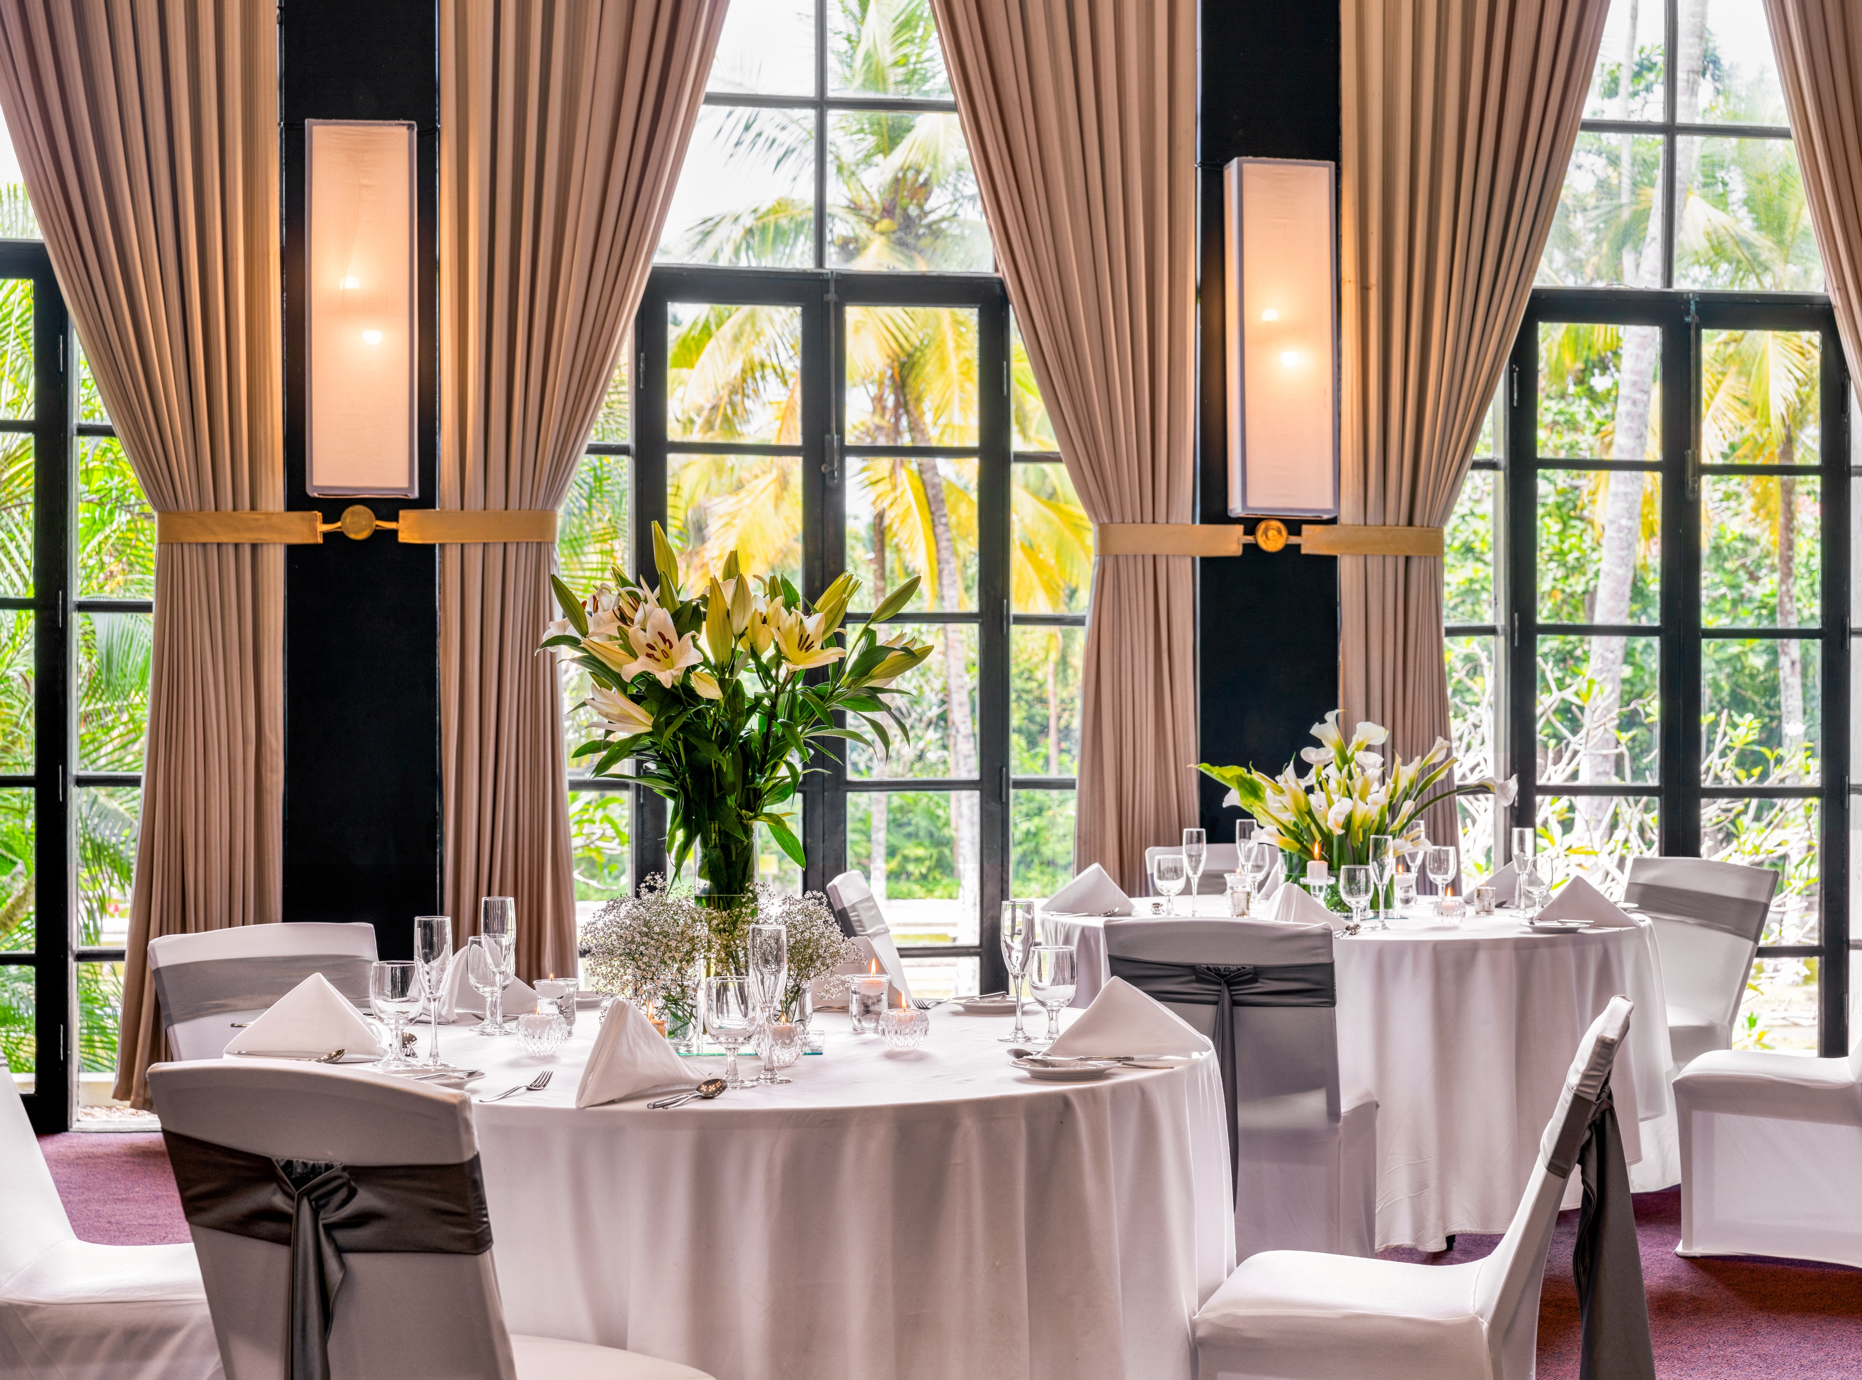
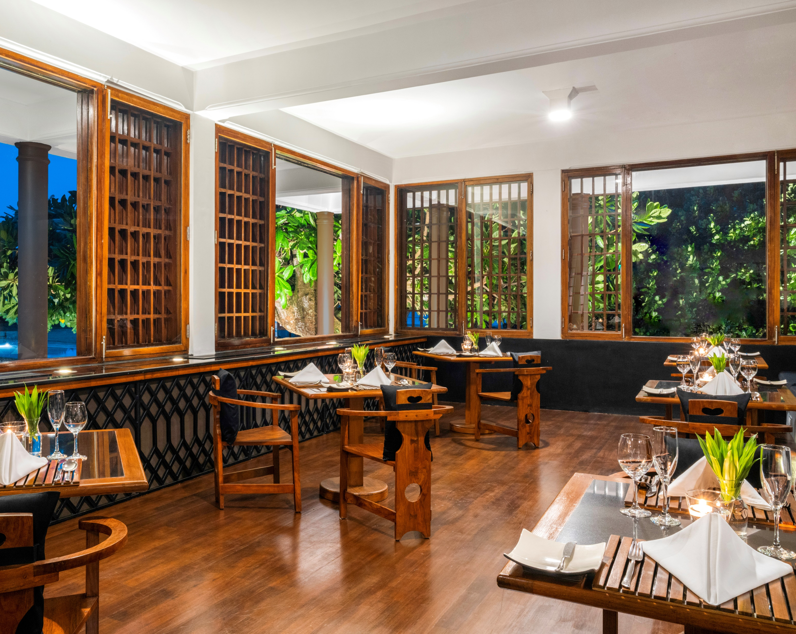
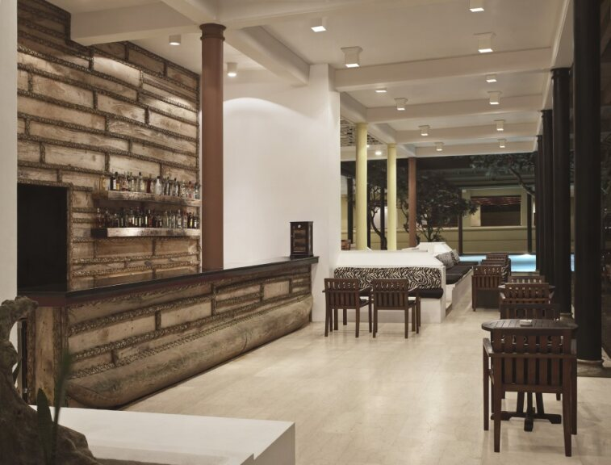
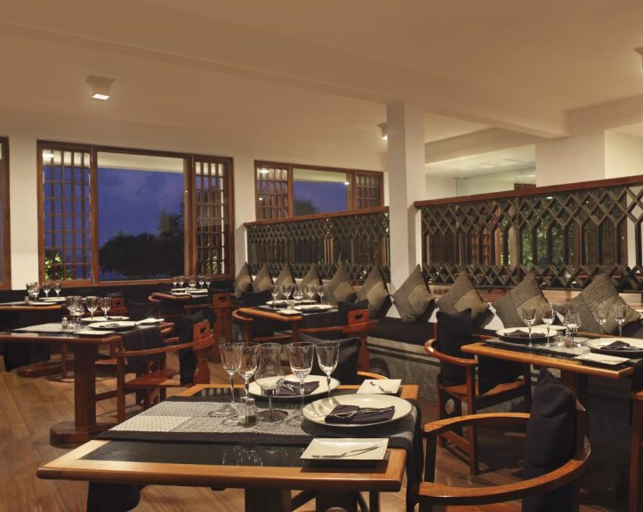
Dining
Restaurants
Jute Restaurant
Mustard Coffee Shop
Bacchus Bar
Pool Bar
Orpheus Bar (Karaoke and Club)

Slide 10
Dining
Jute
Jute Restaurant offers an exquisite dining experience, presenting a fusion of local and international flavors amidst elegant surroundings
Mustard Coffee Shop
A delightful retreat for coffee aficionados and snack lovers, Mustard Coffee Shop is where aromatic brews meet delectable bites, all served with a touch of Heritance charm
Bacchus Bar
Elevate your evenings at Bacchus Bar, the perfect spot to unwind with a curated selection of wines, spirits, and crafted cocktails, all while soaking in the luxurious ambiance of Heritance Ahungalla
Pool Bar
Relax and refresh by the pristine waters with a chilled drink in hand. The Pool Bar offers a selection of tropical concoctions, set against the tranquil backdrop of the shimmering pool
Orpheus Bar
Unleash your inner star at Orpheus Bar! Dive into a lively night of karaoke tunes and club beats, making it the ultimate entertainment hub at Heritance Ahungalla

Slide 11
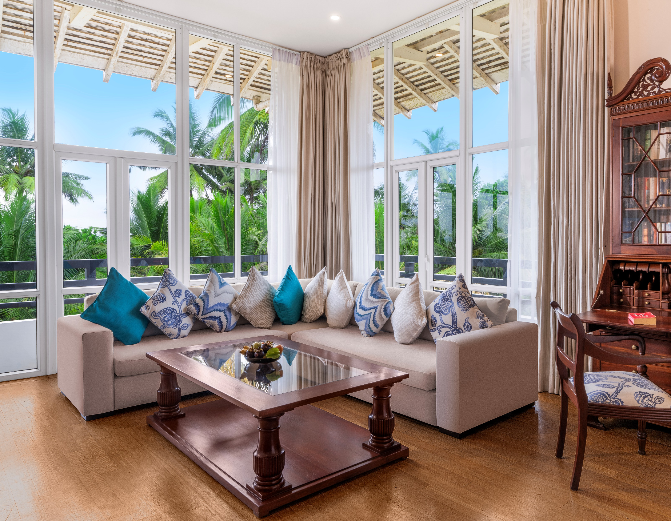
General Room Amenities
Tea/coffee making facility
Mini bar
TV with cable channels
IDD telephones
Air conditioning
In-room safe
Complimentary wi-fi
Rain shower
Hair dryer
Free toiletries
Bathtub
Bathrobe
Bottled water
Private balcony

Slide 12
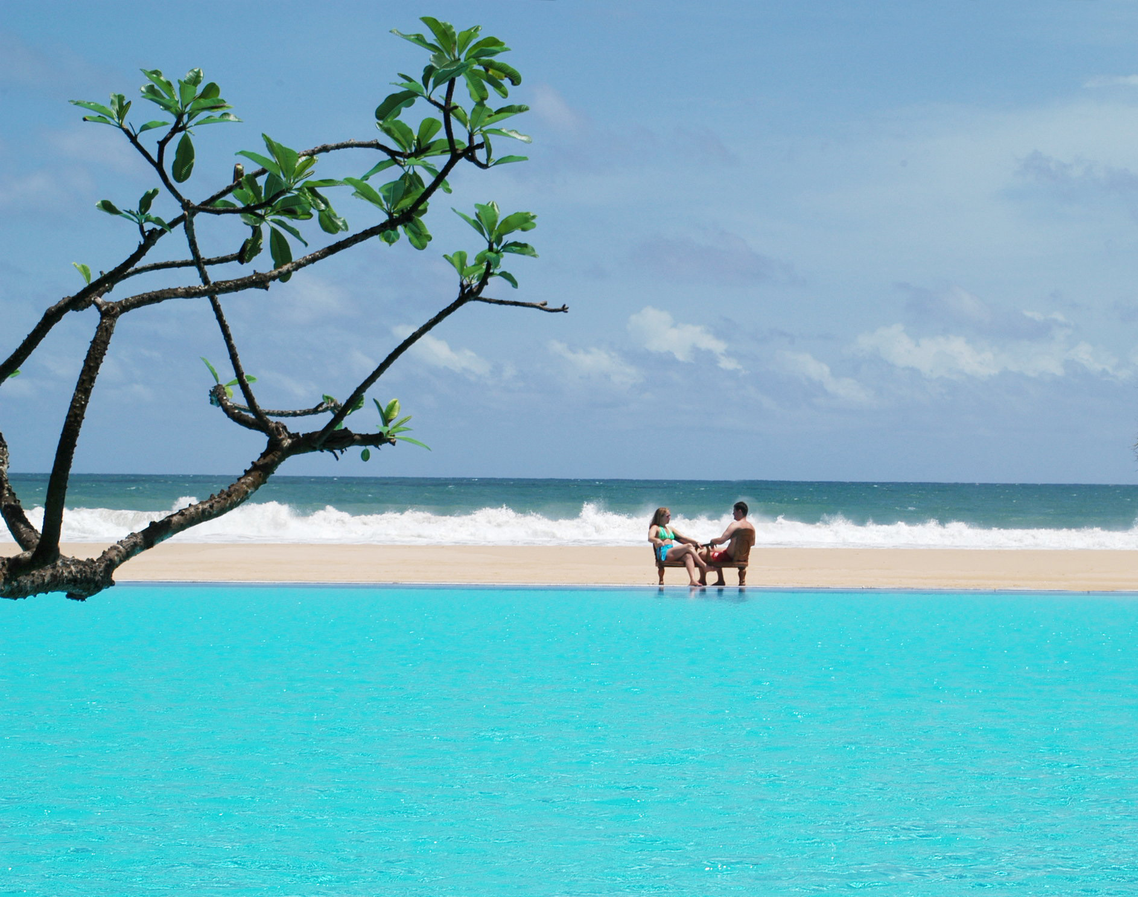
Facilities
Laundry service
24-hour room service
Currency exchange
Complimentary wi-fi
Library
Shopping arcade
Wheelchair and access for differently abled guests
Kids menu and entertainment
Babysitting services and baby chairs
Infinity pool
Green pool
Spa
Tennis court

Slide 13
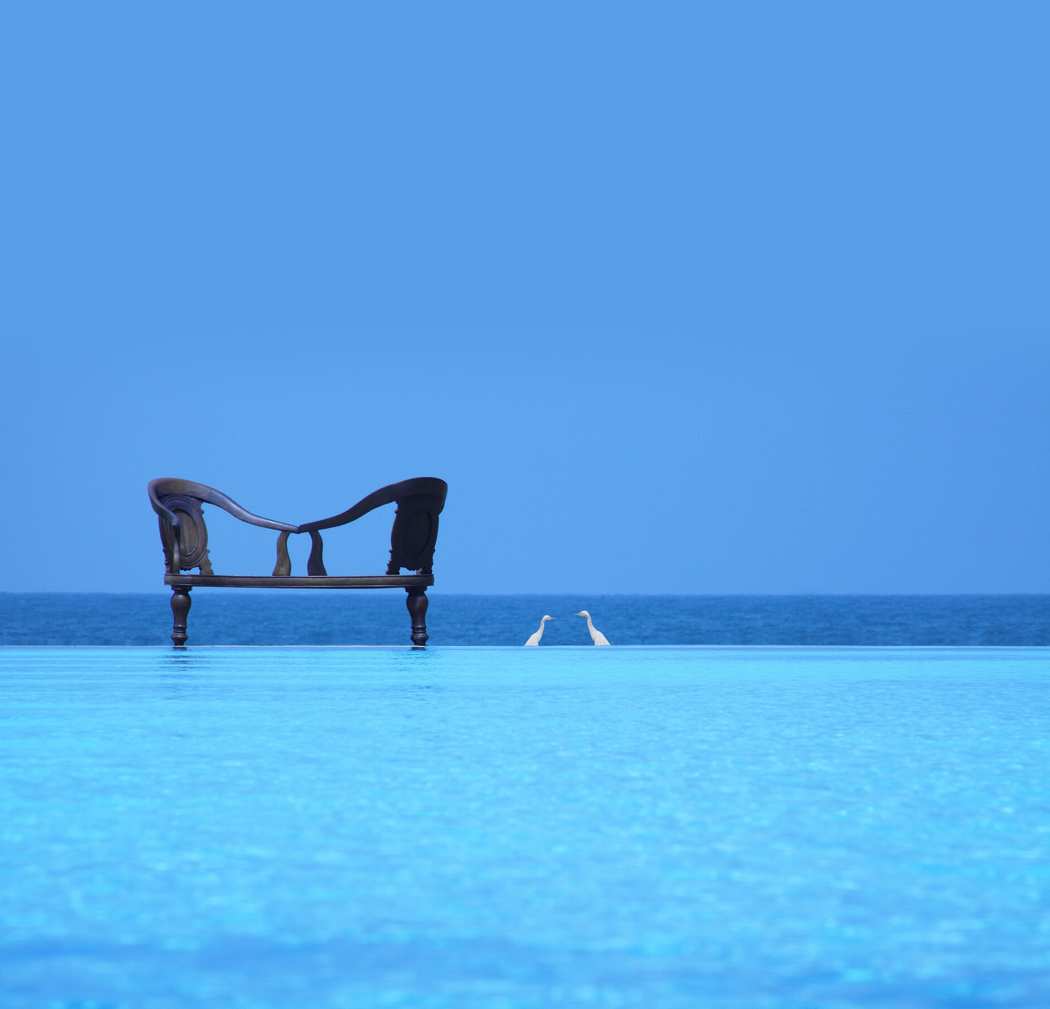
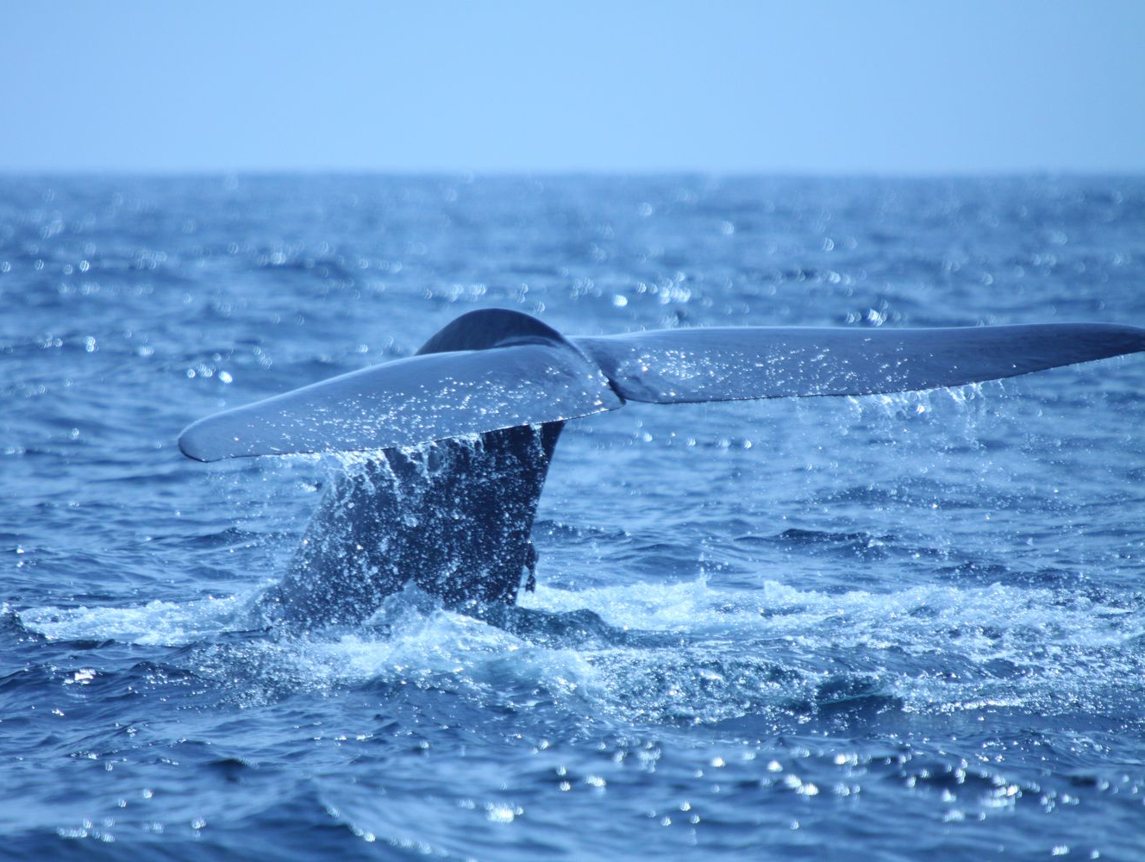
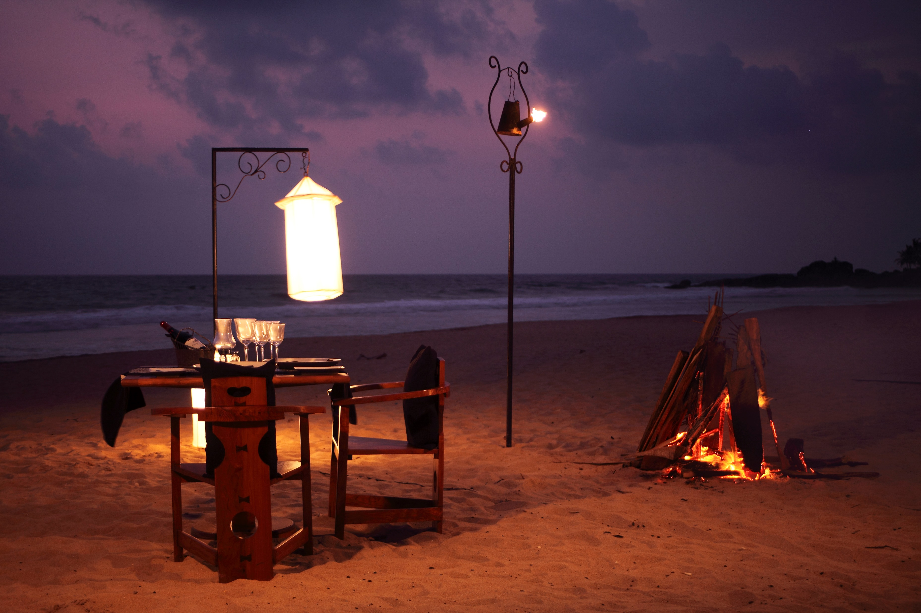
Unique Experiences
Beachside dining
Remarkable architecture
Exciting excursions
Madu ganga river safari
Ambalangoda
Brief garden
Lunuganga
Whale watching
Spa facility

Slide 14
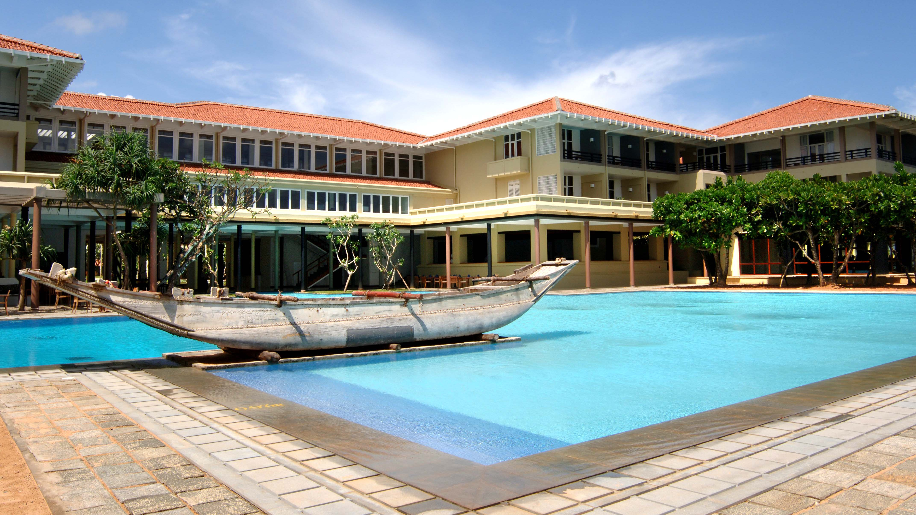

Slide 15
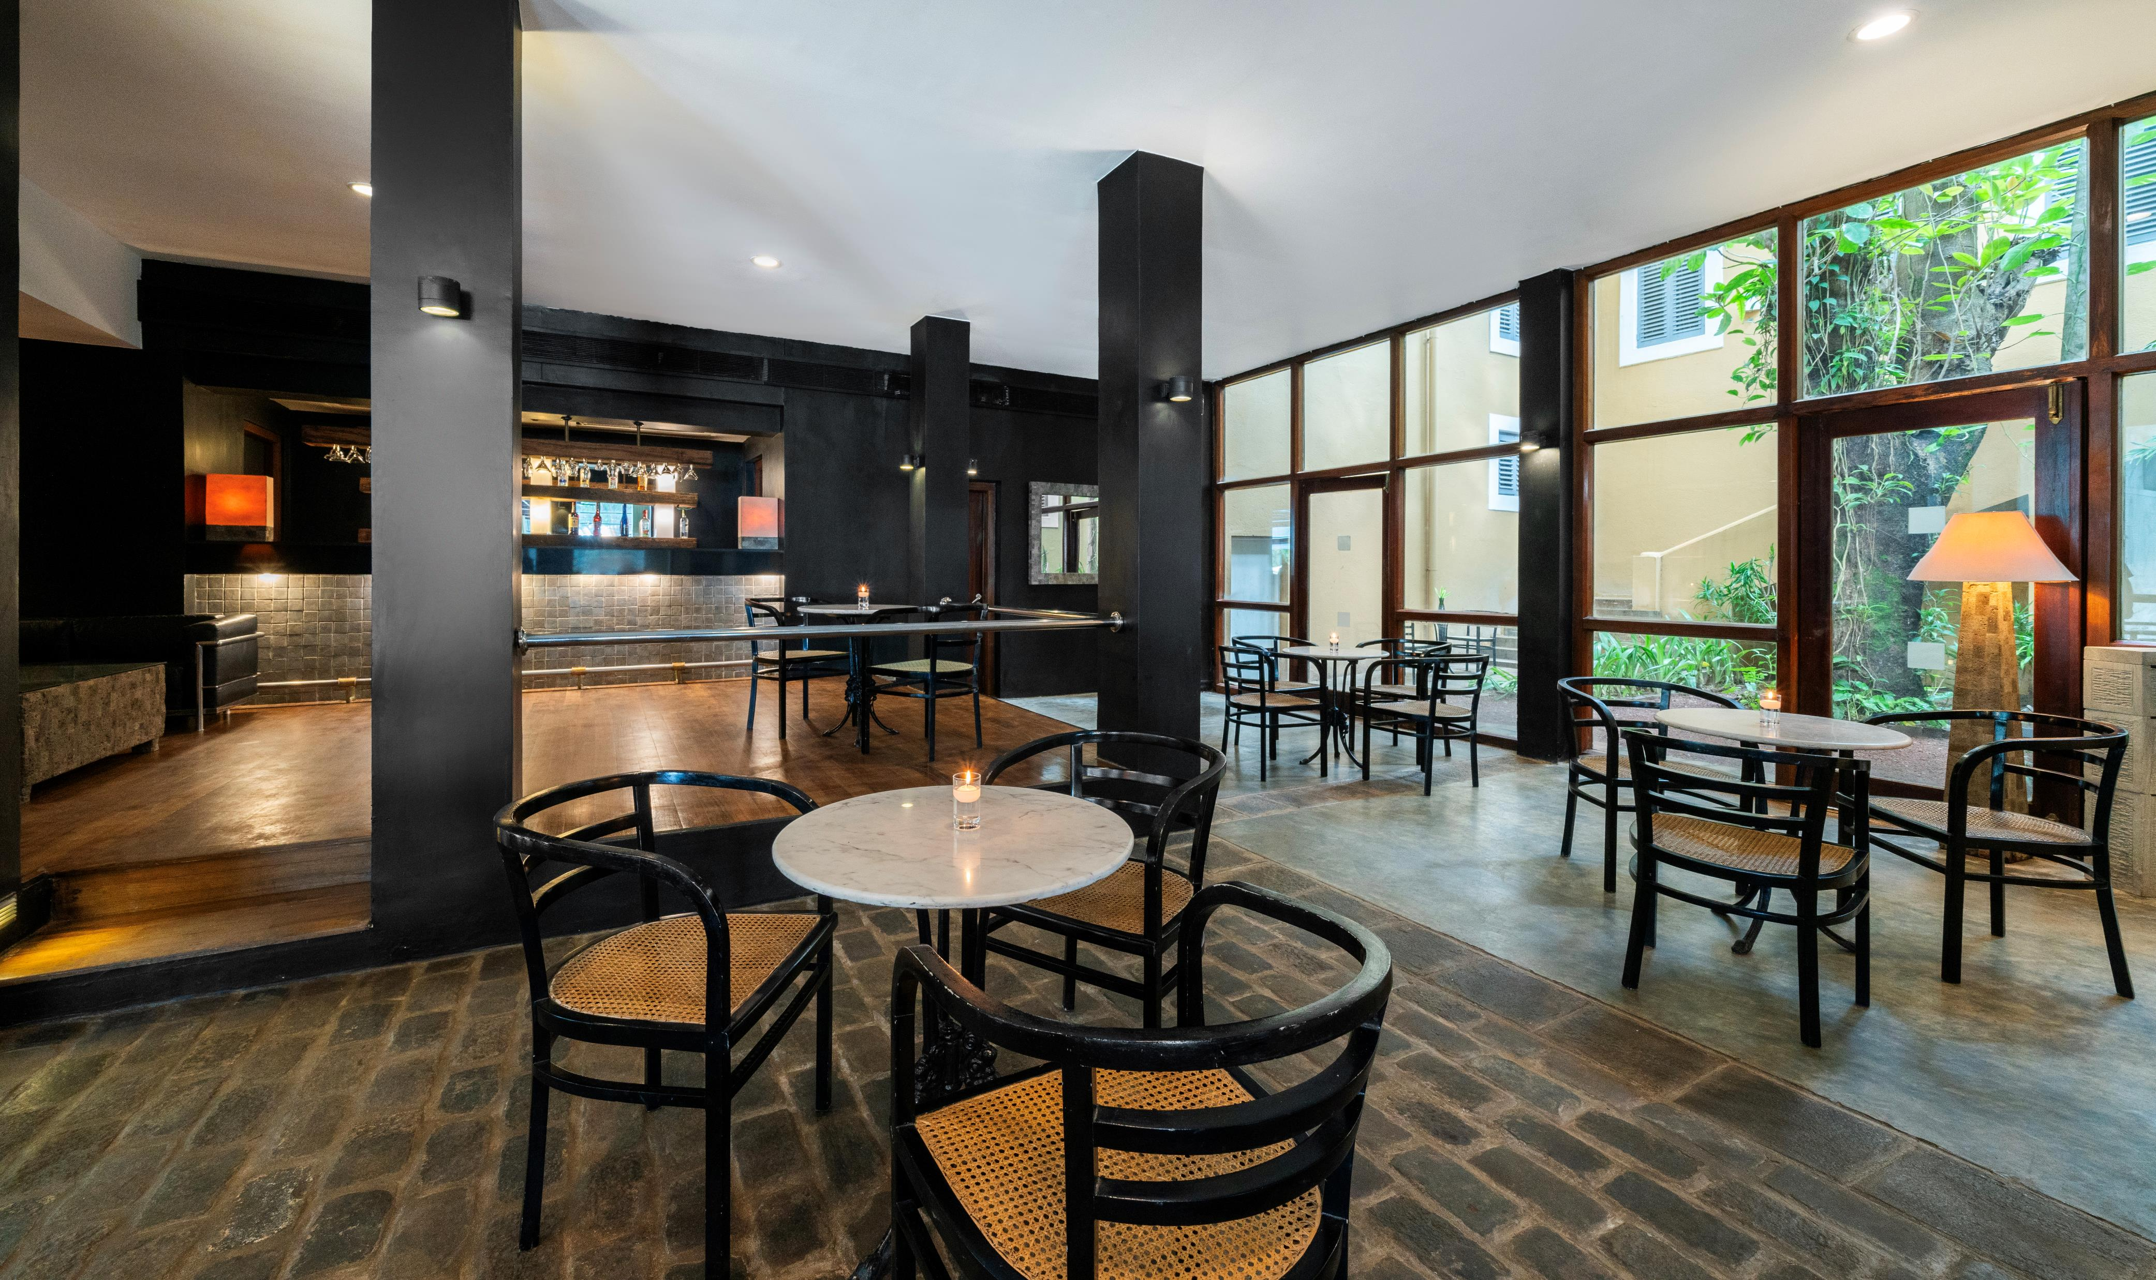

Slide 16
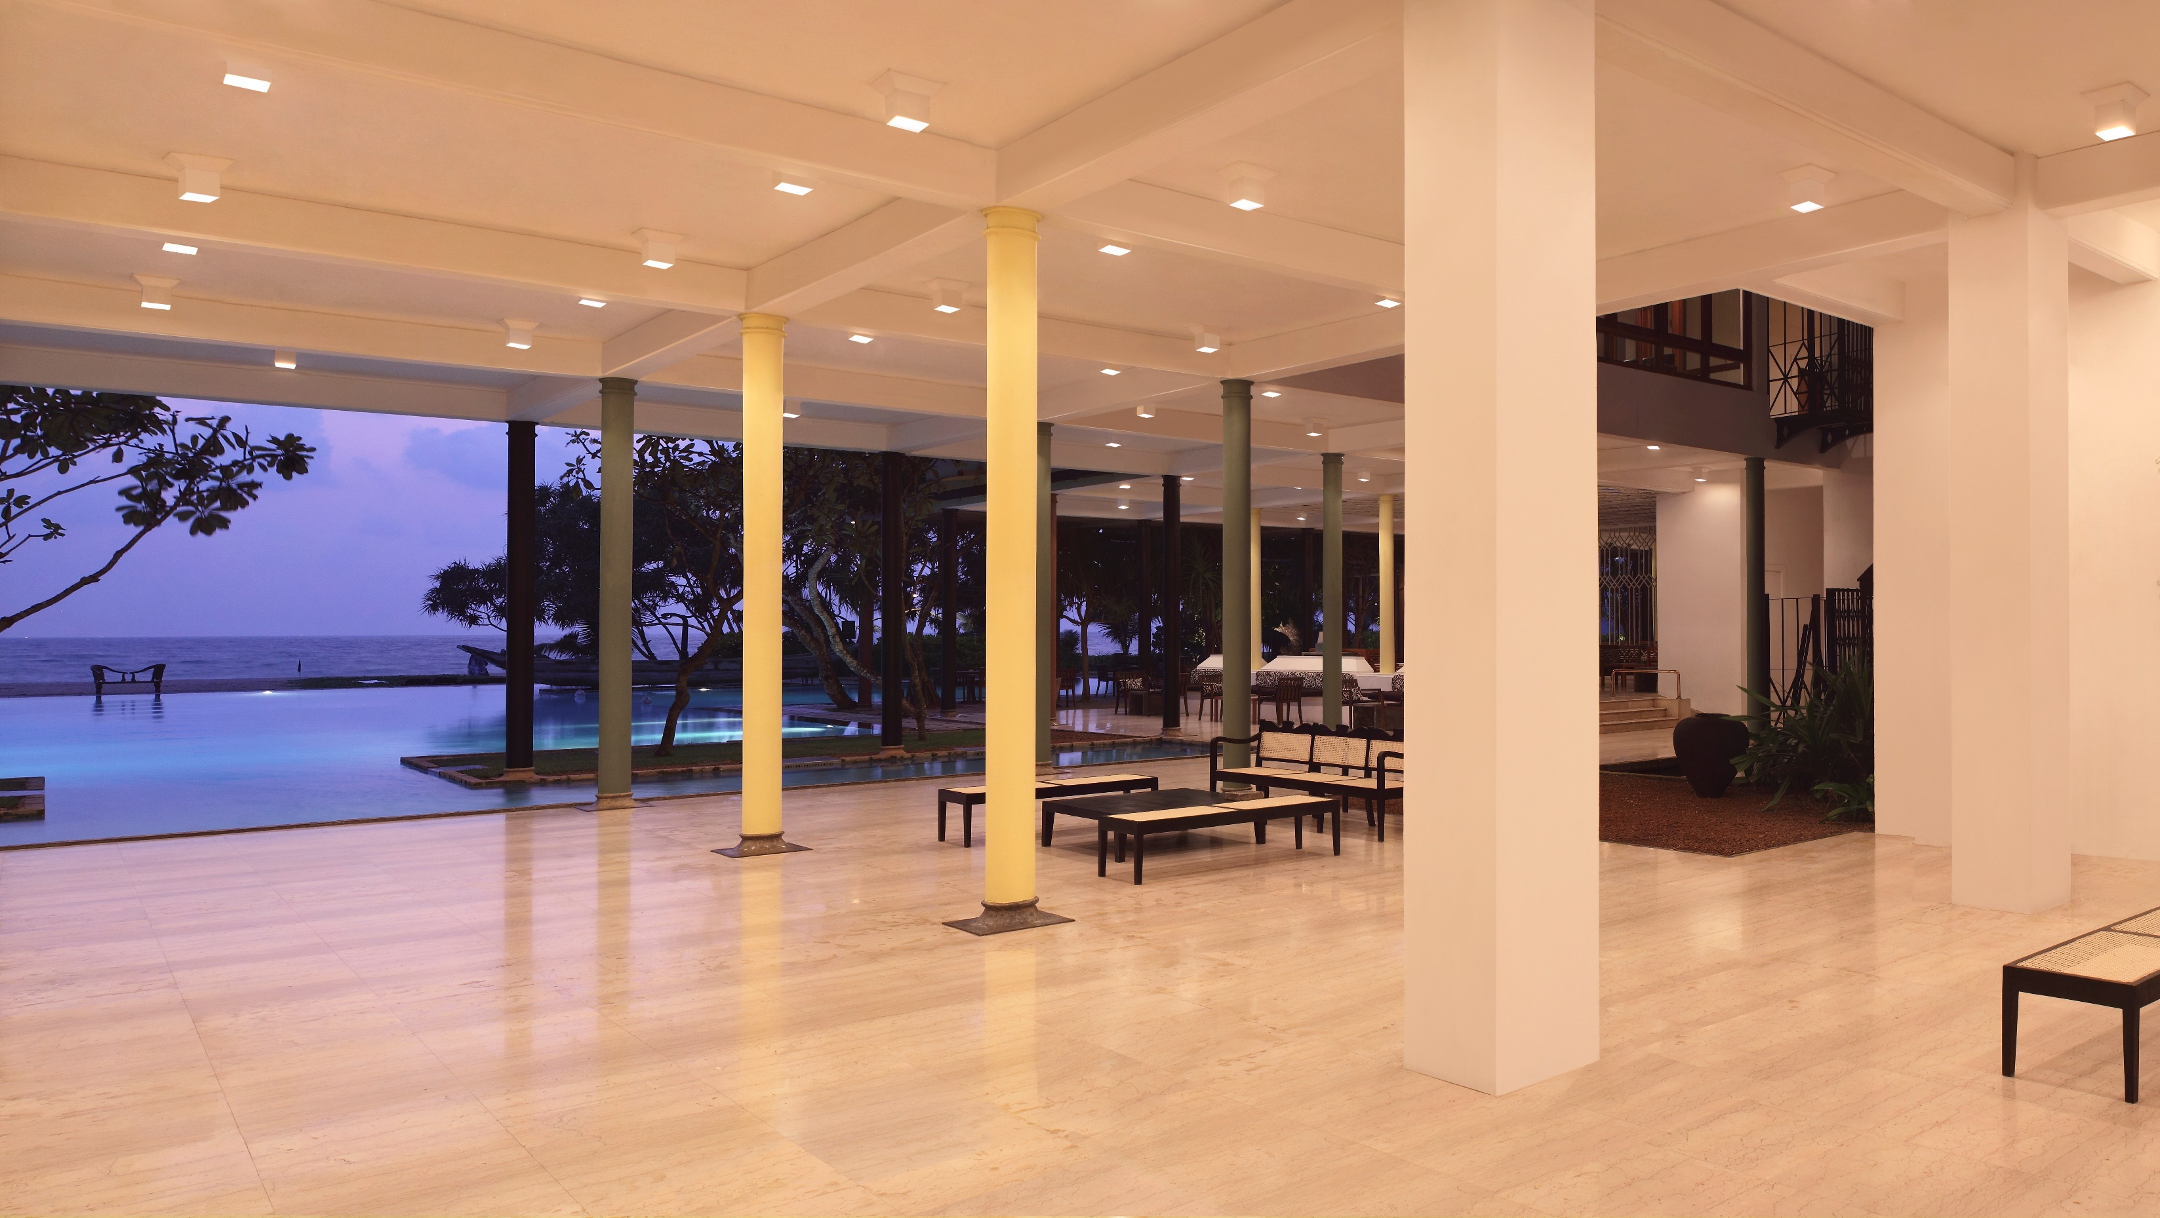

Slide 18
