Slide 1



Slide 2
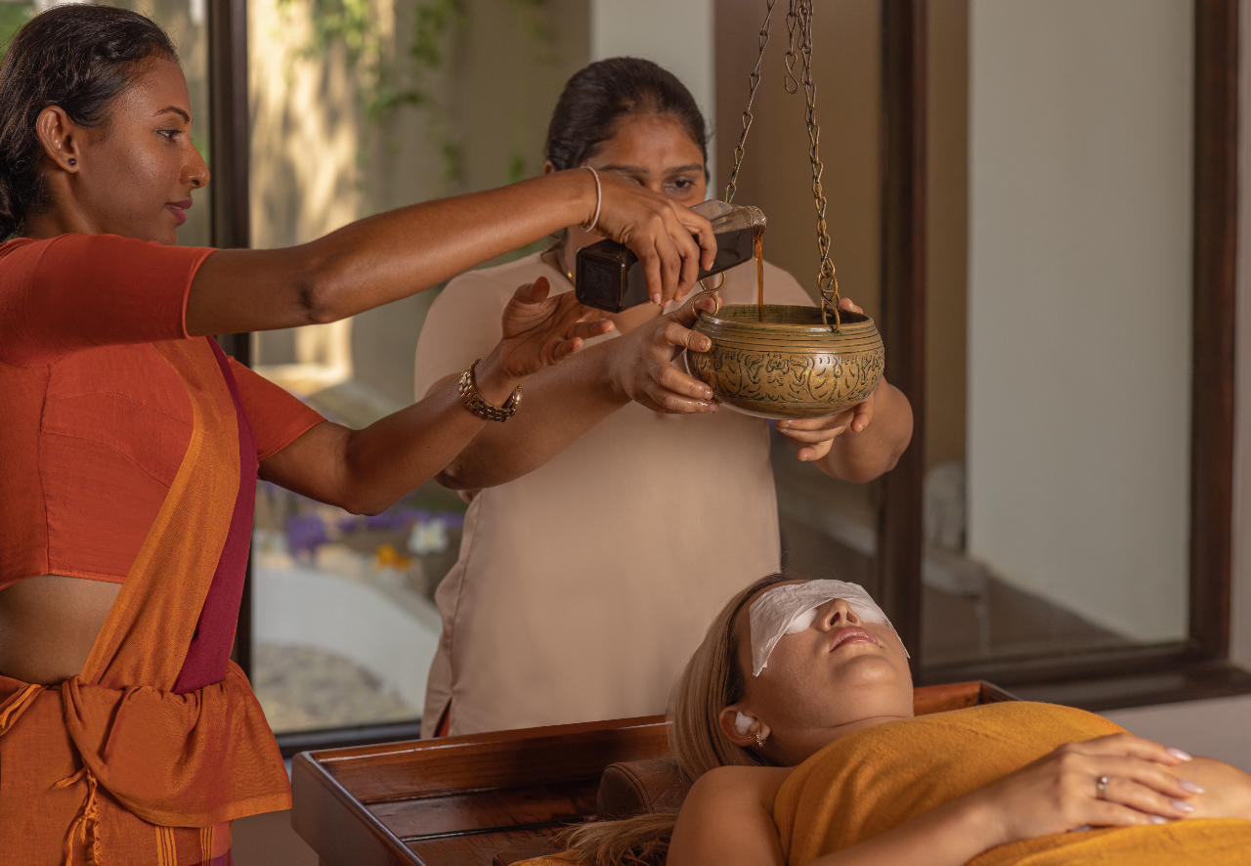
Holistic wellness
Heritance Ayurveda extends the warm Sri Lankan spirit with traditional treatments of ayurveda to promote holistic balance.
Enhance your life with ayurvedic nutrition & celebration of local culture. Located in the southern coastal belt with plenty of sun, sea and sand.

Slide 3
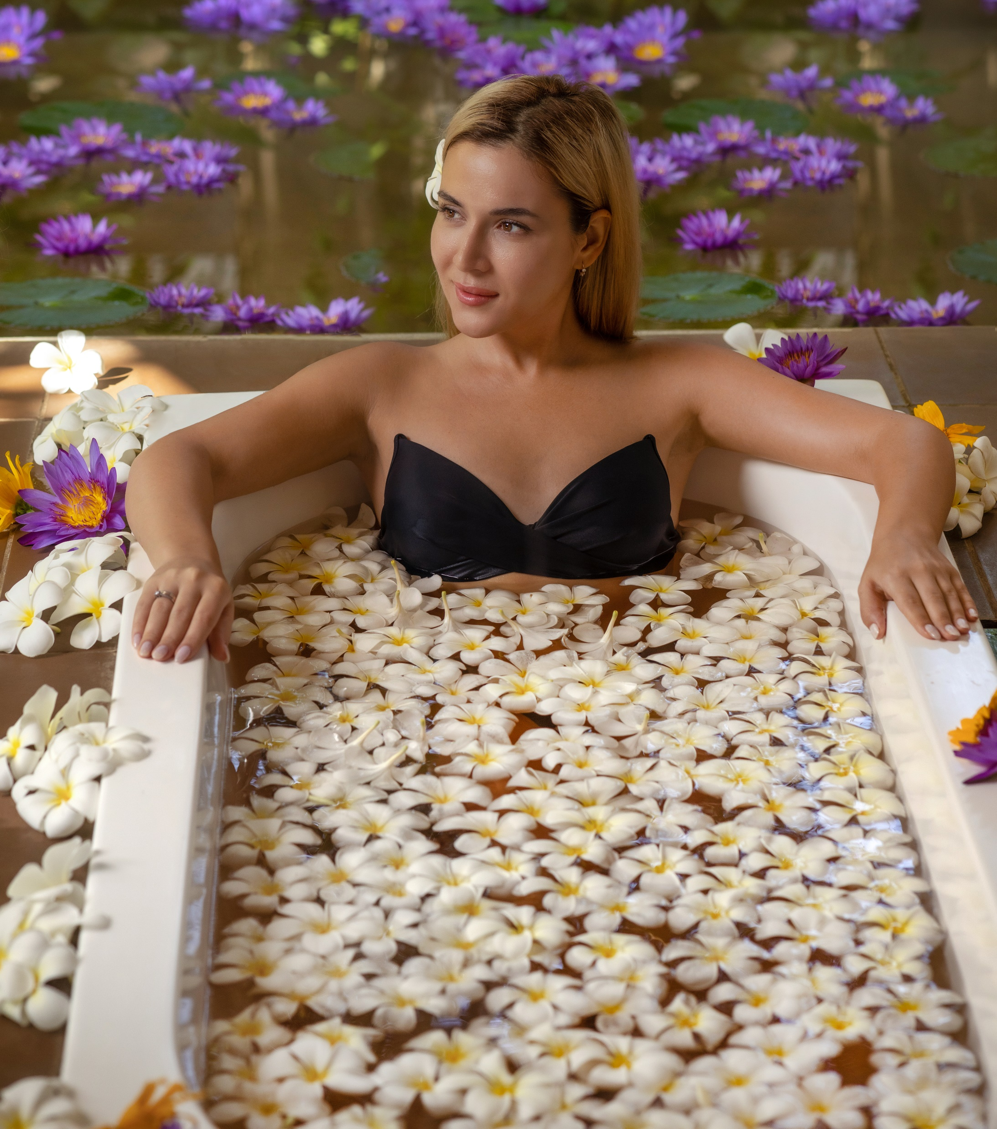
A retreat for the soul
Spanning across six acres of serene, beachfront land, Heritance Ayurveda houses 64 spacious rooms, inclusive of seven suites to present guests with a unique and holistic ayurvedic experience.​
Incorporating a host of amenities to present guests with superior comfort during the destressing holiday; the design of the resort and its accommodation is inspired by the harmonies of nature, with large open spaces and panoramic views of the lush garden and the majestic ocean beyond.​

Slide 4
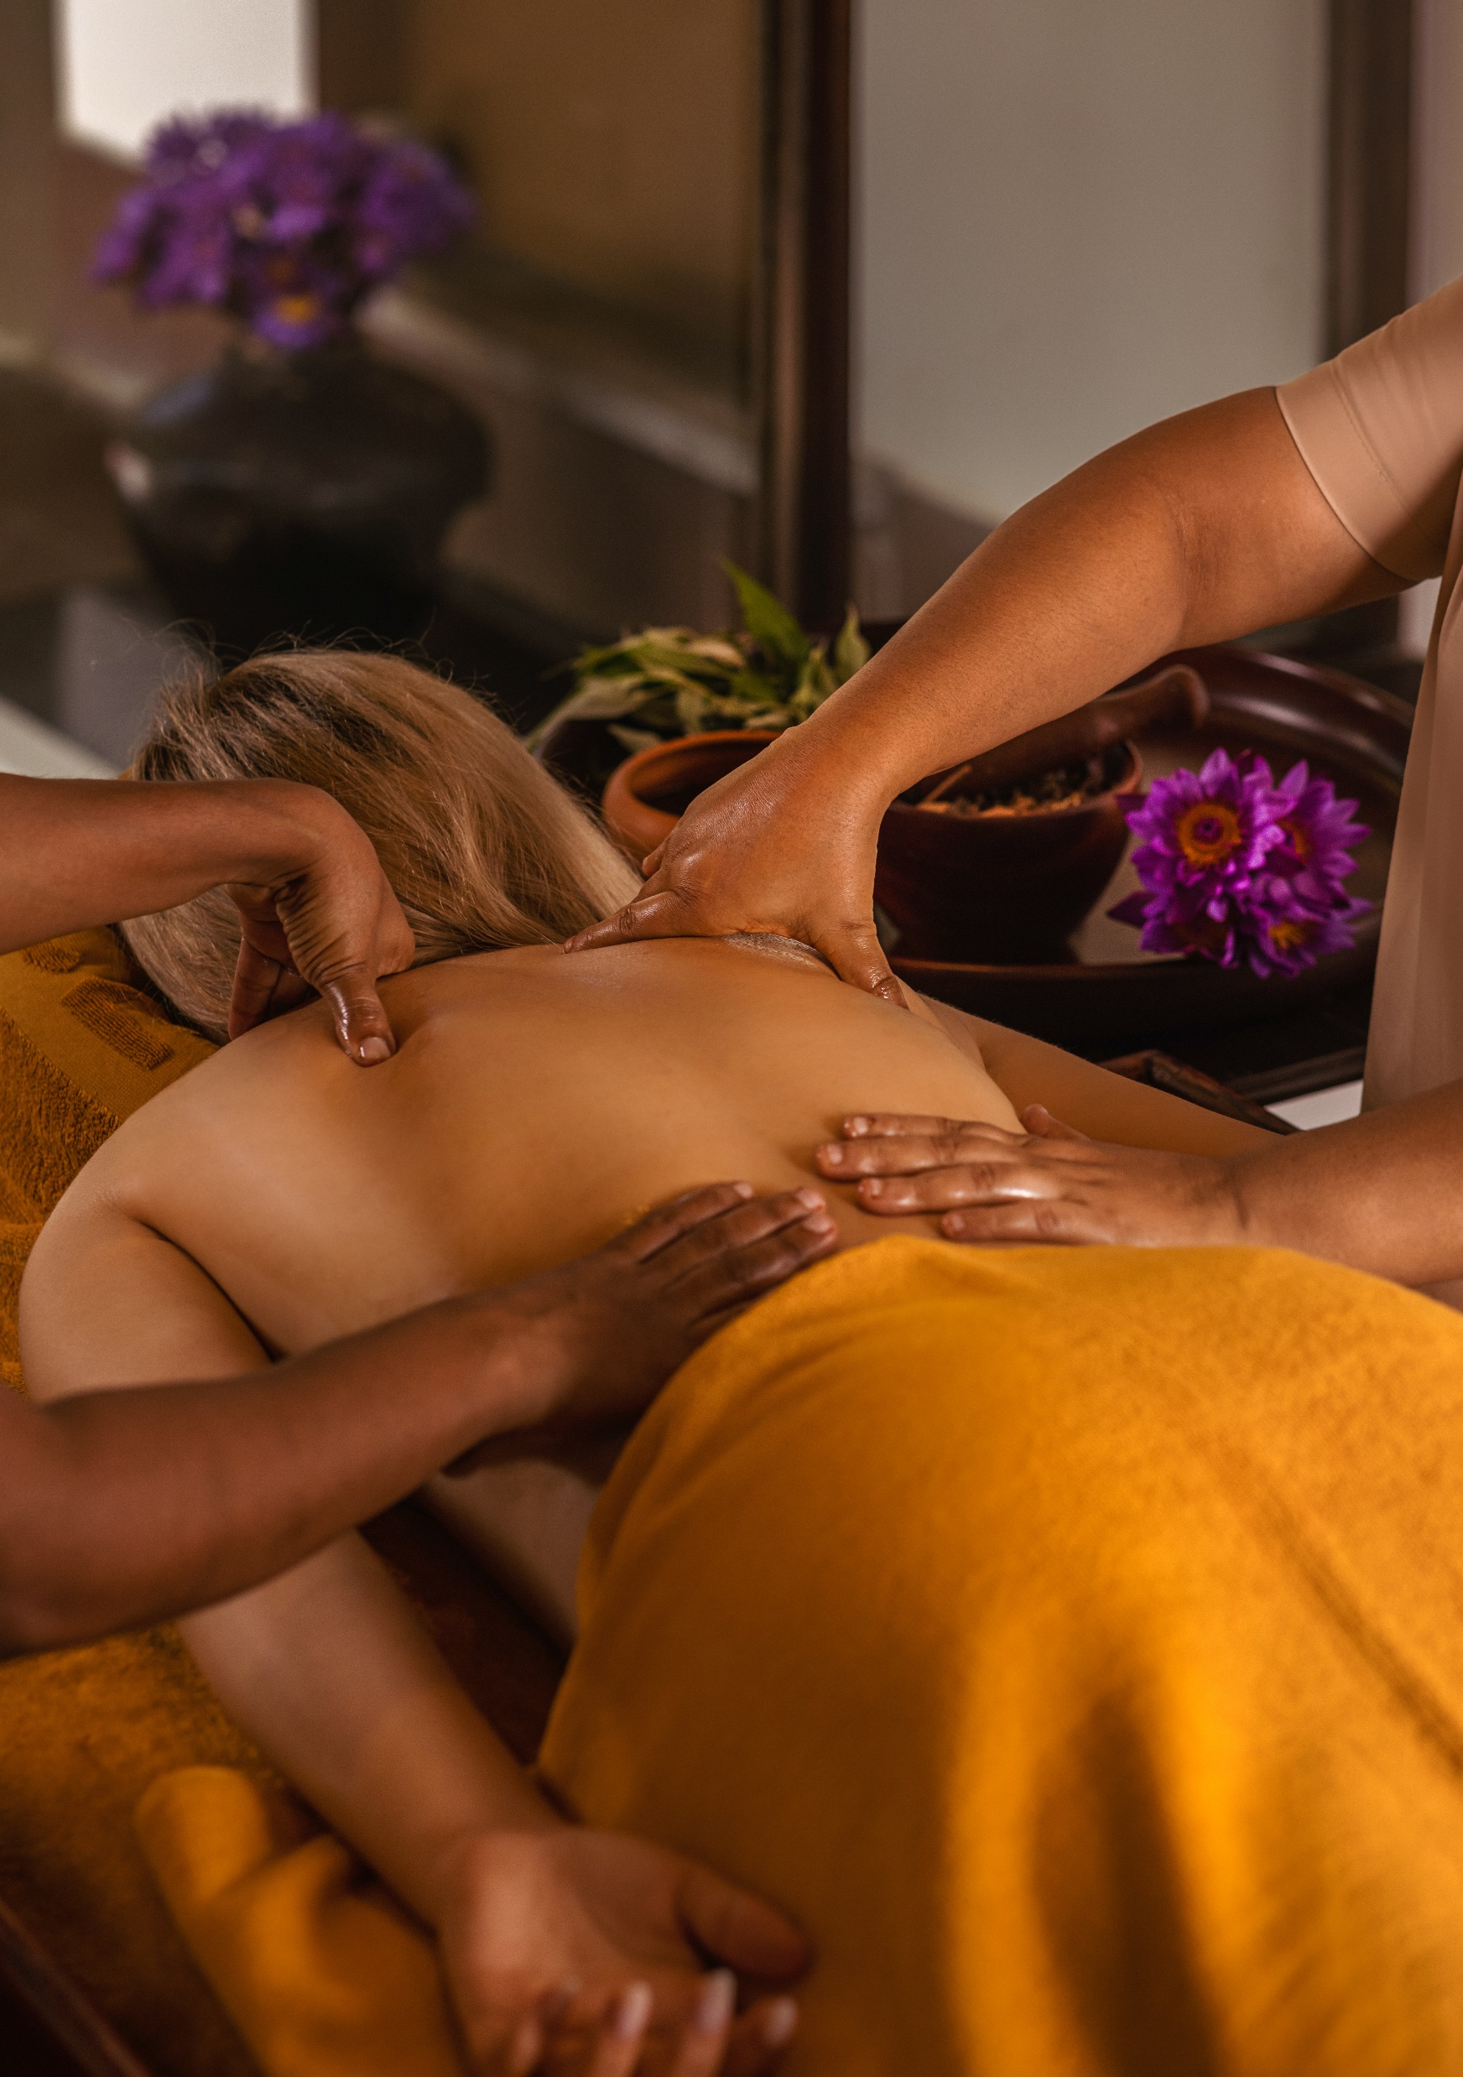
The process
The rudimentary principles of ayurvedic treatment lies on watha (air), pitha (enzymes and hormones), and kapa (phlegm).
It is the intimate balance of these three elements that bring about the wellbeing of a patient.
Consultation with the chief ayurvedic doctor who examines the bodily conditions through your pulse
Treatments are determined by diagnosing the symptoms to treat the root cause, rather than temporarily getting rid of the symptoms
Treatments are aligned to balance mind (bhavana), body (treatment) and soul (yoga), rejuvenating the being and strengthening the core.

Slide 5
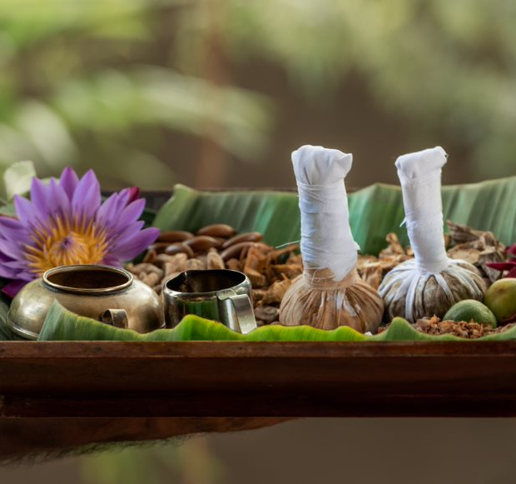
Ancient Treatments
A holistic approach is followed with four to six daily treatments assigned for each person. Prior to treatment a nutritious dietary plan is drawn up and followed.
Our herbal and oil-based treatments are constructed following ancient practices and recipes, with high quality ingredients.
Treatment conducted in three phases with close communication with the guest to ensure that the practices could be followed even after the programme.
Minimum program period limited to seven-day packages

Slide 6
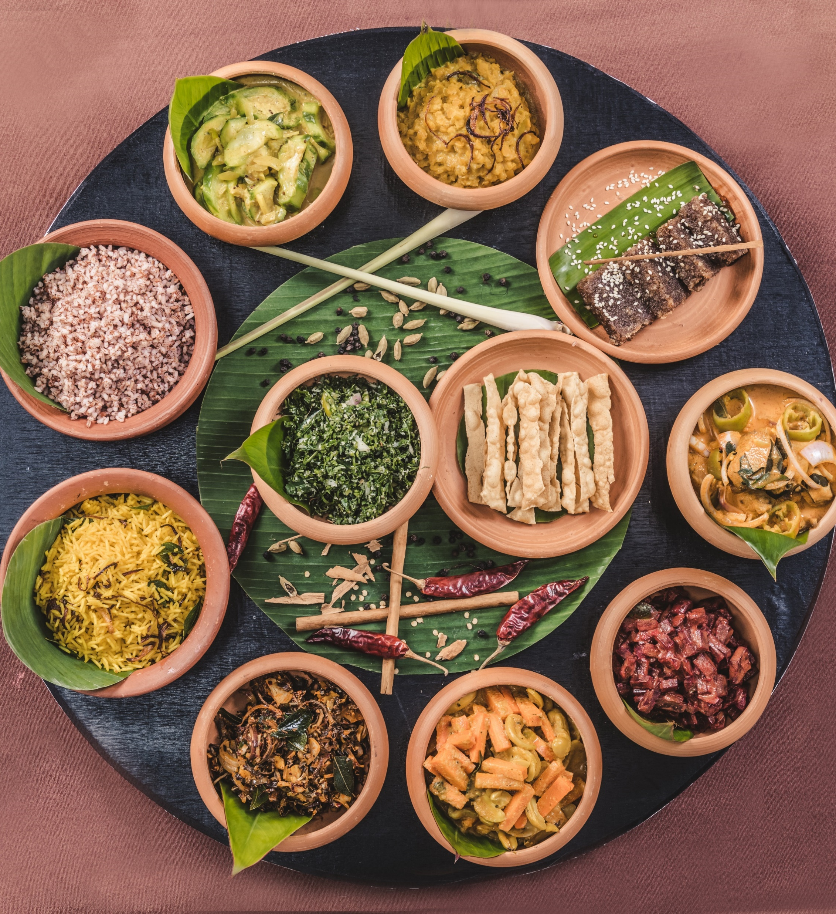
Ayurvedic Nutrition
Each meal is carefully drawn up and prepared by our team of expert chefs, in consultation with our ayurvedic doctors and in-house nutritionist.
Food prepared are marked for the three body types – watha, pitha, kapha – with clear instructions on what guests can eat, what should be enjoyed in moderation and what they should avoid. This is done with a star guidelines prepared by the resort and conveyed to guests.
No acidic food such as tomatoes as a vegetable, or pineapple will be found on the menu; along with items such as cheese, butter, red meats, etc
No liquor or smoking allowed during the duration of this herbal detoxification period.

Slide 7
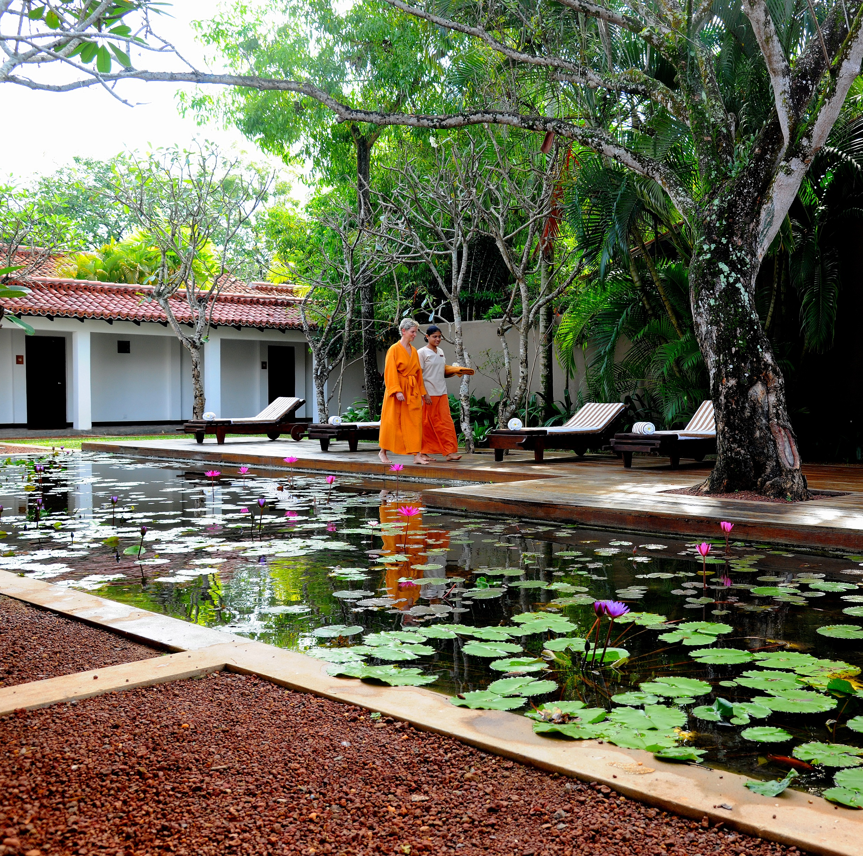
Holistic treatment packages
Slimming program​
Includes special treatments such as herbal massage, ayurvedic diet program, acupuncture and slimming tea​. (Minimum two-week stay​)
Stress-relief program​
Includes varied treatments with main therapy being Shirodhara​. (Minimum two-week stay​)
Rejuvenation program​
Detoxification and regeneration program using herbal medicines to increase body energy and immunity. (One week upwards​)

Slide 8
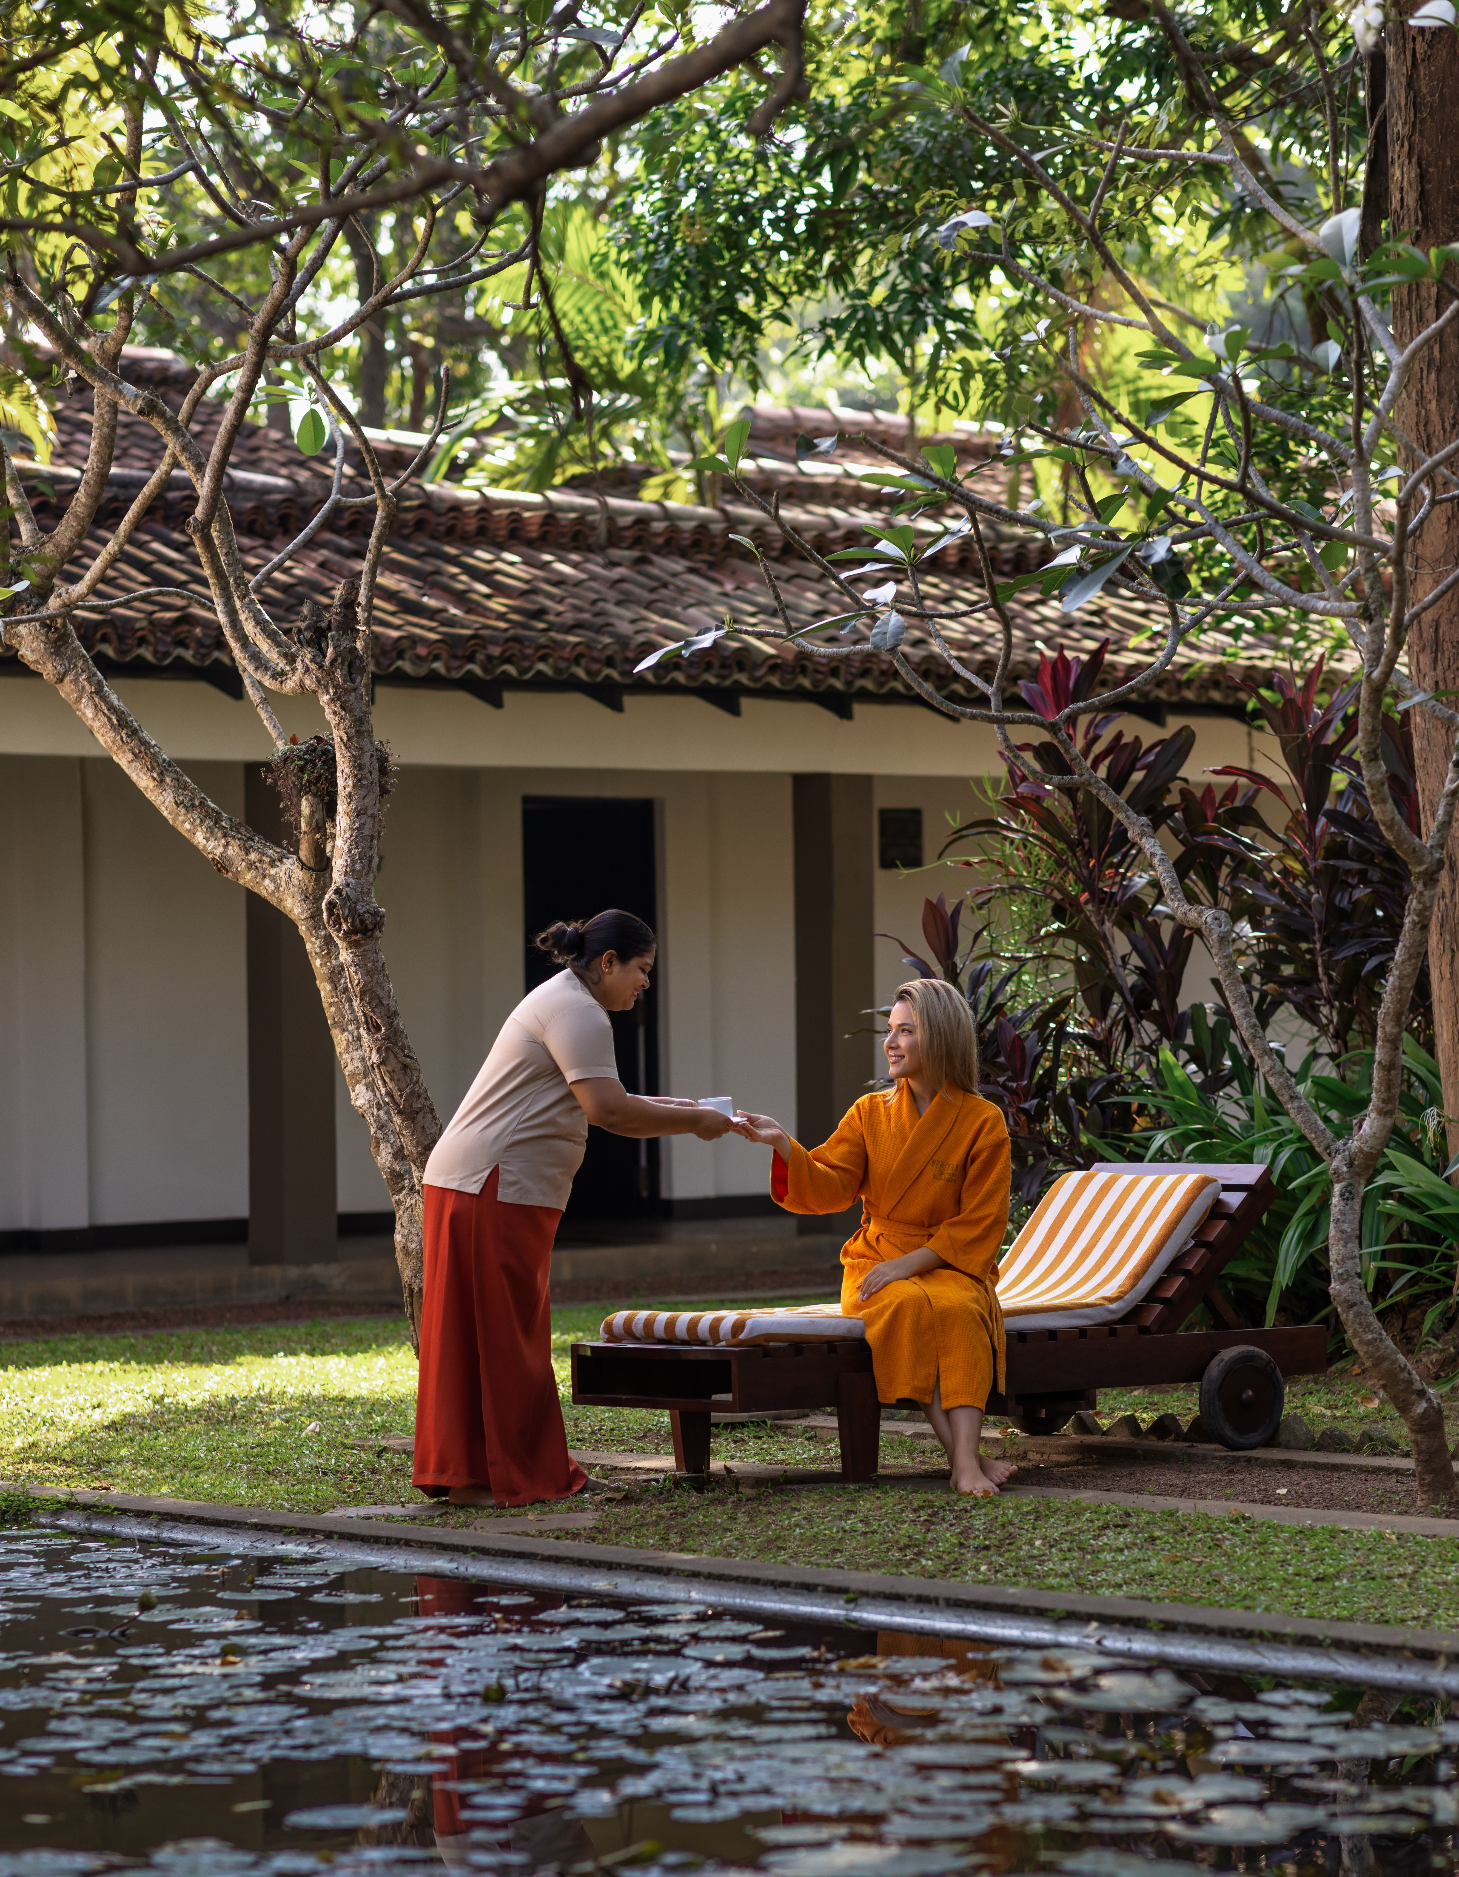

Slide 9
Facilities________
28 treatment rooms​
Five consultation rooms​
Separate space for yoga​
Space for meditation ​
Pool​
Arts and Crafts Centre

Slide 10
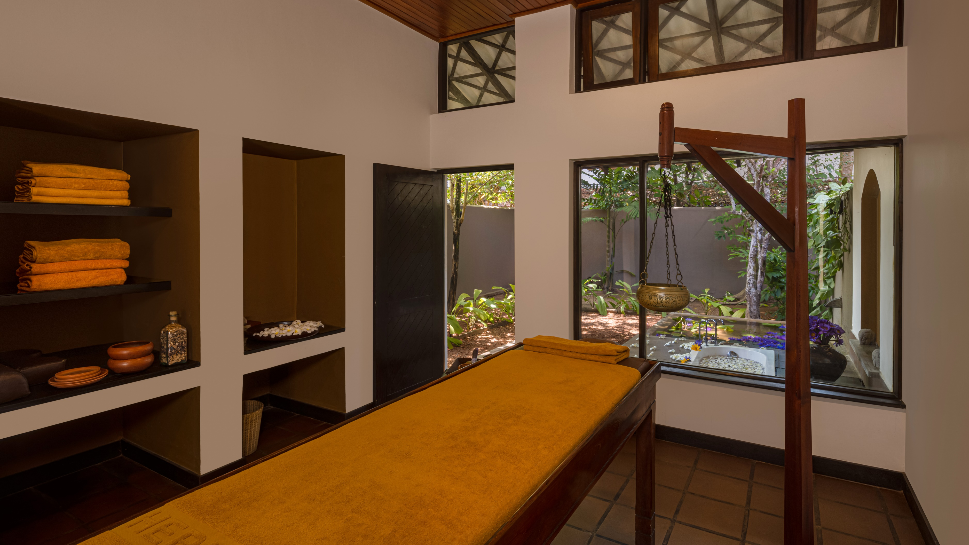

Slide 11


Slide 12


Slide 13
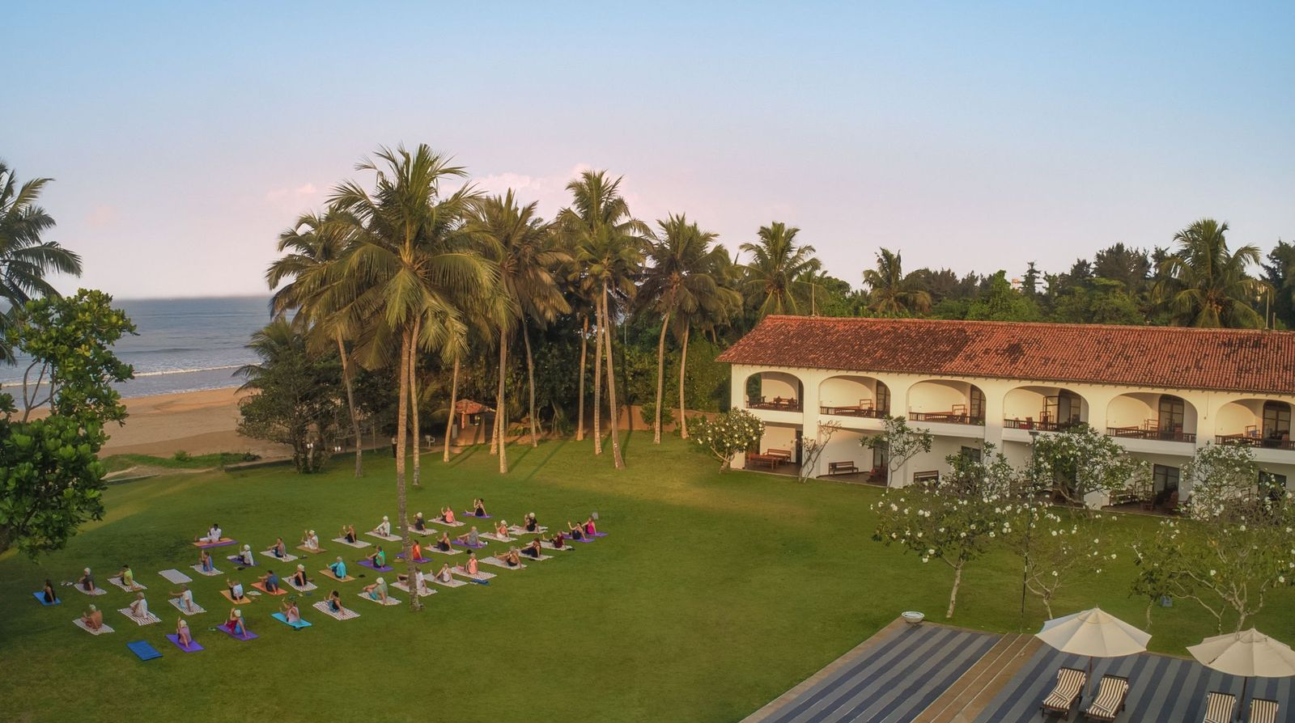

Slide 14
ACCOMMODATION
Category King Single Twin
Classic - 10 06
Deluxe 11 - 25
Corner Suite 05 - -
Suite 06 - 01

Slide 15
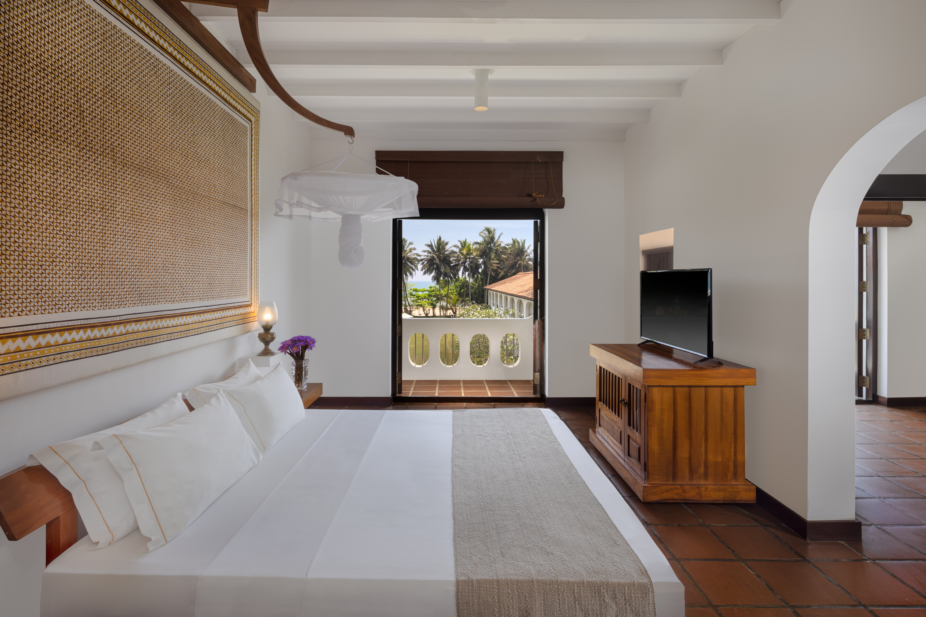
Suite
Serene & Peaceful...

Slide 16
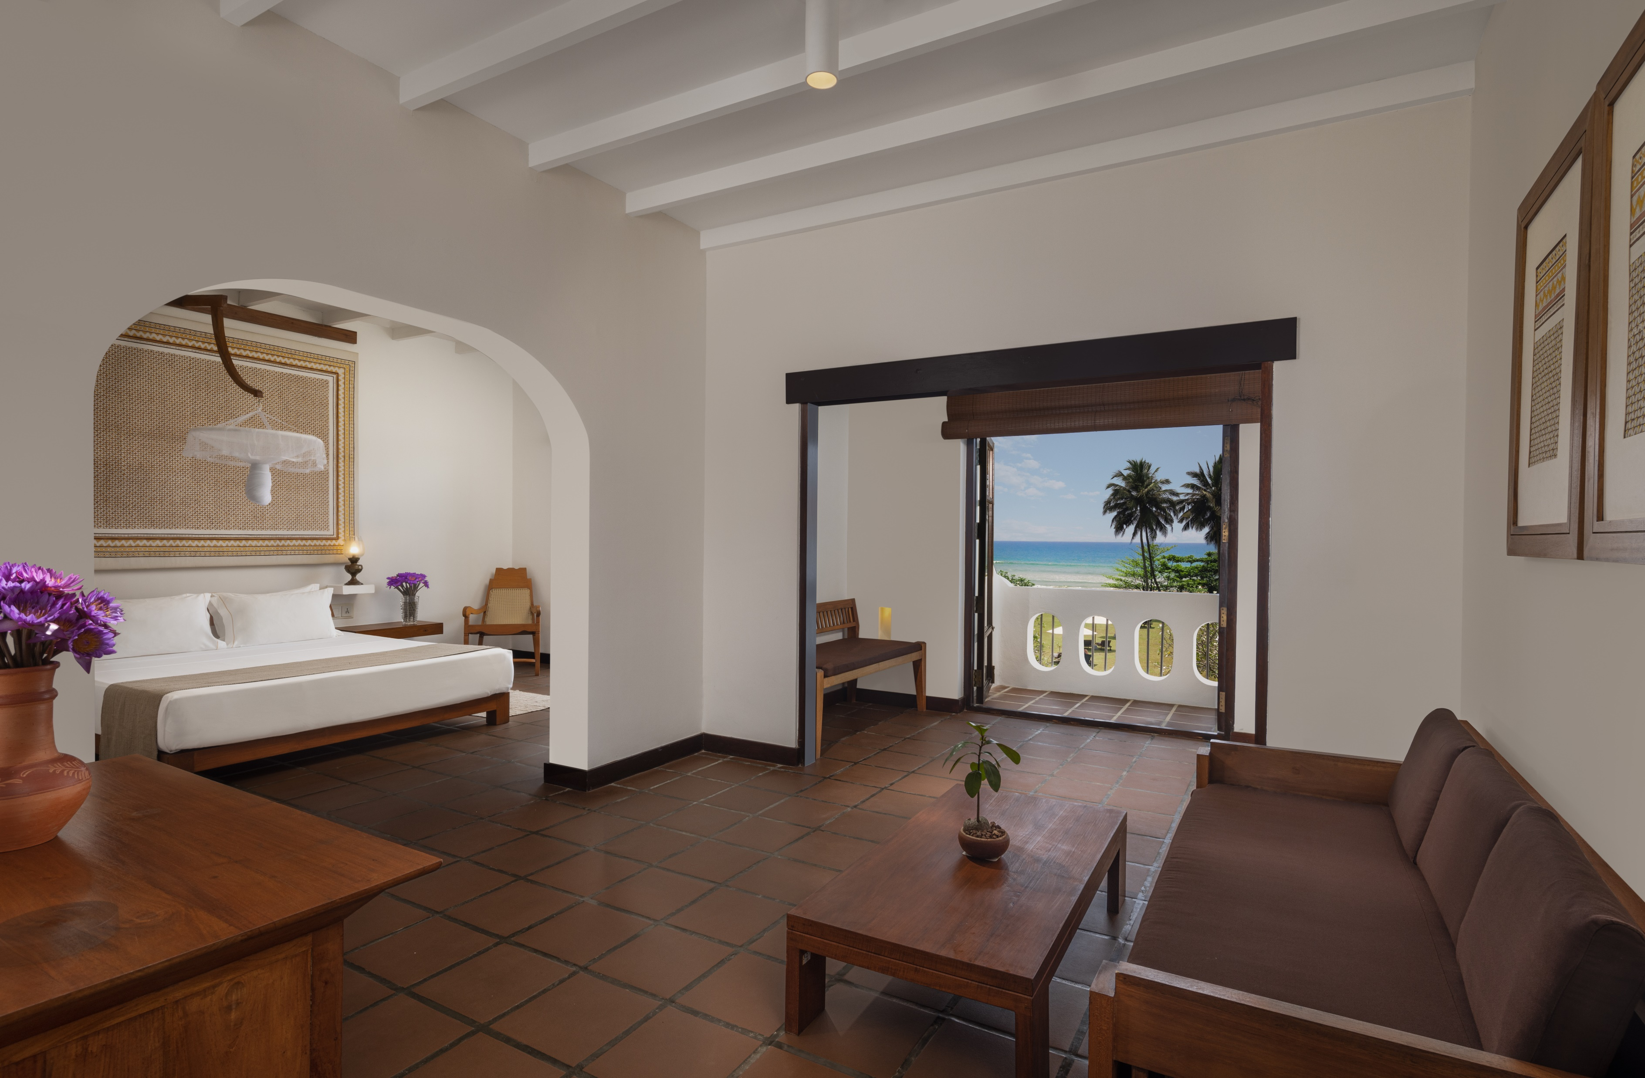

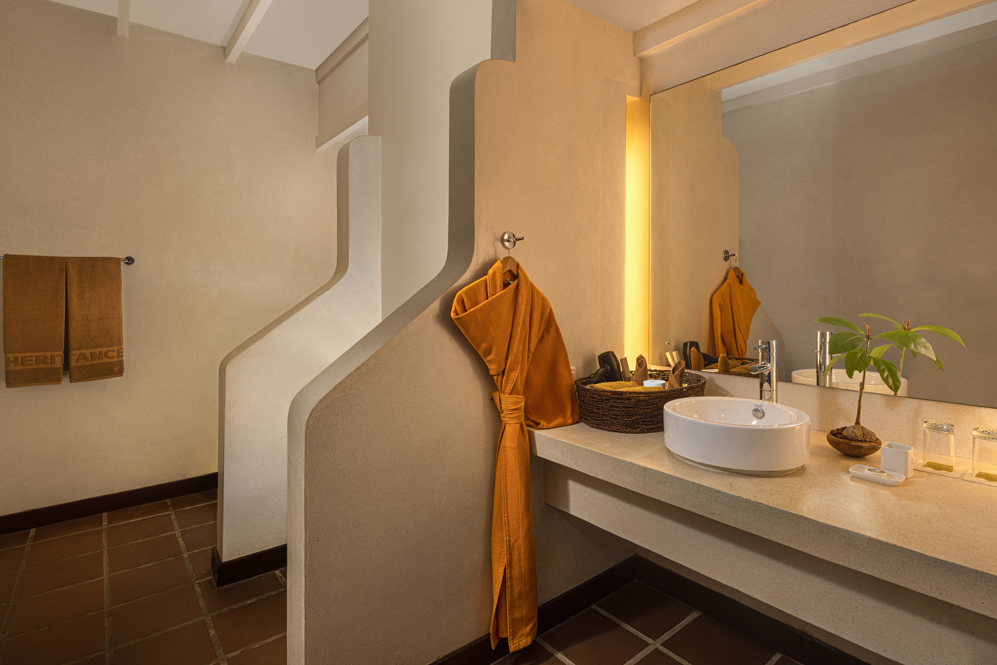

Slide 17
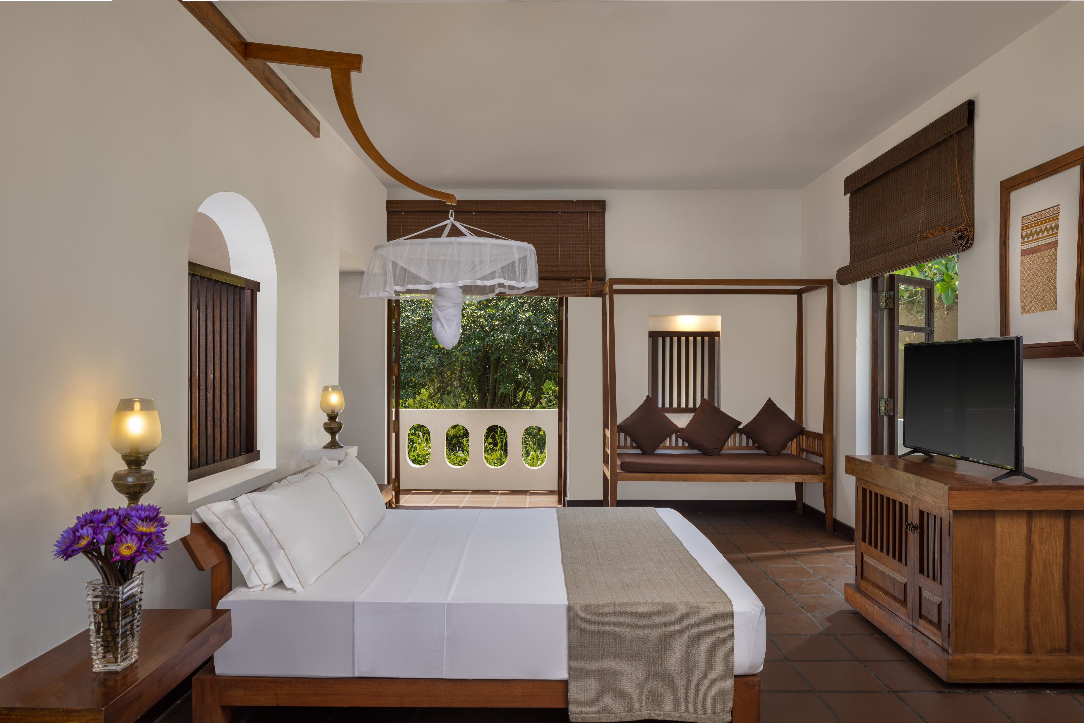
Corner Suite
Meditative and Silent…

Slide 18

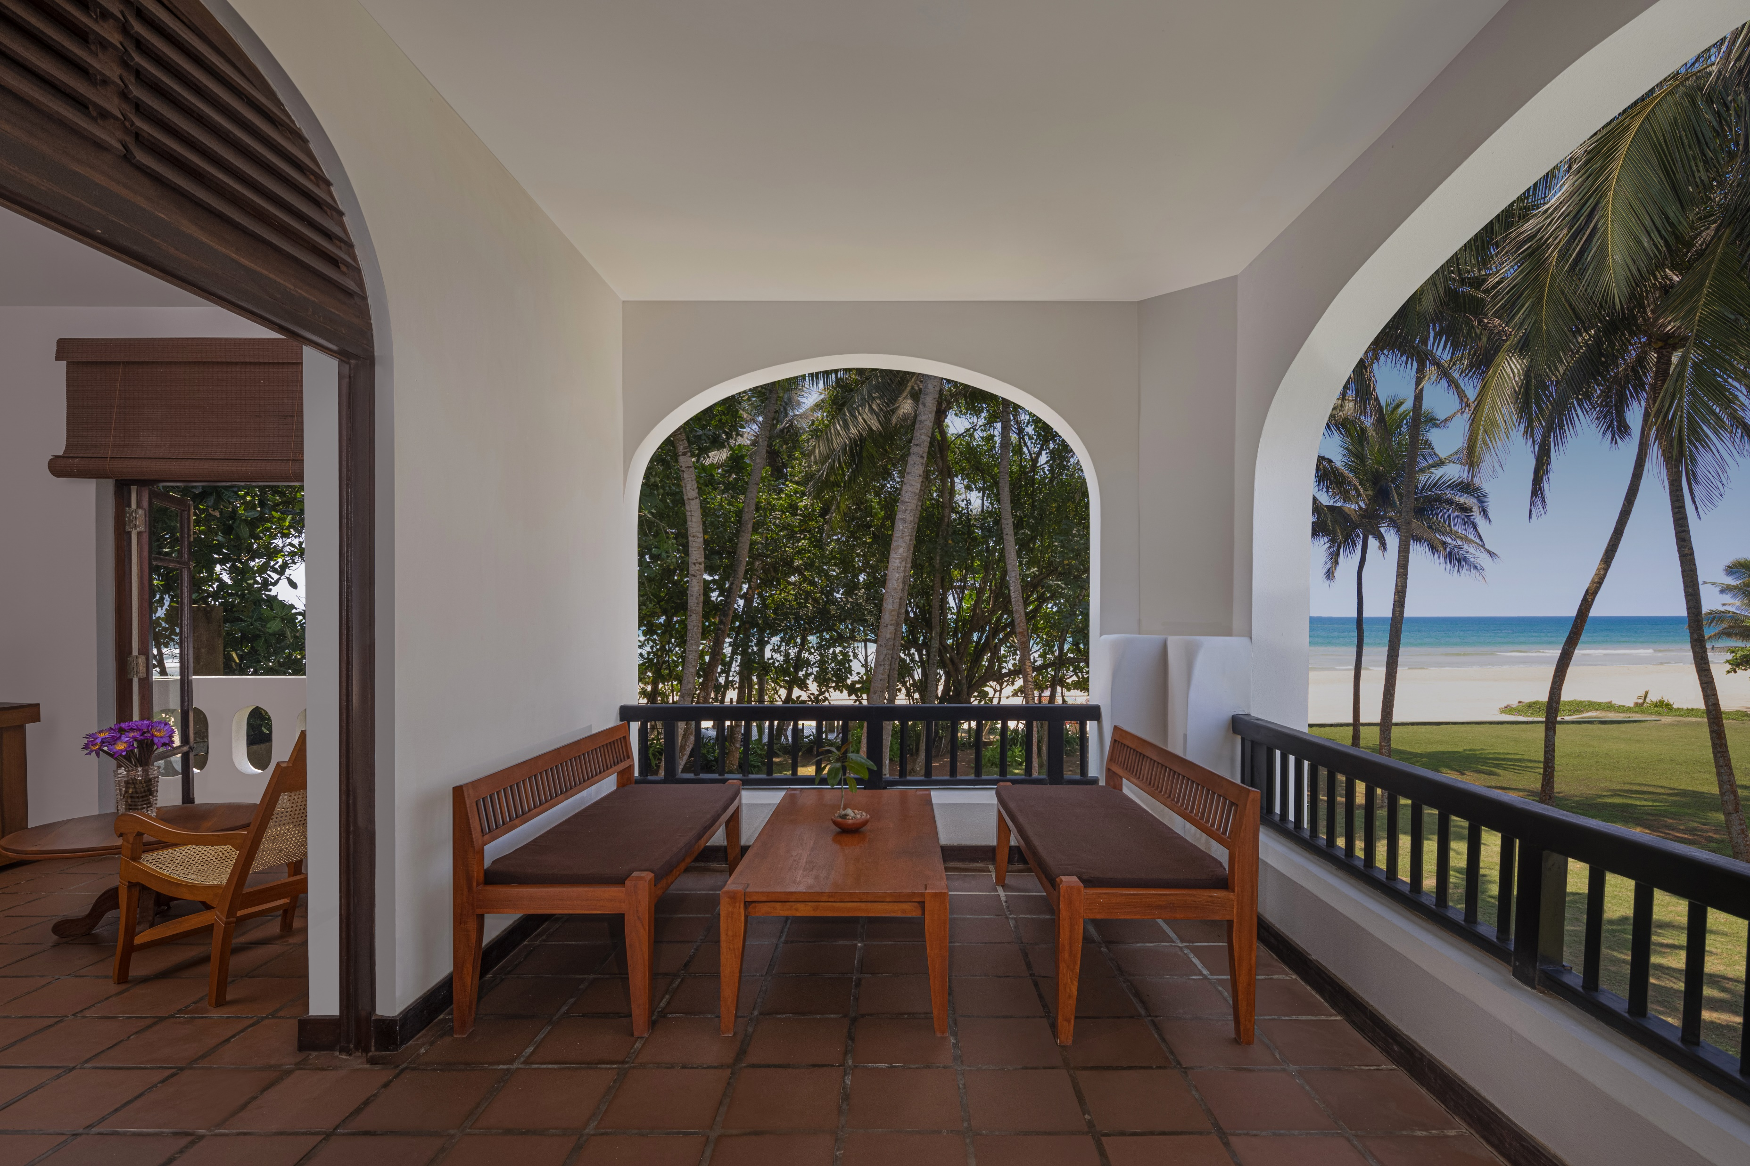
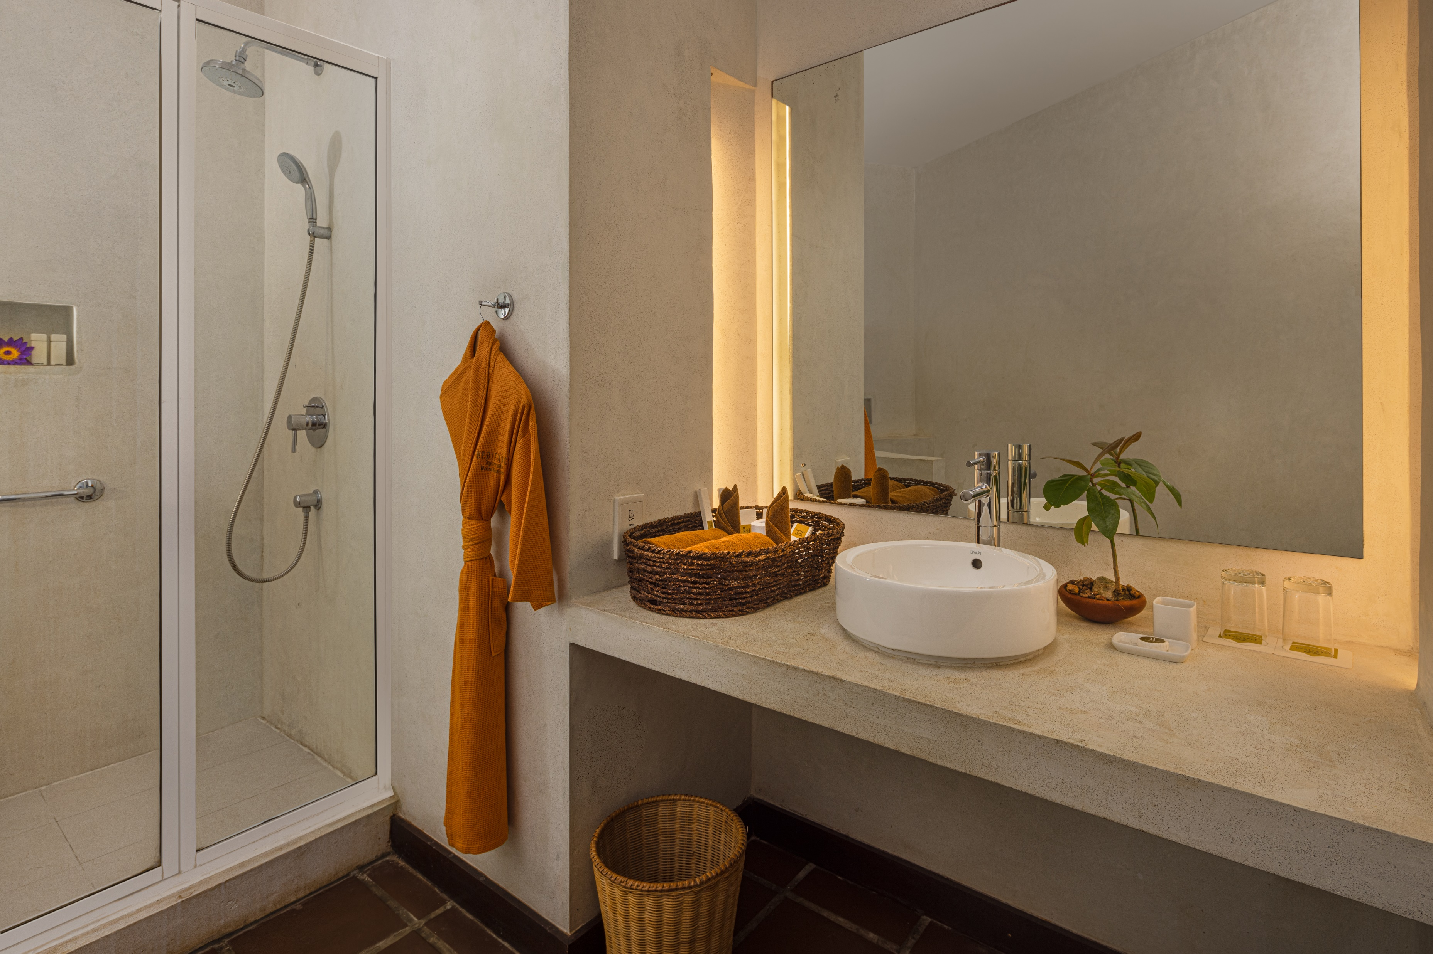

Slide 19

Deluxe
Calm & Tranquil...

Slide 21
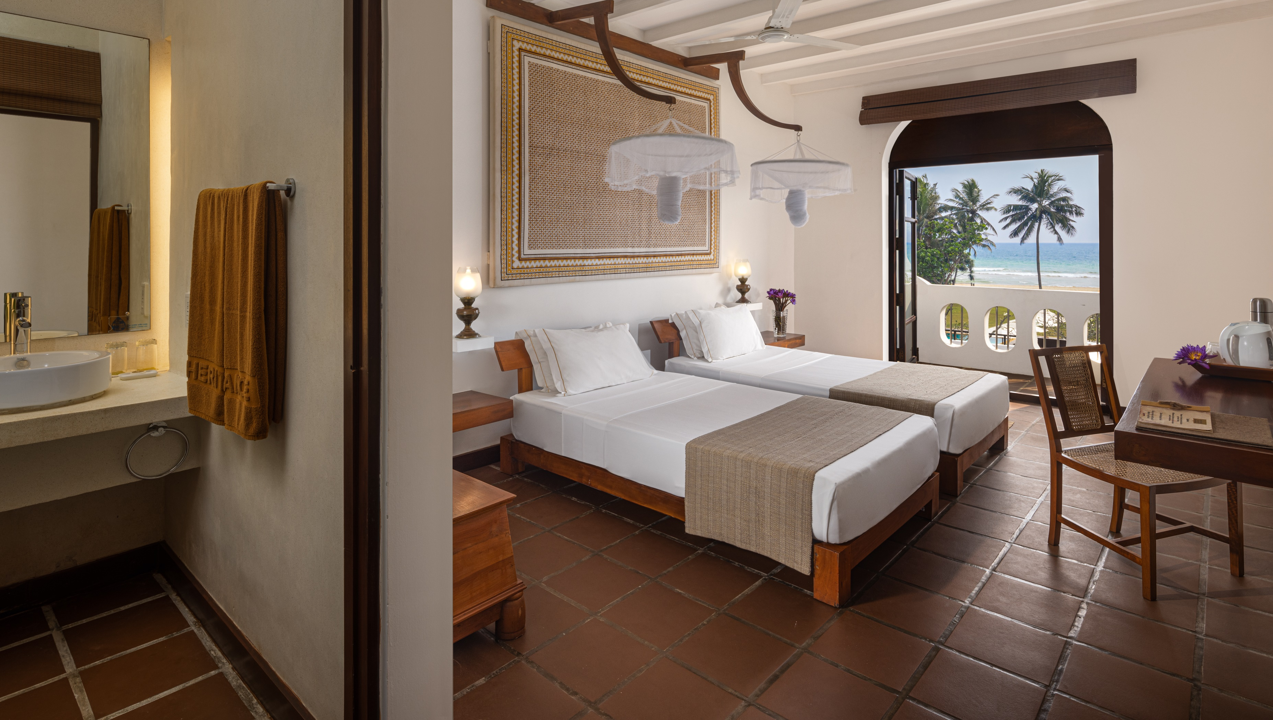

Slide 22
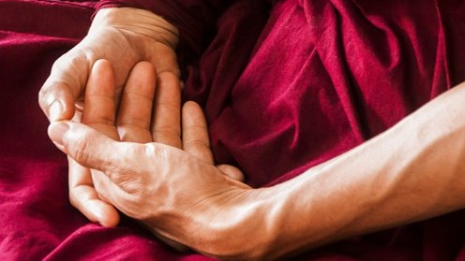

Slide 23

Wellbeing of the Earth
Just as we focus on wellbeing of the mind, body and soul, we are also conscious of our effect to the planet earth.
We were the first hotel in the country to enter into a Net Metering Agreement using solar panels as a renewable energy source
Wet garbage produced at the resort are used in the biogas plant, which in turn is used to prepare herbal decoction
Energy efficient lighting in place
Battery operated cars for transportation within the resort
Dry garbage used as compost
Central cooling system in place

Slide 24
Suwatha Program (Wellbeing Package)
This is a light cleansing and rejuvenating program for 6 -7 days.
Basic principles of Treatments
Deepana, Pachana: Increasing Appetite & Digestive energy in the body – You will get herbal medicine to improve your digestive energy in the stomach from the beginning of treatment program.
Shodana, Shamana: Detoxification and Neutralization of Toxins – Secondarily you get herbal medicine to detoxify and neutralize body toxins alone with other treatments.
Rasayana Body Rejuvenation: Using rejuvenating herbal medicine after cleansing treatments to enhance the Immunity and body strength. Will be given to continue at home.

Slide 25
Suwatha Program (Wellbeing Package) cont’d…
This is a light cleansing and rejuvenating program for 6 -7 days.
Basic principles of Treatments
Mano Santharpana Relaxation and Psychological Rejuvenation: Treatments and other activities to relax and strengthens the mind.
Doctor’s consultations: Understand your present state of health and constitution with pulse diagnosis. Get instructions to protect wellbeing of your body & mind in daily life. Have a list of food which helps to keep the balance and promote the healthy condition of your body.
Treatments: Relax and prepare your body for light cleansing. Cleans your body & mind. Strengthen and rejuvenate
your body.
*Refer detailed itinerary for more information

Slide 26

Moragalla, Beruwala, Sri Lanka​
Tel : +94 34 5555 000​
Fax : +94 34 5555 050​
Email : info.amg@heritancehotels.com​
www.heritancehotels.com/ayurveda​

