Slide 1

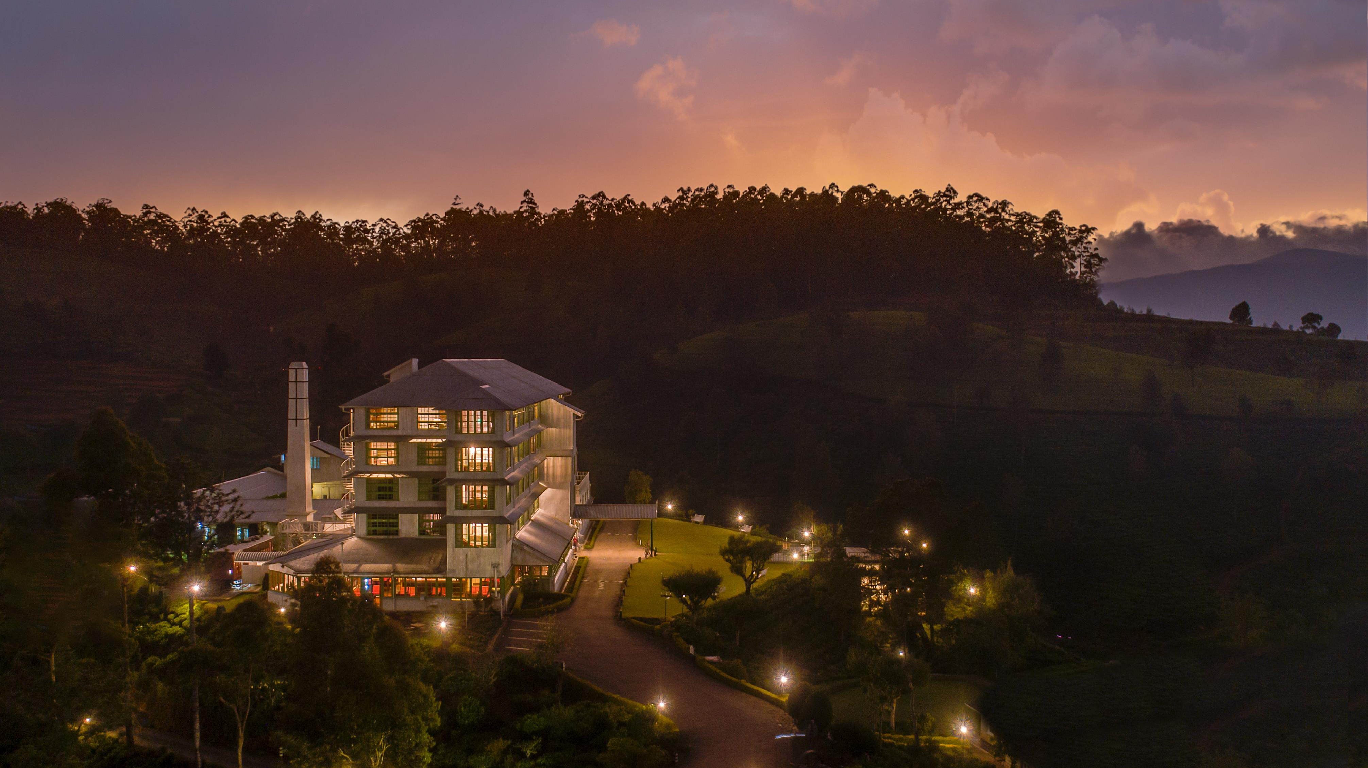

Slide 2
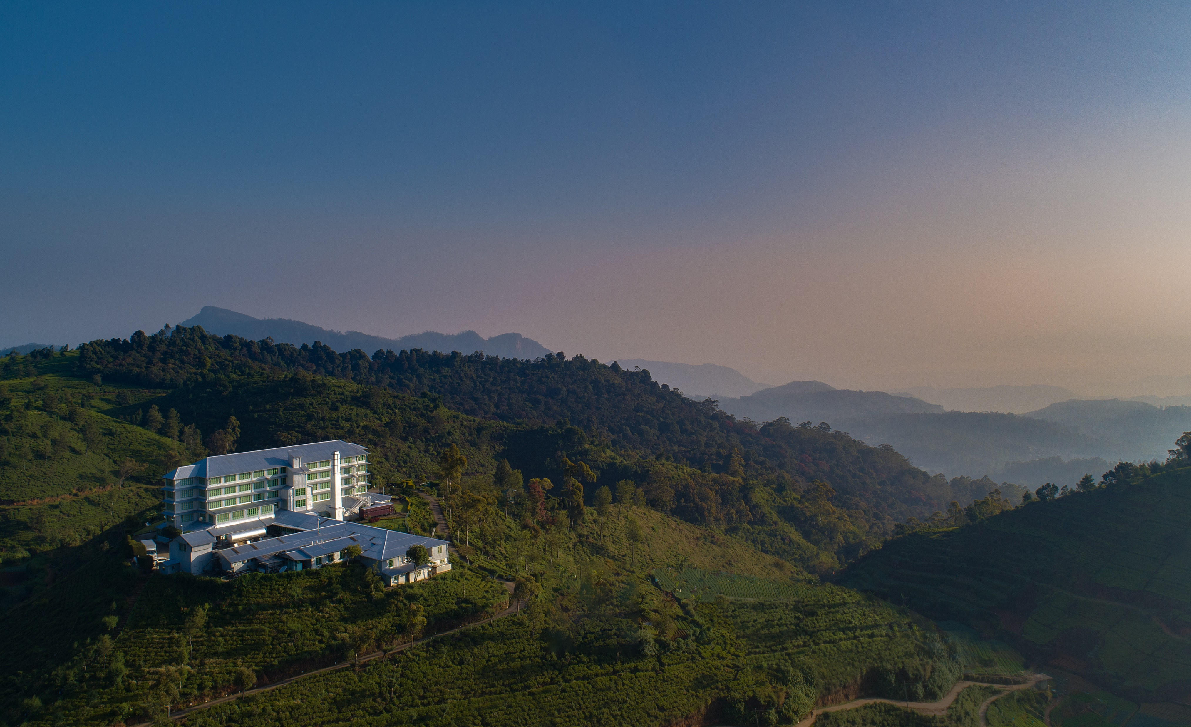
THE PERFECT HIGHLAND EXPERIENCE
Nestled amidst Sri Lanka’s lush mountains and stunning tea plantations, once a bustling tea factory from the 19th Century, we blend historical charm with comfort

Slide 3
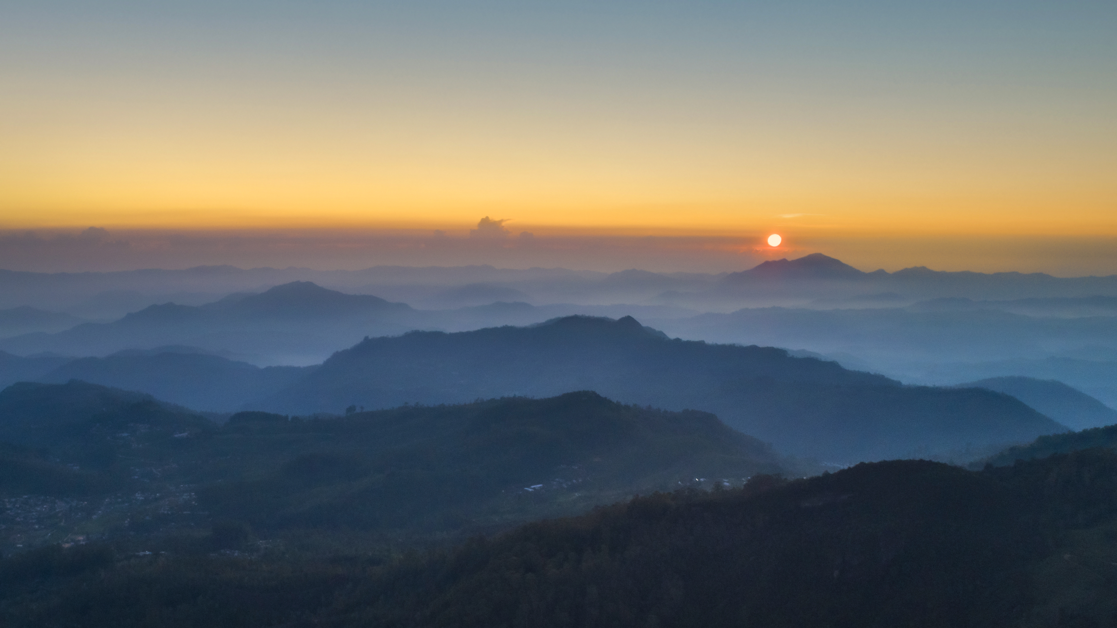

Slide 4
Accommodation
Category | Bedding | No. of Rooms
Superior | King | 18
 | Twin | 11
 | Triple | 6
Premium | King | 2
 | Twin | 1
Executive Floor Deluxe | King | 10
Junior Suite | King | 1
Flower | King | 1

Slide 5
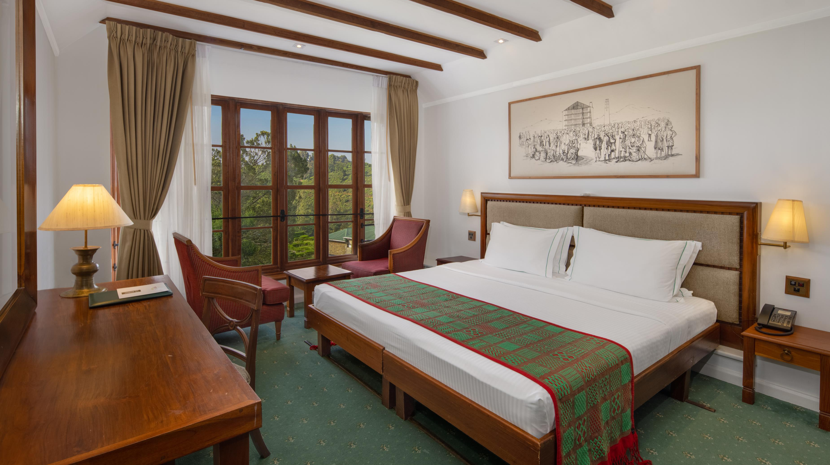
Superior Room

Slide 6
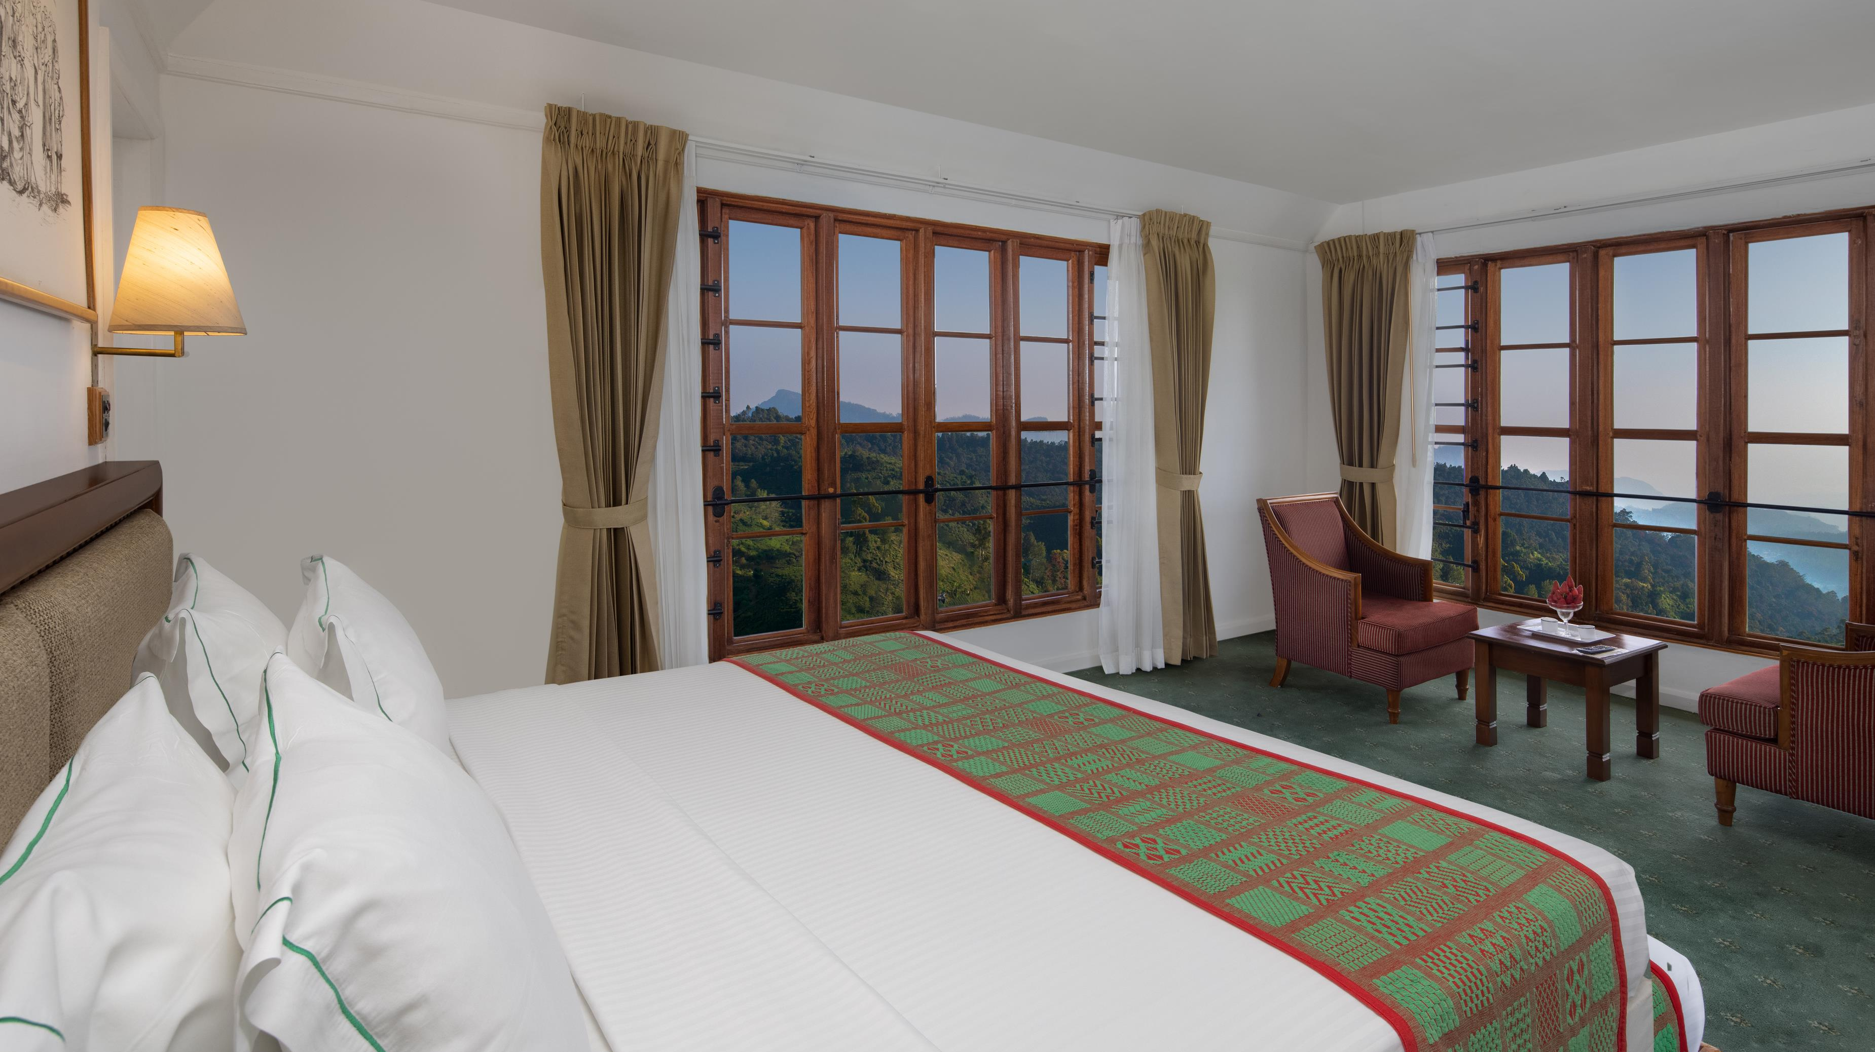
Premium Room

Slide 7
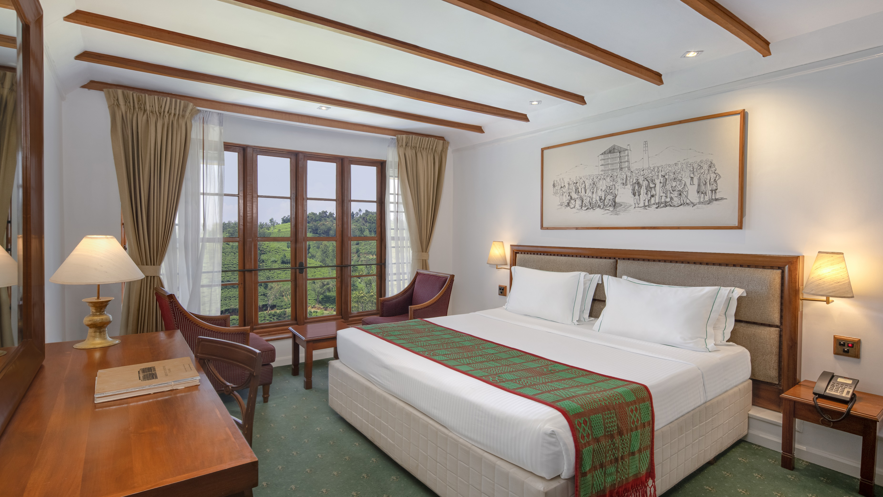
Executive Floor Deluxe

Slide 8
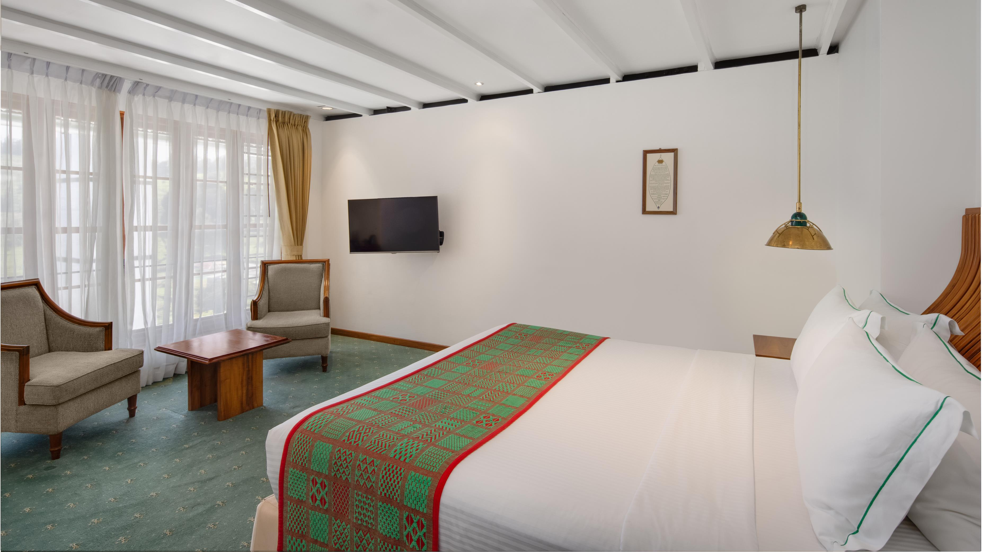
Junior Suite

Slide 9
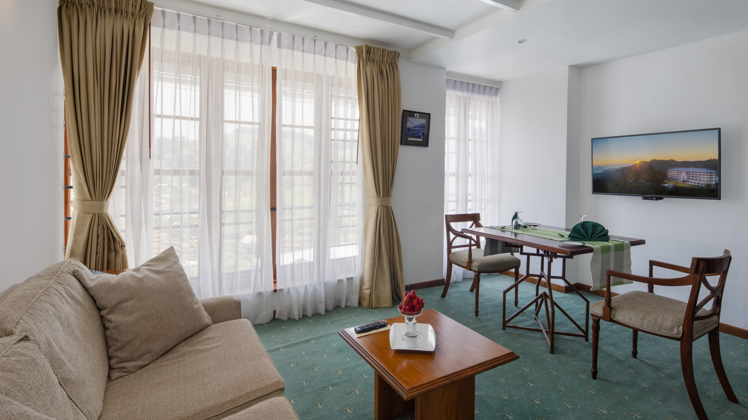

Slide 10
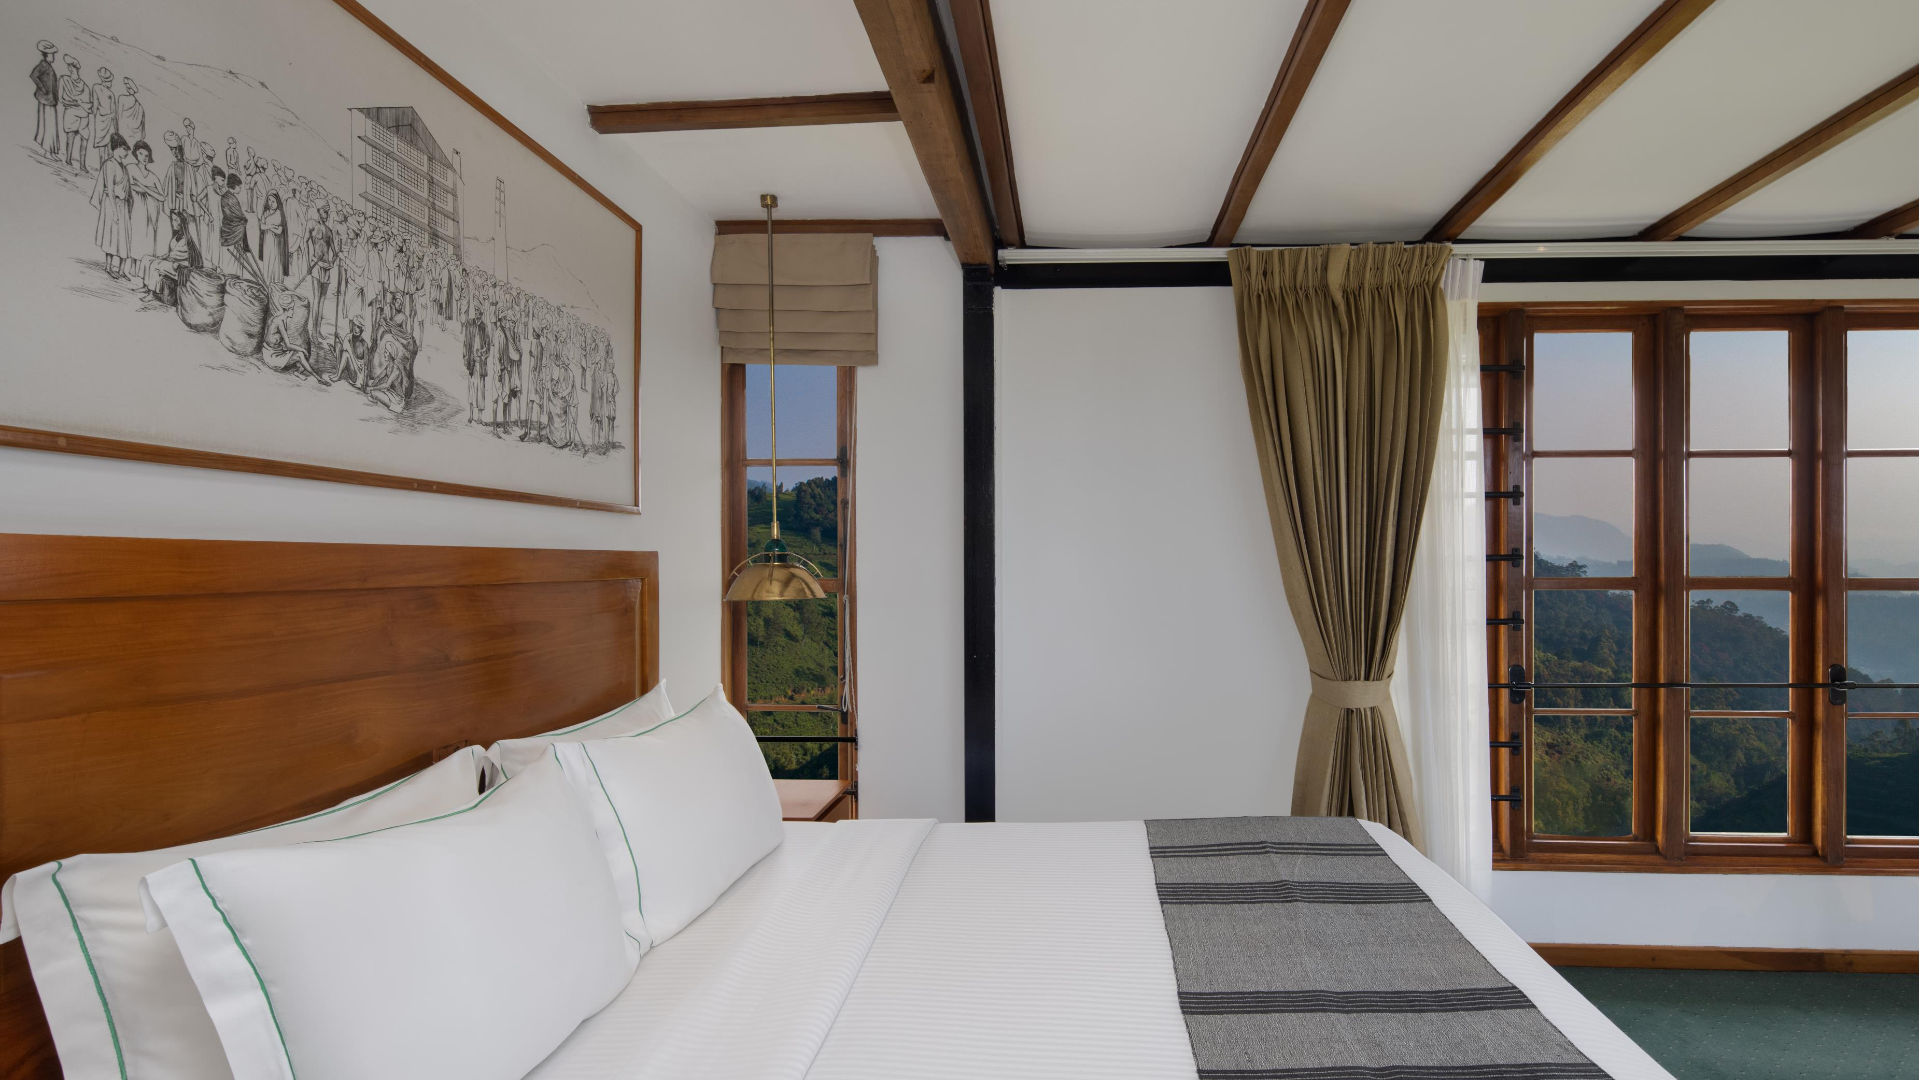
Flowerdew Suite

Slide 11
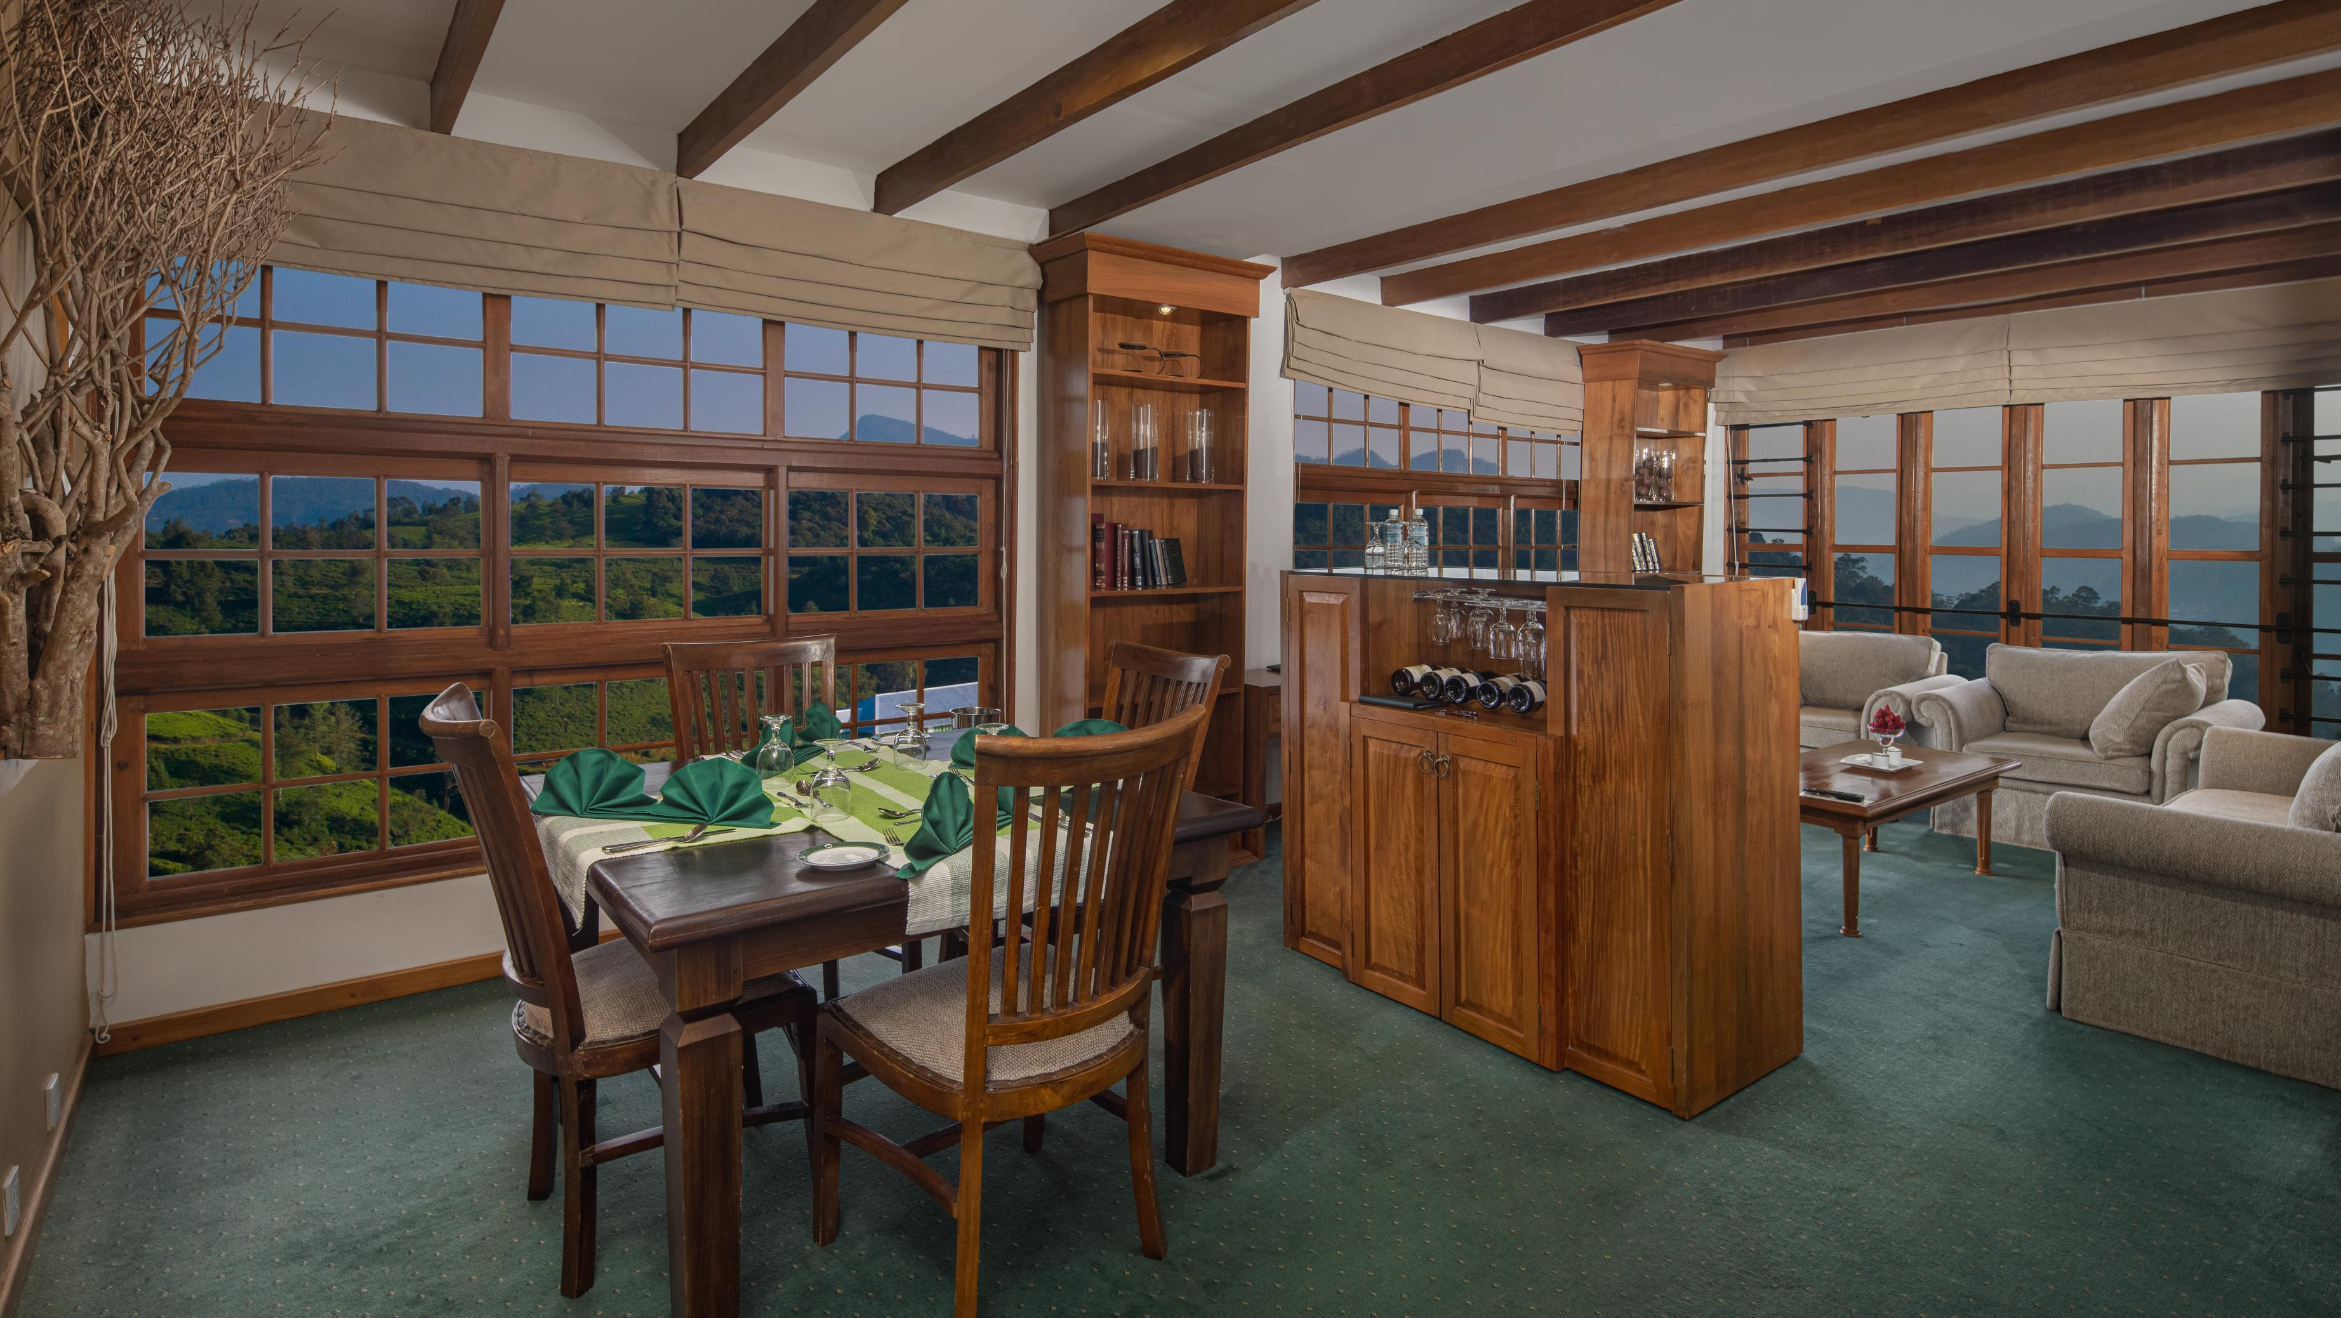

Slide 12
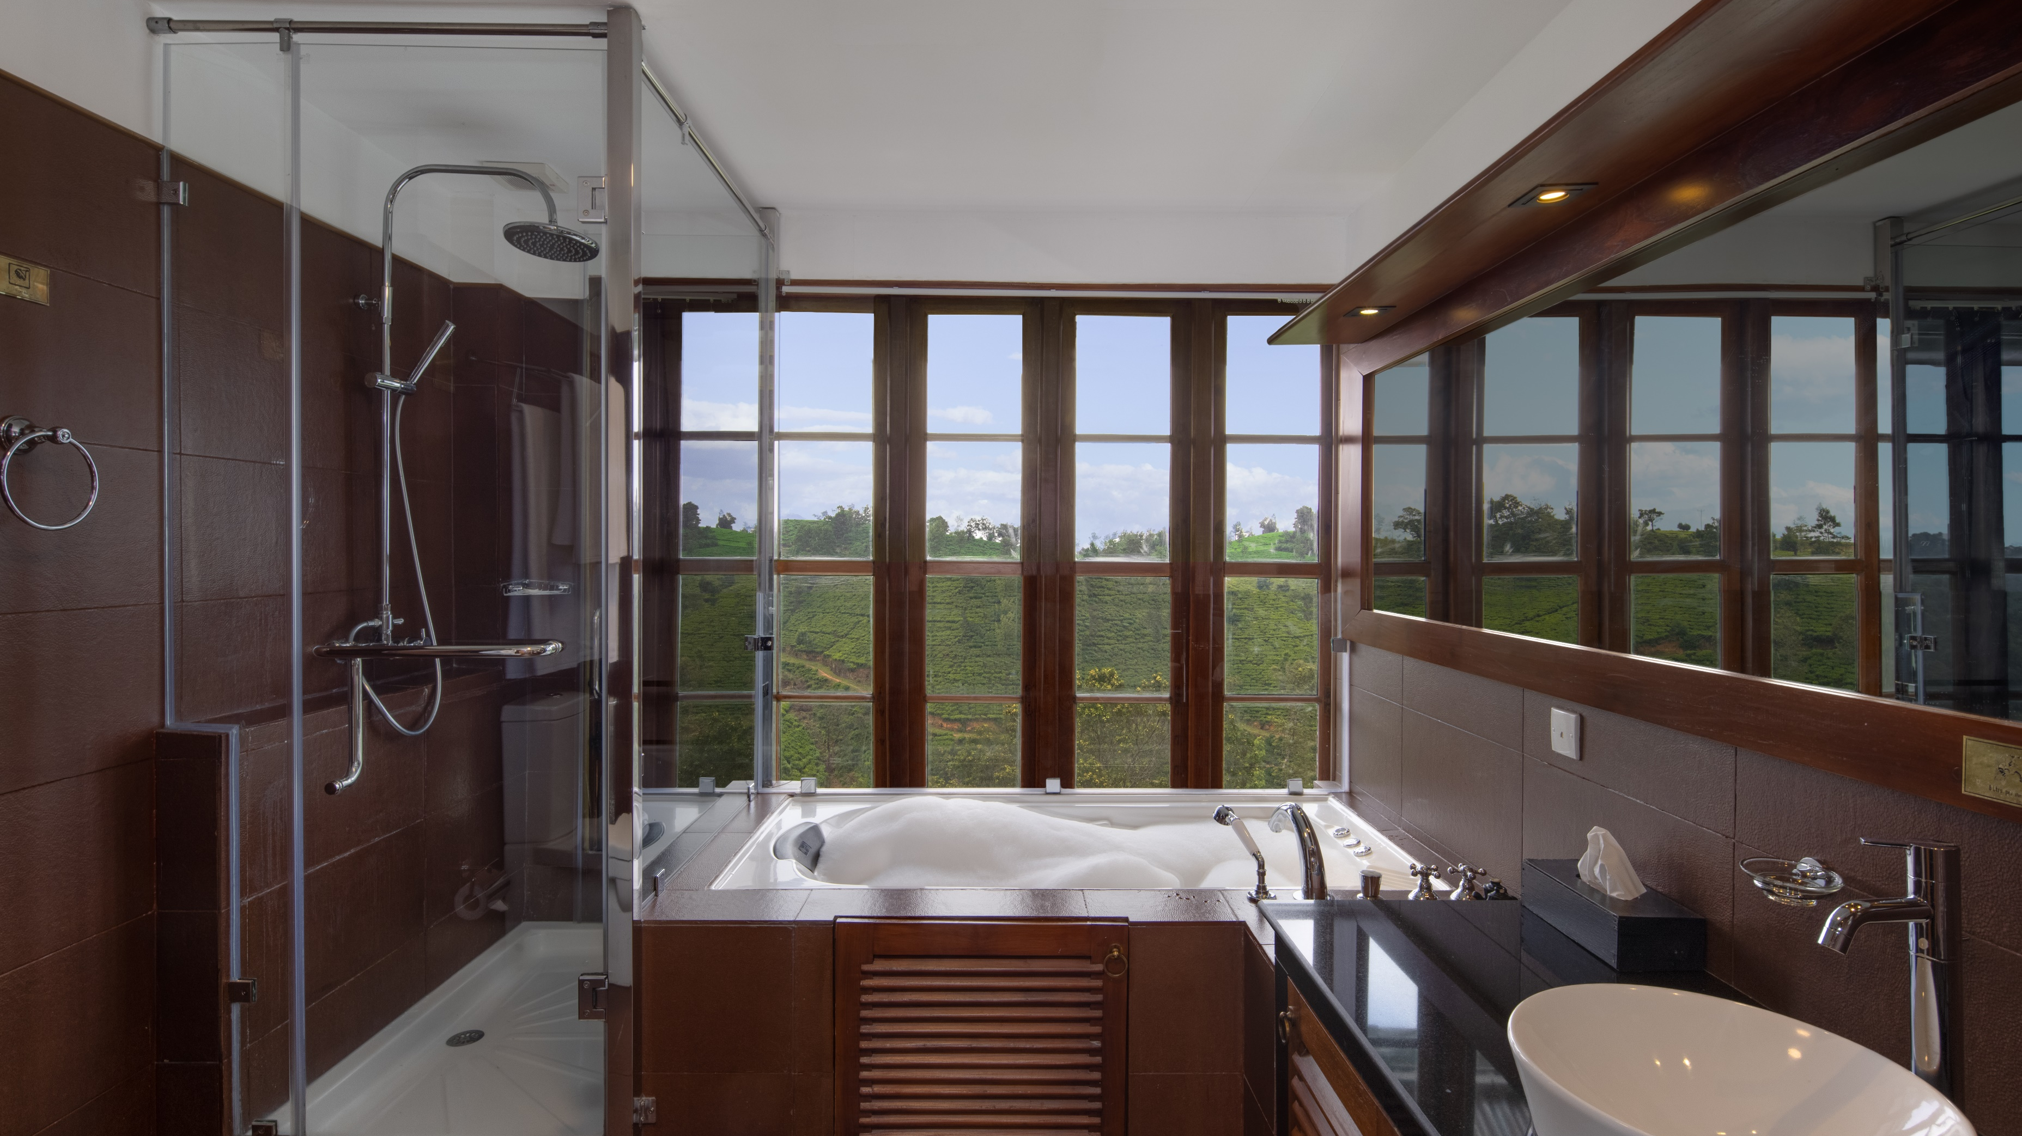

Slide 13
THE PERFECT HIGHLAND EXPERIENCE
Indulge in culinary experiences that weave the rich heritage of tea with the art of modern dining, offering a palette of flavors amongst Sri Lanka's majestic highlands.

Slide 14
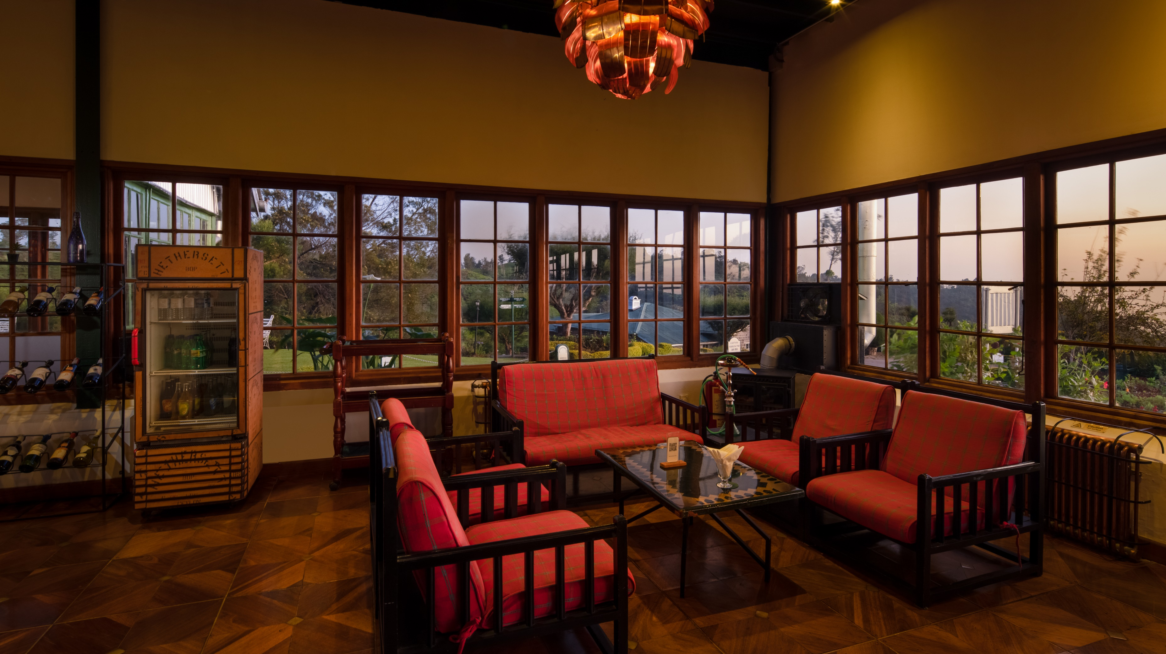
Hethersett Bar

Slide 15
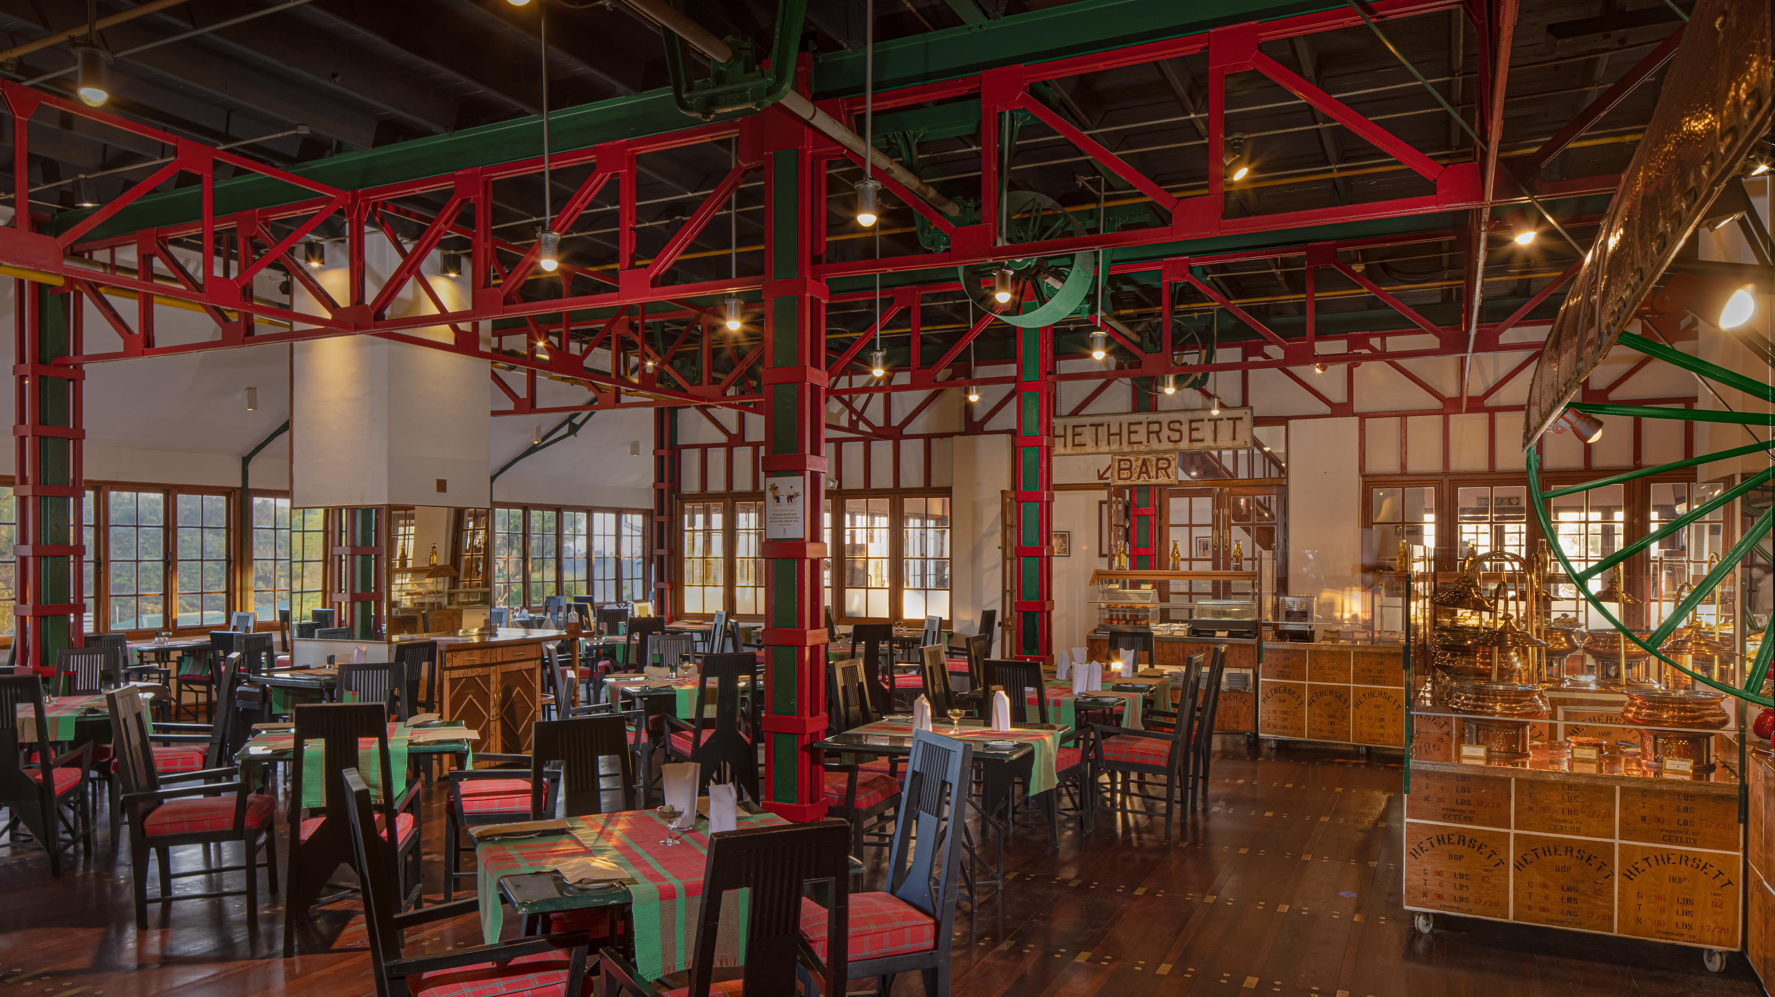
Kenmare Restaurant

Slide 16
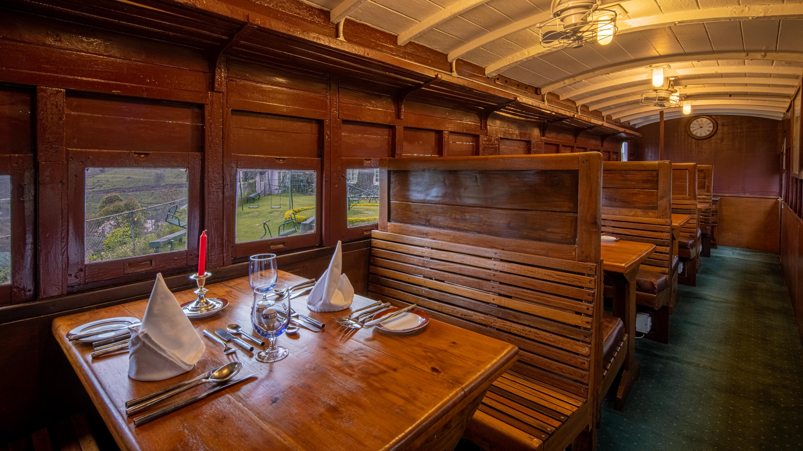
TCK 6685

Slide 17
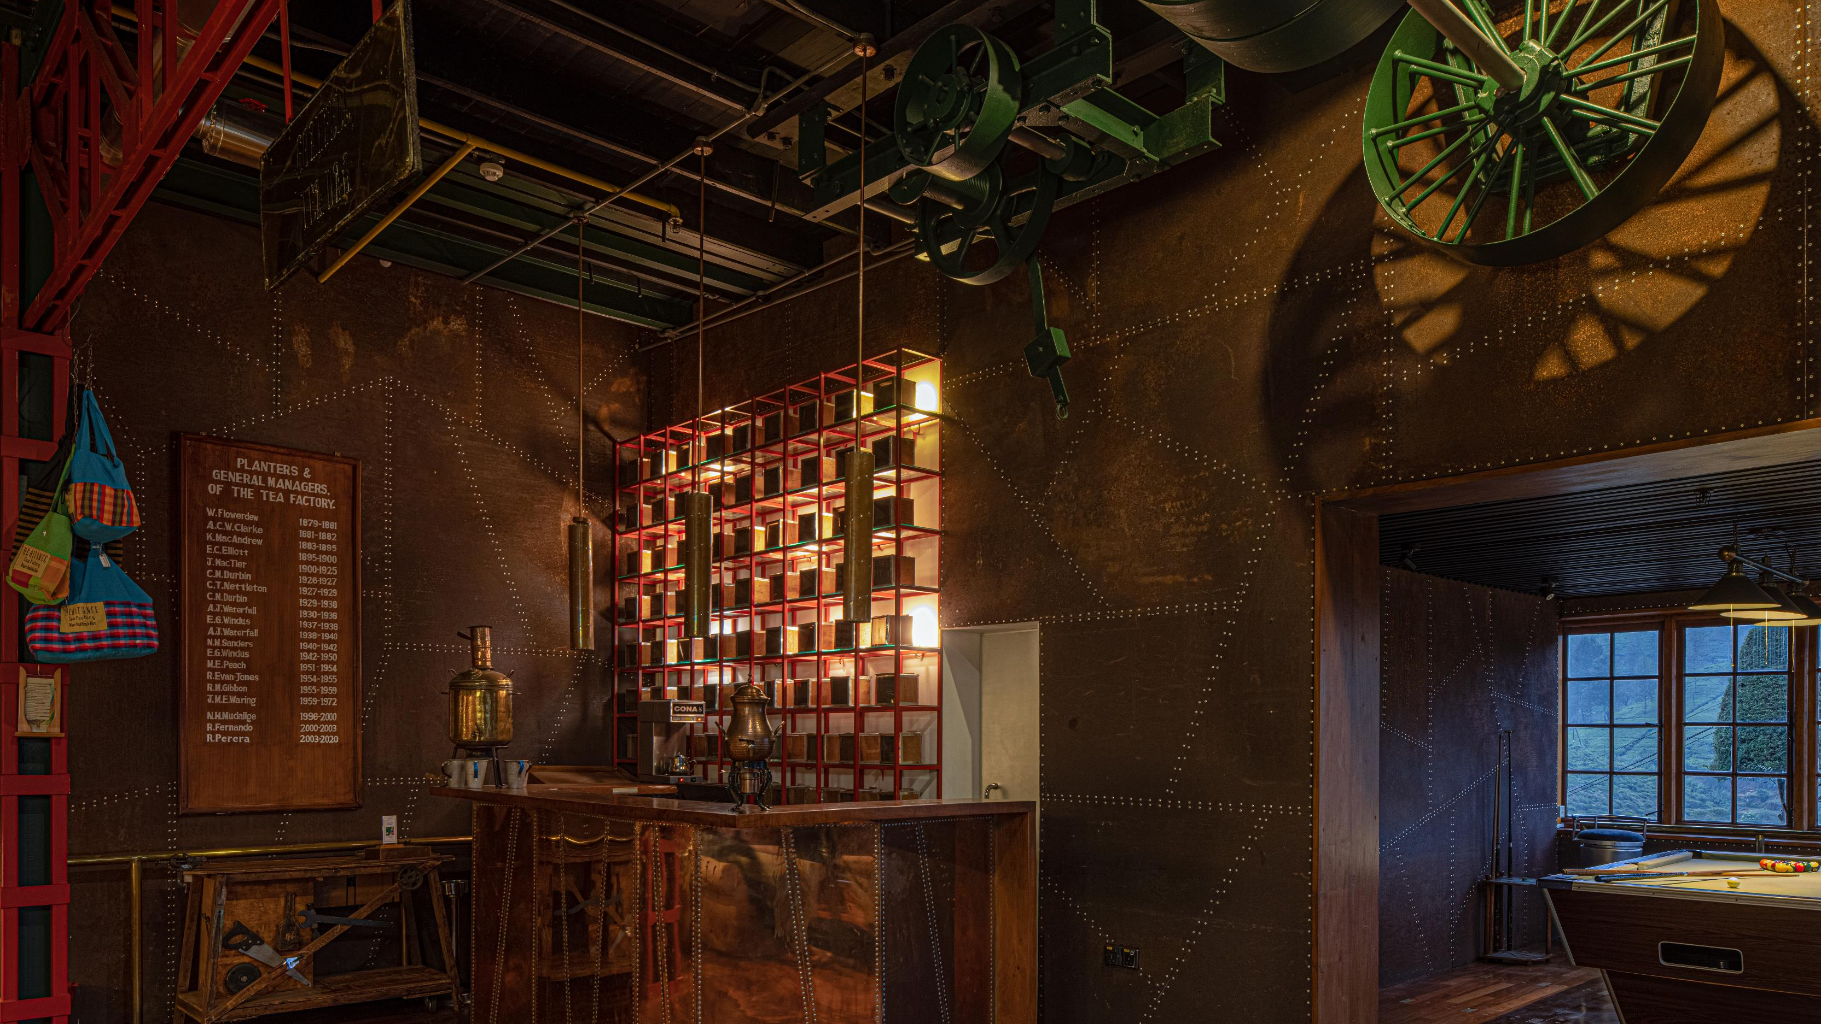
TEA BAR

Slide 18
Facilities and Services
Nearby Attractions | Horton Plains / Nuwara Eliya City / Ella / Hakgala Botanical gardens / Lake Gregory / Victoria Park / Seetha Amman Temple
Stay Experience | Spa / Transportation / Kids park / Library / Sports and games / Souvenir shop / Theme nights / Daily entertainment / Putting green / Indoor games / Fitness center
Excursions | Horton Plains / Ella Tour / Sui9o0ostainability activities / The Mini Tea Factory / Immersive nature walk / Cycling in the tea state / Kandapola High Tea / Tea Plucking / Tea Tasting
Guest Services | Laundry Services / 24-hour room service / Complimentary wi-fi / Access for differently abled guests / Playground / Bicycle rent / Currency exchange / Doctor on call / Baby chairs and cots / Airport transfer

Slide 19
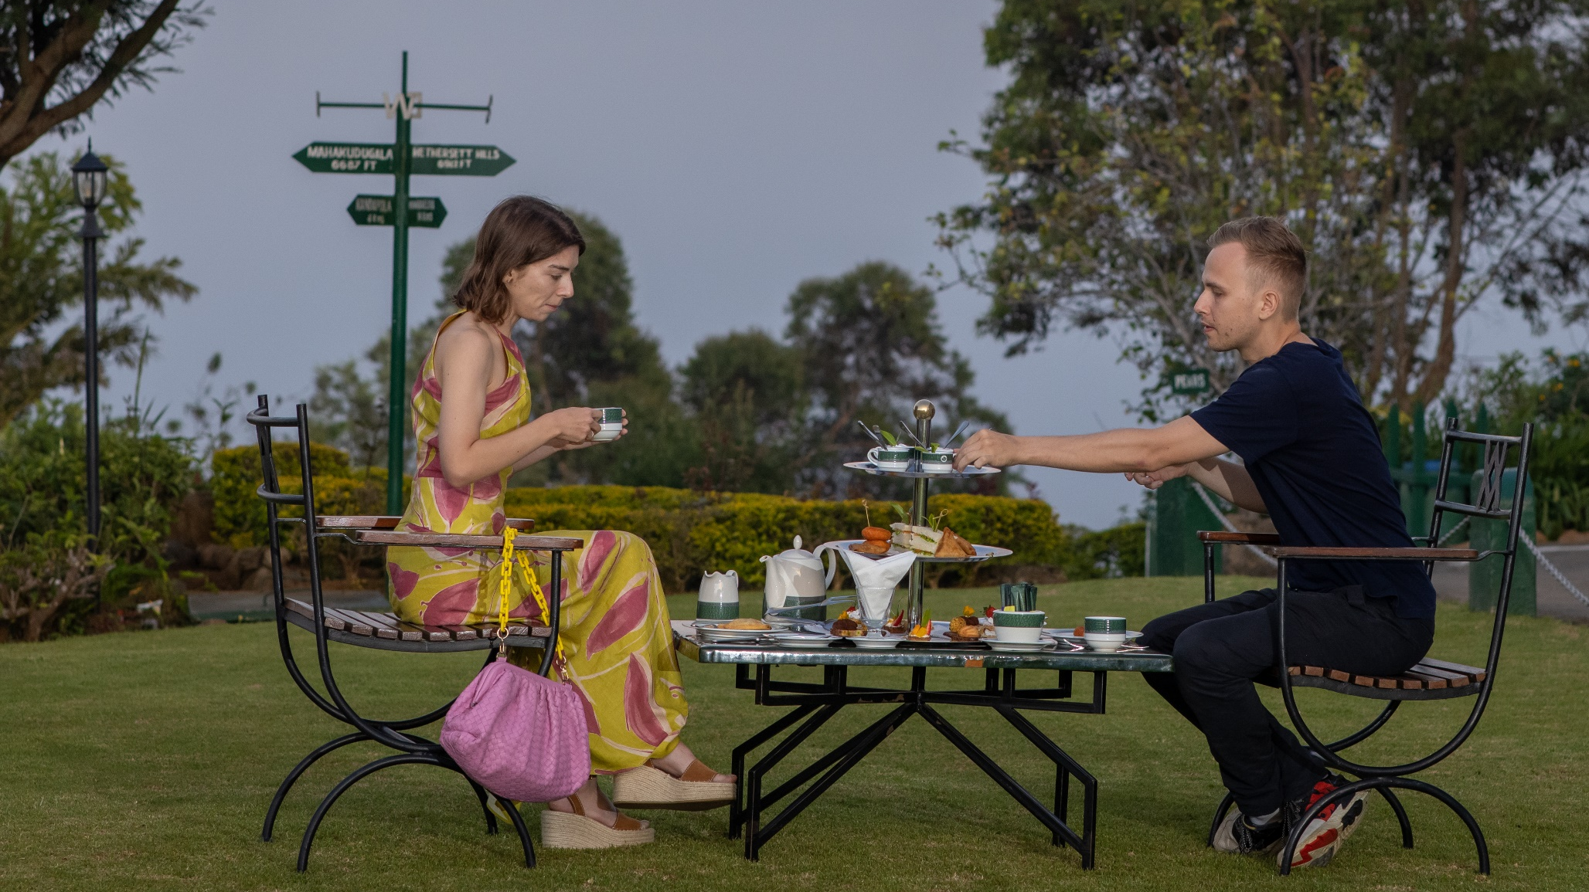
HIGH TEA

Slide 20
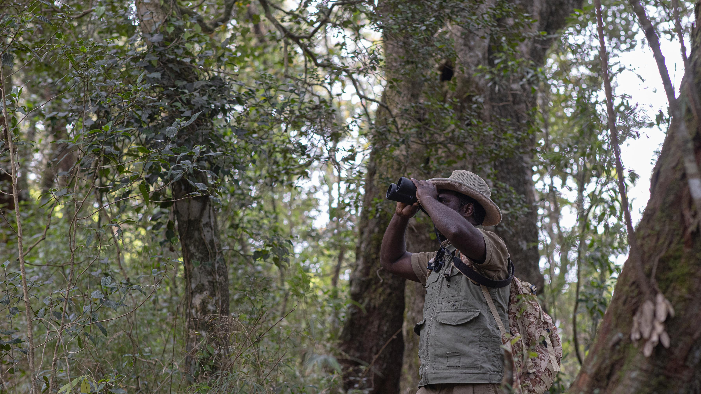
NATURE WALK

Slide 21
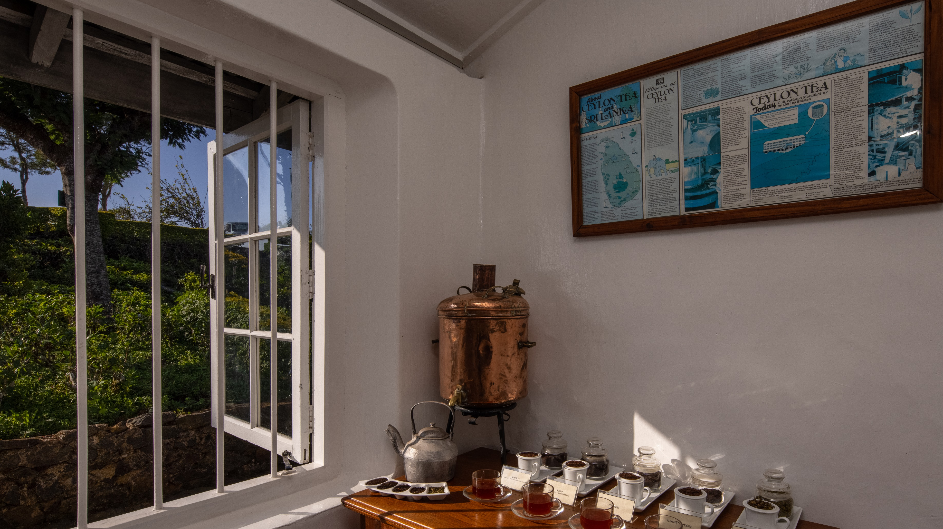
MINI TEA FACTORY

Slide 22
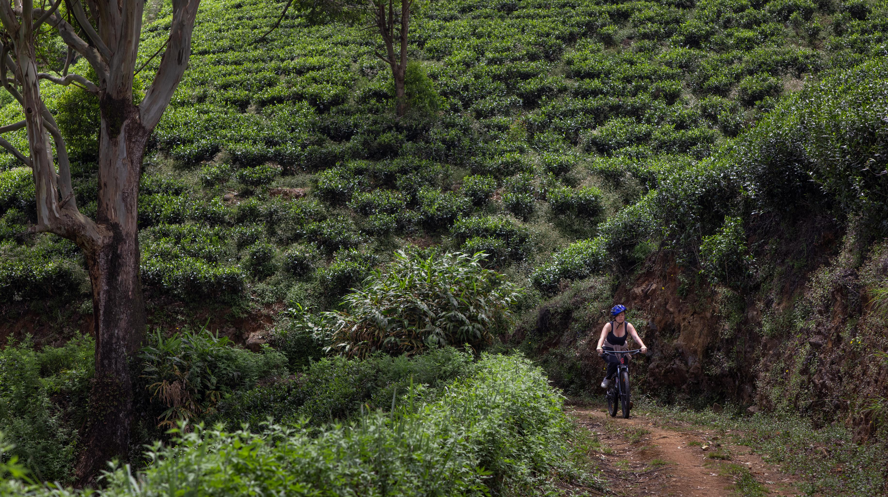
BIKE RIDES

Slide 23
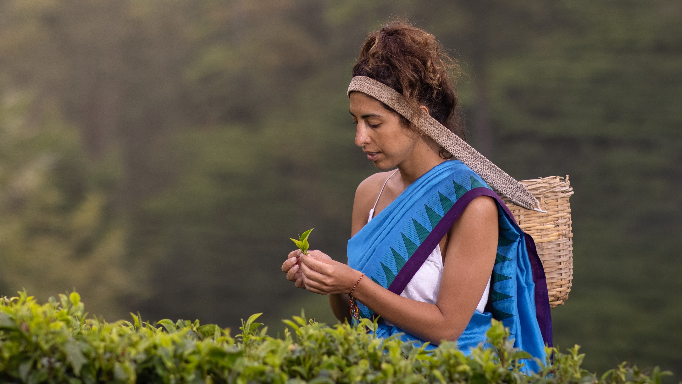
TEA PLUCKING EXPERIENCE

Slide 24


