Slide 1
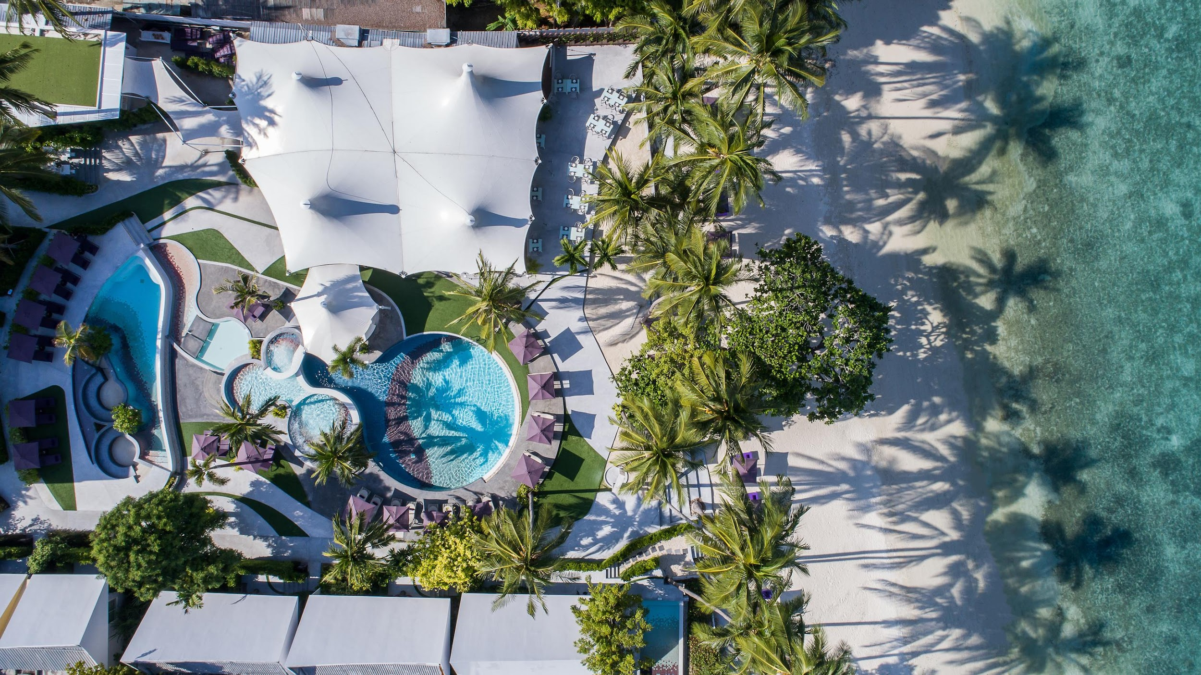

ados@lavidasamui.com

Slide 2
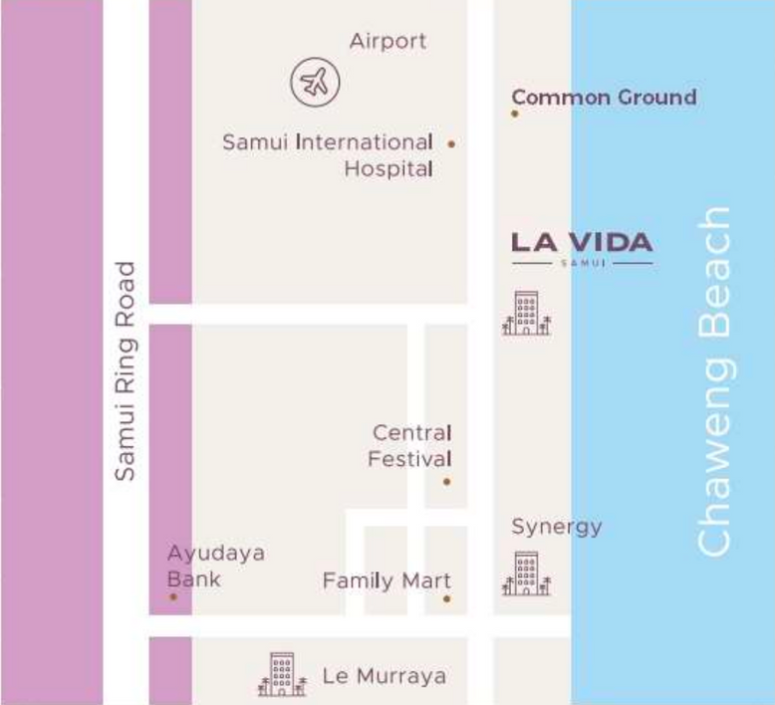



OUR LOCATION
Bang Po
Maenam
Plai Laem
Bo Phut
Na Thon
Koh Samui
Chaweng
Taling Ngam
Situated on Chaweng Beach, LA VIDA is….
2 km. to the North of SYNERGY Samui
2.8 km. from Samui International Airport
0.8 km. from Central Festival Samui
150 m. from Chaweng Walking Street
Lamai
Hua Thanon
Tong Krut

Slide 3
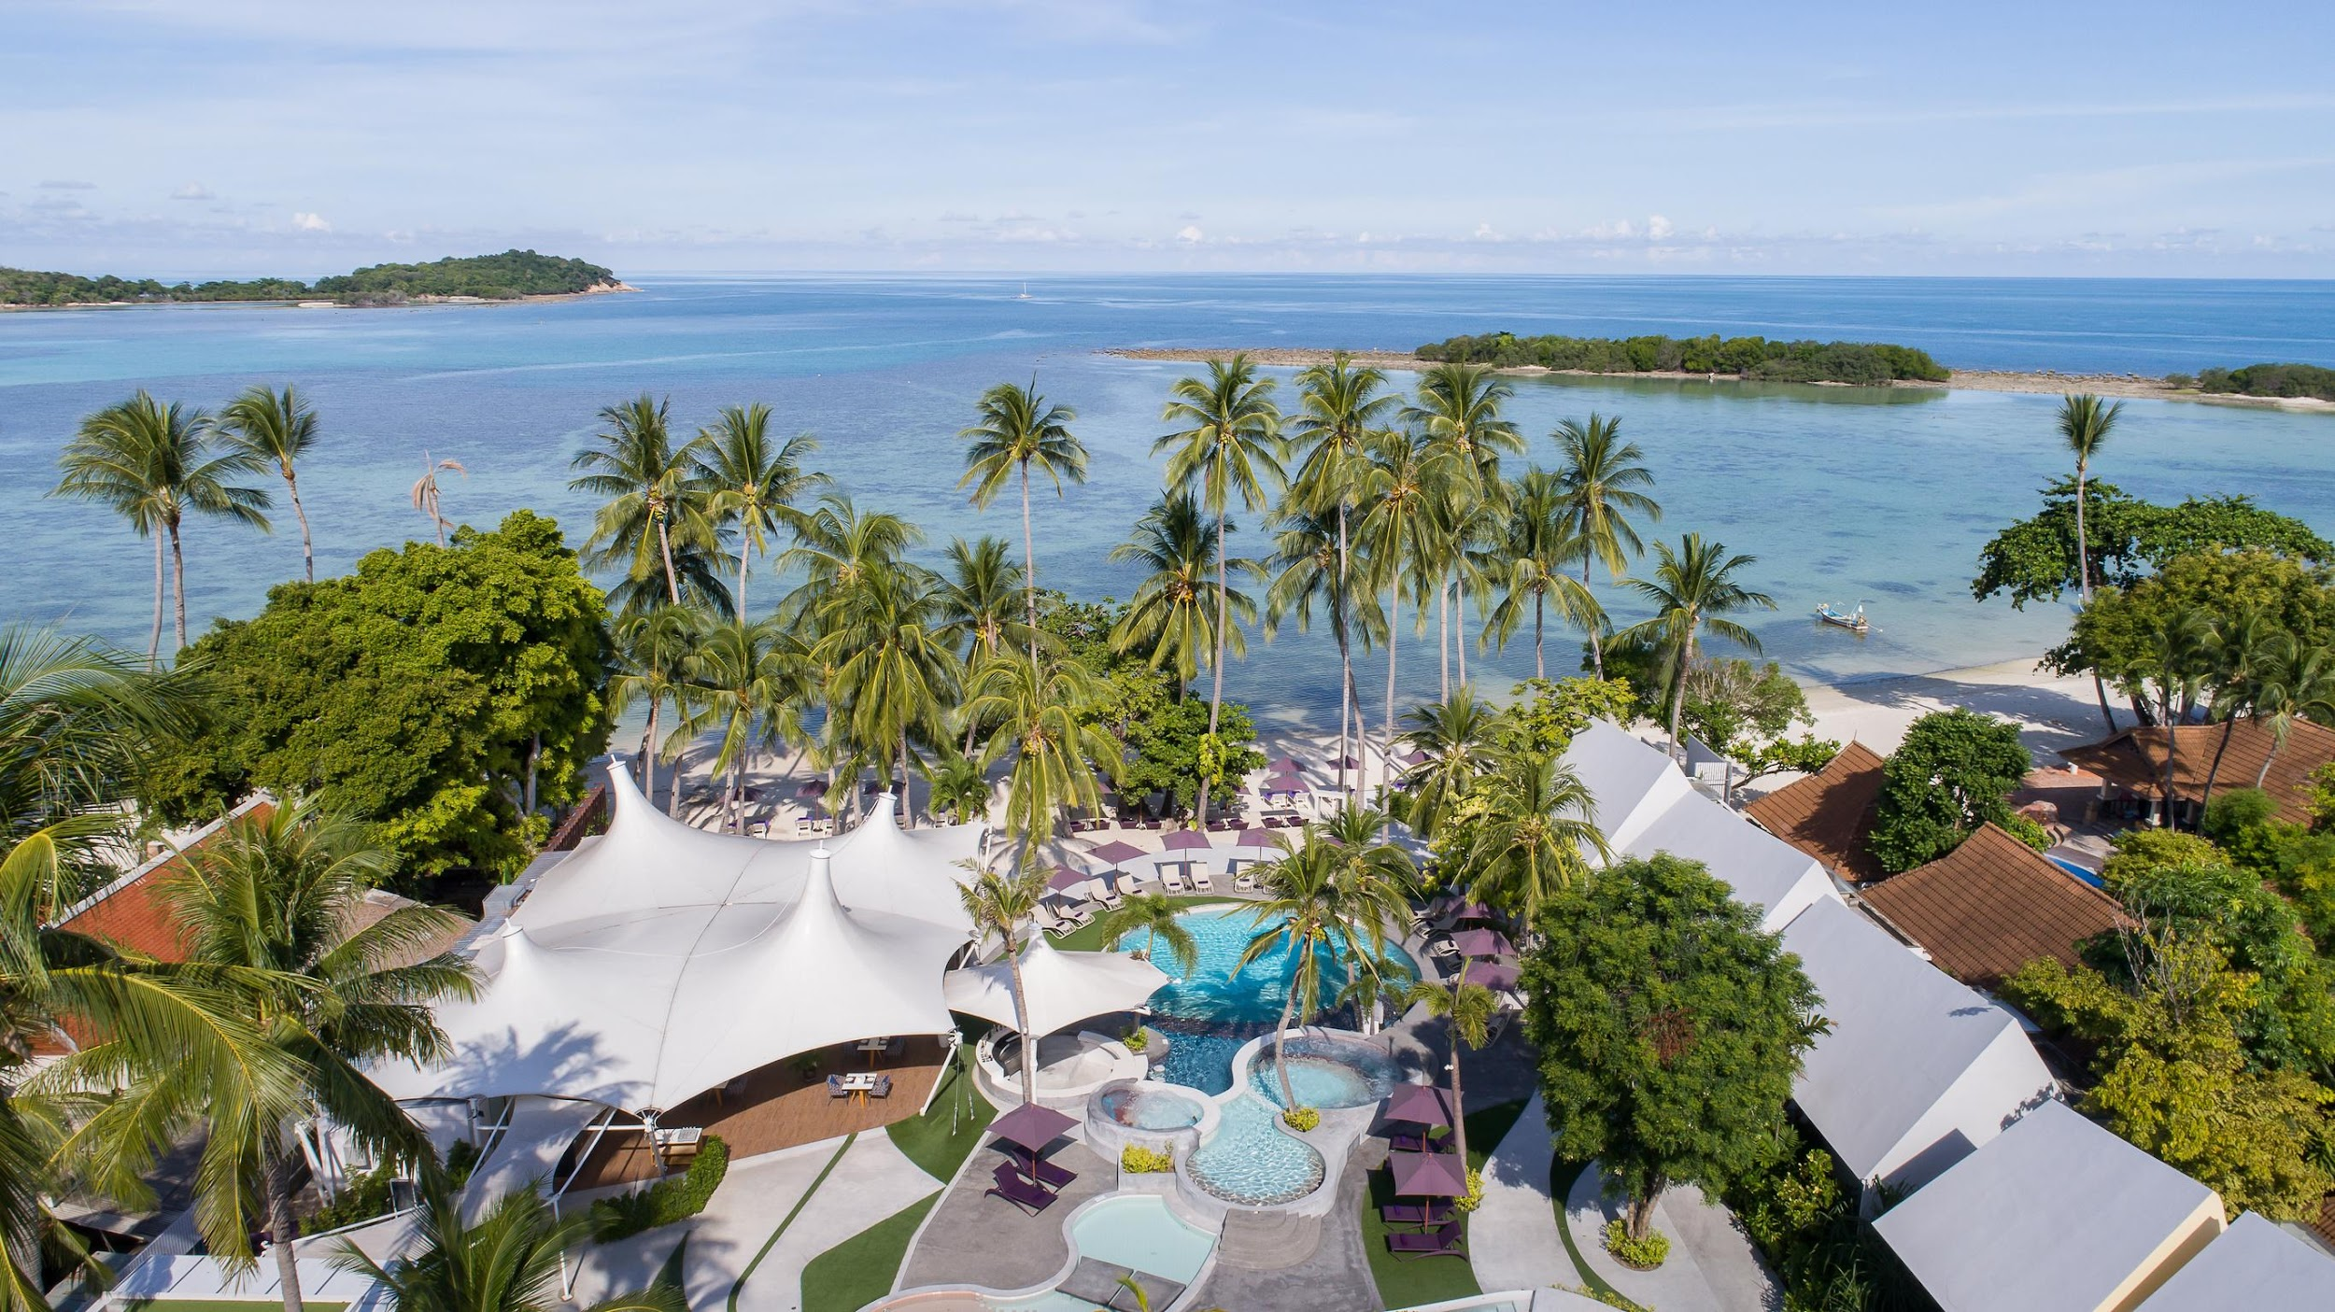
RESORT
OVERVIEW

Slide 4

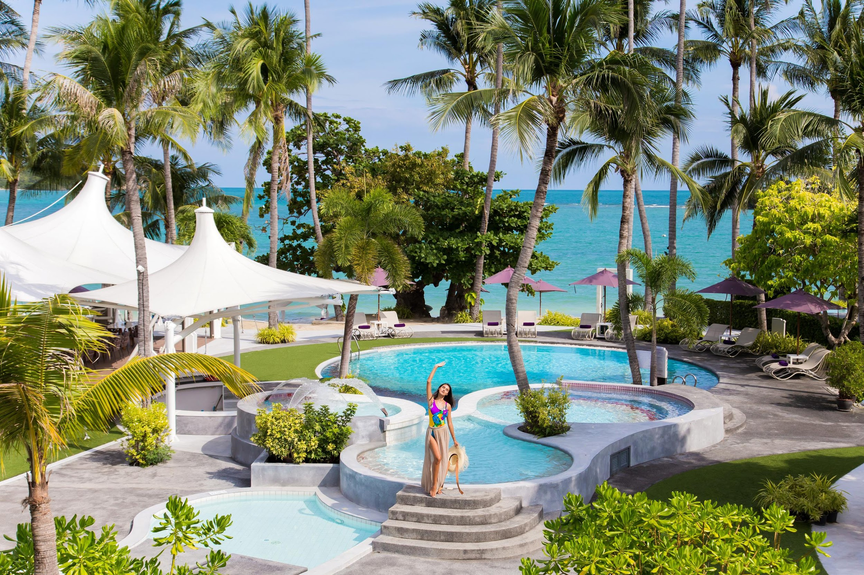
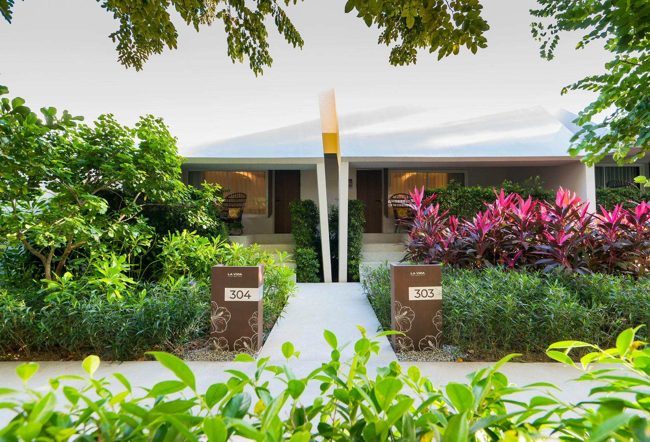
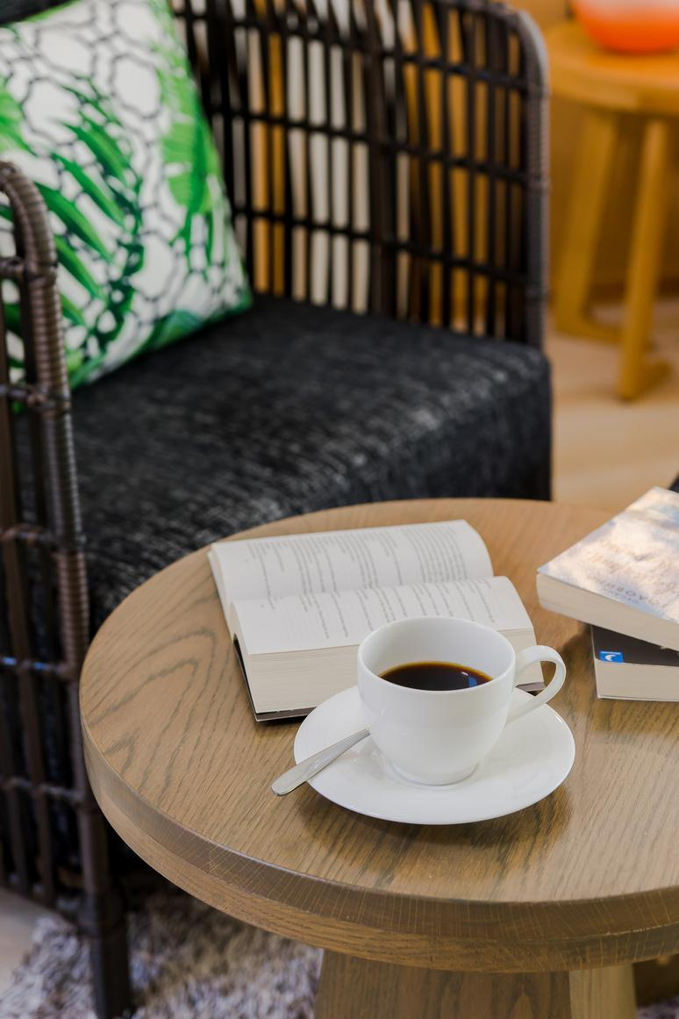
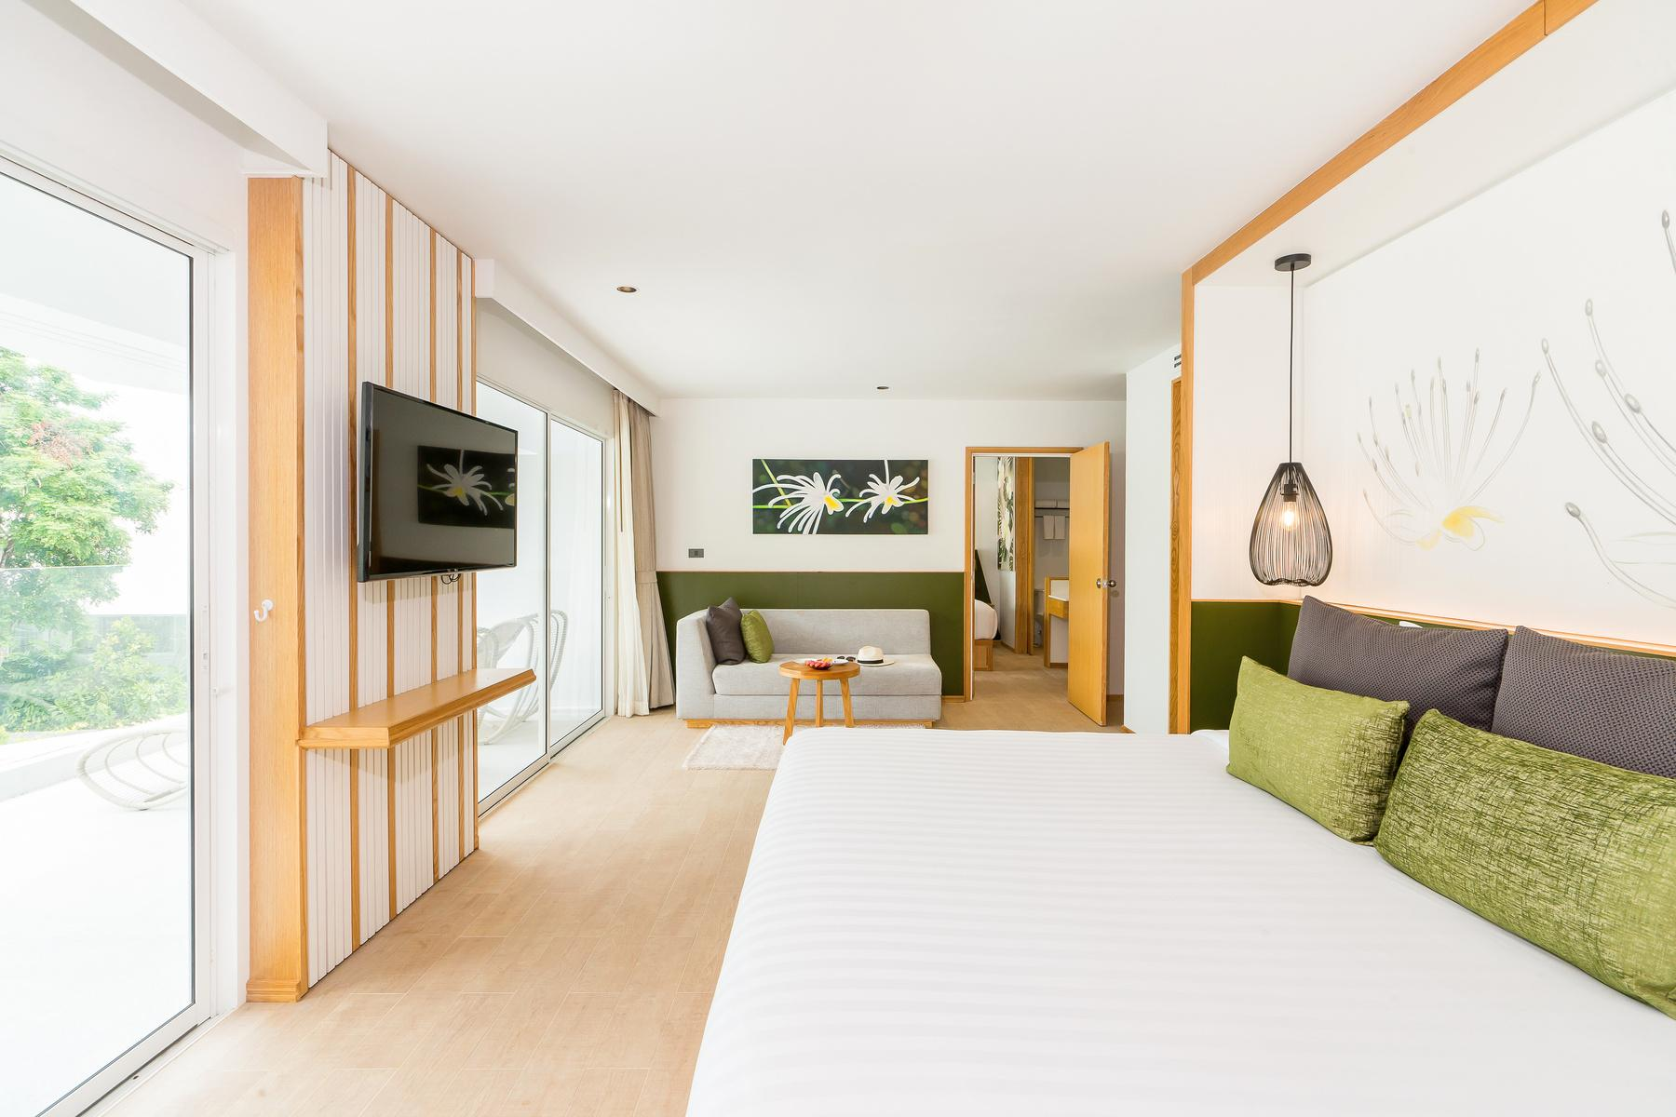
Reconnect with
your vibrant side.
Read More
Our estate consists of 49 beautifully curated rooms, with each section of the hotel inspired by a local flower.

Slide 5

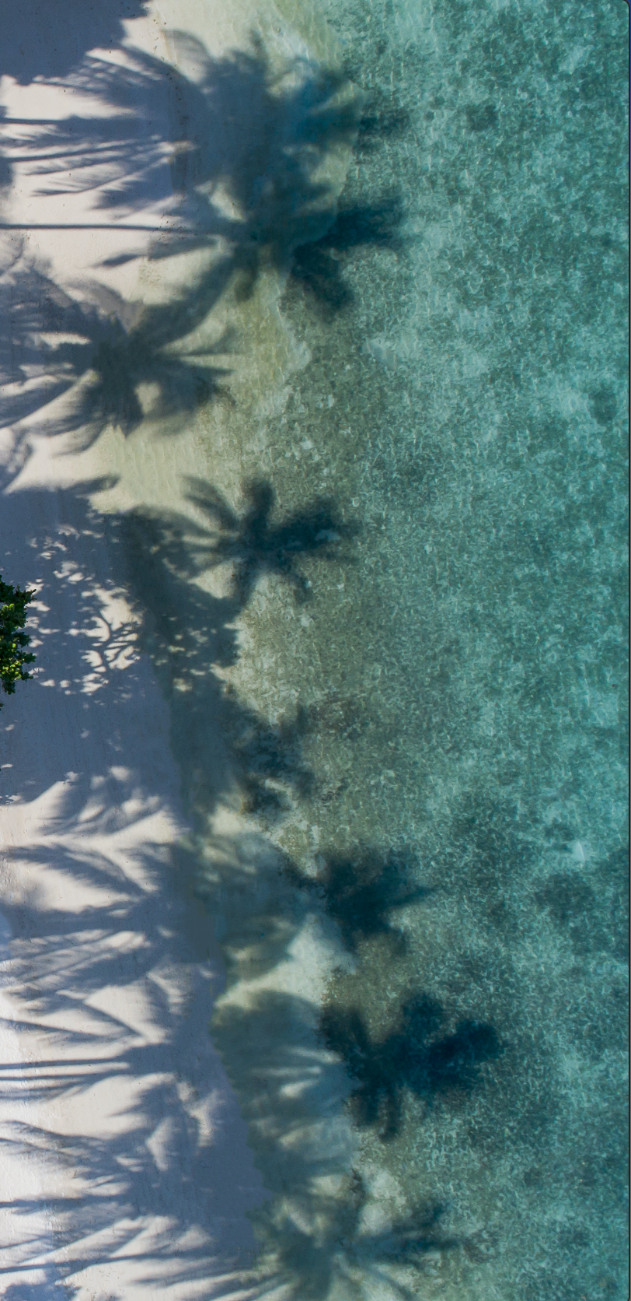




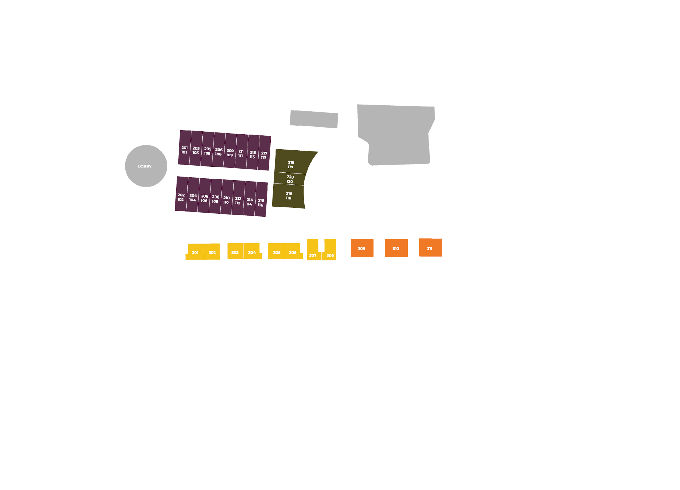









Restaurant
Swimming Pools
& Pool Bar
Reception
401- 425
“The Swing”
Complementary 45 minutes
of fun for each hotel guest per day!
Fitness
Centre
Paddle Boards
& Kayaks

Slide 6

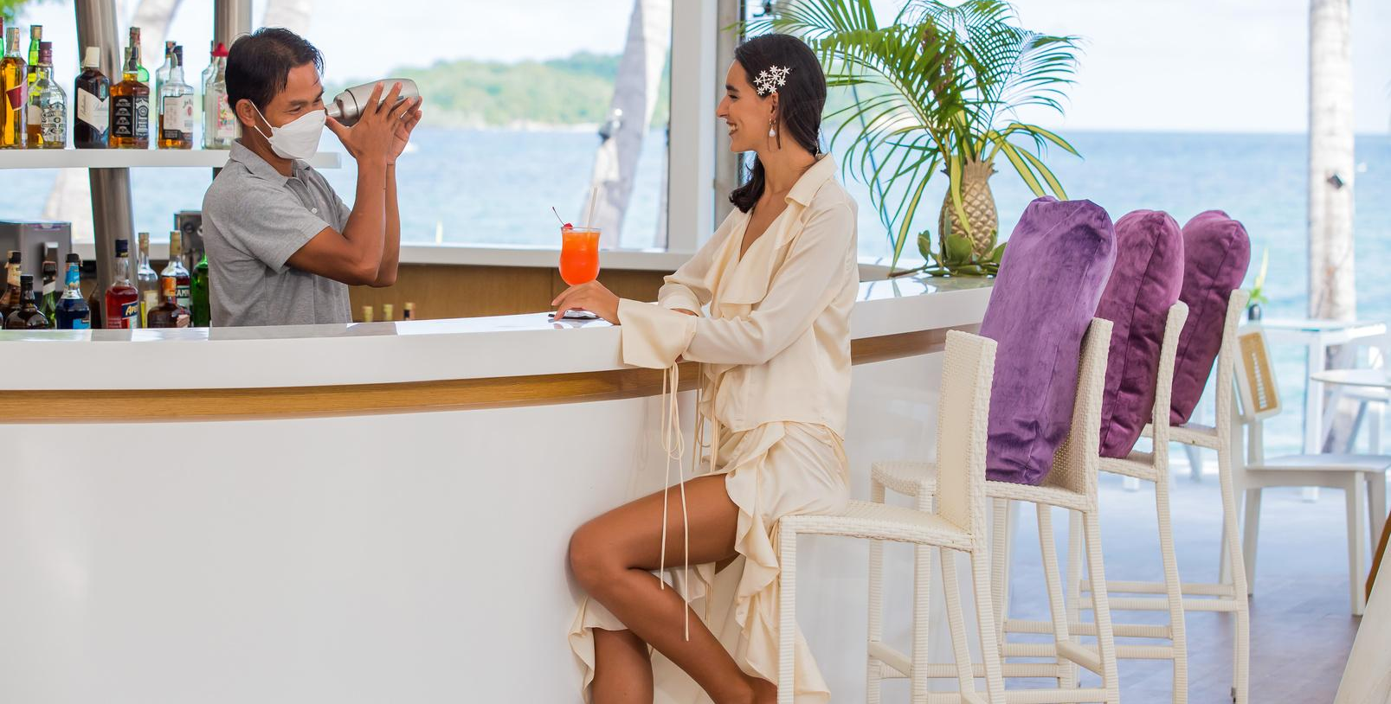
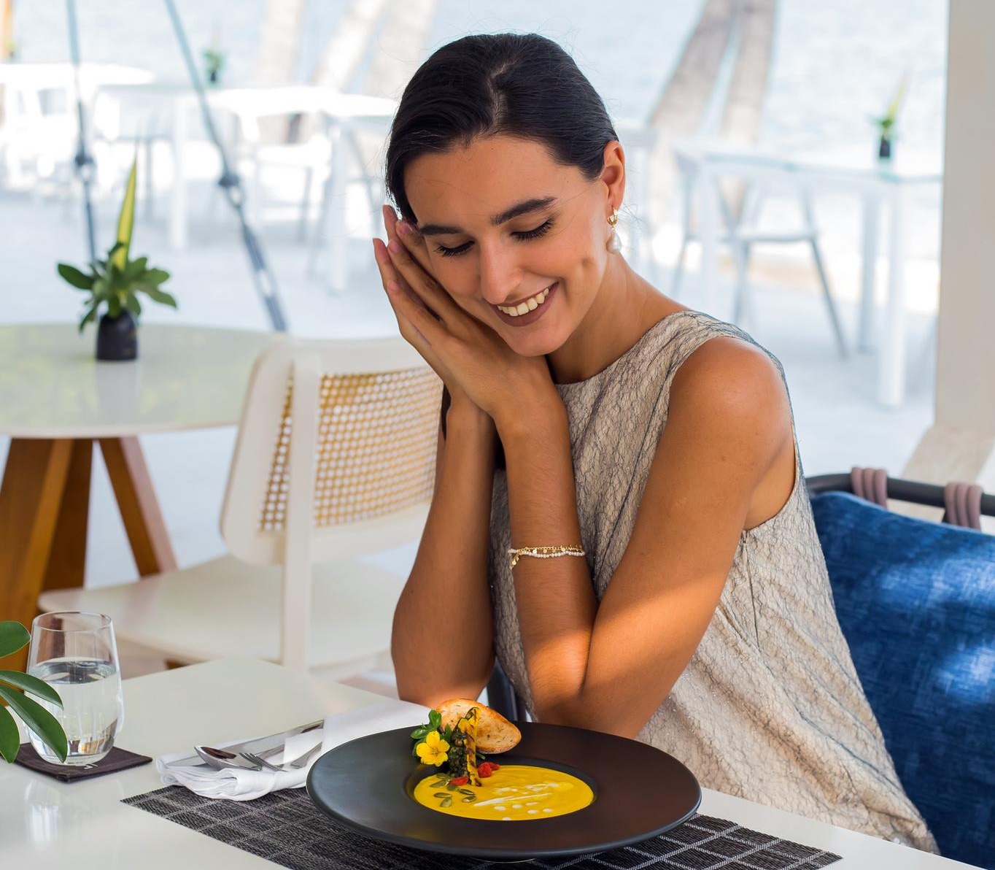

Seat yourself under specially designed marquis in the shape of Morning Glory Flowers. Lago serves Thai, Mediterranean cuisine, fresh seafoods and breakfasts. Capacity: 94 seats

Slide 7
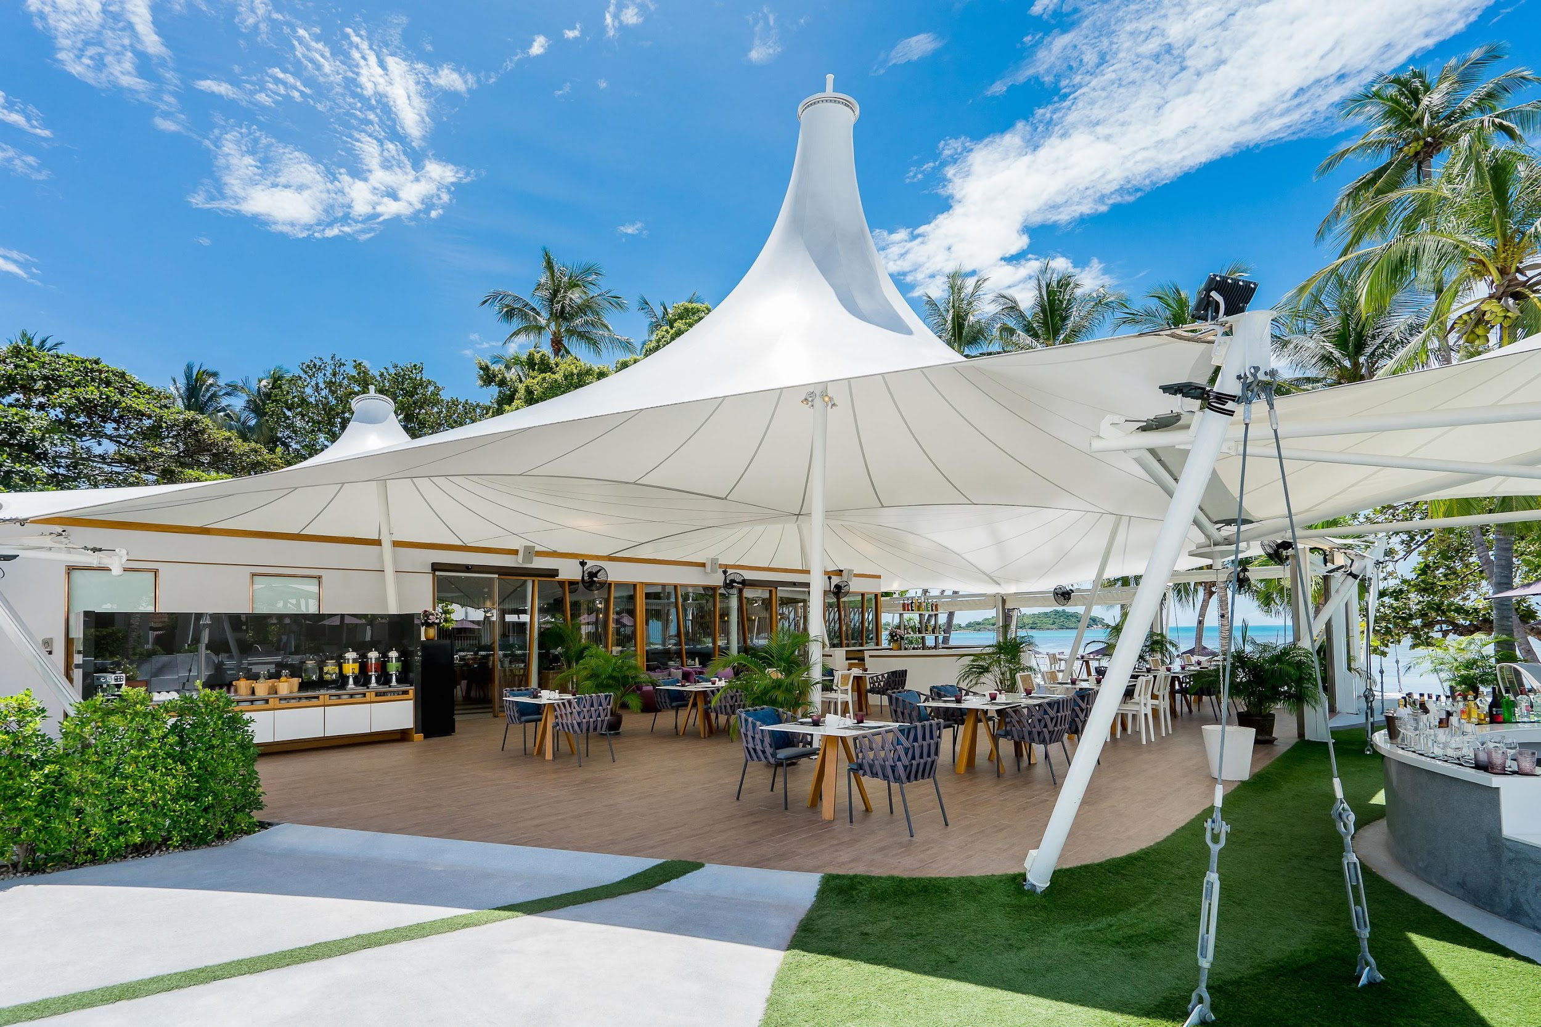
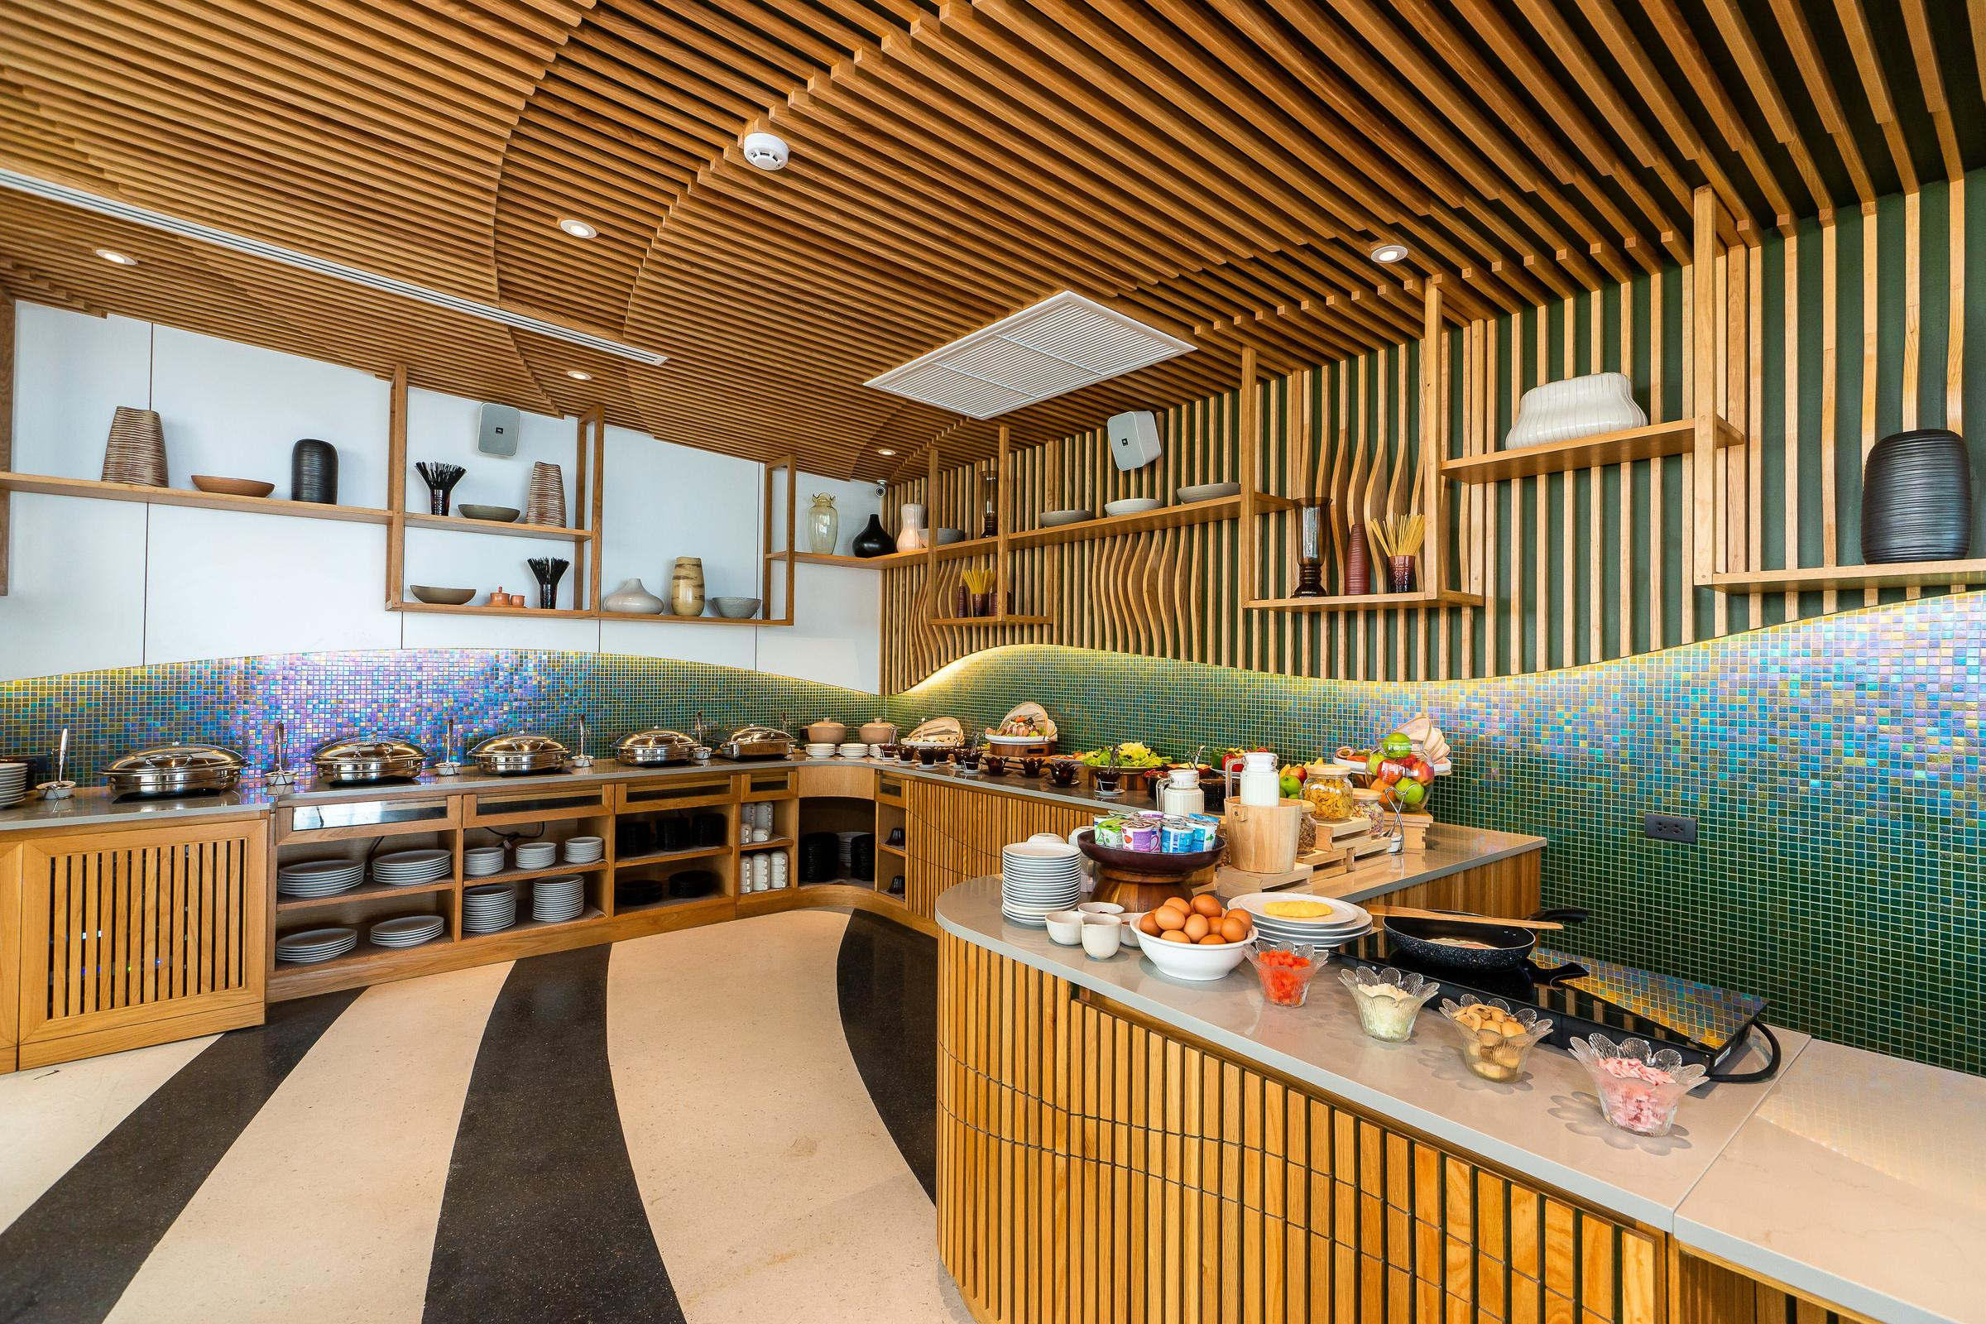
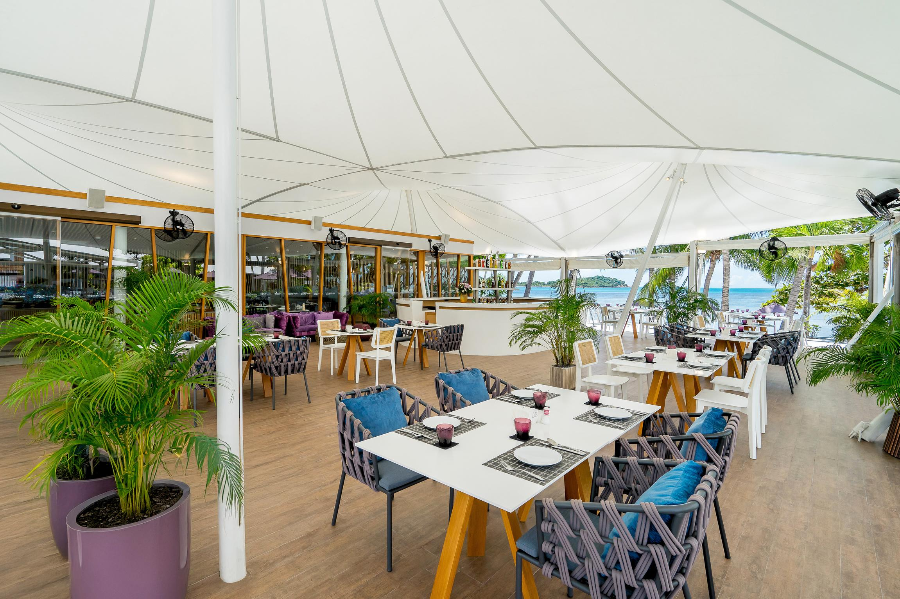

Slide 8
Accommodation

Slide 9
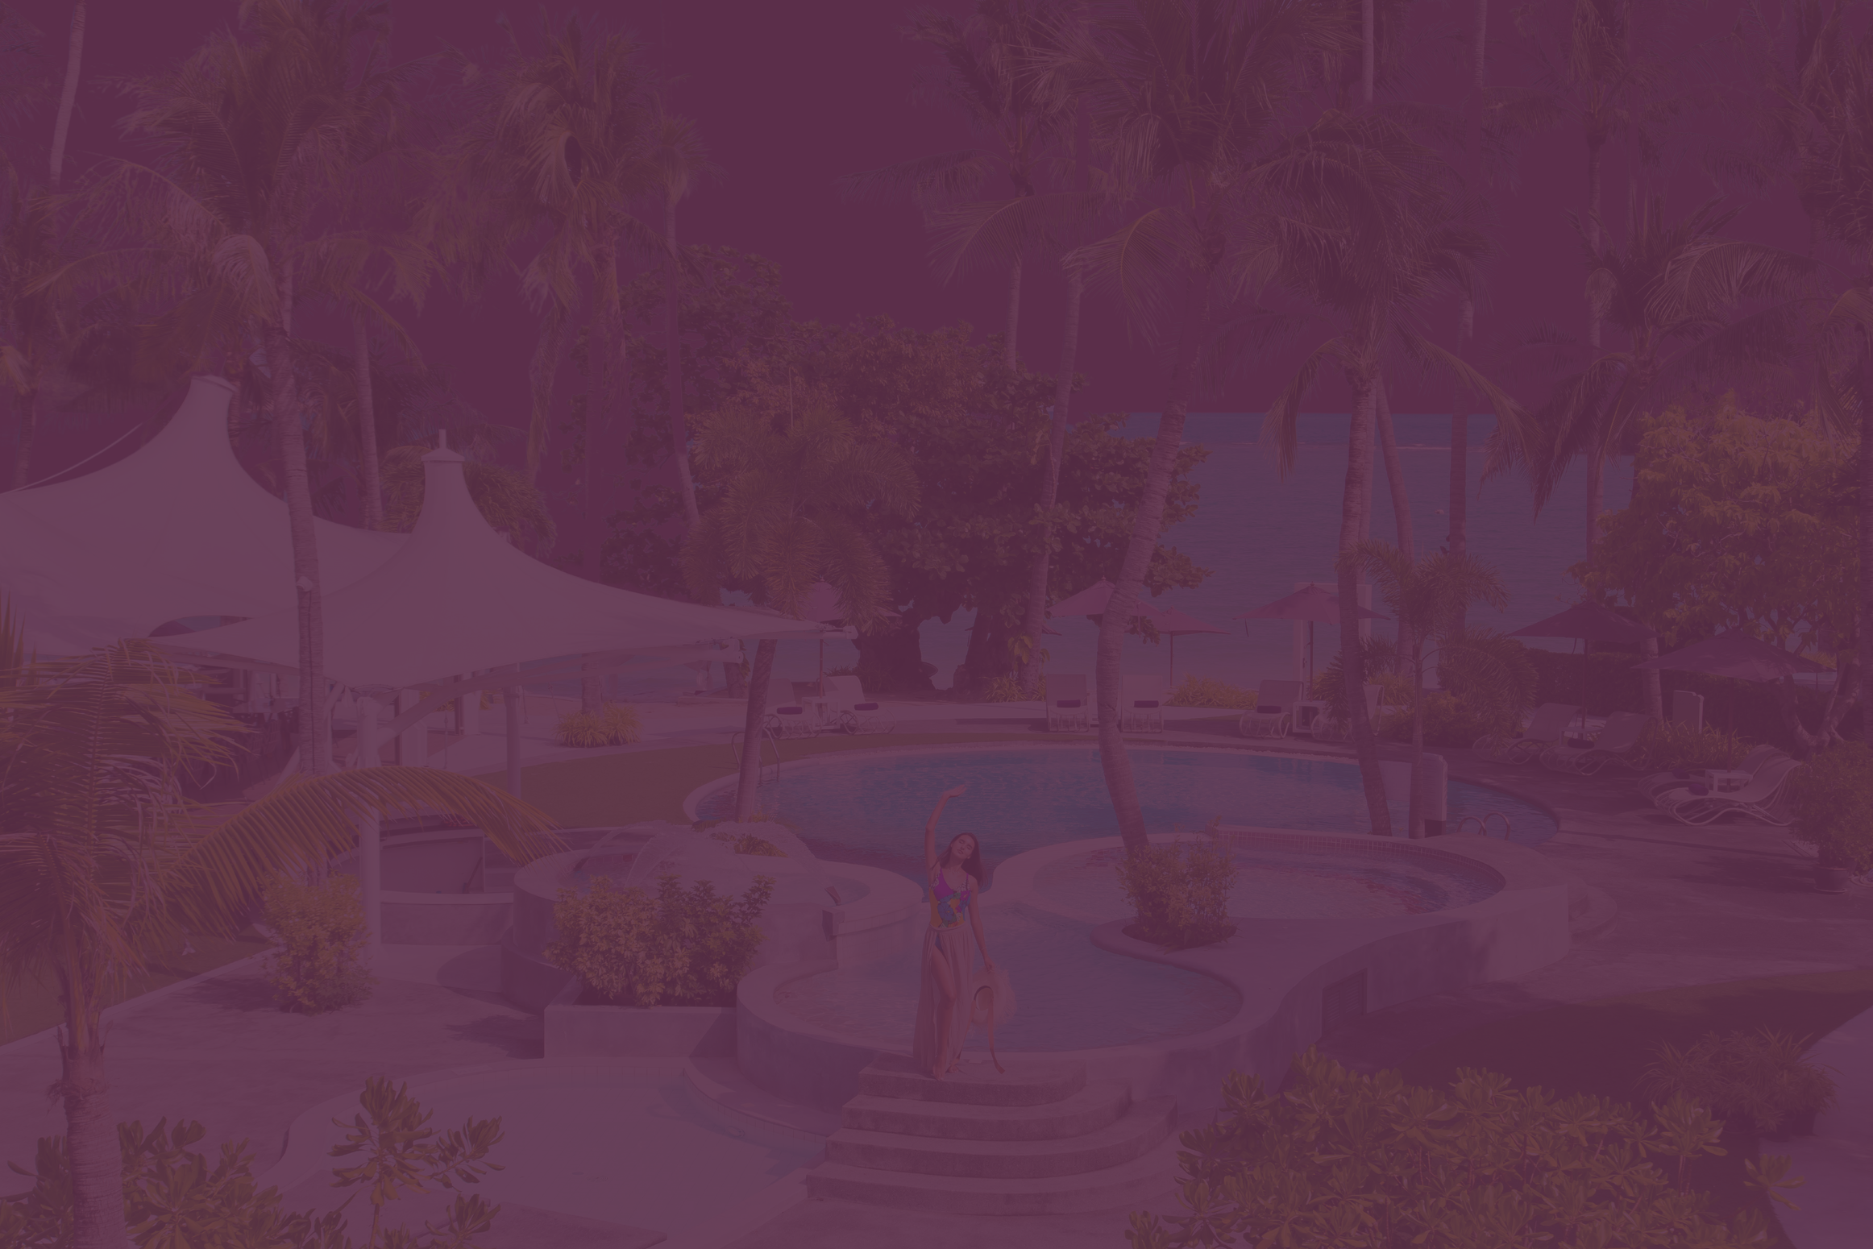
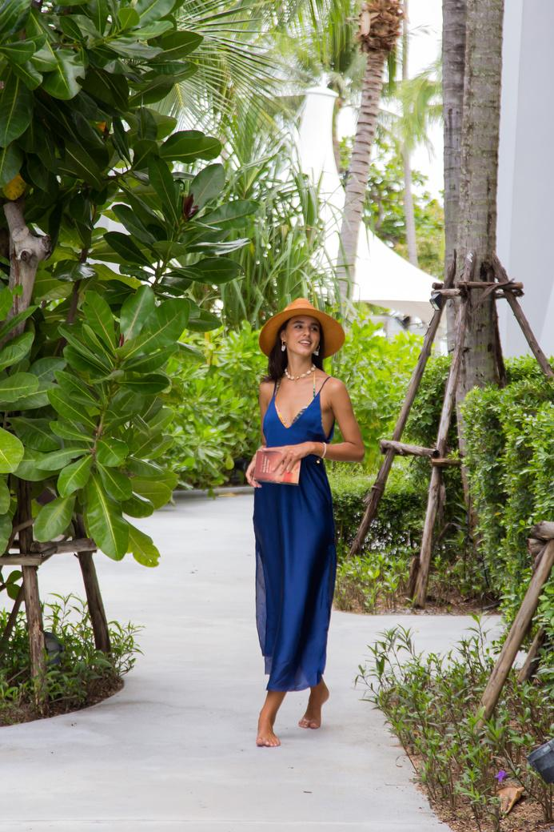
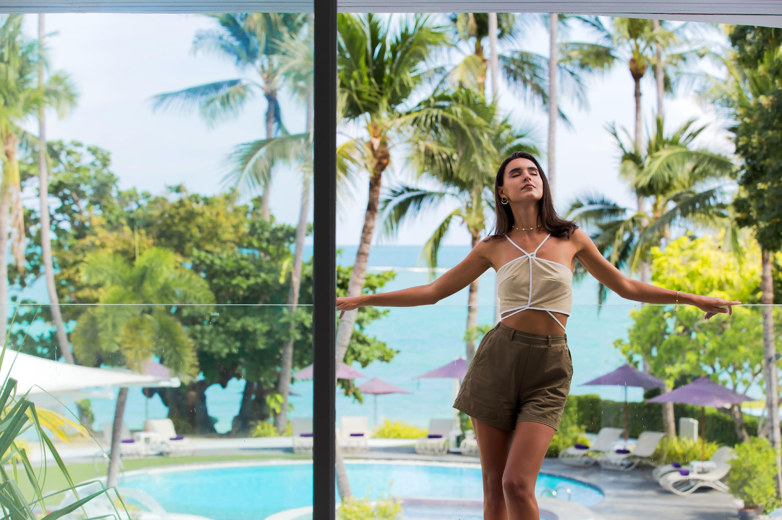
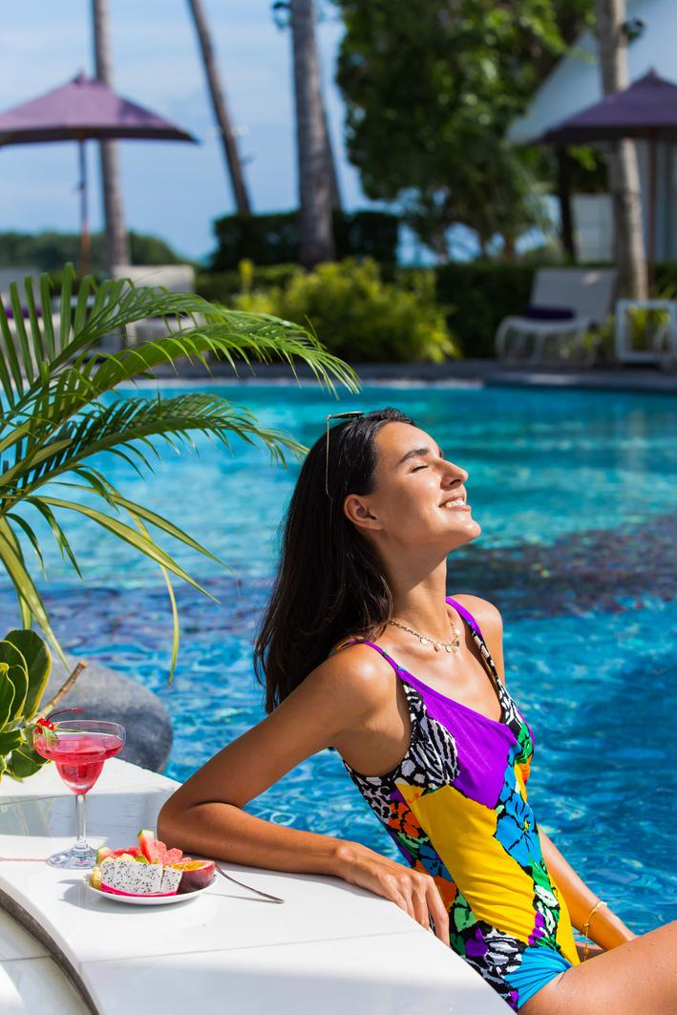
ROOMS
SUITES
VILLAS
DELUXE ROOMS
Total of 32 units (26 Sqm.)
SEAVIEW DELUXE
Total of 2 units (26 Sqm.)
SEAVIEW SUITES
Total of 4 units (54 Sqm.)
VILLA PORTIA
Total of 8 units (33-36 Sqm.)
SEA BREEZE VILLAS
Total of 2 units (45 Sqm.)
BEACHFRONT
POOL VILLA
Total of 1 unit (173 Sqm.)

Slide 10

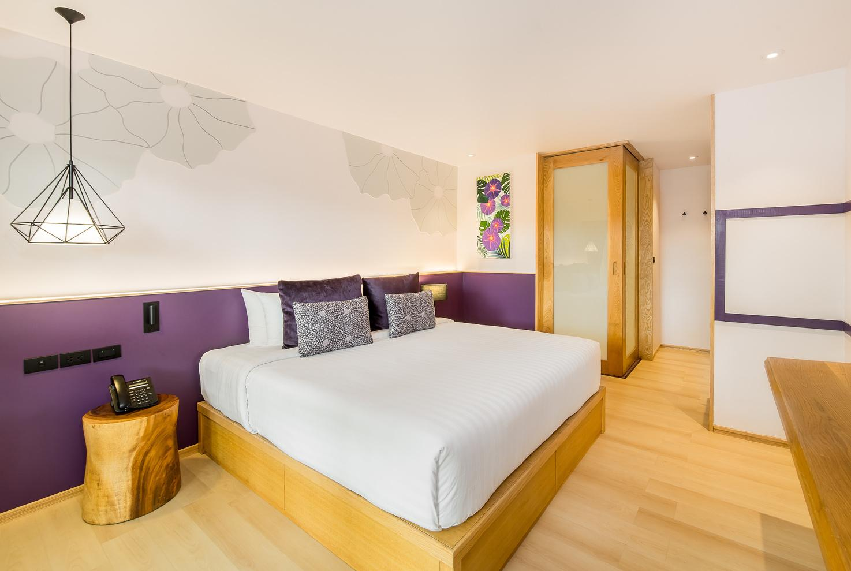
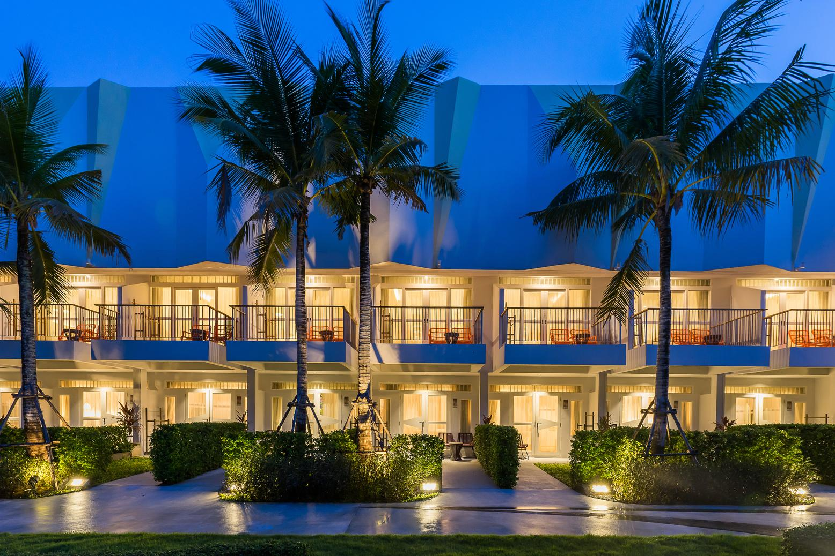


DELUXE ROOMS
These cozy resort rooms make up the majority of our accommodations, offering relaxing space to unwind with elegant decor inspired by Koh Samui’s very own Sea Pandanus trees and Bay hops flowers. Total of 32 units (26 sqm.)

Slide 11
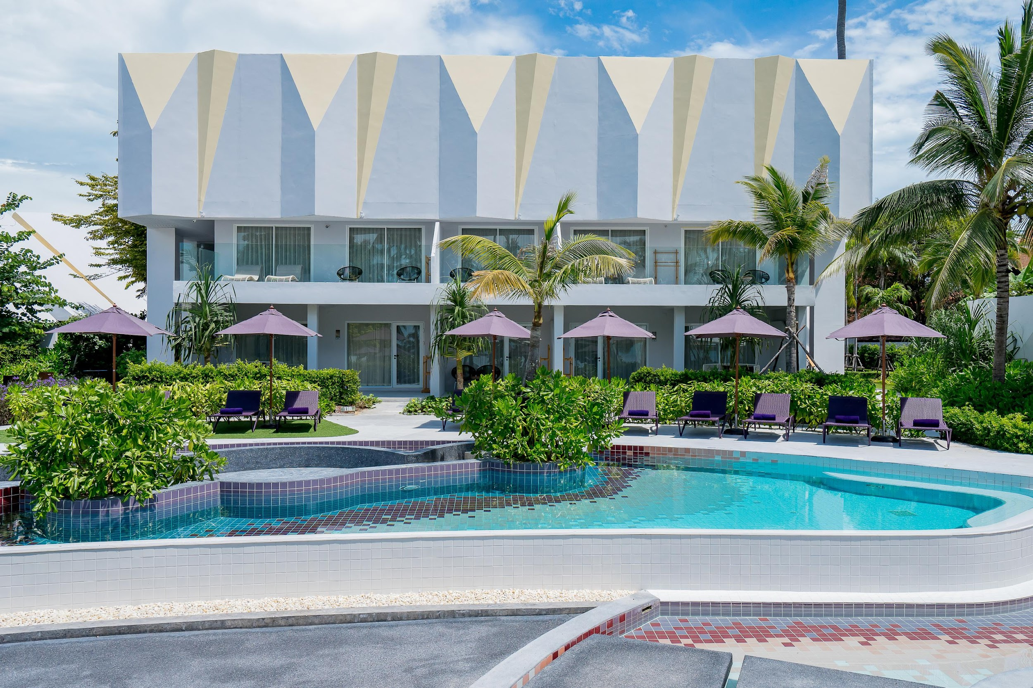
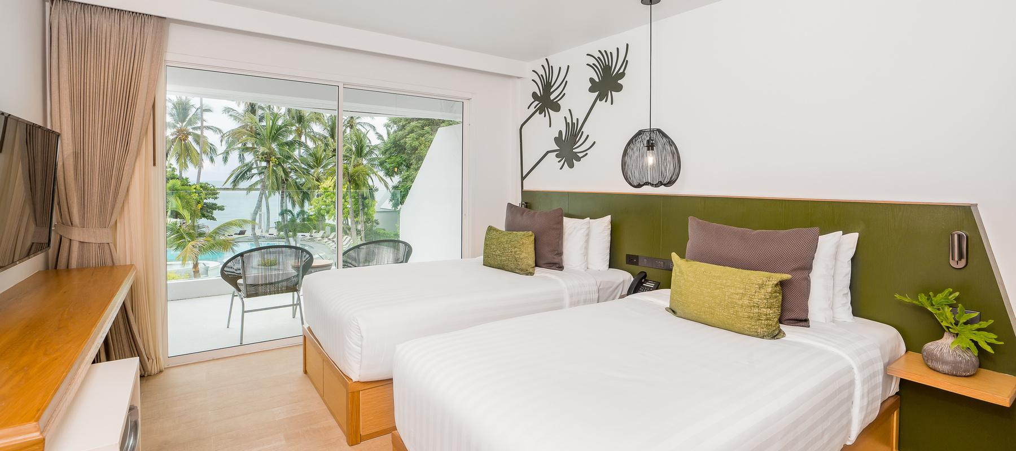

SEAVIEW
DELUXE
With the same layout as our Deluxe Rooms, these rooms are located directly facing the sea, offering an even more relaxing experience for our guests. These rooms are inspired by Ching Chee flowers from the Caper family.
(Book the connecting Seaview Suites to create a 2 bedroom Suite ideal for families)
Total of 2 units (26 sq.m)

Slide 12
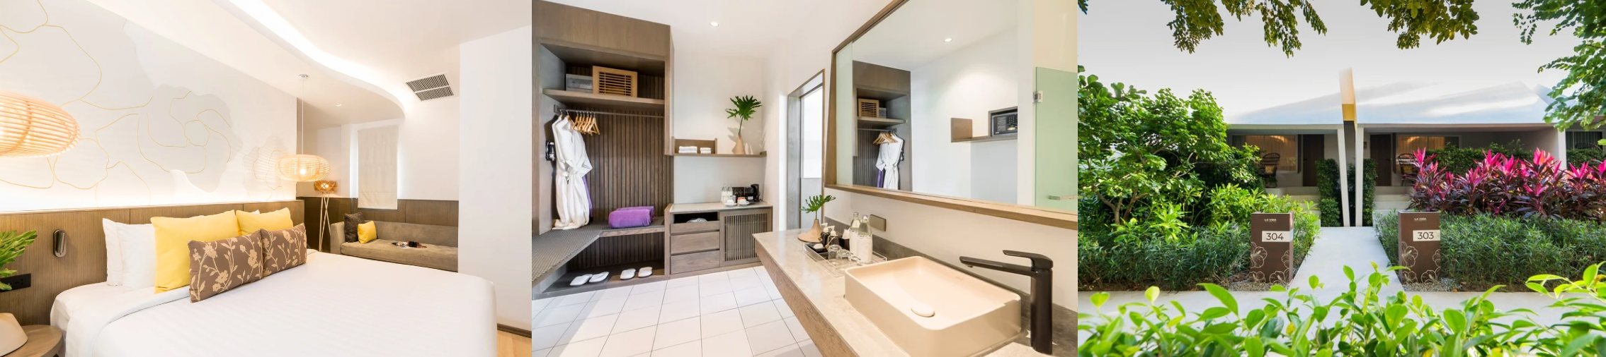


VILLA PORTIA
Offering a perfect blend of affordability and luxury, Villa Portia is the ideal choice for those who want to experience comfort and privacy without compromising on value.
Total of 8 units (33-36 sqm.)

Slide 13
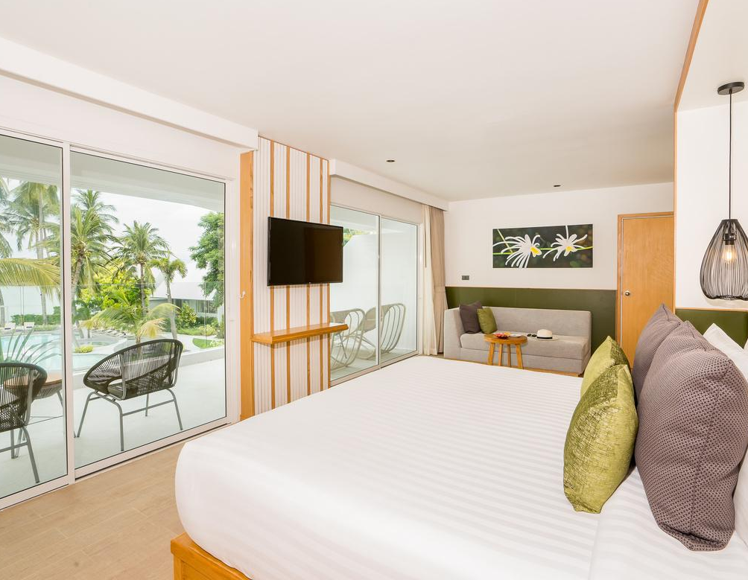
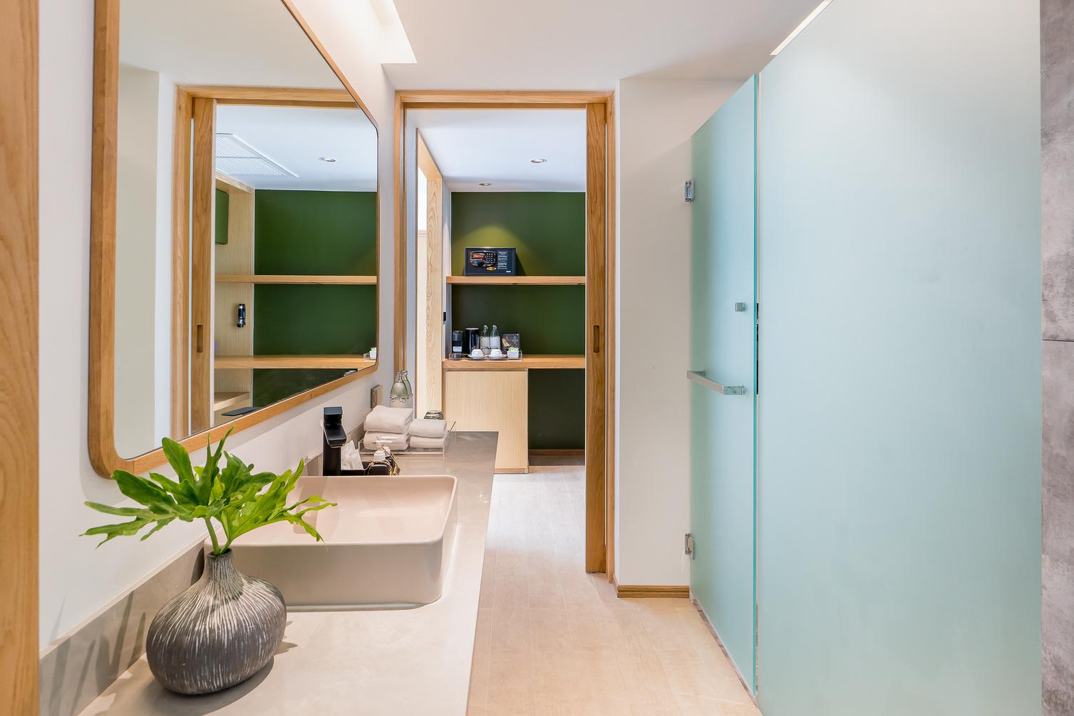
SEAVIEW SUITES
Pamper yourself and indulge in our spacious and elegant Seaview Suite overlooking Chaweng Beach and our generous common area.
(Book the connecting Seaview Deluxe to create a 2 bedroom Suite ideal for families)
Total of 4 units (54 sqm.)
+

Slide 14
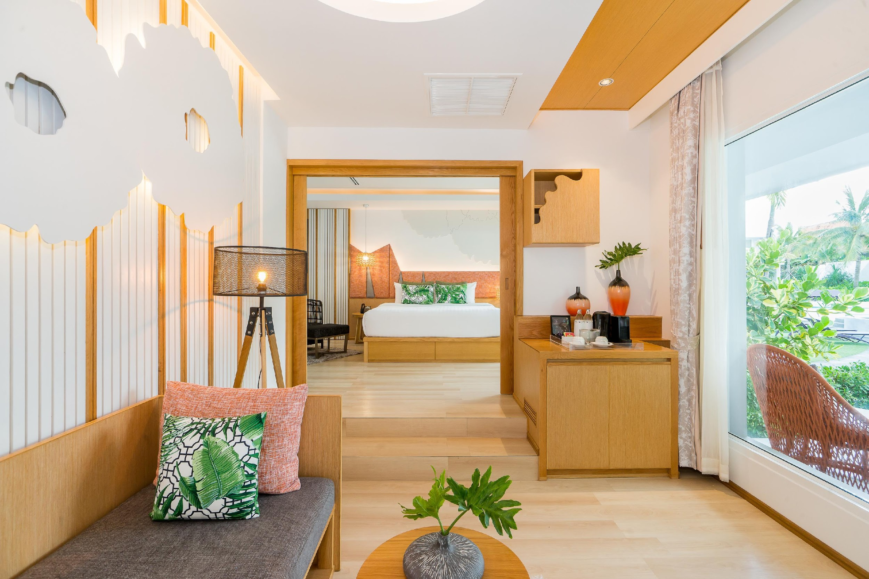
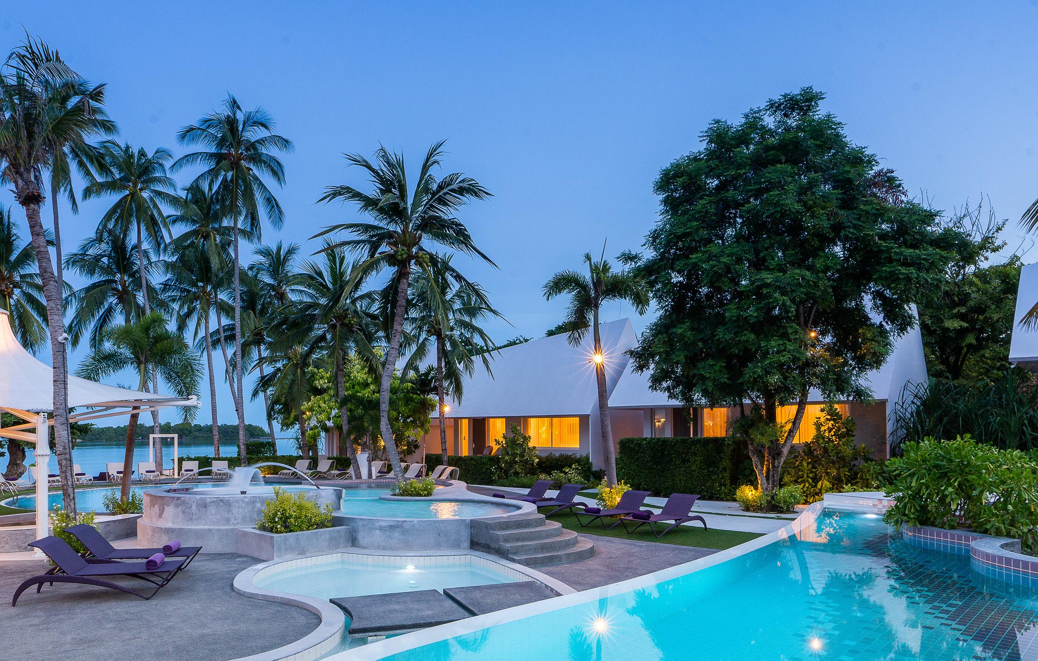

SEA BREEZE VILLAS
With just steps away from the beach, this gorgeous villa type is spacious and vibrant: allowing guests to truly enjoy their ocean retreat.
Total of 2 units (45 sqm.)
+

Slide 15
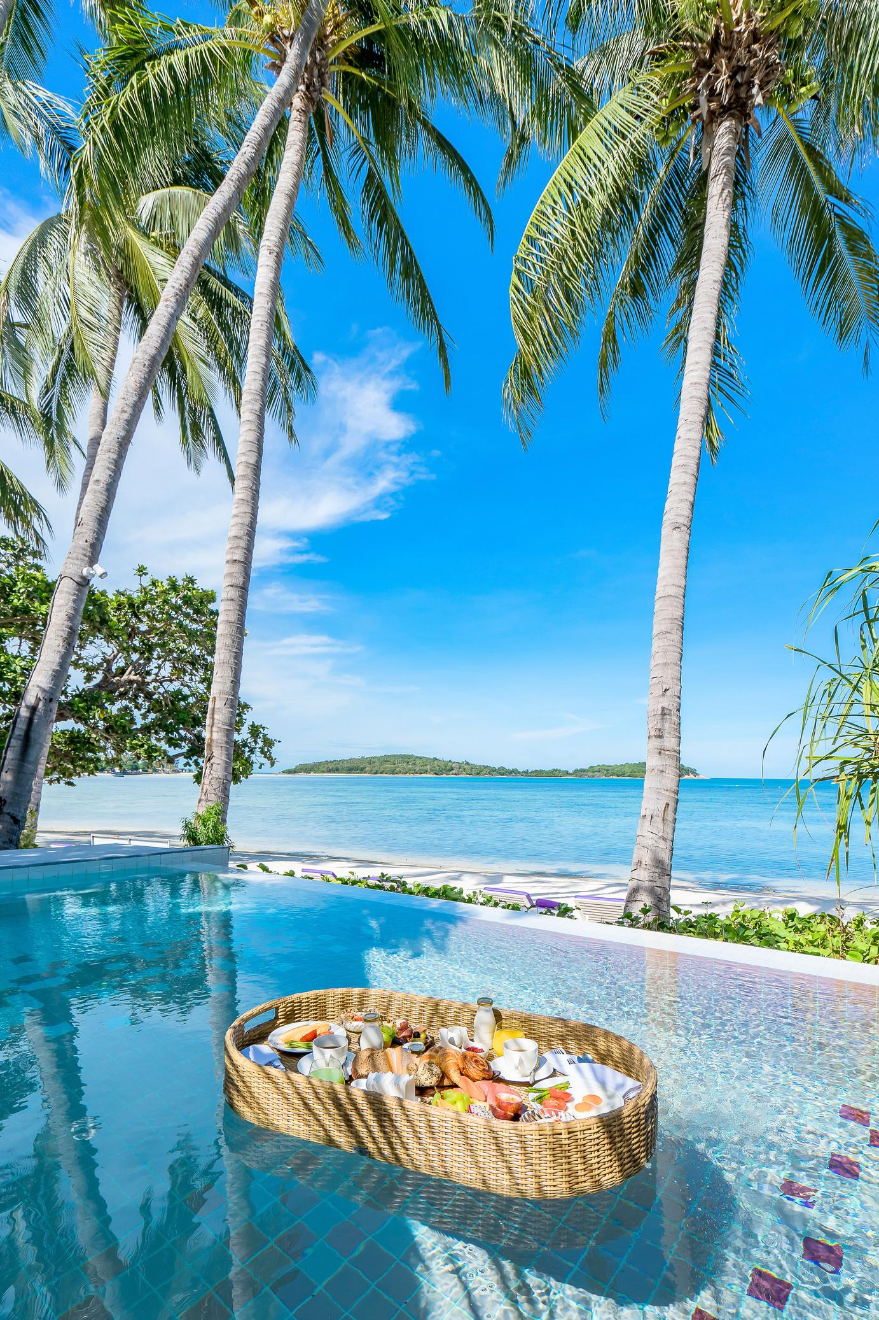
BEACHFRONT POOL VILLA
Indulge in a luxury beachfront escape, our Beachfront Pool Villa boasts a complete island experience. With the same generous layout as the Sea Breeze Villas, this type of villa offers a private pool facing the peaceful lagoon allowing guests to fully recharge and reconnect with those who matter most. Total of 1 units (173 sqm.)
+

Slide 16
Facilities

Slide 17
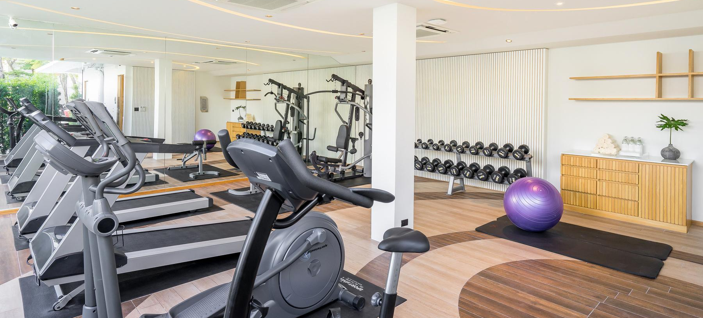
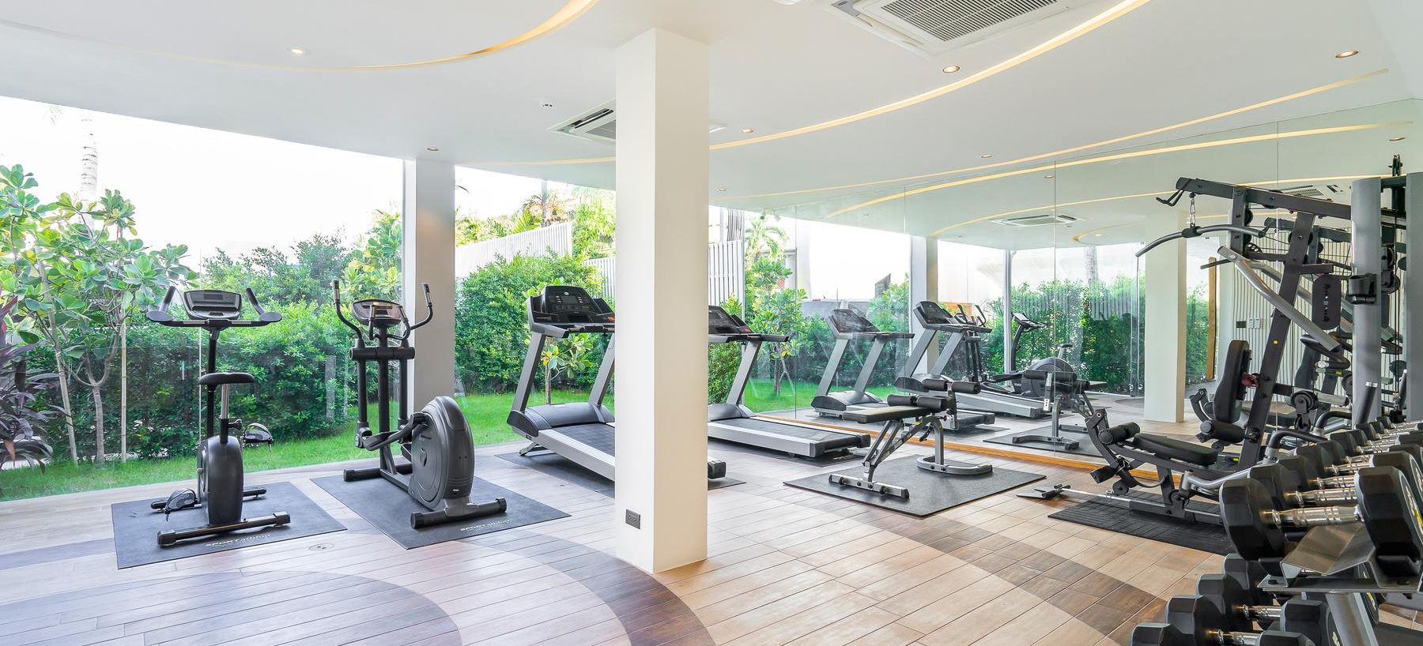
Keep the “VIVA LA VIDA” spirit alive during the holiday! Stay active and energised with access to our fitness center from 6:00 AM to 8:00 PM every day.
Fitness
Centre.
long live life

Slide 18
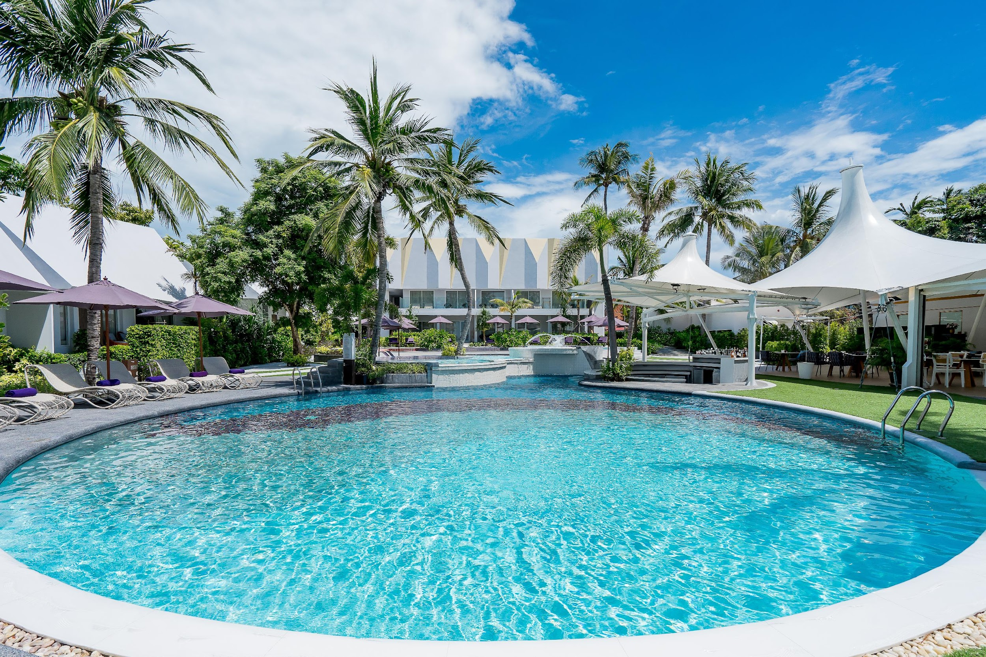
The Pools & Pool Bar

Slide 19

Chaweng Beach, 155/3 Moo 2, Bophut, Koh Samui, Suratthani 84320 Thailand
T: +66 (0) 7730 0435 - 43
F: +66 (0) 7730 0444
www.synergysamui.com l Email: info@synergysamui.com

