Slide 1


Slide 2


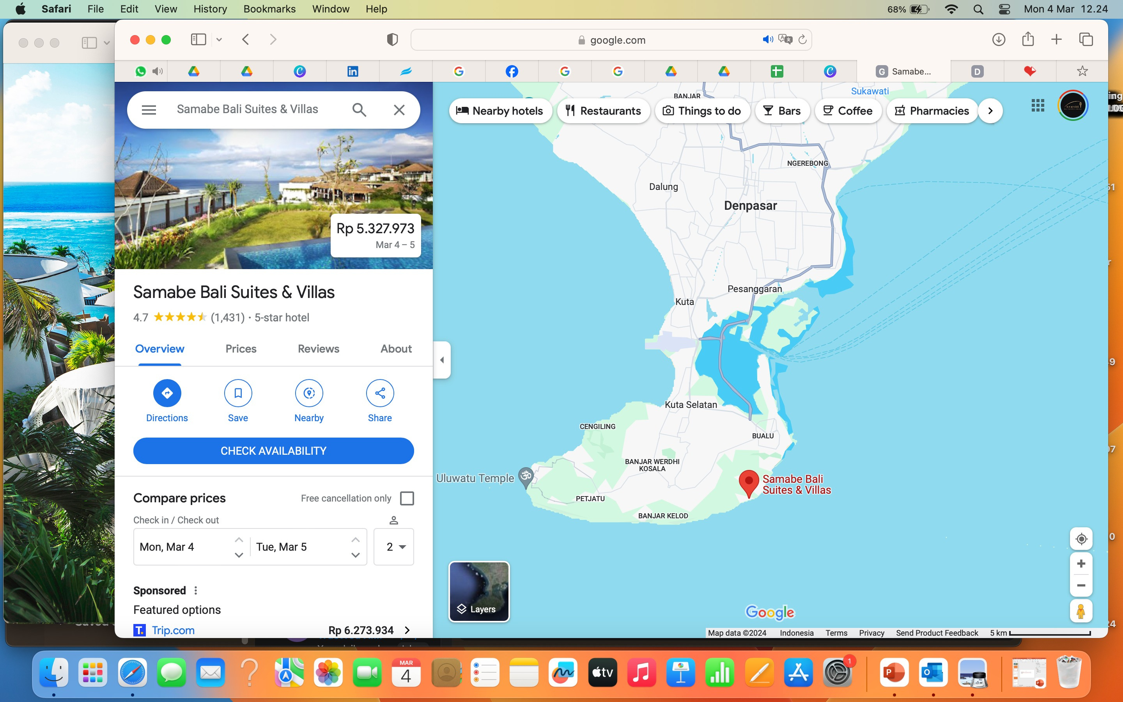
2
PRIME POSITIONED
Only 17 km or about 30 to 35 minutes away from Bali Ngurah Rai International Airport
SAMABE BALI SUITES & VILLAS

Slide 3
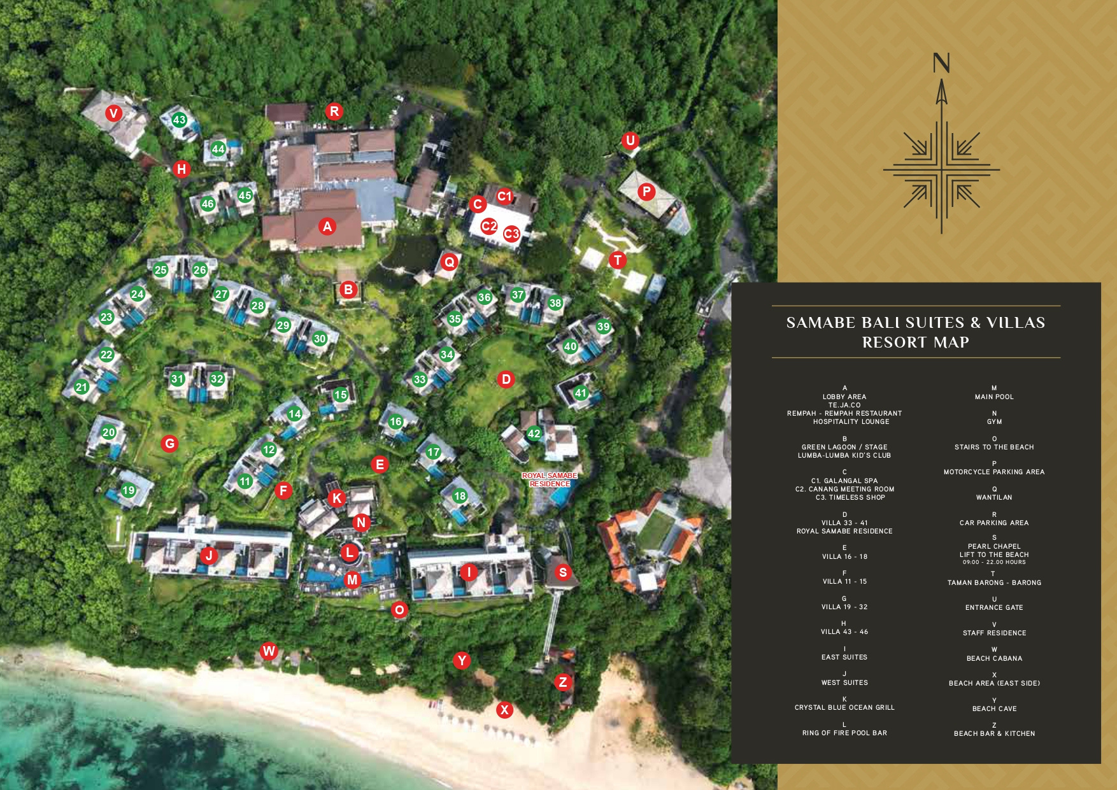
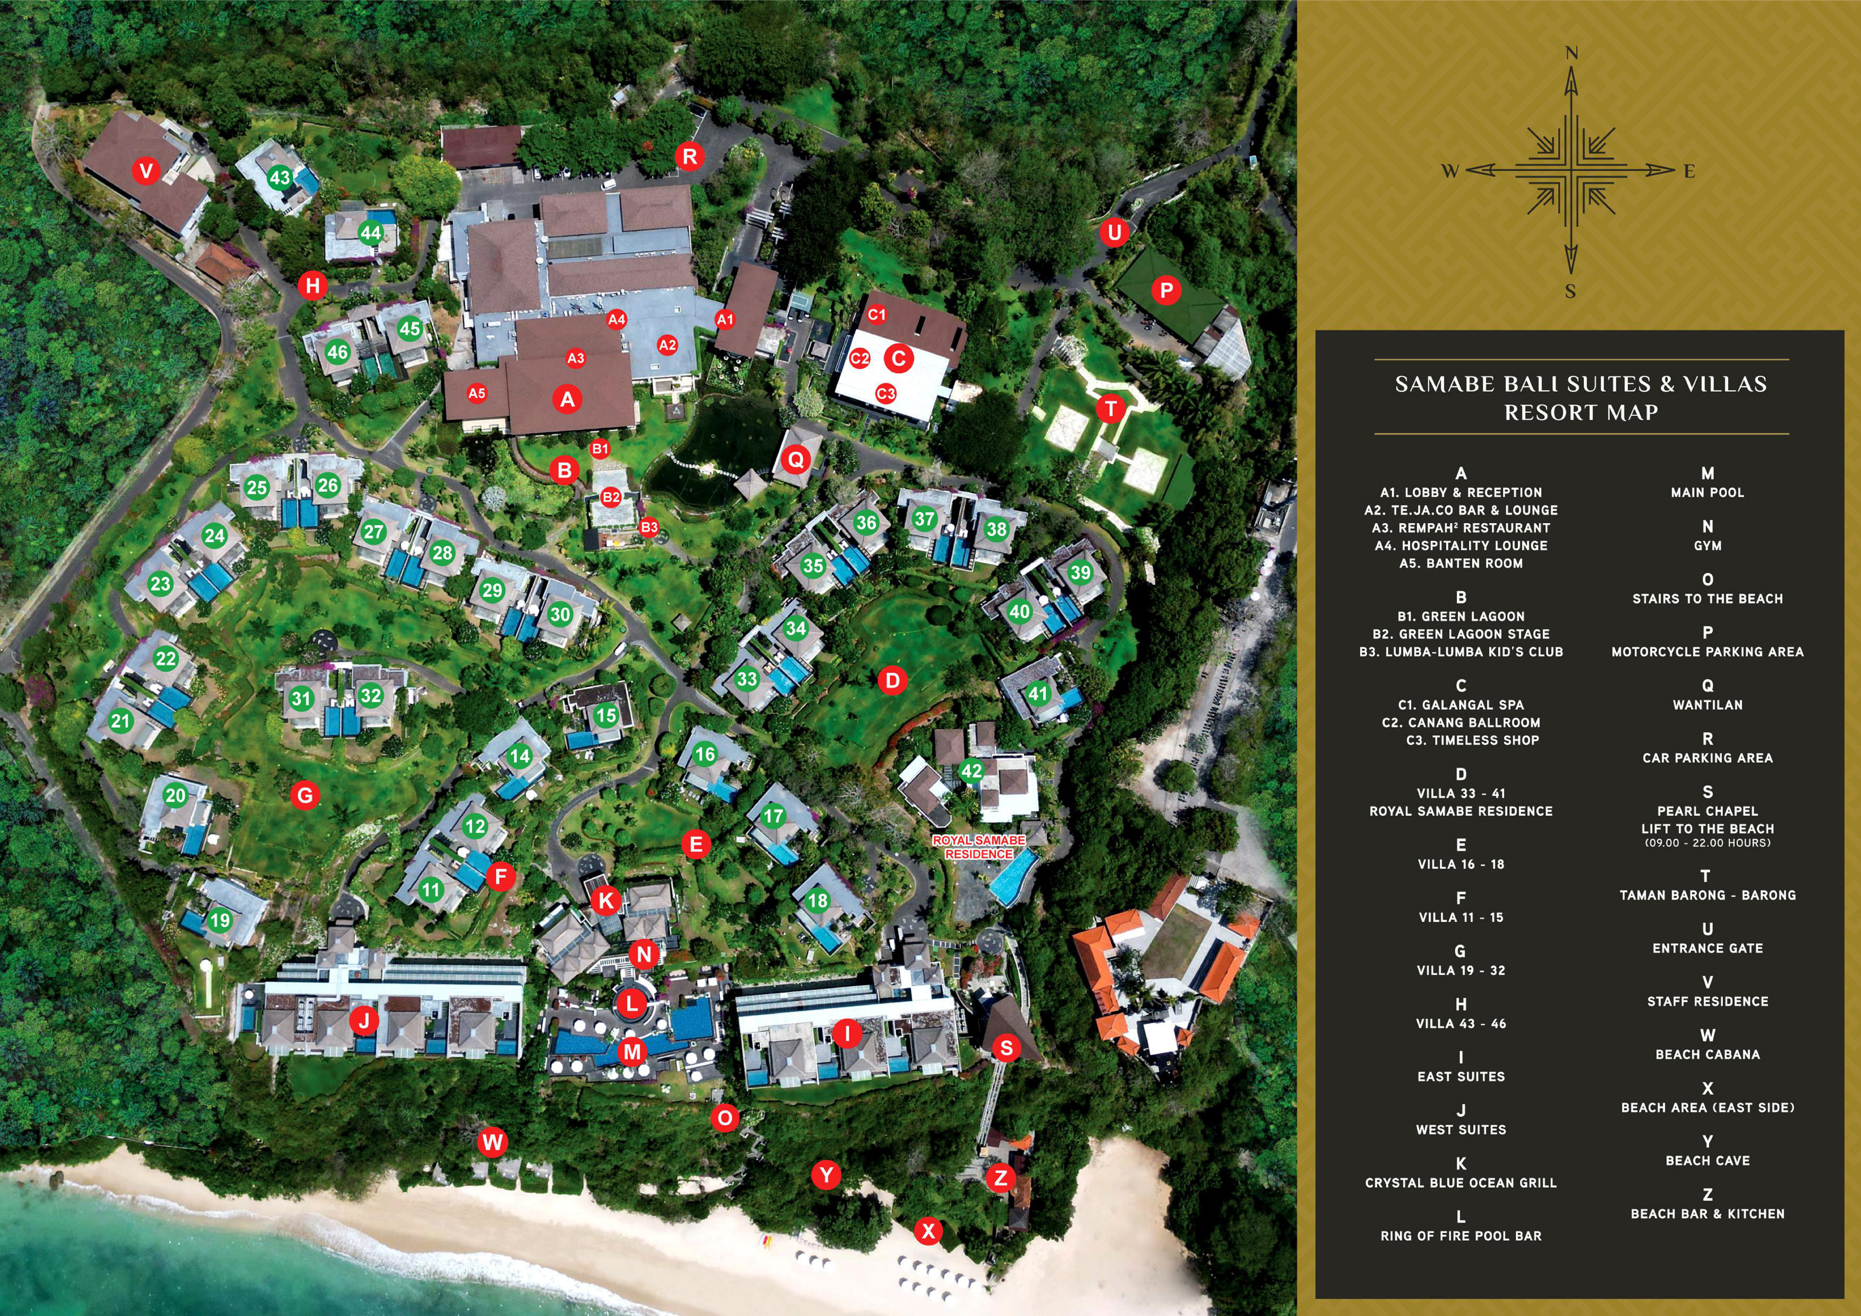
3
SAMABE BALI SUITES & VILLAS

Slide 4
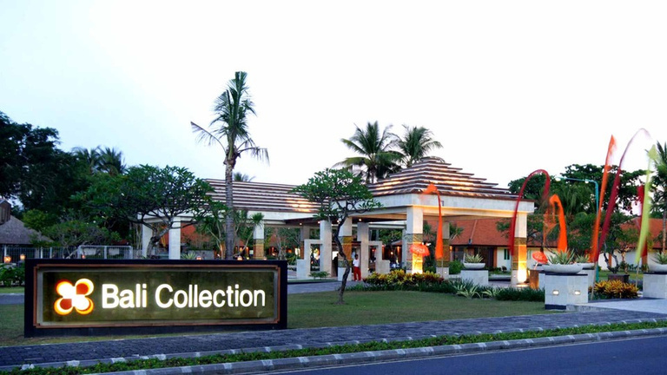
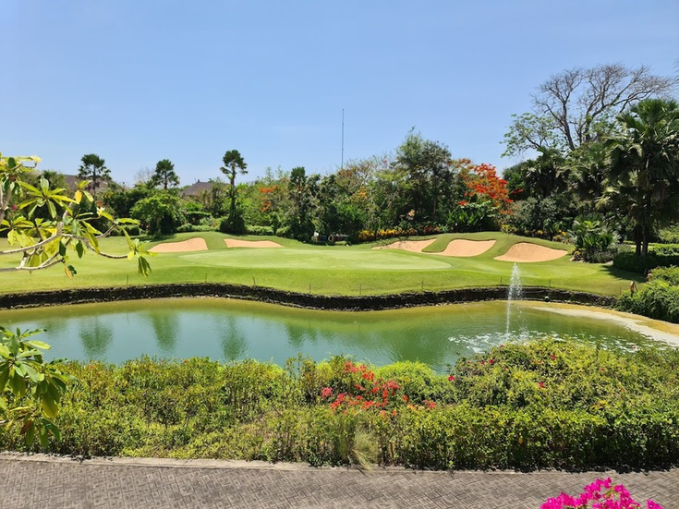
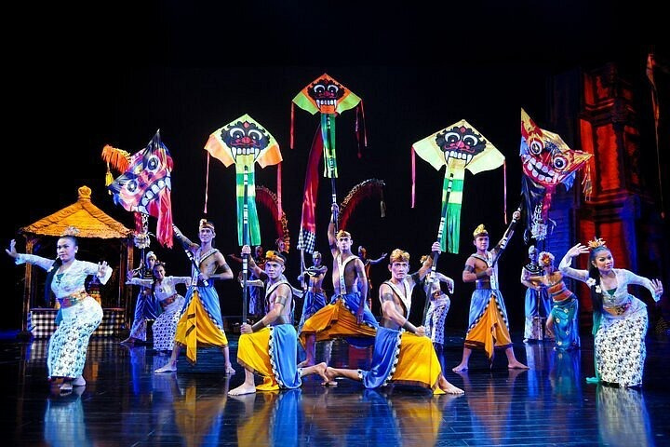
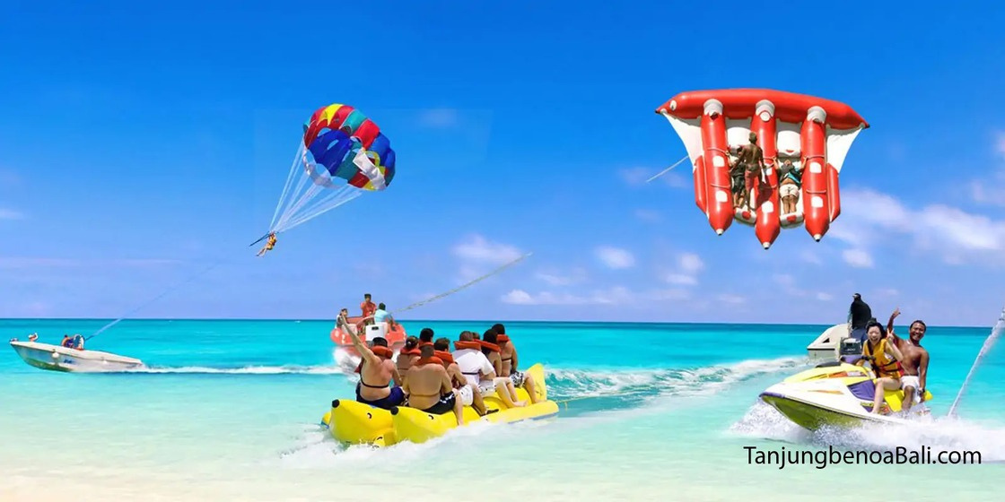
4
NEARBY THE RESORT
Bali Collection Shopping Center
Bali National Golf Club
SAMABE BALI SUITES & VILLAS
Devdan Show
Tanjung Benoa Watersport

Slide 5
5
SUITES & VILLAS
SAMABE BALI SUITES & VILLAS

Slide 6
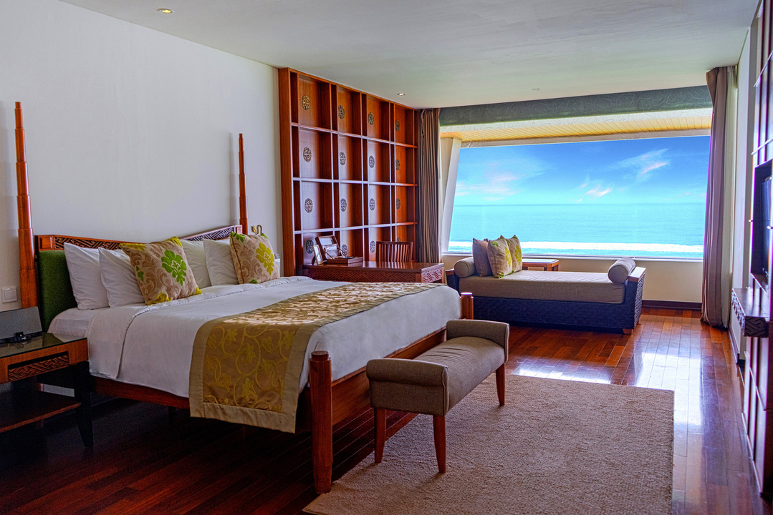
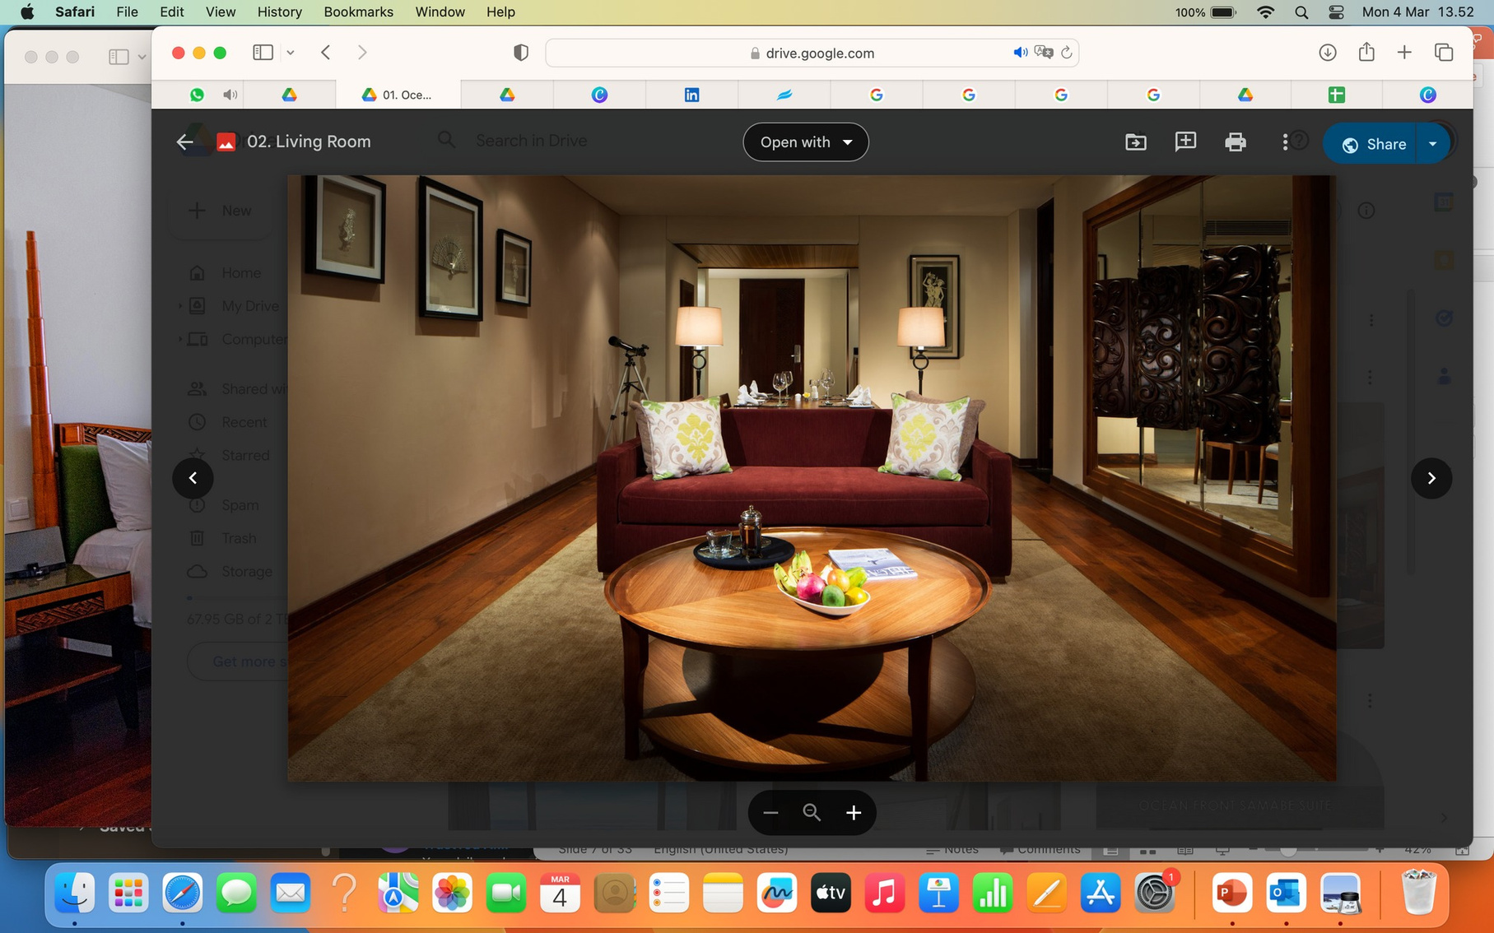
6
SAMABE BALI SUITES & VILLAS
Ocean Front Samabe Suites
1 King Size Bed (200 x 200cm) Ocean Front View, Cliff Top 135 Square Meters 3 Adults + 1 Child

Slide 7
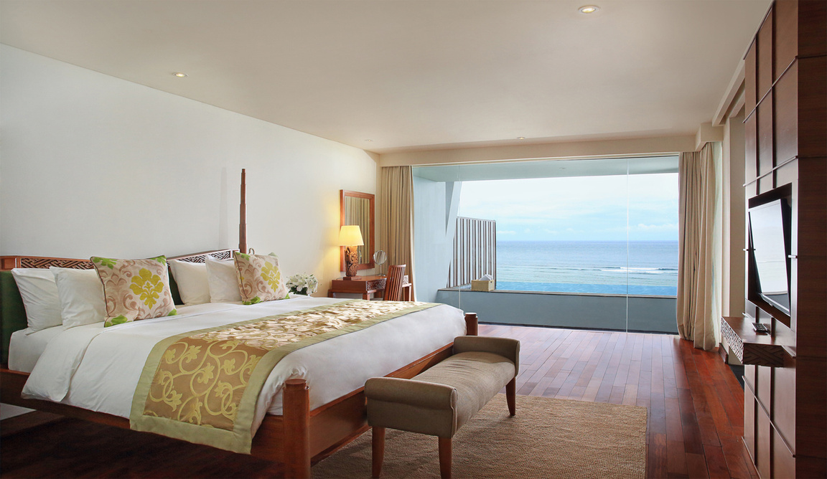
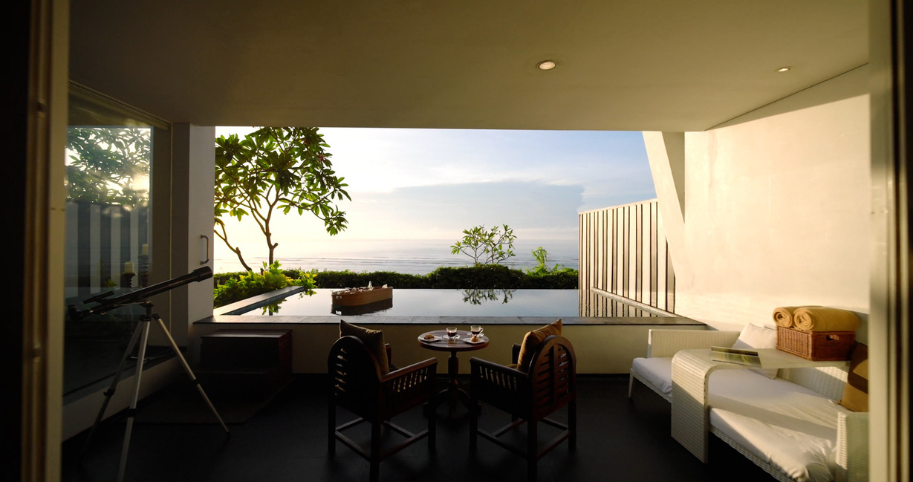
7
SAMABE BALI SUITES & VILLAS
Ocean Front Samabe Pool Suites
1 x King Size Bed (200 x 200 cm) Ocean Front 180 Square Meters 2 Adults + 2 Children

Slide 8
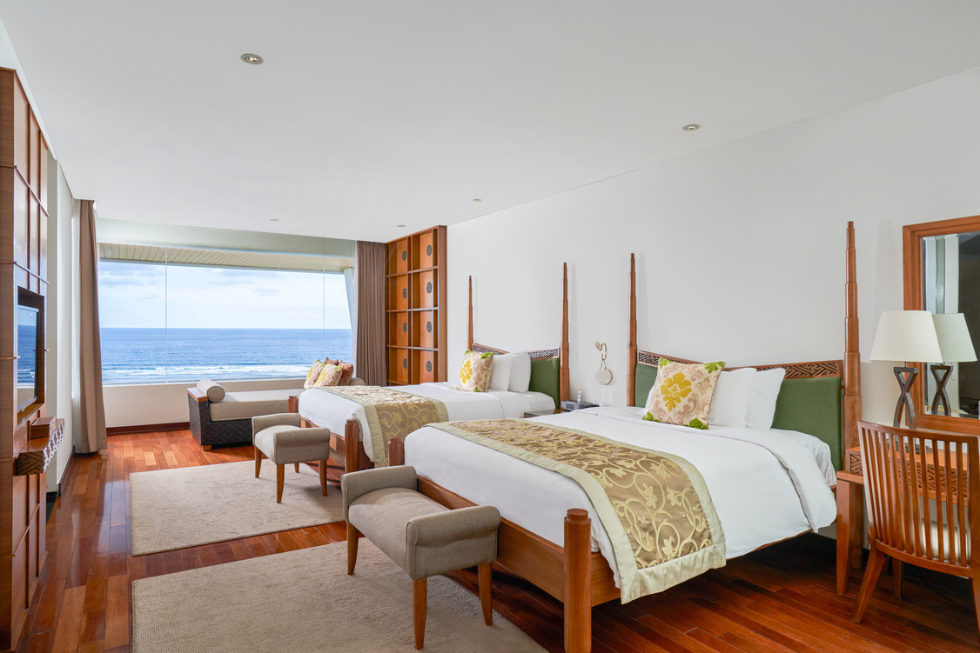
8
SAMABE BALI SUITES & VILLAS
Ocean Front Family Suites
2 x Queen Size Bed (160 x 200 cm) Ocean Front, Cliff Top 135 Square Meters 4 Adults + 1 Child

Slide 9
9
SAMABE BALI SUITES & VILLAS
Ocean Front Family Pool Suites
2 x Queen Size Bed (160 x 200 cm) Ocean Front 180 Square Meters 4 Adults + 1 Child

Slide 10
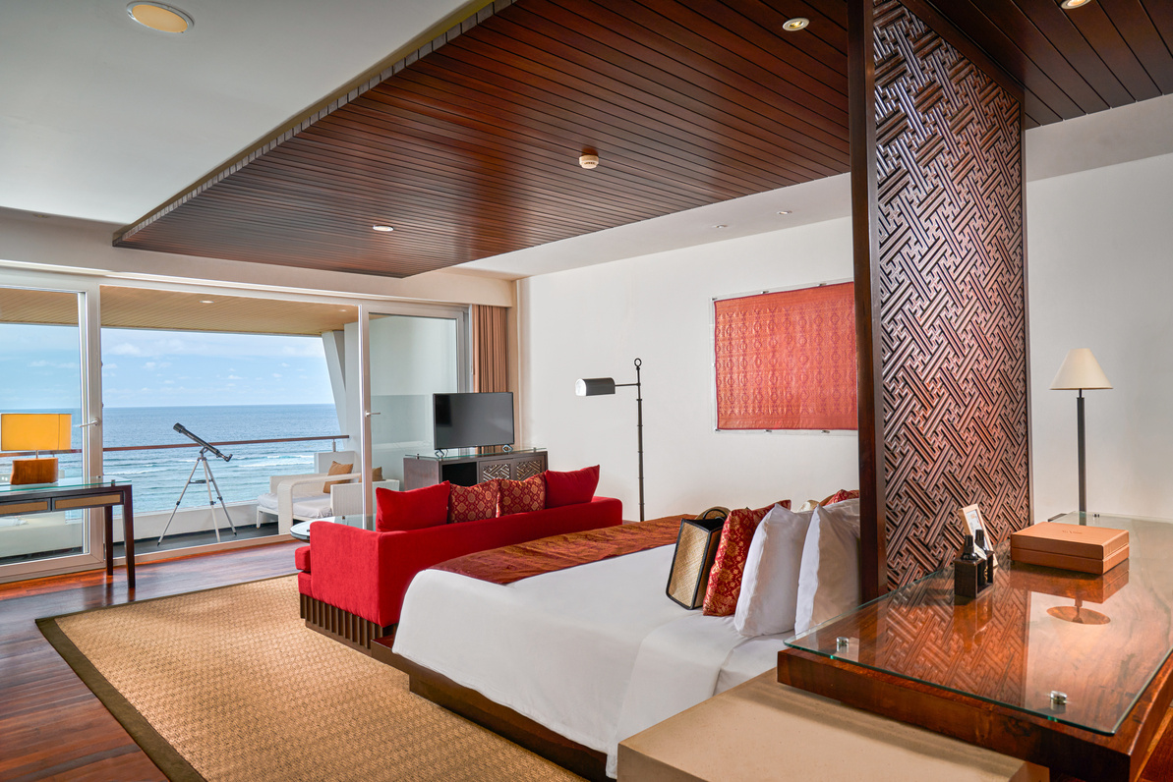
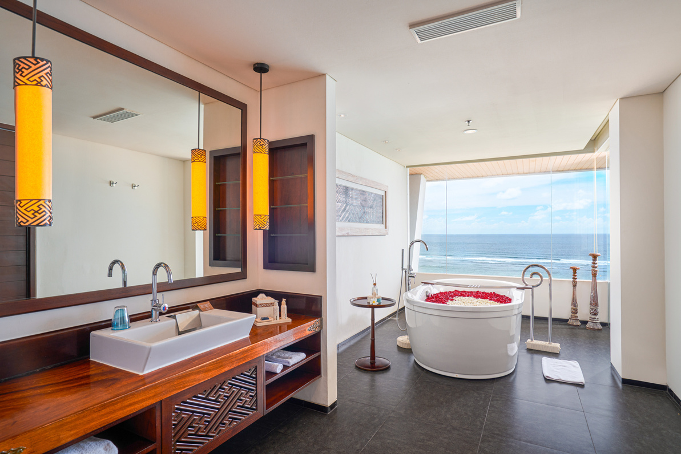
10
SAMABE BALI SUITES & VILLAS
Ocean Front Honeymoon Suites
1 x King Size Bed ( 200 x 200 cm) Ocean Front, Cliff Top 135 Square Meters 2 Adults + 2 Children

Slide 11
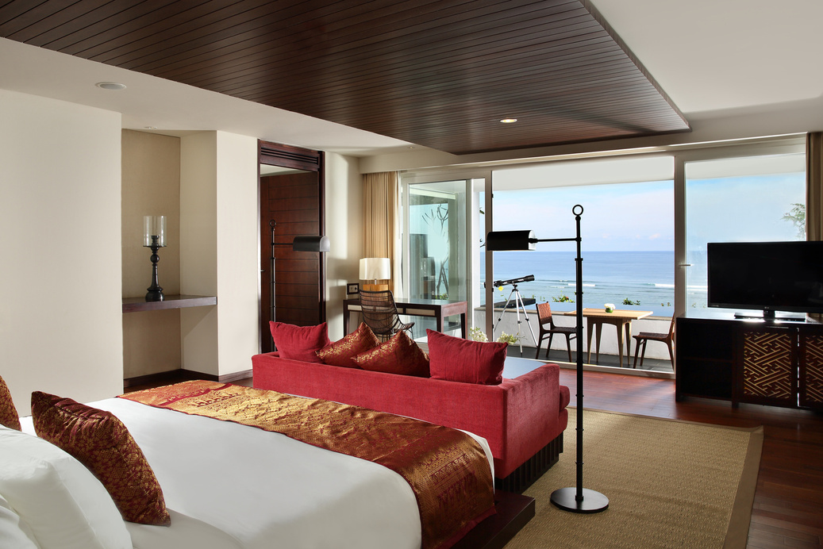
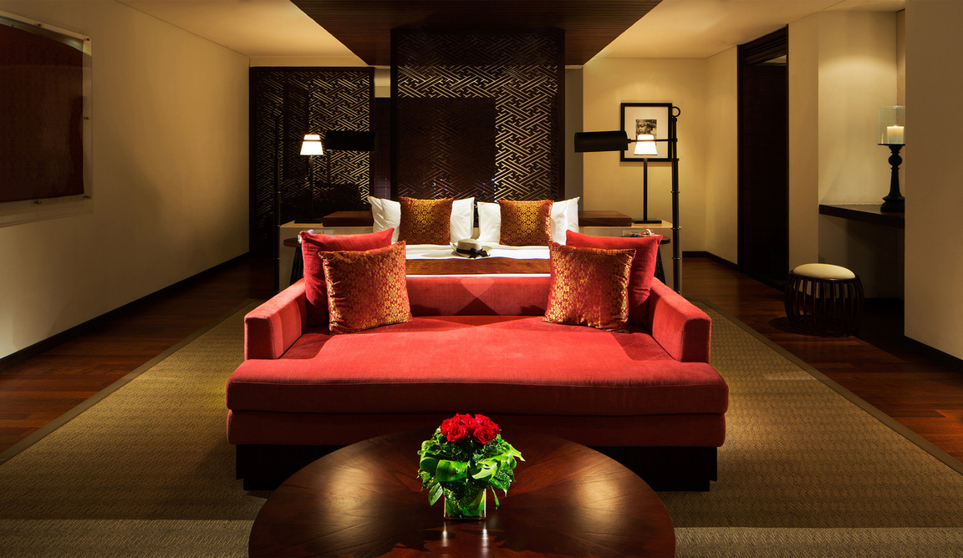
11
SAMABE BALI SUITES & VILLAS
Ocean Front Honeymoon Pool Suites
1 King Bed (200 x 200 cm) Ocean Front 180 Square Meters 2 Adults + 2 Children

Slide 12
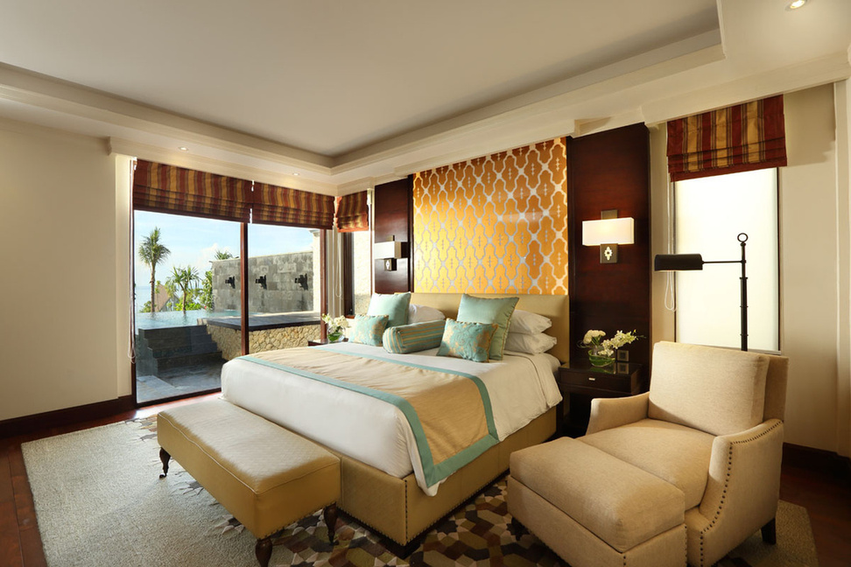
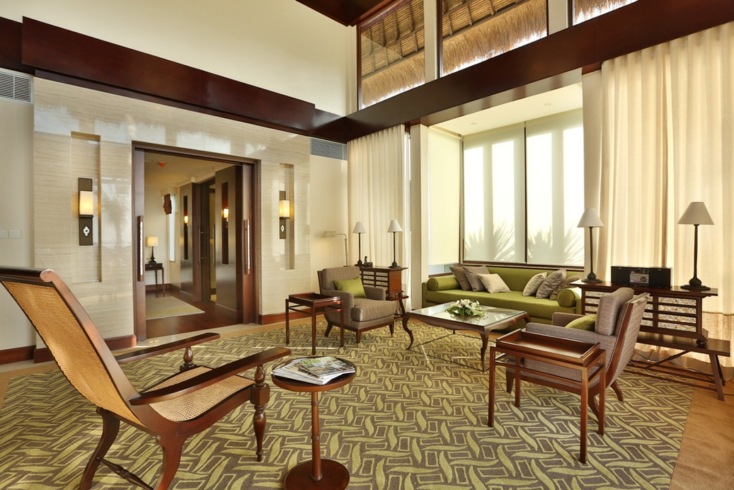
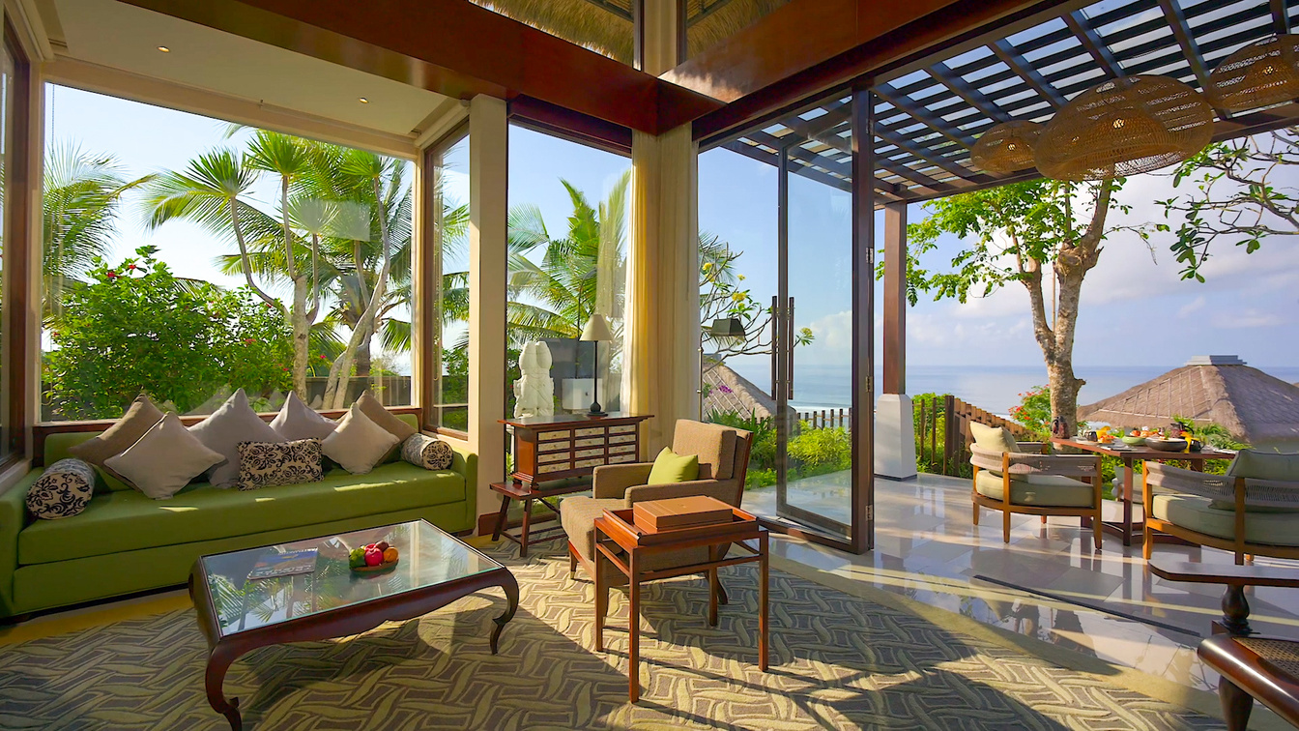
12
SAMABE BALI SUITES & VILLAS
One Bedroom Pool Villa
1 x King Size Bed (200 x 200 cm)
Prime Ocean View, Partial Ocean View or Garden View
375 - 400 Square Meters 3 Adults + 1 Child

Slide 13
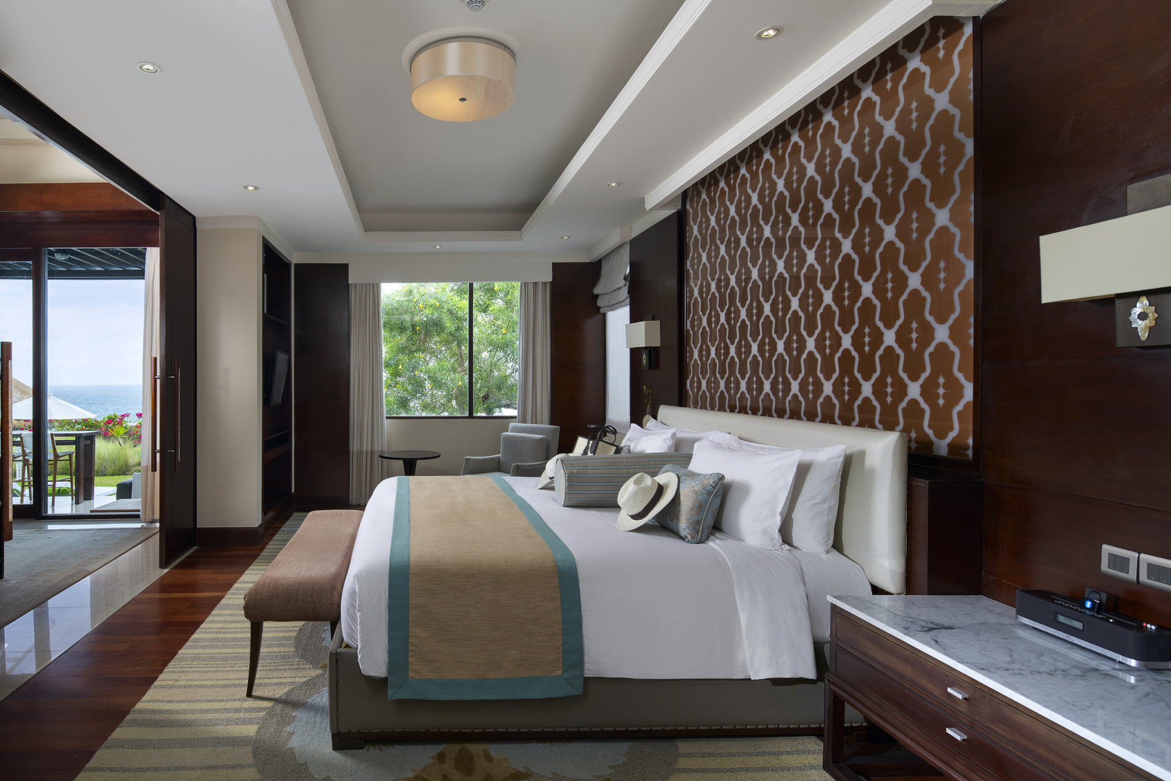
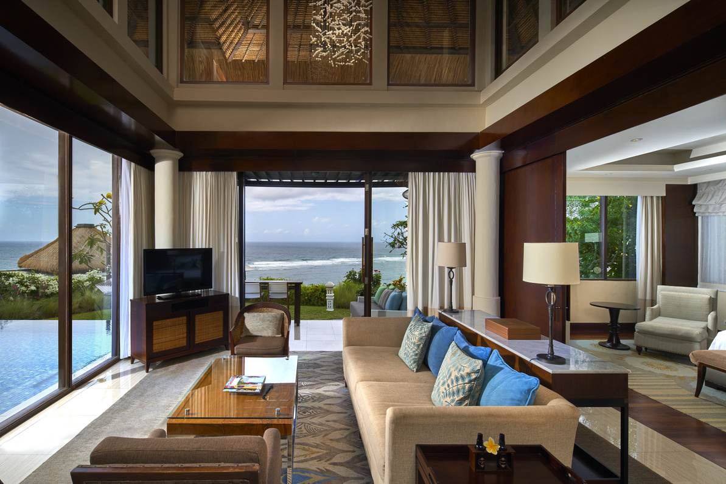
13
SAMABE BALI SUITES & VILLAS
Two Bedroom Pool Villa
1 x King Size Bed (200 x 200 cm) in Master Bedroom 2 x Single Bed (120 x 200 cm) in the Second Bedroom Ocean View or Garden View 400 - 450 Square Meters 5 Adults + 1 Child

Slide 14
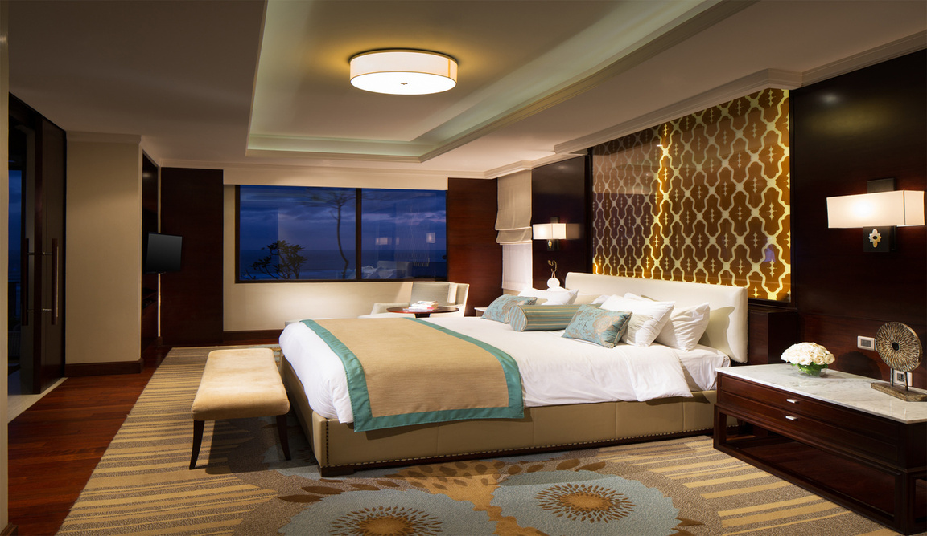
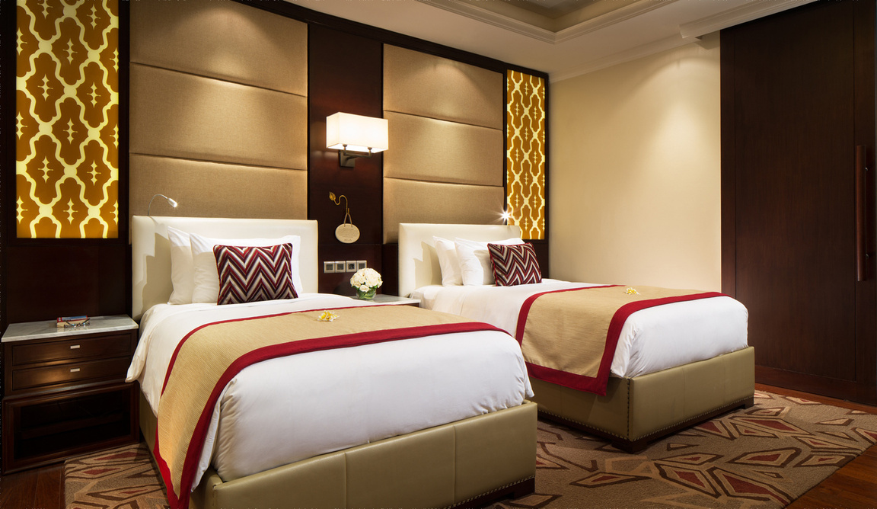
14
SAMABE BALI SUITES & VILLAS
Two Bedroom Penthouse Pool Villa
1 x King Size Bed (200 x 200 cm) in Master Bedroom 2 x Single Beds (120 x 200 cm) in the Second Bedroom Panoramic Ocean Front View 304 Square Meters 5 Adults

Slide 15
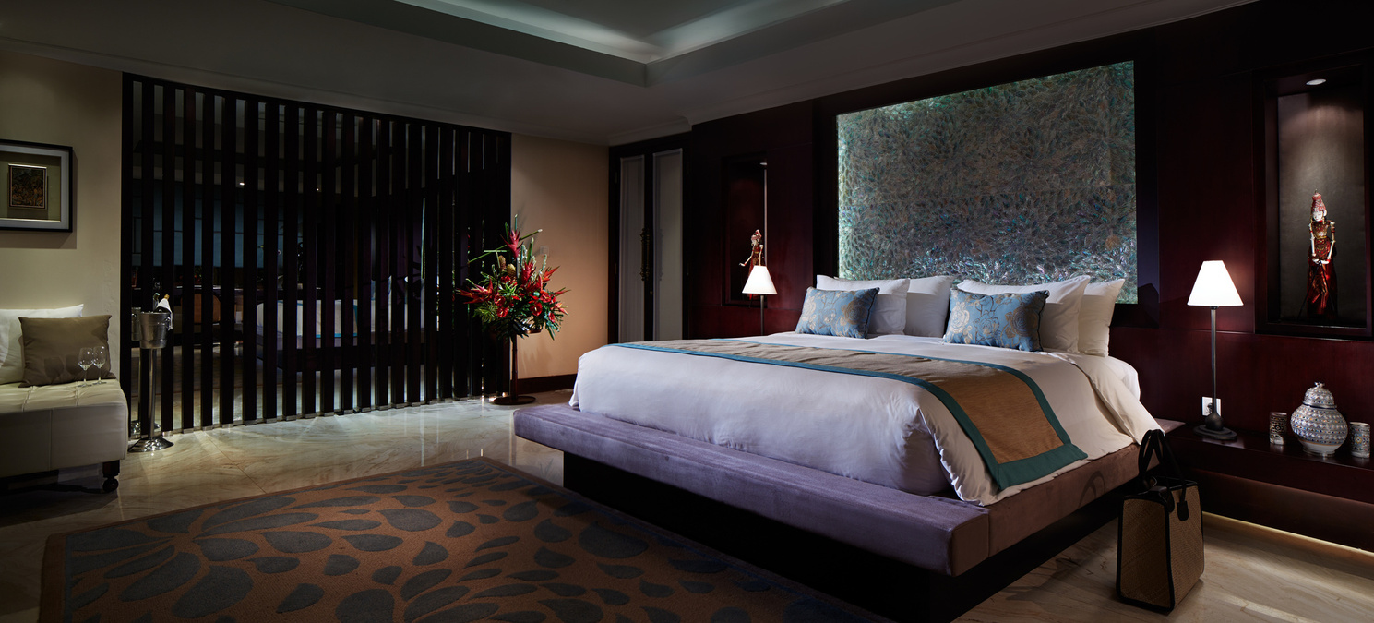
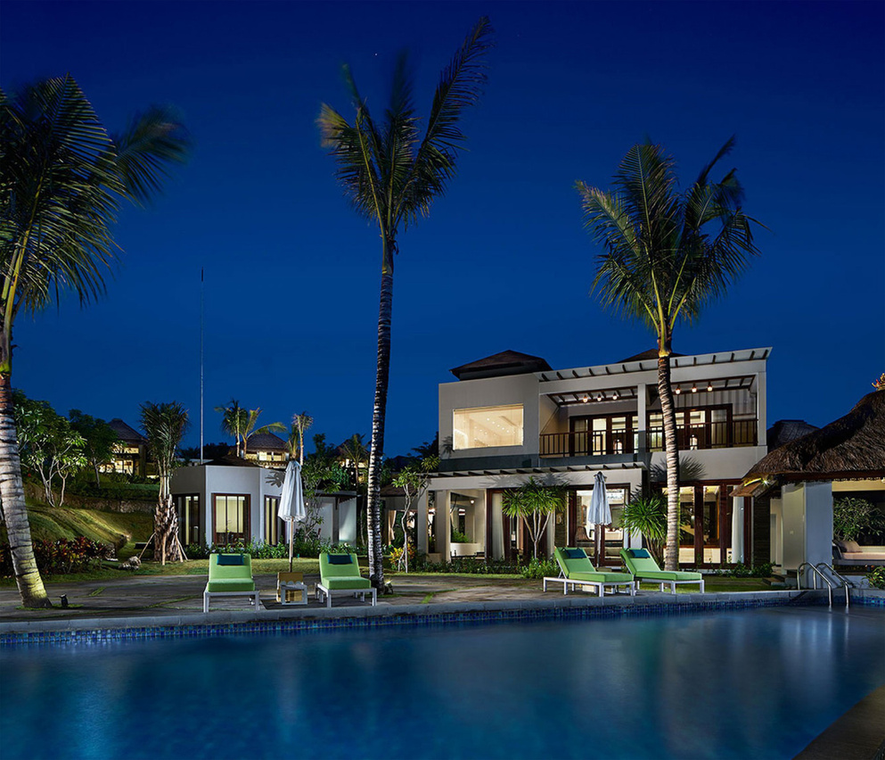
15
SAMABE BALI SUITES & VILLAS
Royal Samabe Residence
1 x King Size Bed (200 x 200 cm) in Master Bedroom 2 x Single Bed (120 x 200 cm) in the Second Bedroom Panoramic Views of the Ocean 1,500 Square Meters with a Private Pool 6 Adults

Slide 16
16
RESTAURANT & BAR
SAMABE BALI SUITES & VILLAS

Slide 17
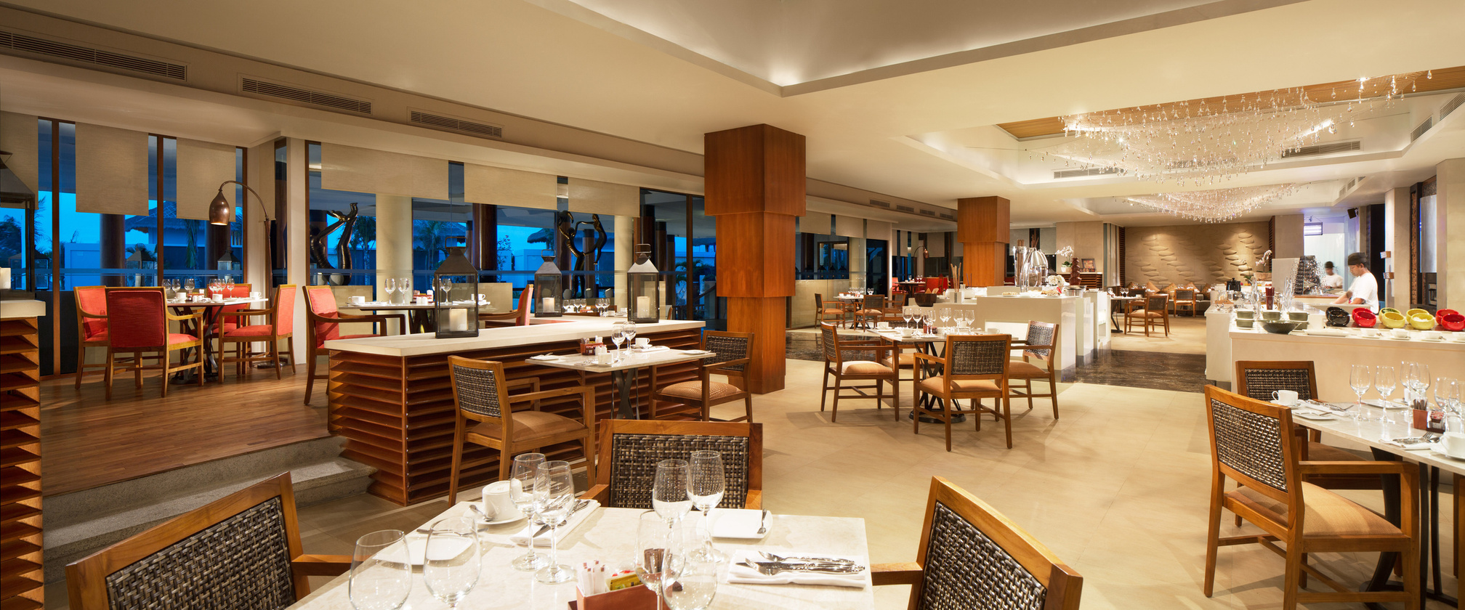
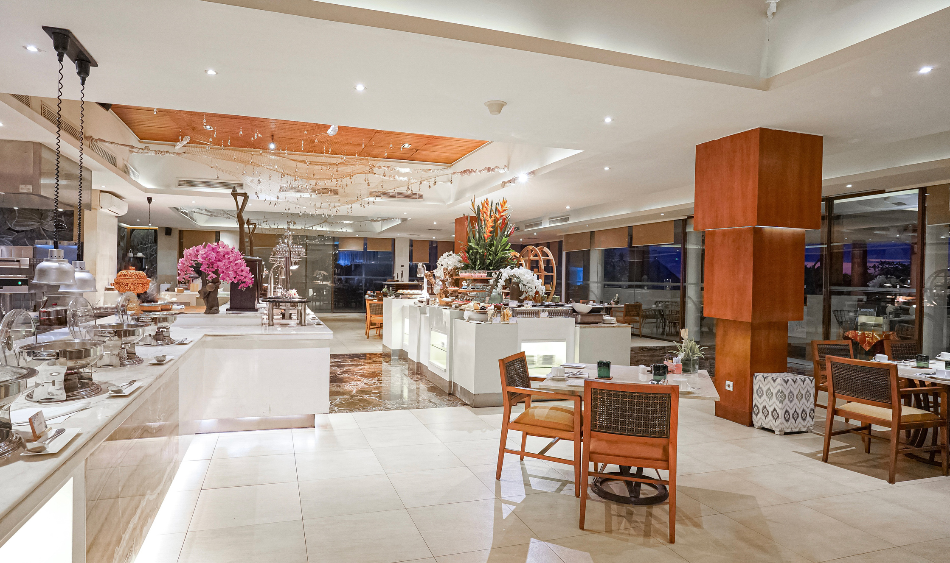
17
SAMABE BALI SUITES & VILLAS
Rempah² Main Dining Room
Rempah² means ‘spices’ in Bahasa Indonesia and is used to create a ‘perfect harmony’ of flavors. With this in mind, our talented culinary team has curated a selection of vibrant Balinese, Indonesian, Asian, and International dishes to tempt your taste buds. Set in a lagoon with lush greenery, we invite you to dine in ‘perfect harmony’ as you enjoy our warm hospitality, authentic cuisine, and relaxing ambiance.
Operational Hours: 06.00 to 23.00 hours

Slide 18
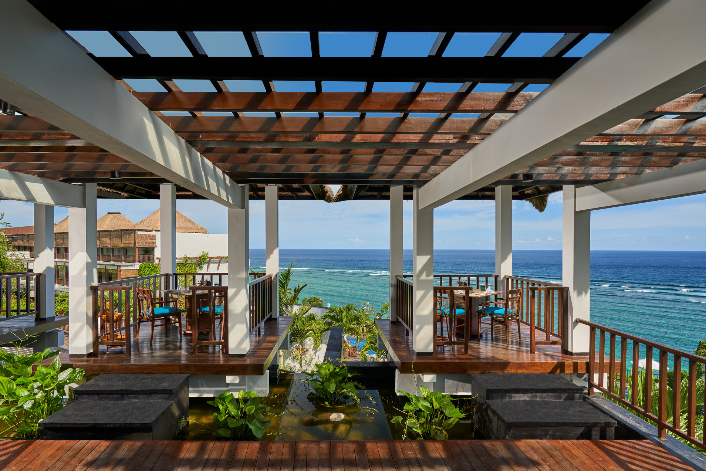
18
SAMABE BALI SUITES & VILLAS
Crystal Blue Ocean Grill
Great taste meets the view. Crystal Blue Ocean Grill is all about fantastic grilled dishes in a laid-back, open-air setting with a charming thatched roof. Open for Lunch and Dinner, you can enjoy your meal while taking in the breathtakingIndian Ocean and our main pool. Delight in our chef's signature dishes, featuring fresh seafood and premium steaks.
Operational Hours: 12.00 to 22.00 hours

Slide 19
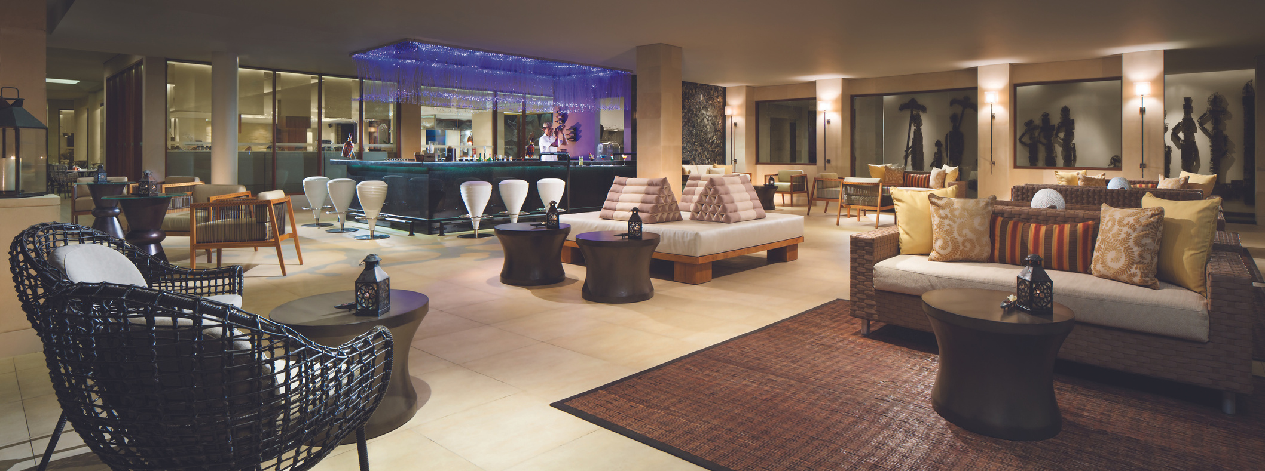
19
SAMABE BALI SUITES & VILLAS
Te.Ja.Co Lounge & Bar
Te.Ja.Co Lounge & Bar serves three elements that make its unique. TE – traditional Tea, JA – traditional Indonesian herbal drinks, called ‘Jamu’, CO – Coffee. Located at the lobby area and cultivate modern ambiance, you can laze around while enjoying a lush garden view. Guest can choose of having a variety of beverages featuring special tropical cocktails, beers, and wine.
Operational Hours: 06.00 – 01.00 hours

Slide 20
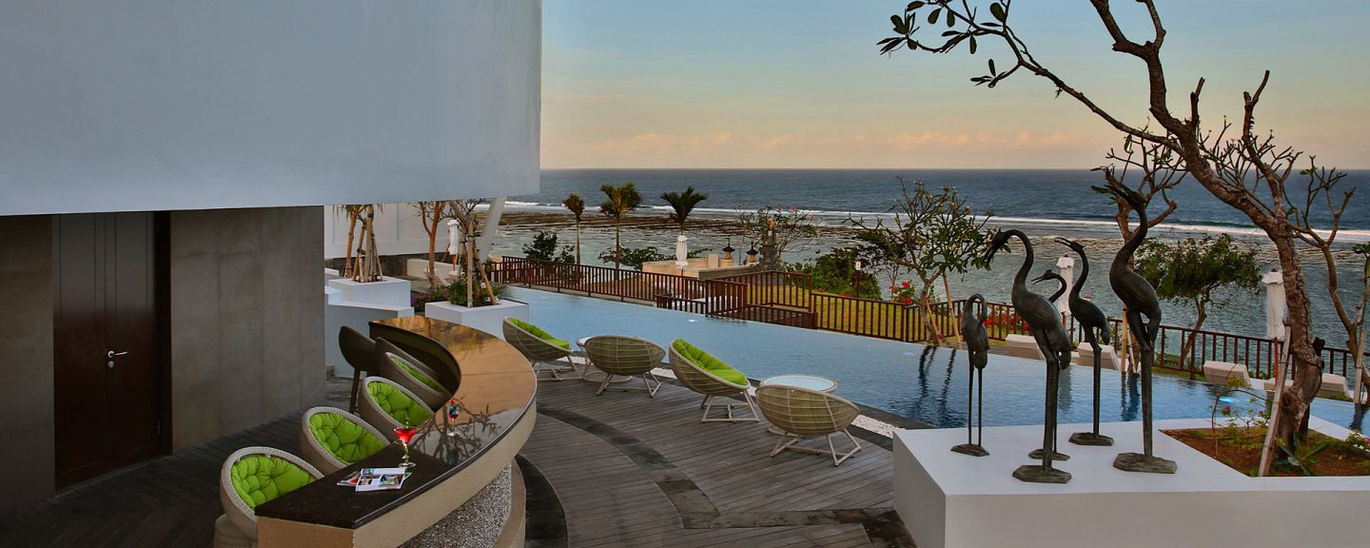
20
SAMABE BALI SUITES & VILLAS
Ring Of Fire Pool Bar
Our savvy bartenders serve good selection of alcoholic and non-alcoholic beverages, from premium brand spirits to signature cocktails. The Ring of Fire Pool Bar is set at the pool side overlooking the unbeatable view of the Indian Ocean.
Operational Hours: 10.00 – 22.00 hours

Slide 21
21
ROMANTIC DINING EXPERIENCE
SAMABE BALI SUITES & VILLAS

Slide 22
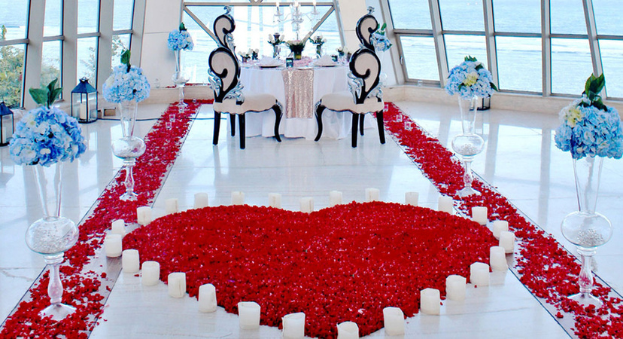
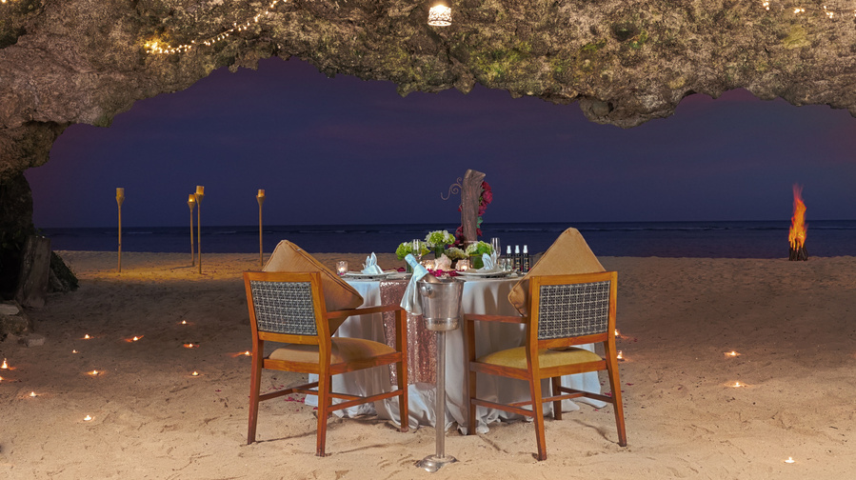
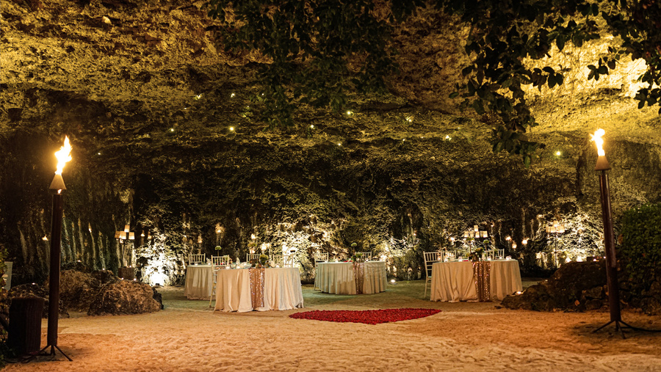
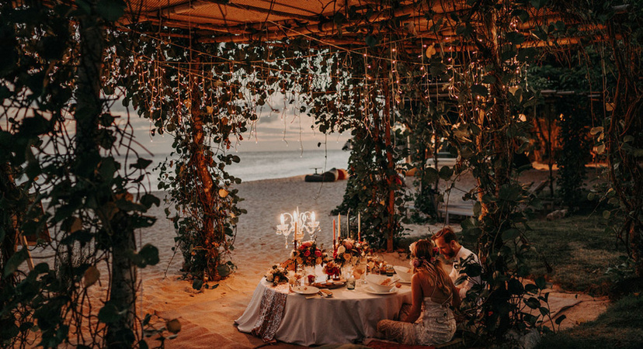
22
The Power of Love Pearl Chapel
The Power of Love Samabe Beach Cave
SAMABE BALI SUITES & VILLAS
Samabe Cave Dinner
Private Beach Gazebo Dinner

Slide 23
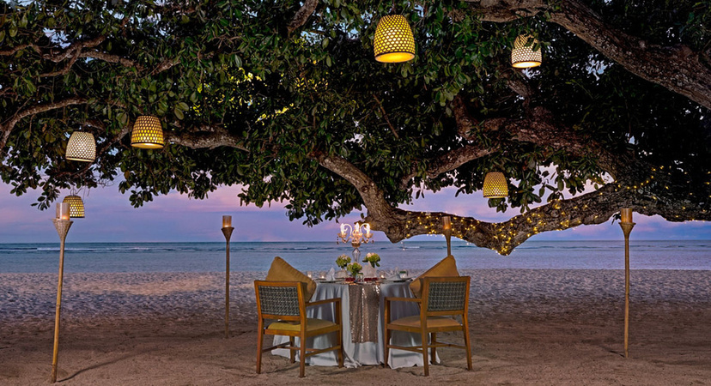
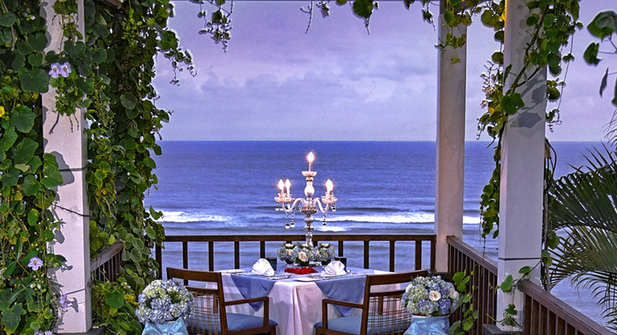
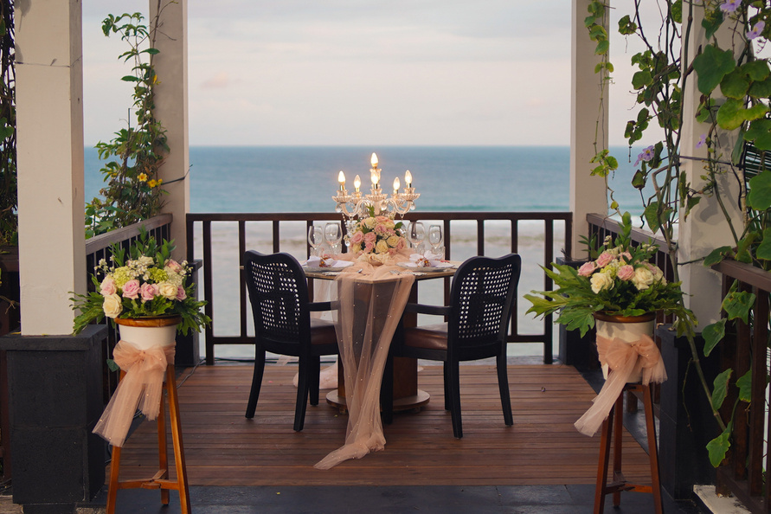
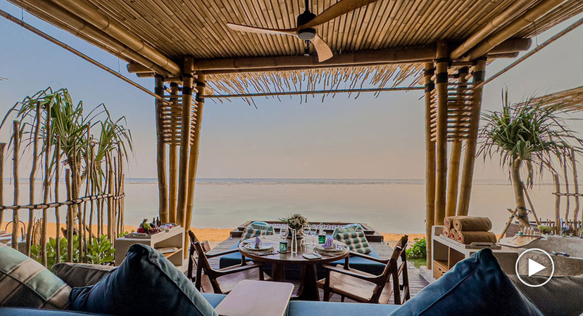
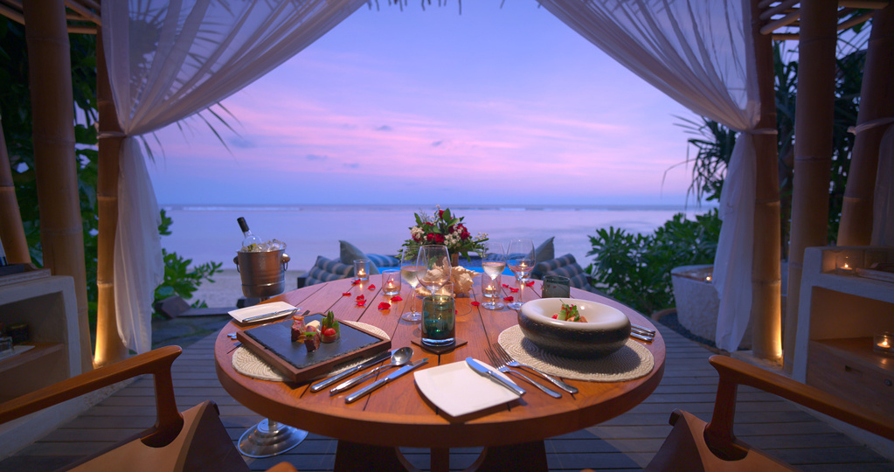
23
Enchanting Tree On The Beach
Private Cliff Gazebo Dinner
SAMABE BALI SUITES & VILLAS
Beach Cabana

Slide 24
24
MICE & WEDDING
SAMABE BALI SUITES & VILLAS

Slide 25
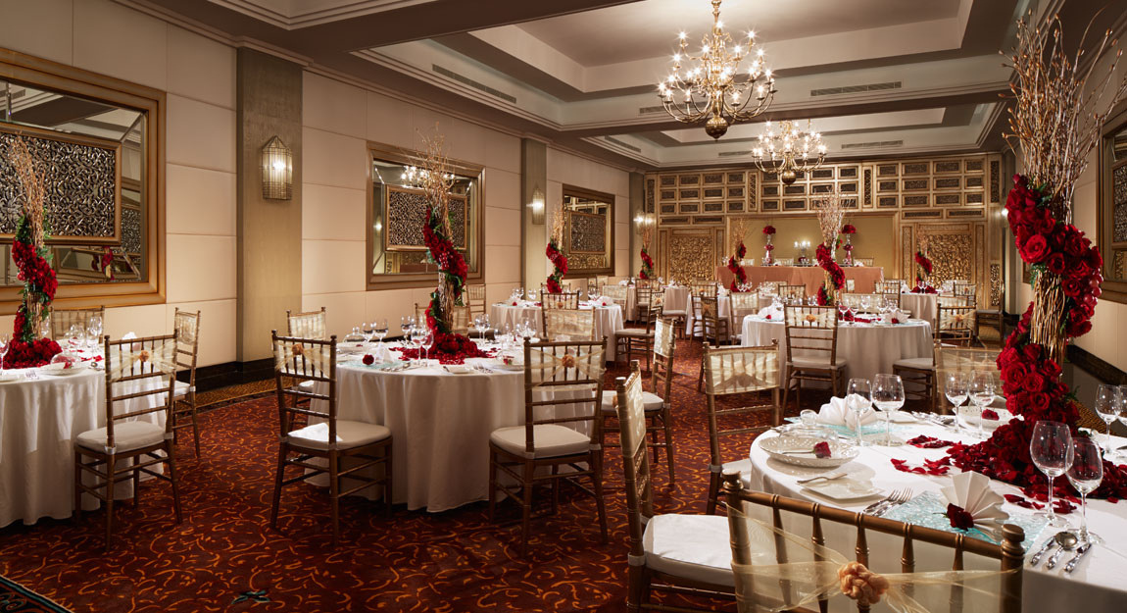
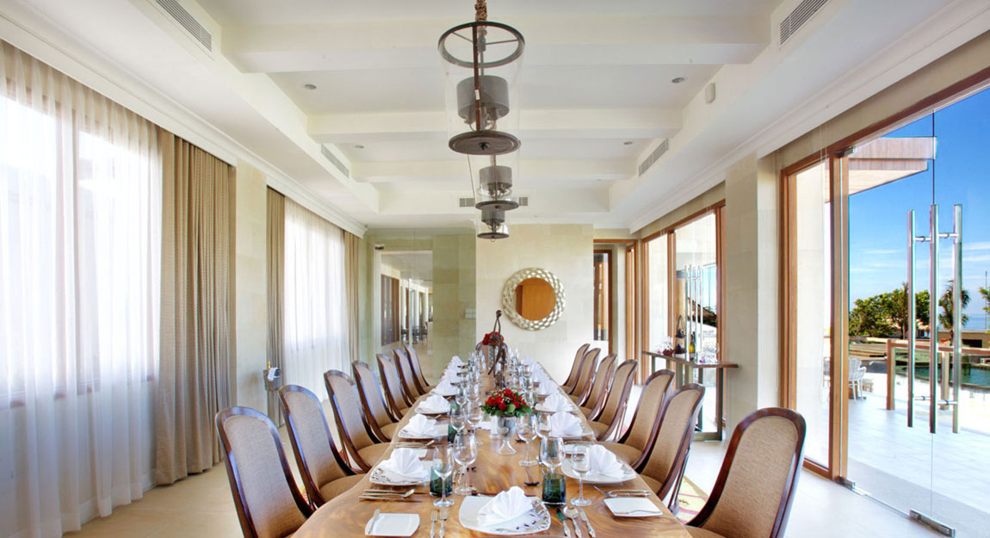
25
SAMABE BALI SUITES & VILLAS
MICE
Nusa Dua is the preferred destination for most business travelers when attending international conferences in Bali. With its Canang Room and Banten Room, Samabe is well prepared to cater for such business events. Canang Room is a large ballroom, suitable for conventions, seminars or gala dinners, and can accommodate groups of up to 80 people. Banten Room is perfectly suited for smaller events, such as meetings and business lunch or dinner.

Slide 26
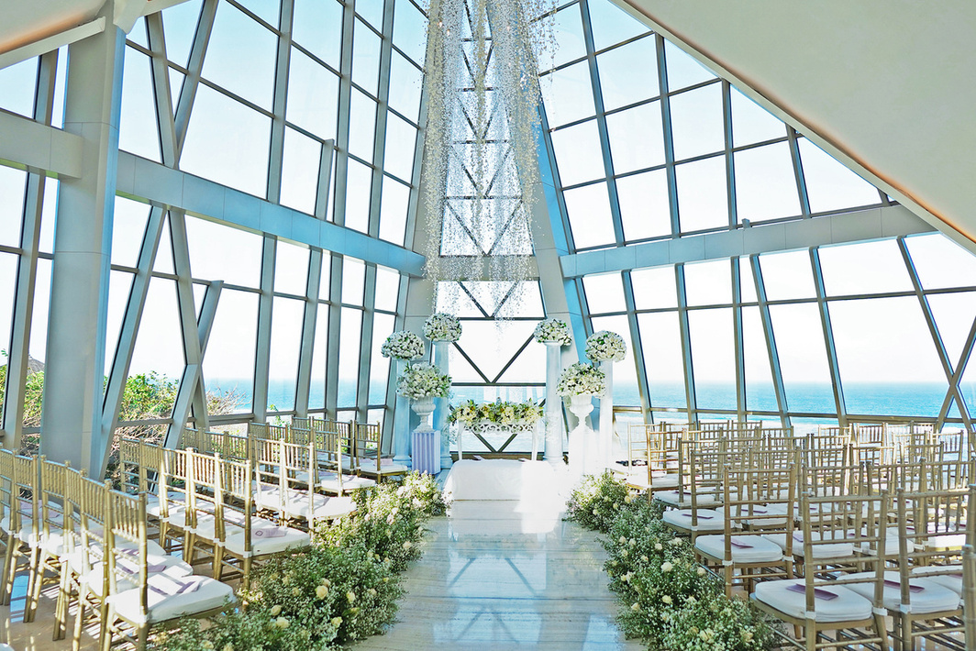
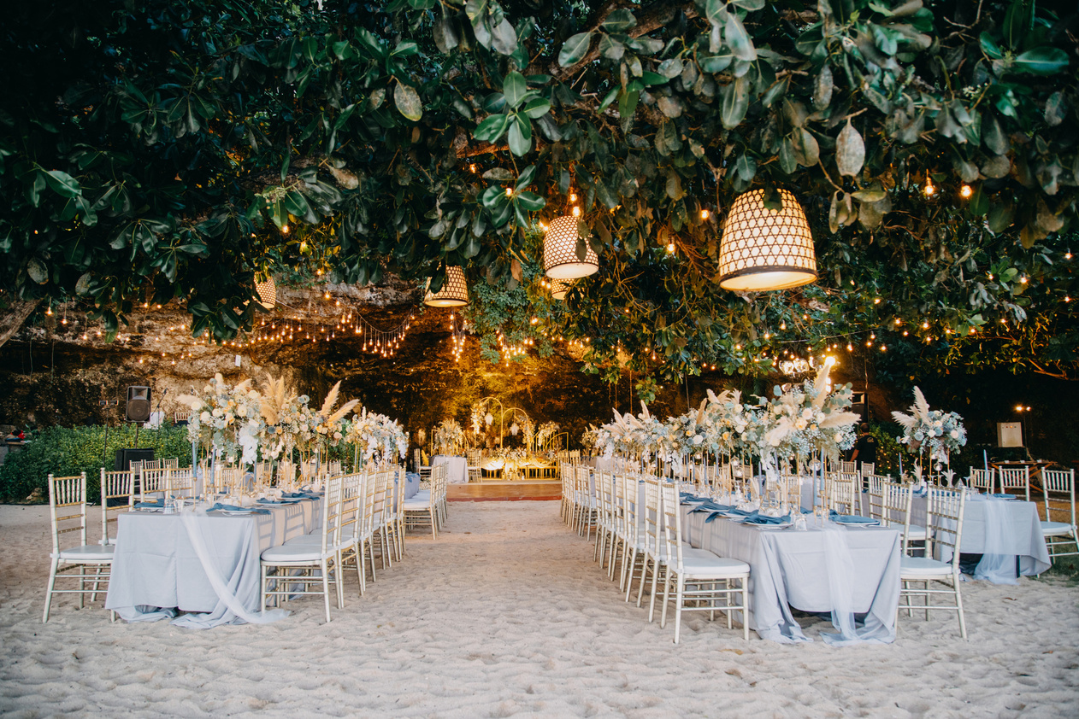
26
SAMABE BALI SUITES & VILLAS
Wedding
For a romantic and sacred moment of your wedding to the joy of a private party of friends, Samabe Bali Suites & Villas is delighted to offer you a selection of venues, with facilities and services that will be customized to your unique needs. Map out your ideas and discuss the specifics with our dedicated team, and we will carry out every detail with care.

Slide 27
27
RESORT FACILITIES
SAMABE BALI SUITES & VILLAS

Slide 28
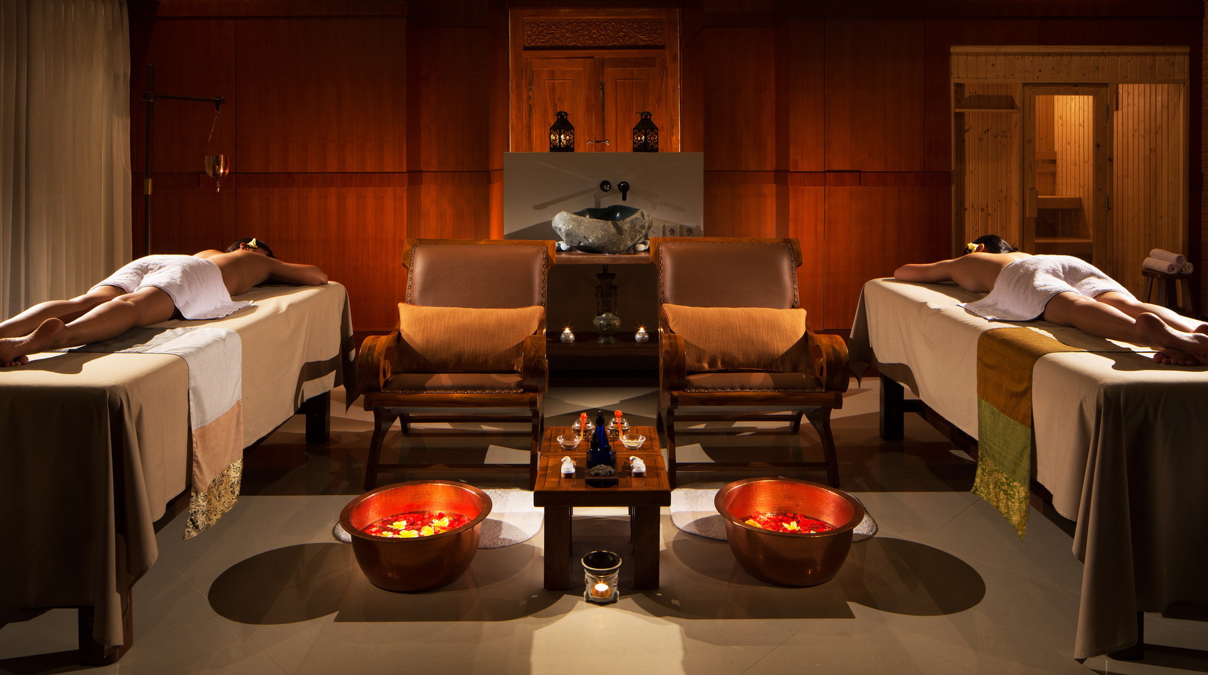
28
SAMABE BALI SUITES & VILLAS
Galangal SPA
Rejuvenate your body and mind, and find your balance at Galangal Spa. Our two spa treatment rooms are located in the building next to the lobby. Galangal Spa offers a wide variety of treatments and massages to suit your need. After treatment, relax in the outdoor sunken tub filled with flower petals. Incense sticks and lit scented candles by the tub help soothe your mind. Organic juice or Herbal Tea is offered with spa retreat programs. Leave your spa room in good spirit!
Operational Hours: 10.00 – 21.00 hours

Slide 29
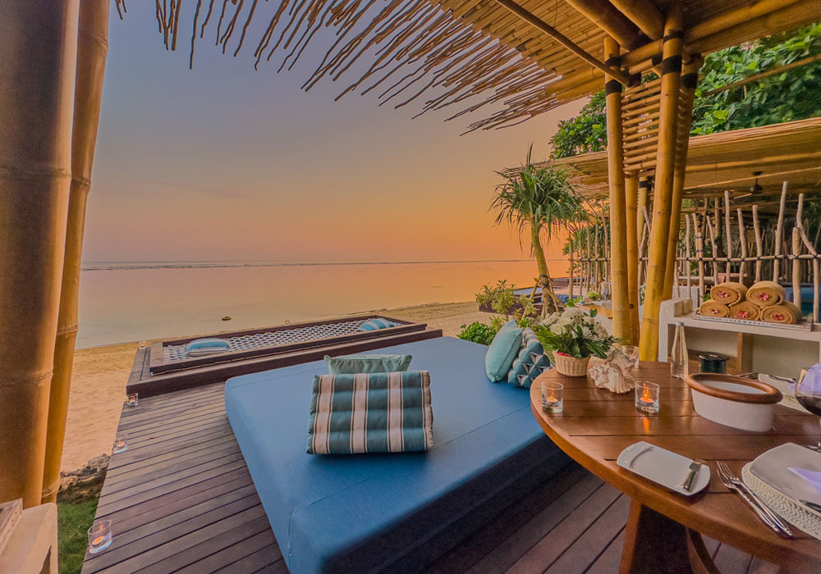
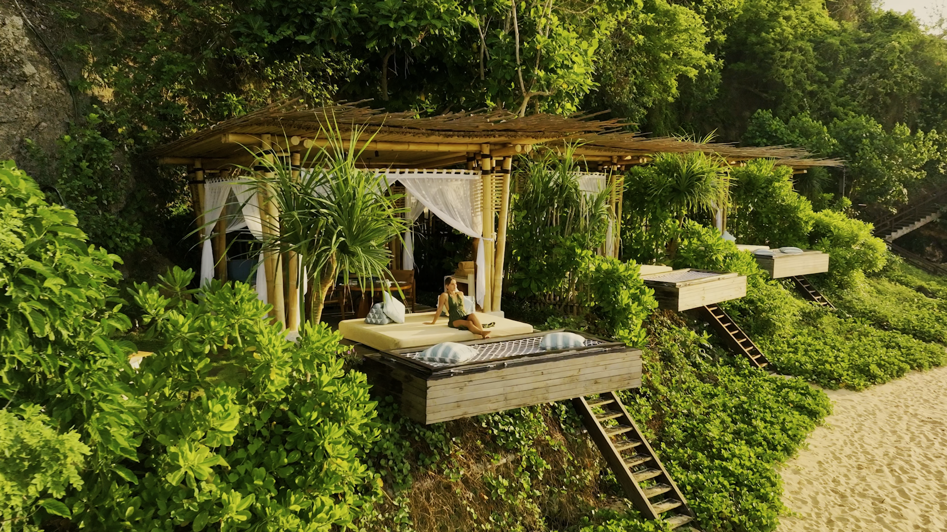
29
SAMABE BALI SUITES & VILLAS
Beach Cabana
Discover tranquility our exclusive beach front cabana featuring stunning ocean view and private tubs. Soak up the sun on cozy sun loungers or find serenity in a hammock. Where you can enjoy not just the view but also delicious bites and drinks while chilling by the sea. This cozy space offers a mature and refined ambiance.
Operational Hours: 11.00 – 22.00 hours

Slide 30
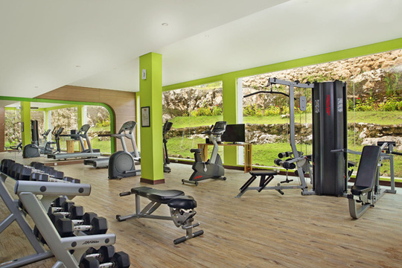
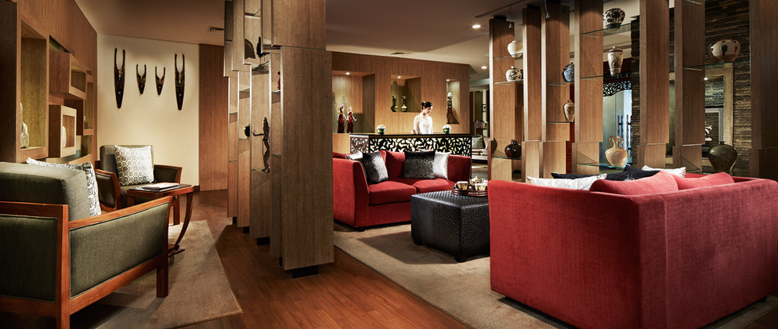
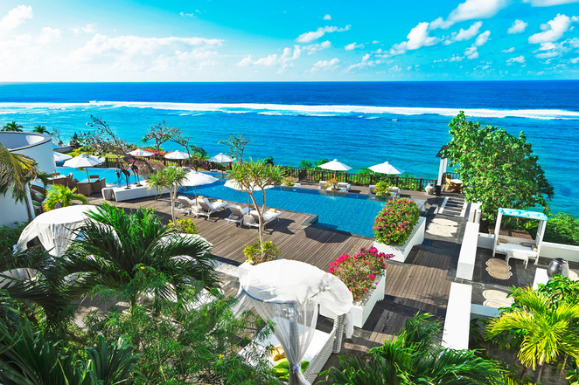
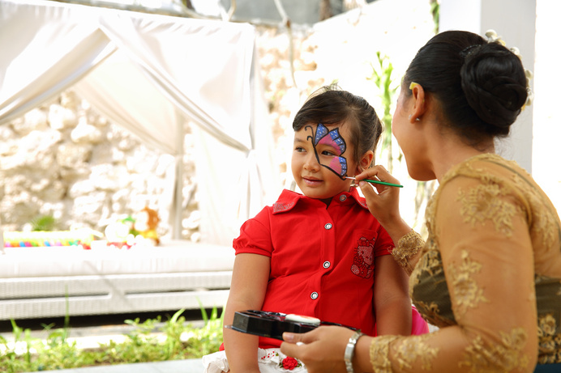



30
Fitness & GYM
Hospitality Lounge
Main Pool
SAMABE BALI SUITES & VILLAS
Lumba -Lumba Kids Club
Timeless Souvenir Shop
Samabe Beach

Slide 31
31
UNLIMITED PRIVILEGED
SAMABE BALI SUITES & VILLAS

Slide 32
32
SAMABE BALI SUITES & VILLAS
Your Stay, Your Way
Personal E-butler service Special welcome amenities Daily laundry service Hospitality lounge A 6-hour mini meeting room use Private airport transfer for 5 night stays

Slide 33

33
SAMABE BALI SUITES & VILLAS
Dining Delights - All Restaurant
Breakfast, Lunch, Dinner, and Daily Afternoon Tea

Slide 34

34
SAMABE BALI SUITES & VILLAS
Unlimited Drink
Complimentary non-alcoholic baverages anytime Mini bar is replenished daily with beers and soft drinks Selection of cocktails, beers, wines, and spirits from 5 pm onwards till midnight in any of the open restaurants and bars

Slide 35

35
SAMABE BALI SUITES & VILLAS
Embrace Adventure
Explore into non-motorized watersports Yoga experience, 24-hour gym, Balinese cultural art & dance lesson Seasonal activities, bike rentals, and daily signature experiences One Samabe Signature Activities (SSA) per night stay

Slide 36


